Slide 1
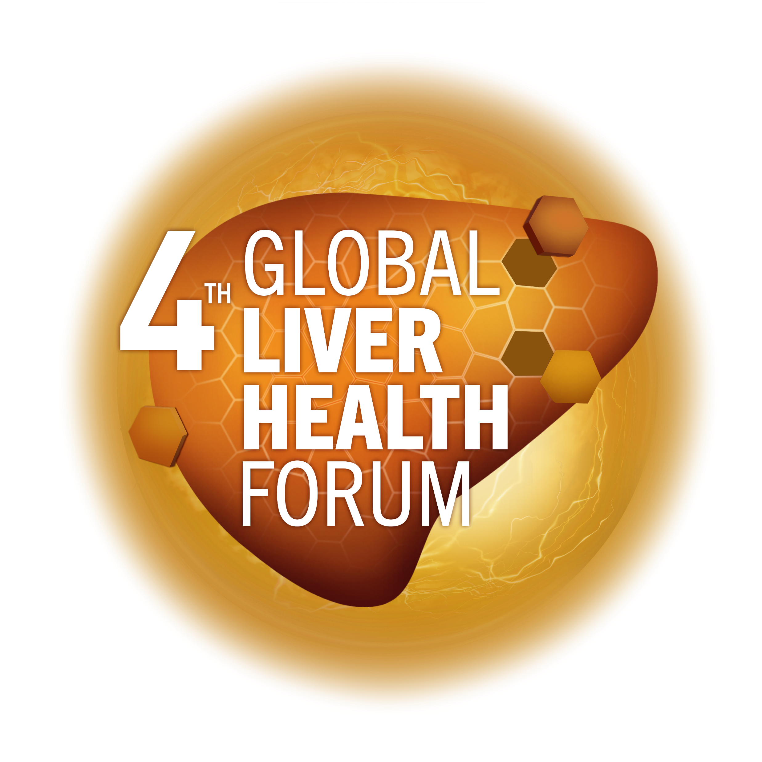
The role of essential phospholipids in the NAFLD/MAFLD continuum
Asad Dajani
MD, DSM, JBD, FAMCP, FRCP (Glasgow)
MAT-GLB-2302795 │ Date of approval: June 2023

Slide 2
Treatment plan for NAFLD/MAFLD
EPL
Targeting comorbid disease:
diabetes, hyperlipidemia, obesity²
Lifestyle modification: diet & exercise¹
Liver supportive agents³
Liver-directed pharmacotherapy³
Bariatric surgery⁴
Rx
complications
SAMe
Others
Silymarin
EPL, essential phospholipid; MAFLD, metabolic dysfunction-associated fatty liver disease; NAFLD, non-alcoholic fatty liver disease; Rx, Prescription medicine(s); SAMe, S-adenosyl methionine.
1. Park YE, et al. Korean J Intern Med 2018;33:64–74; 2. Finck BN. Diabetes 2018;67:2485–93; 3. Dajani A, et al. Saudi J Gastroenterol 2016;22:91–105; 4. Laursen TL, et al. World J Hepatol 2019;11:138–49;
5. Vanni E, et al. Semin Liver Dis 2015;35:236–49.

Slide 3
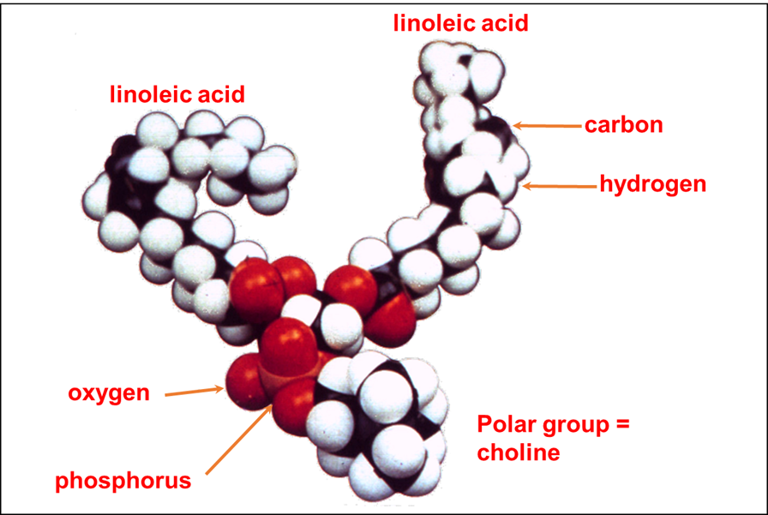
An overview of phosphatidylcholine
Phosphatidylcholine (PC) 94–96%
Dilinoleoyl (18:2-18:2) PC 40–52%
Palmitoyl-linoleoyl (16:0-18:2) PC 23–24%
Oleoyl-linoleoyl (18:1-18:2) PC 12–13%
Linolenoyl-linoleoyl (18:3-18.2) PC 6–7%
Stearoyl-linoleoyl (18:0-18:2) PC 6%
Palmitoyl-oleoyl (16.0-18.1) PC 3–4%
Stearoyl-arachidonoyl (18:0-20.4) PC 1–2%
3
PC, phosphatidylcholine.
Lieber CS et al: Gastroenterology 1994; 106: 152–159

Slide 4
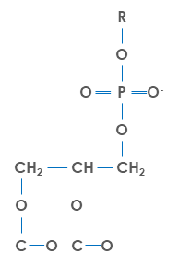
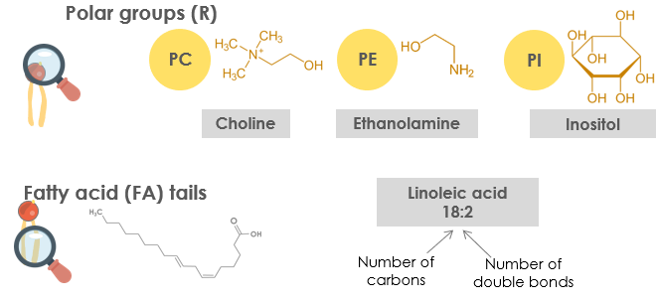
Phospholipids are major components of cellular and subcellular membranes
The most abundant types of phospholipids in mammalian tissues are:¹
Phosphatidylcholine (PC)
Phosphatidylethanolamine (PE)
Provide cell integrity²
Support membrane fluidity
and permeability²
Help transport molecules
The PC/PE ratio is a
key regulator of
membrane integrity^{1,2}
Polar head group
Hydrophilic
head
Phospholipid functions
Phosphate
Glycerol
Saturated
fatty acid
Hydrophobic
tails
Phospholipid
bilayer
Unsaturated
fatty acid
PC, phosphatidylcholine; PE, phosphatidylethanolamine; PI, phosphatidylinositol
1. Li Z, et al. Cell Metab 2006;3(5):321–31; 2. Escribá PV, et al. J Cell Mol Med 2008;12(3):829–75

Slide 5
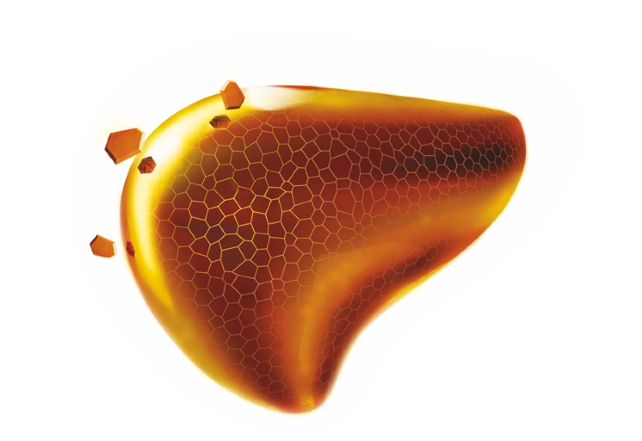

DLPC makes Essentiale different from phospholipids obtained from a normal diet
1,2 DILINOLEOYL-
PHOSPHATIDYLCHOLINE
(DLPC)
POLYENYL-
PHOSPHATIDYL-
CHOLINE (PPC)
PHOSPHATIDYL-
CHOLINE (PC)
PHOSPHOLIPIDS (PL)
LECITHIN
DLPC and PPC refer to "Essential phospholipids" or "EPL", whose mention of "essential" denotes the fact that these active ingredients are phospholipids that are derived from essential fatty acids.
DLPC, 1-2-dilinoleoylphosphatidycholine (also known as: 1,2-dilinoleoyl-sn-glycero-3-phosphocholine)
Gundermann KJ, et al. Pharmacol Rep 2016;3:643–59

Slide 6
Phospholipids are major structural lipids of eukaryotic membranes
Role: Recovery and maintenance
EPLs can be used to supplement Rx for:
MAFLD
Activation of phospholipid-dependent enzymes
Metabolic effects:
  Accelerate synthesis of lipoproteins and convert neutral fats and cholesterol into easily metabolized forms
  Activate synthesis of RNA and normalize protein metabolism
  Increase synthesis of glycogen in the liver
Improve detoxification function of the liver
Decrease fatty infiltration of hepatocytes
Inhibit or correct fibrogenic processes
Influence apoptosis
Anti-inflammatory and anti-oxidant properties
Auto
immune
LC
EPL
DILI
VH
ASH
ASH, alcoholic steatohepatitis; DILI, drug-induced liver injury; EPL, essential phospholipids; LC, cirrhosis of the liver; MAFLD, Metabolic dysfunction-associated fatty liver disease; RNA, ribonucleic acid; Rx, prescription medicine(s); VH, viral hepatitis. Gundermann KJ, et al. Pharmacol Rep 2011;63:643–59.

Slide 7
Preclinical evidence has revealed various functions of EPL
Though EPL preparations have
been approved for use in humans since 1957, very little is known about their MoA at the cellular and sub-cellular level¹
Incorporated
into cell membranes
Reduces liver fibrosis and cirrhosis
Increases membrane fluidity
Preclinical trials have provided insights into multiple MoAs of EPL that are potentially involved in their hepatoprotective effects²
EPL²
Stimulates
liver
regeneration
Inhibits lipid peroxidation
These potential MoAs of EPL are amenable to further study in vitro
Reduction of liver steatosis
Anti-cholestatic
effect
Data presented at EASL 2022 suggest metabolic effects in human HepaRG cell lines on IL-6 and Fas levels³
EPL, essential phospholipids; IL-6, interleukin 6; MoAs, mechanisms of action.
1. Küllenberg D, et al. Lipids Health Dis 2012;11:3; 2. Gundermann KJ, et al. Pharmacol Rep 2011;63:643–59; 3. Wupperfeld D, et al. Abstract presented at EASL 2022; #SAT095

Slide 8
What is the current clinical evidence supporting the use of EPLs in patients with NAFLD/MAFLD?

Slide 9
EPLs are associated with significant improvements of symptoms in NAFLD/MAFLD – effects on disease burden
Lean MAFLD
Diabetic MAFLD
Hyperlipidemic MAFLD
 | Subjects | After treatment | Subjects | After treatment | Subjects | After treatment
Asymptomatic | (n=70) 61.9% | (n=92) 81.4% | (n=64) 59.8% | (n=85) 79.4% | (n=55) 52.9% | (n=80) 76.9%
Symptomatic | (n=43) 38.1% | (n=21) 18.6% | (n=43) 40.2% | (n=22) 20.6% | (n=49) 47.1% | (n=24) 23.1%
General symptoms Asthenia Sleeping disorder Irritability | (13/43) 30.2% (13/43) 30.2% (14/43) 32.6% | (3/21) 14.3% (2/21) 9.5% (3/21) 14.3% | (19/43) 44.2% (13/43) 30.2% (21/43) 48.8% | (4/22) 18.2% (3/22) 13.6% (6/22) 27.3% | (19/49) 44.2% (13/49) 30.2% (21/49) 48.8% | (13/24) 30.2% (8/24) 18.6% (6/24) 13.9%
GI symptoms Postprandial distress Flatulence RUQ pain Nausea Heartburn | (12/43) 27.9% (13/43) 30.2% (9/43) 20.9% (8/43) 18.6% (5/43) 11.6% | (4/21) 19.0% (6/21) 28.6% (2/21) 9.5% (2/21) 9.5% (3/21) 14.3% | (21/43) 48.8% (21/43) 48.8% (9/43) 20.9% (8/43) 18.6% (5/43) 11.6% | (6/22) 27.3% (8/22) 36.4% (4/22) 18.2% (3/22) 13.6% (2/22) 9.1% | (21/49) 42.9% (21/49) 42.9% (9/49) 18.3% (8/49) 16.3% (5/49) 10.2% | (9/24) 20.9% (18/24) 41.9% (4/24) 9.3% (7/24) 16.3% (2/24) 4.65%
Clinical finding Jaundice Hepatomegaly | (4/43) 9.3% (9/43) 20.9% | (2/21) 9.5% (4/21) 19.0% | (5/43) 11.6% (13/43) 30.2% | (2/22) 9.1% (2/22) 9.1% | (5/49) 10.2% (13/49) 26.5% | (3/24) 6.97% (11/24) 25.6%
 |  | P<0.01 |  | P<0.01 |  | P<0.01
GI, gastrointestinal; RUQ, right upper quadrant
Dajani A, et al. Arab J Gastroenterol 2015;16:99–104.

Slide 11
Patient satisfaction correlates with objective laboratory improvements for patients with MAFLD receiving EPLs
Clinician satisfaction and laboratory improvements
Patient satisfaction and liver structure improvements
Laboratory improvements, median change from baseline | Clinician satisfaction
Laboratory improvements, median change from baseline | Low + very low | High + very high | p value†
ALT (U/L) | –8.00 | –15.00 | <0.001
AST (U/L) | –7.00 | –13.00 | <0.001
GGT (U/L) | –6.00 | –10.00 | <0.001
HbA1c (%) | –0.10 | –0.15 | 0.029
Total cholesterol (mmol/L) | –0.60 | –1.10 | <0.001
HDL (mmol/L) | 0.10 | 0.10 | 0.028
LDL (mmol/L) | –0.40 | –0.80 | <0.001
VLDL (mmol/L) | 0.00 | –0.20 | <0.001
Triglycerides (mmol/L) | –0.20 | –0.40 | <0.001
ALP (U/L) | –8.50 | –13.60 | <0.001
Total bilirubin (µmol/L) | –1.00 | –2.00 | <0.001
 | Improvement |  | p value‡
Patient’s satisfaction, %* | Low + very low | High + very high
Diffuse hyperechogenicity of the liver parenchyma on ultrasound | 65.3 | 84.6 | <0.001
Heterogeneity of liver structure on ultrasound | 61.8 | 81.2 | <0.001
Vascular blurring and/or underlined vascular pattern on ultrasound | 67.4 | 87.9 | <0.001
Distal attenuation of the echo-signal | 51.8 | 77.8 | <0.001
High or very high satisfaction was associated with significantly greater decreases from baseline in most laboratory parameters
vs low or very low treatment satisfaction
High or very high treatment satisfaction was associated with
significant improvements in ultrasound dynamics vs low or very
low treatment satisfaction
This study was a pooled analysis (EPOCH-2) of three Russian real-world studies: MANPOWER; LIDER; LIDER-2 (N=3,384)
*Clinicians’ and patients’ satisfaction with EPL treatment were assessed on a 10-point scale, where 1 is the lowest satisfaction and 10 is the highest satisfaction. †Wilcoxon signed-rank test. ‡chi squared test.
ALP, alkaline phosphatase; ALT, alanine aminotransferase; AST, aspartate aminotransferase; GGT, Gamma-glutamyl transferase; HbA1c, glycated haemoglobin; HDL, high-density lipoproteins; LDL, low-density lipoproteins; VLDL, very low-density lipids
Ivashkin VT, et al. Drugs Real World Outcomes 2021;8:369–82

Slide 12
Reduction in ALT and AST from baseline has been
seen with EPL
Results of a direct meta-analysis of RCTs comparing the effect of treatment with EPL + AD vs AD alone¹
Change in ALT (IU/L) levels from baseline*
Change in AST levels from baseline (U/L)
Author (year)
MD [95% CI]
Wu Y. (2009)²
–12.00 [–17.50, –6.50]
Author (year)
MD [95% CI]
Yin D. (2000)³
–15.36 [–16.33, –14.39]
Wu Y. (2009)²
–17.00 [–19.63, –14.37]
Li Z. (2013)⁴
–3.84 [–11.17, 3.49]
Sas E. (2013)⁵
–12.50 [–13.53, –11.47]
RE Model (Chi²=10.55, df=2,
p=0.01, I²=81.0%)
–11.28 [–17.33, –5.23]
p<0.0003
RE Model (Chi²=9.76, df=1,
p=0.00, I²=89.8%)
–14.58 [–18.98, –10.18]
– 20
–15
–10
–5
0
5
Total n=202
Mean treatment duration: 4.76 months
–20
–18
–16
–14
–12
–10
Total n=371
Mean treatment
duration: 1.97 months
Mean difference
Mean difference
A significantly greater reduction in ALT levels was achieved with EPL + AD therapy compared with AD therapy alone
The pooled change from baseline in AST levels
was –14.58 U/mL
*<0 favours EPL >0 favours control
AD, anti-diabetic treatment; ALT, alanine aminotransferase; CI, confidence interval; df, degrees of freedom; EPL, essential phospholipid; MD, mean difference; RCT, randomised controlled trial; RE, random effects
1. Dajani A, et al. World J Clin Cases 2020;8:5235–49; 2. Wu Y. J TCM Univ Hunan 2009;29:41–2; 3. Yin D, et al. Med JQ illu 2000;15:277–8;
4. Li Z. Inner Mongol J Tradit Chinese Med 2013;31:10–1; 5. Sas E, et al. J Hepatol Suppl. 2013;58(Suppl 1):S549

Slide 14
Patients with more severe NAFLD and diabetes:
Treatment with EPL + AD versus AD alone
Changes in hepatic echo-texture and signs of fatty liver following 6 months of EPL treatment:
Hepatic echo-texture was significantly improved with EPLs versus SOC
Ultrasonographic signs of fatty liver significantly decreased with EPLs
versus SOC
The development of hepatic fibrosis was significantly slowed down with EPLs compared with control (p=0.03)
Study | Outcome | EPL (N=178)
Ultrasound studies (hepatic echo-texture) | Improvement | 101/152 (66.4%)*
 | No change | 7/152 (4.6%)
Ultrasonographic signs of fatty liver | Decrease | 93/114 (81.6%)**
Randomised, prospective, single-blind clinical trial investigating the effect of polyunsaturated phosphatidylcholine (EPL) in patients with T2DM and NASH (1998–2012)
*P=0.02; **P<0.05. Data shown as n(%). AD, anti-diabetic therapy; SOC, standard of care
Sas E, et al. J Hepatol 2013;58:S409–S566.

Slide 15
EPLs reduce transaminase levels in patients with NAFLD regardless of cardiometabolic comorbidities
Lean MAFLD
Diabetic MAFLD
Hyperlipidemic MAFLD
100
90
80
70
60
50
40
30
20
10
0
100
90
80
70
60
50
40
30
20
10
0
100
90
80
70
60
50
40
30
20
10
0
87
91
84
78
72
68
49
Mean values (IU)
Mean values (IU)
Mean values (IU)
44
41
38
41
40
ALT
AST
ALT
AST
ALT
AST
Before RX After RX
Before RX After RX
Before RX After RX
Figures represent mean changes in transaminases before and after treatment for all three treatment groups
ALT, alanine aminotransferase; AST, aspartate aminotransferase
Dajani A, et al. Arab J Gastroenterol 2015;16:99–104

Slide 17
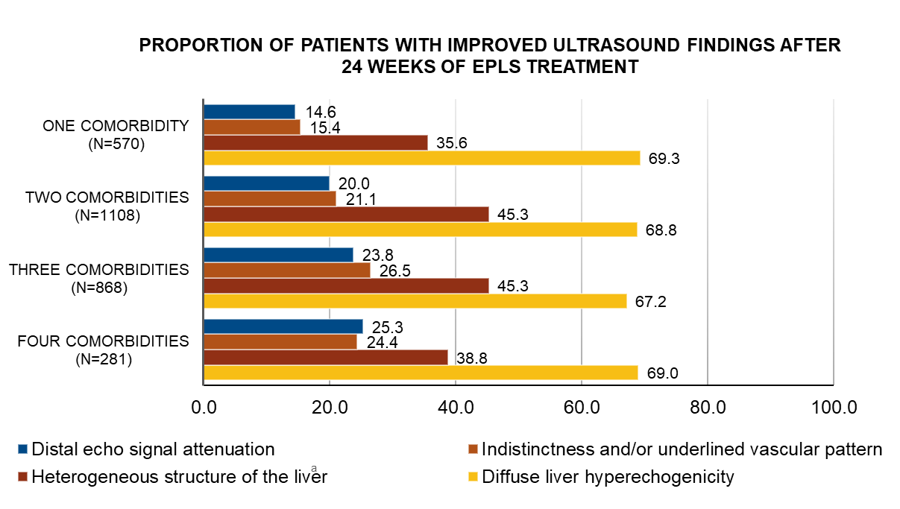
EPLs improve diffuse liver echogenicity independently of the number or type of comorbidities (MANPOWER Study)
A worsening of heterogeneous structure of the liver occurred in 0.2% of patients in each comorbidity subgroup.
EPLs, essential phospholipids; RCTs, randomised controlled trials
Maev IV, et al. BMJ Open Gastroenterol 2020;7:e000341

Slide 19
Evidence levels of adjunctive treatments for patients with MAFLD are inconsistent
Level of existing evidence supporting the efficacy of various adjunctive treatments
for MAFLD/NASH from a narrative review:
Very high
UDCA
Vitamin E* (+ Vitamin C)
High
Vitamin D
Level of existing scientific evidence
Resveratrol
EPLs
Medium
Phyllanthus
Garlic
Glycyrrhizic acid
Coenzyme
Q10
Metadoxine
Low
Artichoke
Ademetionine
Silymarin
Lack of improvement
or deterioration
Low probability
of improvement
Medium probability
of improvement
High probability
of improvement
Very high probability
of improvement
Likelihood of improvement of clinically meaningful parameters
Hepatoprotective agents, including EPLs, remain an important part of the treatment of MAFLD as adjunctive therapies
*Vitamin E has been used in either combination or very high dose.
NASH, non-alcoholic steatohepatitis; UDCA, ursodeoxycholic acid
Dajani A, et al. Drugs Ther Perspect 2021;37:249–64

Slide 20
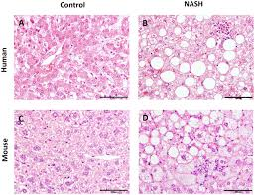
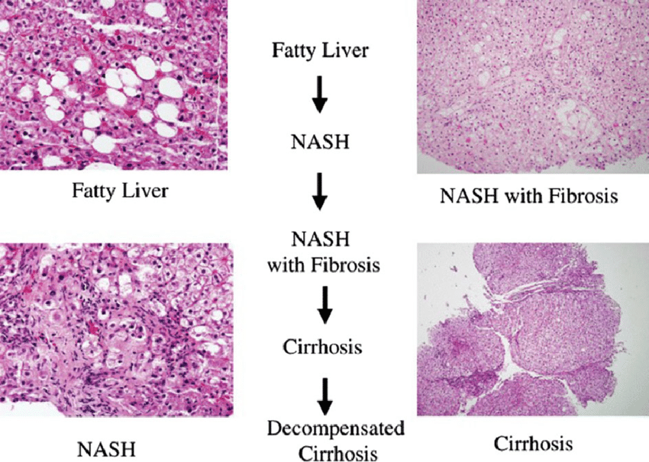
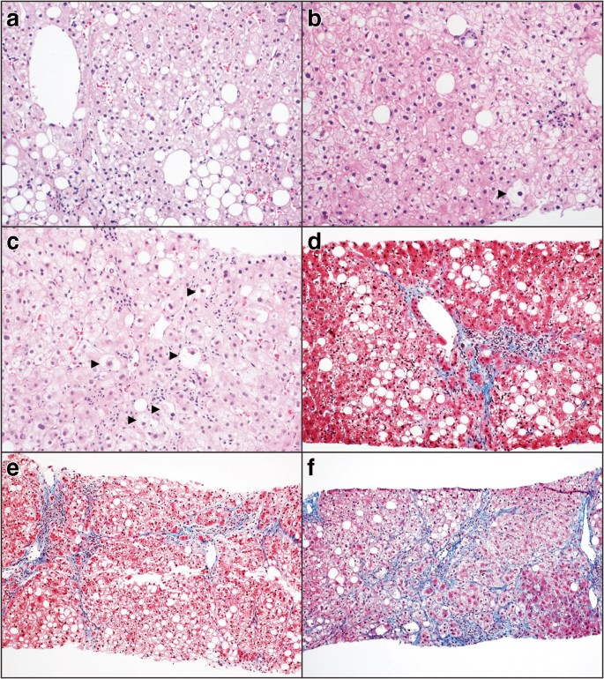
Liver disease progression: overview of management strategies
Simple steatosis
NASH ± fibrosis
Cirrhosis
Lifestyle : Diet and exercise (where possible for people with cirrhosis)
Hepatoprotection: EPL, Vitamin E, Silymarin (uncertain effects: UDCA, SAMe)
Treatment of comorbid disease
Diabetes: metformin, pioglitazone, liraglutide, SGLT2i (insufficient data for effect on cirrhosis)
Hyperlipidemia: statins, ezetimibe, pemafibrate (insufficient data for effect on cirrhosis)
Medicine targeting liver
PPAR (α/γ) (Elafibranor)
Farnesoid agonists (OCA)
Cenicriviroc
Selonsertib
Bariatric surgery
OCA, obeticholic acid
Fu Y, et al. Front. Pharmacol 2022;13:973366

Slide 21
Conclusions
1
Adjunctive therapy with hepatoprotective treatments may offer an additional reliable therapeutic strategy for symptom alleviation in MAFLD/NAFLD
2
EPLs have been associated with reduced transaminase levels, improved ultrasonography and elastography results, reduced steatosis and reduced disease burden in patients with MAFLD/NAFLD
3
The use of EPLs has been associated with a favourable tolerability and safety profile
4
Further studies are required to fully delineate the role of EPL across the NAFLD continuum and support their use in the management of liver disease with or without
concomitant and metabolic diseases
EPL, essential phospholipids; MAFLD, metabolic dysfunction-associated fatty liver disease; NAFLD, non-alcoholic fatty liver disease; NASH, non-alcoholic steatohepatitis;
RCTs, randomized controlled trials; RWE, real-world evidence

