Slide 1

To what extent can HRQoL impact clinical outcomes in NAFLD/MAFLD
Professor Wei
Hepatopacreatobiliary Center
Beijing Tsinghua Changgung Hospital
Tsinghua University, China
MAT-GLB-2302797-v-2.0 │ Date of approval: June 2023

Slide 2
Disclosures
Research grant: Abbvie, Bristol-Myers Squibb, Gilead, Pfizer and Sanofi
Consulting: Abbvie, Bristol-Myers Squibb, Gilead, MSD, Novartis, Novo Nordics, Pfizer, Roche and VirsiRNA

Slide 3
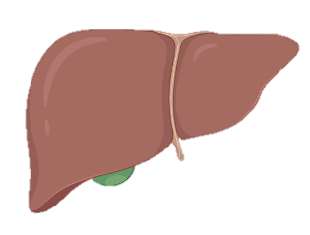
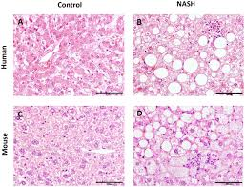
MAFLD is a multisystemic disease characterized by hepatic steatosis in the presence of metabolic risk factors
In 2020, an international consensus of experts proposed MAFLD as a more appropriate term versus NAFLD to describe liver disorders strongly related to dysmetabolic diseases, regardless of alcohol intake or other coexisting causes of liver disease¹
MAFLD criteria can discriminate more patients at risk of liver-related events as compared with NAFLD criteria¹
The criteria for MAFLD diagnosis:
Hepatic steatosis in association with obesity²
T2D or metabolic dysregulation²
MAFLD affects more than a third of the
global population^{1,3}
MAFLD is associated with increased morbidity
and mortality^{3*}
*Including: end-stage liver disease, hepatocellular carcinoma, death and liver transplantation, and has extrahepatic consequences, including cardiometabolic diseases and cancers3
MAFLD, metabolic associated fatty liver disease; NAFLD, non-alcoholic fatty liver disease; T2D, type 2 diabetes.
1. Pipitone RM, et al. Ther Adv Endocrinol Metab 2023;14:20420188221145549; 2. Eslam M, et al. J Hepatol 2020;73:202–9;
3. Eslam M, et al. Nat Rev Gastroenterol Hepatol 2022;19:638–51.

Slide 4
The importance of PROs in metabolic liver disease
PROs, patient-reported outcomes

Slide 5
A key component to improving the diagnosis and treatment of metabolic liver disease is understanding the symptoms
Many patients with abnormal liver function tests, indicating potential metabolic liver disease diagnosis, are categorized as asymptomatic¹
Although NAFLD and MALFD are often described as asymptomatic, patients frequently report experiencing non-specific symptoms, such as:^{2–4}
Fatigue
Anxiety
Abdominal discomfort
Hepatomegaly
Malaise
Experiencing non-specific symptoms can impact patient-reported outcomes, contributing to the burden of metabolic liver disease²
Patient-reported outcomes may provide direct insights into health outcomes of metabolic liver disease,
including common symptoms, from the people who experience them
1. Gao E, et al. Transl Gastroenterol Hepatol 2021;6:28; 2. Yamamura S, et al. J Gastroenterol Hepatol 2021;36:629–36; 3. Muhummad A. Integr Med (Encinitas) 2019:18;42–9;
4. Sangro P, et al. J Physiol Biochem 2023 [online ahead of print].

Slide 6
Real-world evidence utilising physician-described PROs indicates that metabolic liver disease is not asymptomatic
In an observational, cross-sectional, real-world survey (RESTORE),
the most common symptoms of NAFLD described by physicians (GEs and GPs) using patients’ language were:
GEs (N=95) |  |  | GPs (N=115)
Symptom | GEs (%) |  | Symptom | GPs (%)
Bloating | 62 |  | Bloating | 57
Weakening | 33 |  | Pain* | 47
Tiredness/fatigue | 31 |  | Weakening | 21
Pain* | 28 |  | Feeling of fullness | 27
Feeling of fullness | 24 |  | Stomach aches | 26
The results from RESTORE demonstrated that physicians (GE and GPs) and patients with NAFLD report several non-specific symptoms, with abdominal and tiredness-related symptoms being among the most common, highlighting that NAFLD is not asymptomatic
*Right upper quadrant pain/below right ribs/in the right side/in liver area, p<0.01 (Mann-Whitney U test).
RESTORE was an observational, noninterventional, cross-sectional survey collecting retrospective real-world data from patients with NAFLD among GEs and GPs with at least 3 years’ experience in Poland. The objectives of this study were to: examine the most relevant tools, symptoms and practices leading to NAFLD diagnosis by GEs and GPs; establish the most common comorbidities in NAFLD; and evaluate which factors contribute to current treatment decisions and hepatoprotectant recommendations, and if there are any differences among GEs and GPs. There were no additional diagnostic or therapeutic interventions, additional specialist consultations or medical visits. Mean numbers of patients seen by GEs and GPs were 290/month and 785/month, respectively; of these patients, 36.4/month (13%) and 50.8/month (6%), respectively, had liver conditions or diseases.
GEs, gastroenterologists; GPs, general practitioners. Hartleb M, et al. Eur J Gastroenterol Hepatol 2022;34:426–34.

Slide 7
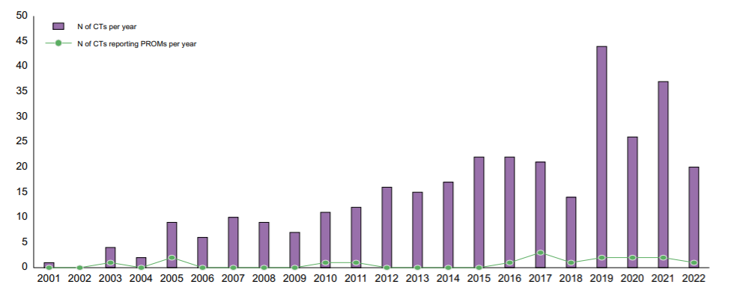
Further inclusion of PROs in clinical trial protocols could provide data on symptoms to support patient-centered care
Number of NAFLD trial protocols including PROs per year (2001–2022)
Despite an increase in NAFLD clinical trials in recent years, PRO inclusion in clinical trial protocols has remained relatively unchanged
PROs offer insights into the wider impact of a disease from the patient perspective, including evaluation of symptoms, functioning and HRQoL
These insights may support the identification of novel diagnostic and therapeutic strategies for metabolic liver diseases, such as MAFLD
CT, clinical trials; HRQoL, health-related quality of life.
Sena E, et al. JHEP Reports 2023;5:100597.

Slide 8
The impact of MAFLD
on HRQoL

Slide 9
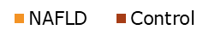
Metabolic liver diseases, such as NAFLD, are associated with impaired patient HRQoL
C1: Overall HRQoL assessment
C2: Physical health assessment
C4: Impact on daily activities
Rating of good/excellent health status
Number of days
Number of days
84.4%
P<0.0001
P<0.001
P<0.0001
22% of patients reported poor or
fair overall HRQoL status
The reported poor physical health in NAFLD patients may be related to fatigue
Impaired HRQoL resulted in a reduced ability to perform daily activities
Limited real-world data on the association between MAFLD and HRQoL are currently available
Using National cross-sectional health survey data collected by an interviewer-administered questionnaire conducted in participants’ homes by trained interviewers, clinical data from patients with NAFLD (determined by a Fatty Liver Index score ≥60 in the absence of HCV, HBV and significant alcohol consumption) and healthy control (participants without chronic liver diseases and with a Fatty Liver Index score ≤30) were collected. Four components of participants’ HRQoL over a 30-day period were assessed during the scheduled visit: C1, rate your health status as poor, fair, good, very good or excellent; C2, thinking about your physical health, which includes physical illness and injury, for how many days during the past 30 days was your physical health not good; C3, thinking about your mental health, which includes stress, depression and problems with emotions, for how many days during the past 30 days was your mental health not good; and C4, about how many days did poor physical or mental health keep him/her from doing your usual activities, such as self-care, work or recreation. C, component; HBV, hepatitis B; HCV, hepatitis C. Golabi P, et al. Health Qual Life Outcomes 2016;14:18.

Slide 10





The chronic course of NAFLD / MAFLD can augment the long-term impact of the disease on HRQoL
NAFLD / MAFLD disease progression
Rapid
progressors
F1
F2
F3
F4
Slow progressors
Steatosis
Steatosis + lobular inflammation
NASH ± portal inflammation
Early fibrosis
Advanced fibrosis
and cirrhosis
Progression to cirrhosis has been associated with decreased physical functioning HRQoL scores in NAFLD¹
‘Dynamic’ steatotic/steatohepatitic phase
‘Non-linear’ fibrotic phase
A decrease in NAFLD disease activity scores (by ≥2 points) has been associated with improvements in physical functioning, fatigue and worry^{1,2}
The association between NAFLD / MAFLD and obesity and Type 2 diabetes mellitus can further increase the impact of the disease on HRQoL³
NASH, non-alcoholic steatohepatitis.
1. Younossi ZM, et al. Hepatol Commun 2021;5:1201–11; 2. Younossi ZM, et al. Clin Gastroenterol Hepatol 2022;20:2050–8; 3. Assimakopoulos K, et al. J Psychosom Res 2018;112:73–80.

Slide 11
Several tools have been validated for the assessment of HRQoL in metabolic liver disease
Scores
Population
HRQoL Dimensions
Short form-36 (SF-36)¹
Generic HRQoL instruments
Physical functioning, role physical, bodily pain, general health, vitality, social
functioning, role emotional and mental health, with the inclusion of physical
component and mental component summary scores
EuroQoL-5D (EQ-5D)²
Generic HRQoL instruments
Mobility, self-care, usual activities, pain/discomfort, and anxiety/depression
Chronic Liver Disease Questionnaires (CLDQ)³
Liver disease-specific HRQoL instruments
A widely validated disease-specific HRQoL instrument developed for
patients with chronic liver disease
NASH-CHECK⁴
Liver disease-specific HRQoL instruments
A disease-specific PRO instrument that can be used to assess
symptoms and HRQoL among patients with NASH
Chronic Liver Disease Questionnaires-NAFLD version (CLDQ-NAFLD)⁵
Liver disease-specific HRQoL instruments
Abdominal, activity/energy, emotional, fatigue, worry, and systemic
1. Younossi ZM, et al. Hepatol Commun 2021;5:1201–11; 2. Hwang TI, et al. Int J Environ Res Public Health 2021;18:13145; 3. Chang PE, et al. JGH Open 2019;20:191–7;
4. Doward LC, et al. Patient 2021;14:533–43; 5. Younossi ZM, et al. Liver Int 2017;37:1209–18.

Slide 12
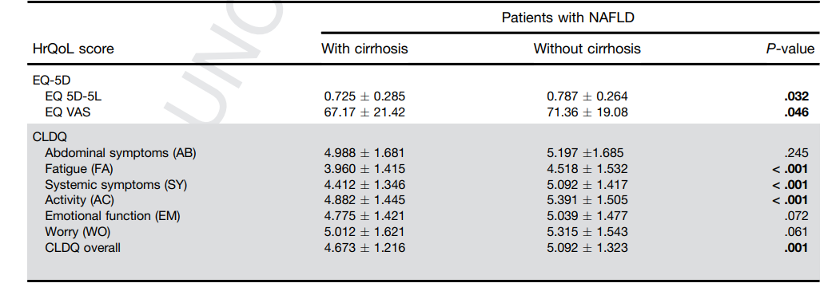
Validated tools have been utilized for investigating the association between HRQoL and NAFLD in a real-world setting
Comparisons of EQ-5D indices and CLDQ domains between patients with NAFLD with and without cirrhosis
CLDQ scores were significantly lower in patients with cirrhotic NAFLD compared with patients with
non-cirrhotic NAFLD, highlighting significant HRQoL impairment in patients with NAFLD
This prospective study was conducted across 4 UK participating centers and utilized the EQ-5D and CLDQ to assess HRQoL in people with NAFLD (N=513). The primary aim of this study was to assess HRQoL in patients with NAFLD with or without advanced fibrosis and compare this with the UK general population. Secondary aims were to examine the associations of fibrosis severity and metabolic comorbidities with impairments in HRQoL in these patient subgroups. Data are presented as mean ± standard deviation. Papatheodoridi M, et al. Clinical Gastroenterology and Hepatology 2023.

Slide 13
Validated tools have been utilized for investigating the association between HRQoL and MAFLD in a real-world setting
Association between MAFLD and stress, mental health and HRQoL*
 | OR | (95% CI) | p-value
Stress | 1.265 | (1.046–1.530) | 0.016
Suicidal impulse | 1.109 | (0.893–1.377) | 0.347
EQ-5D (–0.1) | 1.091 | (1.019–1.169) | 0.013
A decrease in the EQ-5D score of 1 was associated with an increased risk of MAFLD
An increase in the stress perception rate was associated with an increased risk of MAFLD
Stress and HRQoL appear to be associated with MAFLD, as assessed using the EQ-5D instrument,
with lower HRQoL scores observed in patients with MAFLD
*Adjusted for significant variables, including age, sex, level of education, tobacco use, and alcohol consumption.
The study aimed to: investigate the association between MAFLD and HRQoL; evaluate whether stress perception and mental health among patients with MAFLD affects HRQoL; and to identify the underrated burden on patients with MAFLD. Using data from the 5th Korean National Health and Nutrition Examination Surgery (KNHANES V, 2010 to 2012) conducted by the Korean Centers for Disease Control and Prevention, 17,476 survey participants (aged 19–70 years old) were assessed. MAFLD was defined as a Fatty Liver Index score ≥60 and the EQ-5D was used to assess HRQoL. CI, confidence interval; OR, odds ratio. Hwang TI and Han AL. Int J Environ Res Public Health 2021;18:13145.

Slide 14
Importance of RWE data
in evaluating MAFLD outcomes

Slide 15
Beyond PROs and HRQoL, assessing disease severity as an MAFLD outcome is of importance
Several NITs are available for the identification of patients at high risk of steatosis and significant fibrosis
Steatosis detection
Fibrosis detection
FLI
HSI
NFS
FIB-4
HFS
Score | Risk
<30 | Low
30–60 | Intermediate
>60 | High
Score | Risk
<30.0 | Low
30.0–36.0 | Intermediate
>36.0 | High
Score | Severity
<-1.455 | F0–F2
-1.455–0.675 | Indeterminant
>0.675 | F3–F4
Scoreª | Severity
<1.3 | F3–F4 excluded
1.3–2.67 | Further investigation
>2.67 | F3–F4
Score | Severity
<0.12 | Low
0.12–0.47 | Intermediate
>0.47 | High (F3–F4)
High risk scores indicate fatty liver
F3–F4 severity indicates the presence of advanced fibrosis
Allow for steatosis diagnosis with good accuracy
Do not provide a quantitative evaluation of liver fat
The combined use of NFS and FIB-4 tests can lead to increased accuracy
The HFS test has been proposed to be most beneficial for the identification of patients who should undergo liver biopsy analysis
NITs may improve the evaluation and diagnosis of MAFLD outcomes in the real-world setting
ªFIB-4 scores for 36–64-year-olds; an alternative scoring system is available for patients aged ≥65 years. FIB-4, fibrosis-4; FLI, fatty liver index; HFS, hepamet fibrosis score; HSI, hepatic steatosis index; NFS, NAFLD fibrosis score; NIT, noninvasive testing.
Binet Q, et al. Acta Gastroenterol Belg 2022;85:346–57.

Slide 16
TOWARDS1: RWE suggests that FIB-4-MetDis may be used for the screening of advanced fibrosis in patients with NAFLD
A new diagnostic tool (MetDis) was developed using reduced HDL-C and raised fasting glucose to screen for advanced fibrosis
Diagnostic performance of new algorithms combined with metabolic factors
Diagnostic algorithm | Accuracy (%) | Sensitivity (%) | Specificity (%) | PPV (%) | NPV (%)
MetDis-NFS | 79.27 | 71.05 | 80.77 | 40.30 | 93.85
NFS-MetDis | 84.02 | 48.78 | 91.13 | 52.63 | 89.91
MetDis-FIB-4 | 80.08 | 81.58 | 79.81 | 42.47 | 95.95
FIB-4-MetDis | 85.31 | 65.79 | 88.89 | 52.08 | 93.40
Combining MetDis with the standard non-invasive test FIB-4 (FIB-4-MetDis) significantly reduced the number of patients requiring liver biopsy compared with FIB-4 alone (37% to 17%, p<0.001)
FIB-4-MetDis demonstrated improved
diagnostic performance versus FIB-4 alone
As liver biopsy is an invasive procedure, the development of a new algorithm combining metabolic disorders with non-invasive measurements may improve the diagnosis of advanced fibrosis through serving as a simple assessment for use by clinicians,
including those in the primary care setting
TOWARDS1 was an observational, multicenter, cross-sectional registry study conducted across 14 sites in mainland China. The aim of the study was to explore the role of metabolic disorders in screening advanced fibrosis in NAFLD patients (aged 18–65 years with liver biopsy-proven NAFLD). A total of 246 histologically-proven NAFLD patients were enrolled in this study. The severity of fibrosis in patients with different components of metabolic disorders were compared and new algorithms were developed to identify advanced fibrosis.
NPV, negative predictive value; PPV, positive predictive value. Shi YW, et al. J Clin Trans Hepatol 2021;9:607–14.

Slide 17
Summary
1
As a proposed alternative nomenclature to NAFLD, MAFLD is a multisystemic disease characterized by hepatic steatosis in the presence of overweight status / obesity, Type 2 diabetes mellitus or metabolic dysregulation
2
PROs have demonstrated that NAFLD / MAFLD is not an asymptomatic disease and the inclusion of such measures in clinical trials may provide valuable insights for the diagnosis and treatment of metabolic liver diseases
3
The chronic course of NAFLD / MAFLD can have a long-term impact on patient HRQoL, as assessed through the use of validated tools, such as EQ-5D and CLDQ
4
Assessment of outcomes using NITs in the RWE may provide insights to improve the diagnosis of MAFLD and management of associated outcomes
CLDQ, chronic liver disease questionnaire; EQ-5d, EuroQol-5D; HRQoL, health-related quality of life; NAFLD, non-alcoholic fatty liver disease; NIT, non-invasive tests; MAFLD, metabolic-dysfunction associated fatty liver disease; RWE, real-world evidence

