Slide 1

Defying the Trends: Leveraging Liver Health to Improve Patient Outcomes.
MAT-GLB-2203893-v1.0
Date of approval: September 2022

Slide 2

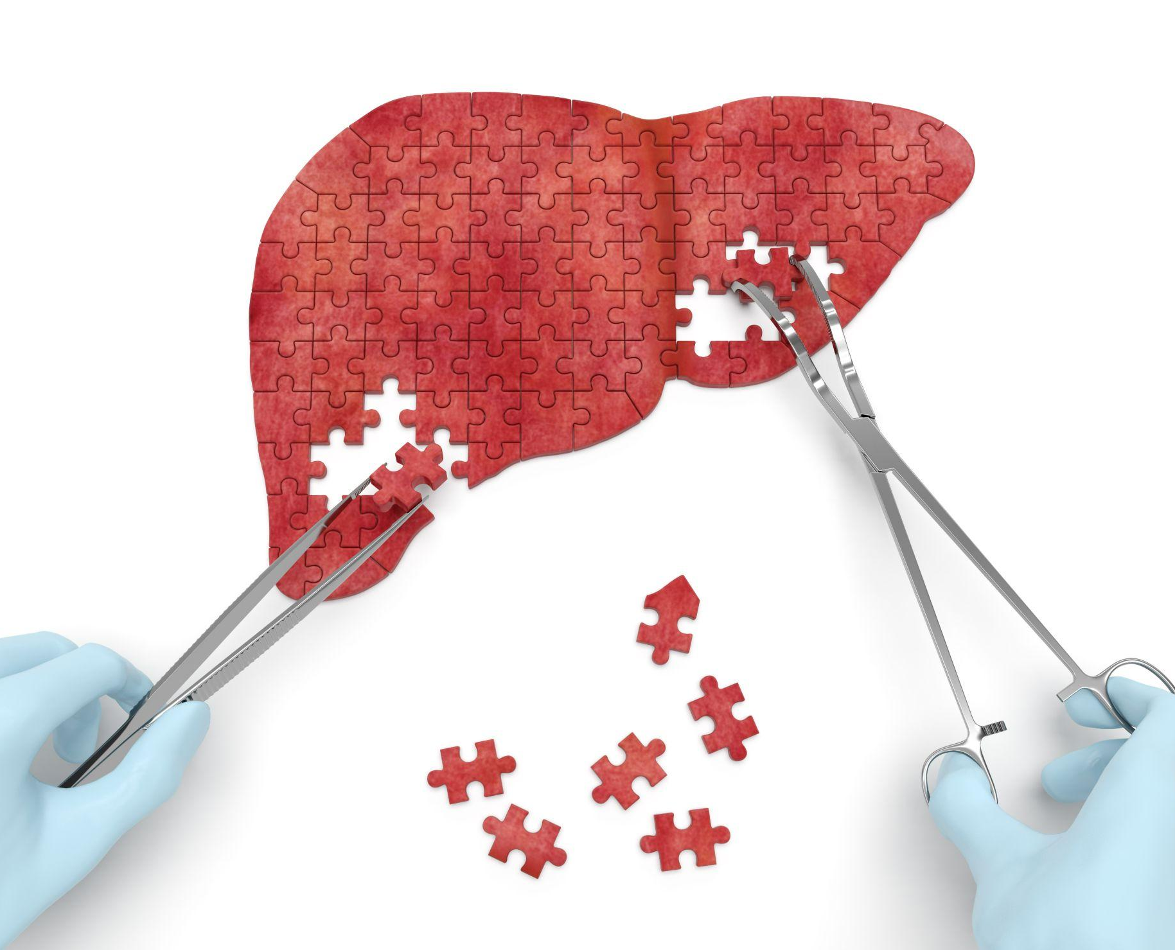
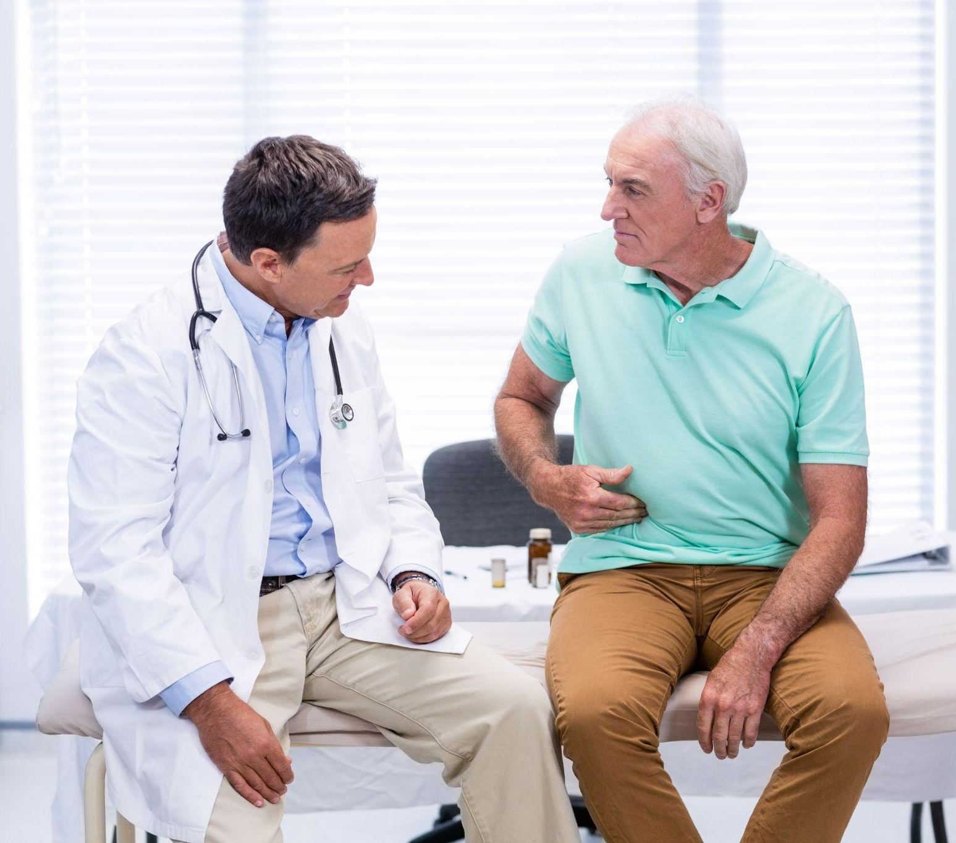
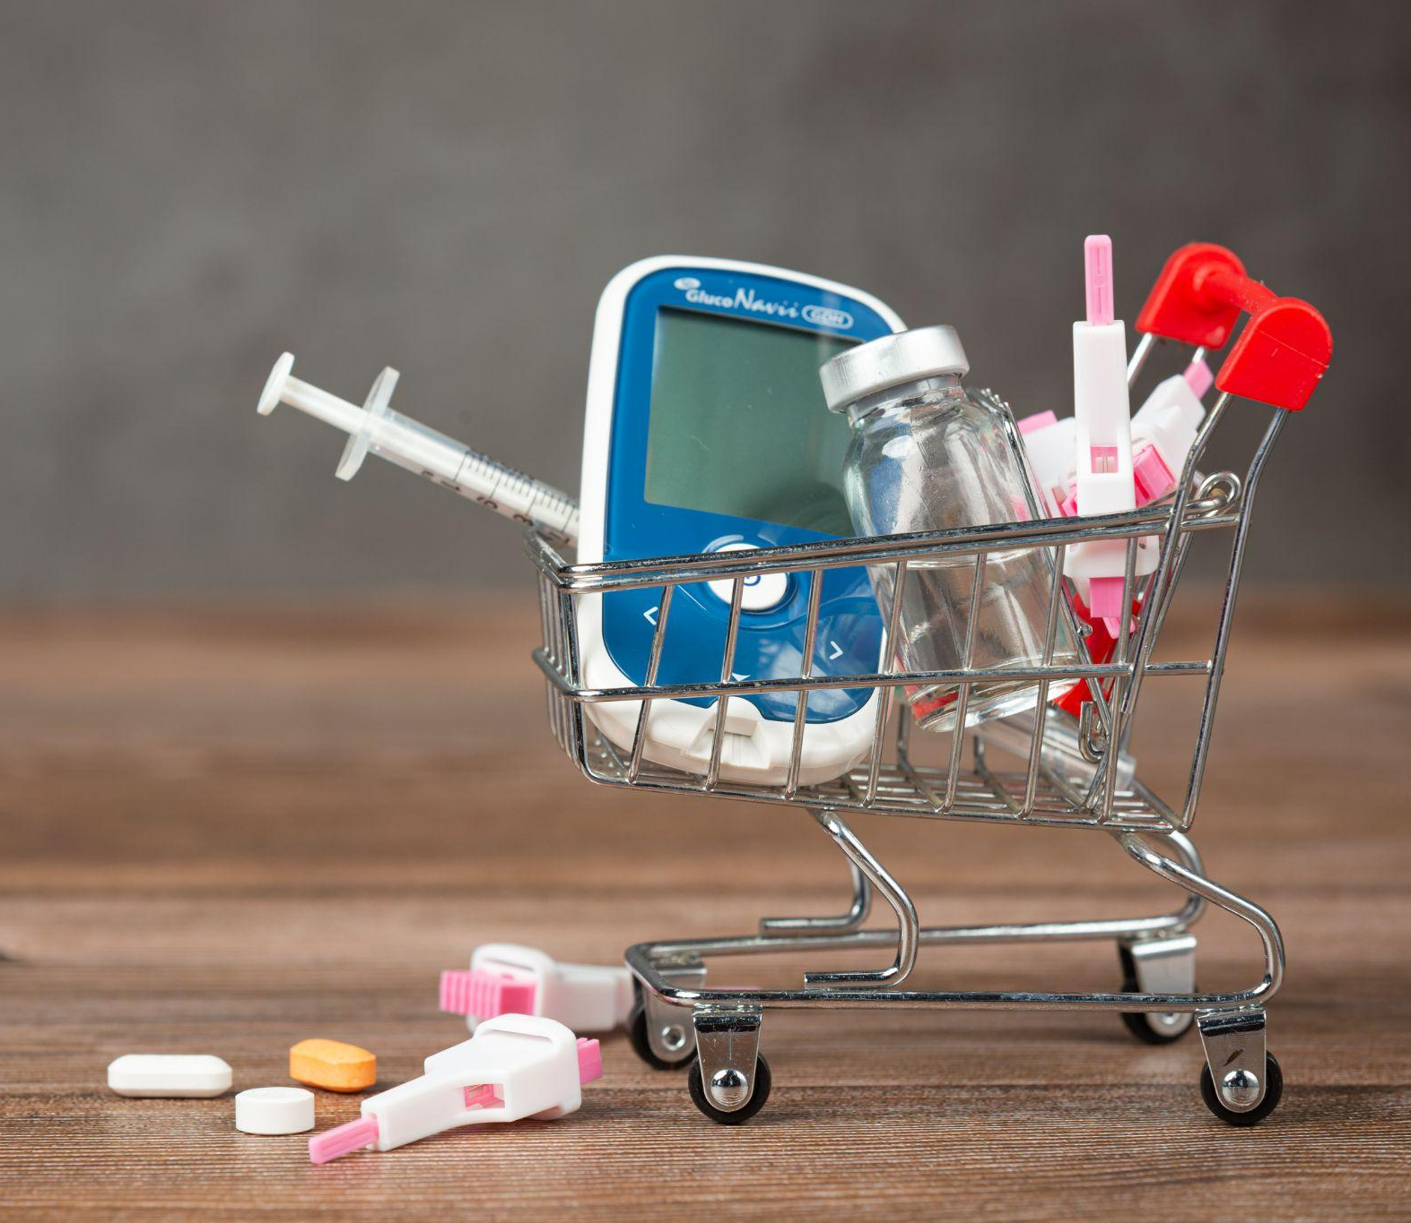

The issue.
Rising trends in obesity,¹ diabetes,² heart disease,³ alcohol-related liver disease,⁴ DILI,⁵ and COVID-19 have resulted in increased liver disease⁶
COVID-19, coronavirus disease; DILI, drug-induced liver injury
1. WHO https://www.who.int/news-room/fact-sheets/detail/obesity-and-overweight#:~:text=Worldwide%20obesity%20has%20nearly%20tripled,%2C%20and%2013%25%20were%20obese. Accessed September 2022; 2. WHO https://www.who.int/news-room/fact-sheets/detail/diabetes Accessed September 2022; 3. Roth A et al. J Am Coll Cardiol 2020;76:2982–3021; 4. https://www.gov.uk/government/news/alcoholic-liver-deaths-increased-by-21-during-year-of-the-pandemic#:~:text=There%20was%20a%20rapid%20increase,2.9%25%20between%202018%20and%202019. Accessed September 2022; 5. Navarro VJ et al. Hepatology 2017;65:363–73;
6. Velarde-Ruiz Velasco JA, et al. Ver Gastroenterol Mex (Engl Ed) 2020;85:303–11
Notes:
Insert high impact stats - health equity, ALD, FLD, and COVID
Health Equity
African American men are 60% more likely to have liver cancer and die as compared to non-Hispanic white men
Hispanics have a higher prevalence rate of NAFLD/NASH (28%) compared with Asians (18%), African Americans (3%), and other races (6%)
Risk Factors Info
At least 70% of liver cancer cases could be prevented with the elimination of risk factors.
Approximately two billion adults have obesity
Over 400 million adults have diabetes
Both of which are risk factors for NAFLD, NASH and HCC

Slide 3





GLI creates collaborative processes to address these issues.
GLI, global liver institute; NASH, non-alcoholic steatohepatitis

Slide 4




Mission.
Vision.
Values.
To improve the lives
of individuals and families impacted by liver disease through promoting innovation, encouraging collaboration, and scaling optimal approaches
to help eradicate
liver diseases.
For liver health
awareness to be universal and for liver disease
to take its proper place
on the global public health agenda consistent with
its prevalence and impact.
Patient-centeredness.
Collaboration.
Integrity.
Inclusion.
Results.
Notes:
To improve the lives of individuals and families impacted by liver disease through promoting innovation, encouraging collaboration, and scaling optimal approaches to help eradicate liver diseases.
Vision
For liver health awareness to be universal and for liver disease to take its proper place on the global public health agenda consistent with its prevalence and impact.
Values
Patient-centeredness.
Collaboration.
Integrity.
Inclusion.
Results.

Slide 5
GLI’s NASH Council.
Launched in 2017 at the Milken Institute School of Public Health, the GLI NASH Council shines a spotlight and coalesces an expanded set of stakeholders, in addition to hepatology, around the urgency of developing mechanisms for quantifying and addressing the epidemic of NAFLD and NASH in the U.S. and abroad. The NASH Council convenes twice per calendar year on a virtual basis.
Growth to 80+ Members, including:
Patient organizations
Industry (e.g., pharmaceutical, diagnostic)
Medical Societies
Health Systems
Researchers, Specialists
Non-Profit Organizations
GLI, global liver institute; NAFLD, non-alcoholic steatohepatitis; NASH, non-alcoholic steatohepatitis

Slide 6
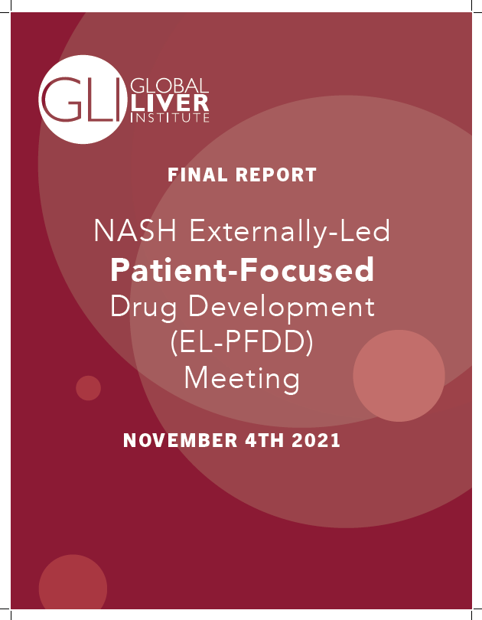

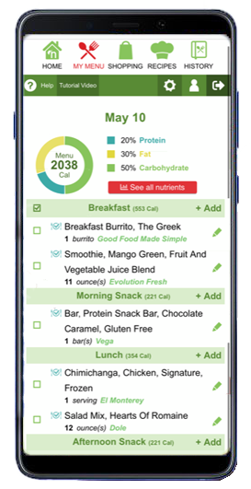



NASH Council Achievements.
The Language of NASH
U.S. NASH Action Plan
GLI, in collaboration with NASH Council member, Clinical Care Options, launched the CME course, NASH Core Curriculum: A Comprehensive Online Resource Center
GLI’s proposed coding revisions in ICD-10-CM
NASH Externally-Led Patient-Focused Drug Development (EL-PFDD) Meeting for the U.S. Food and Drug Administration (FDA) on 11/4/2021
Collaboration with United States Preventive Services Task Force (USPSTF)
Partnership with NutriStyle Inc. for creation of nutrition app
CME, Continuing Medical Education; GLI, global liver institute; ICD-10-CM, International Classification of Diseases, Tenth Revision, Clinical Modification; NASH, non-alcoholic steatohepatitis

Slide 7
International #NASHDay.
This 5th #NASHDay was a tremendous global success:
More than 70 global partners
More than 70 countries and territories represented
22 scientific society and international organization endorsements.
#NASHDay received more than 15 million impressions, 4 million accounts, through 4,000 posts.
The press release, distributed to international media outlets, had a total potential reach of 400 billion
NASH, non-alcoholic steatohepatitis

Slide 8
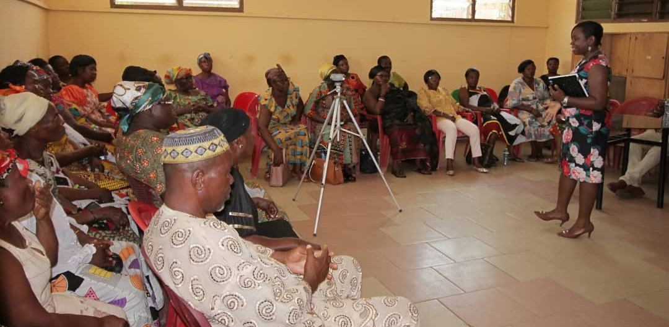
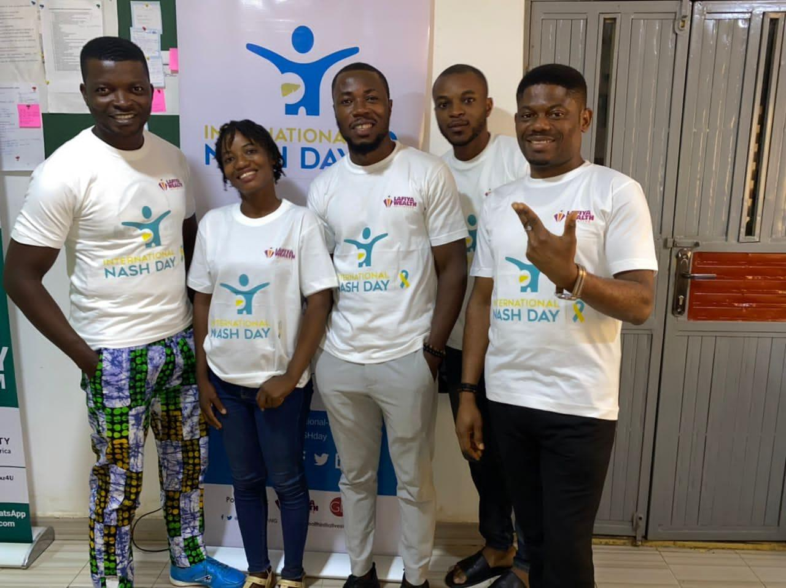
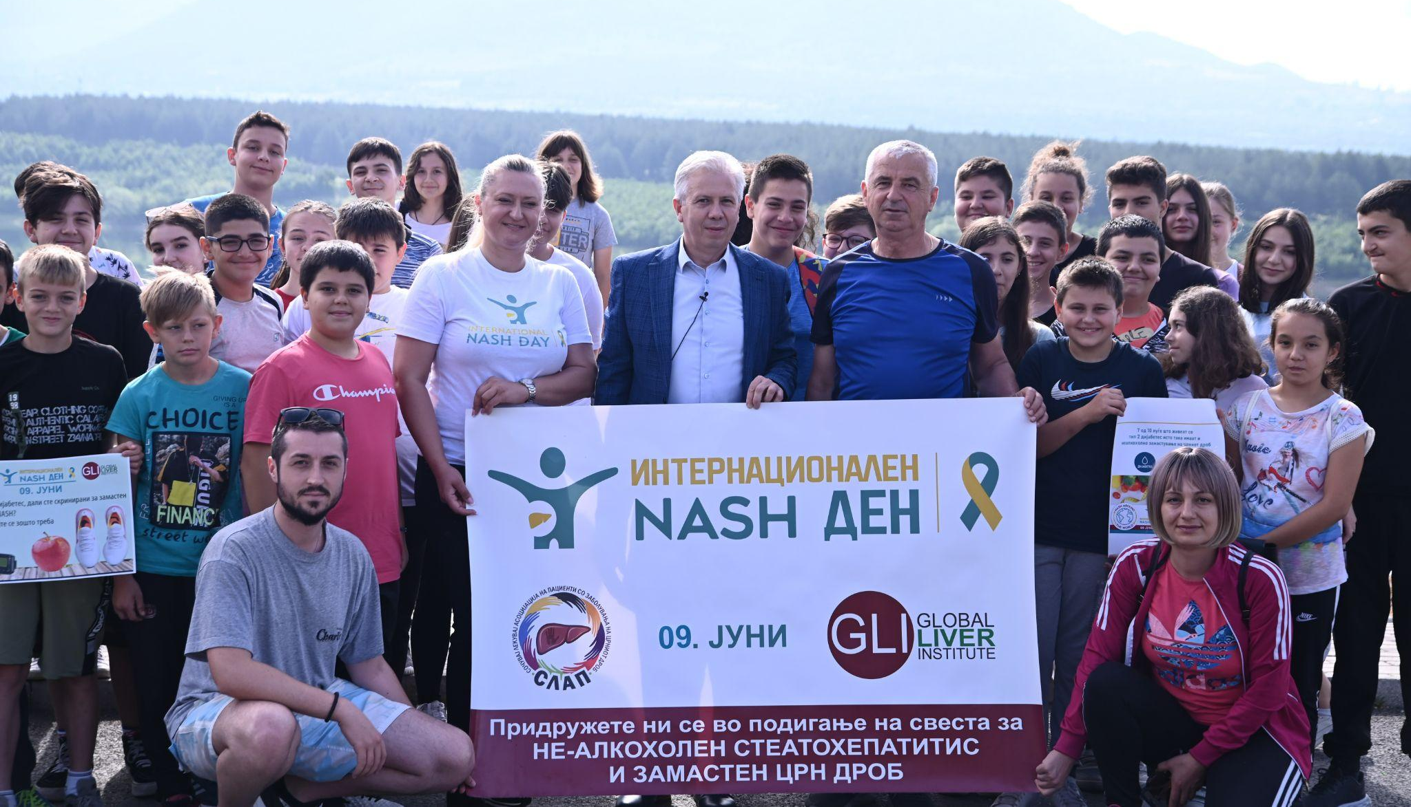
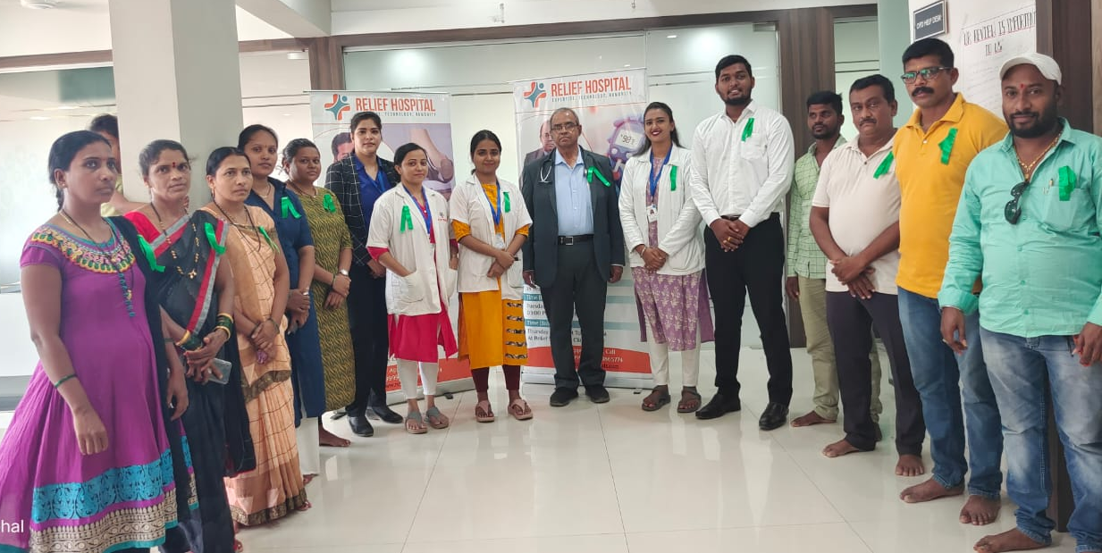
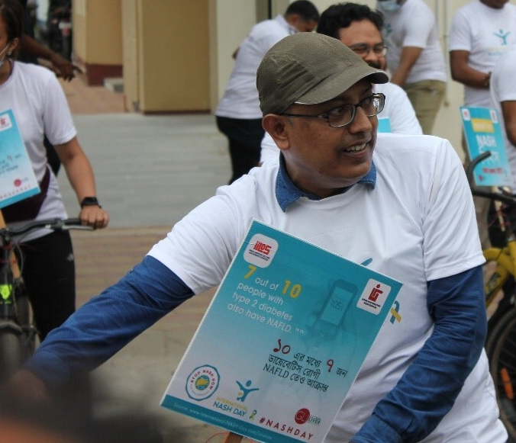
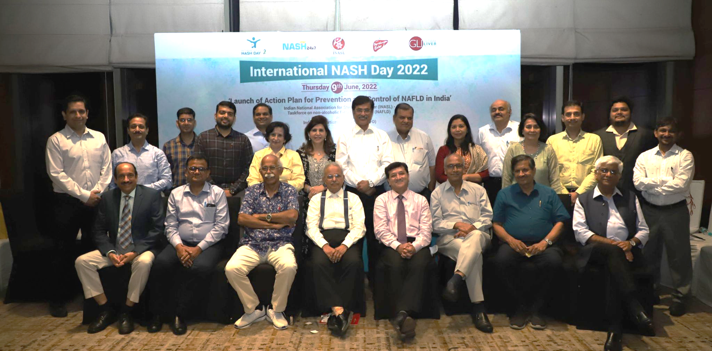
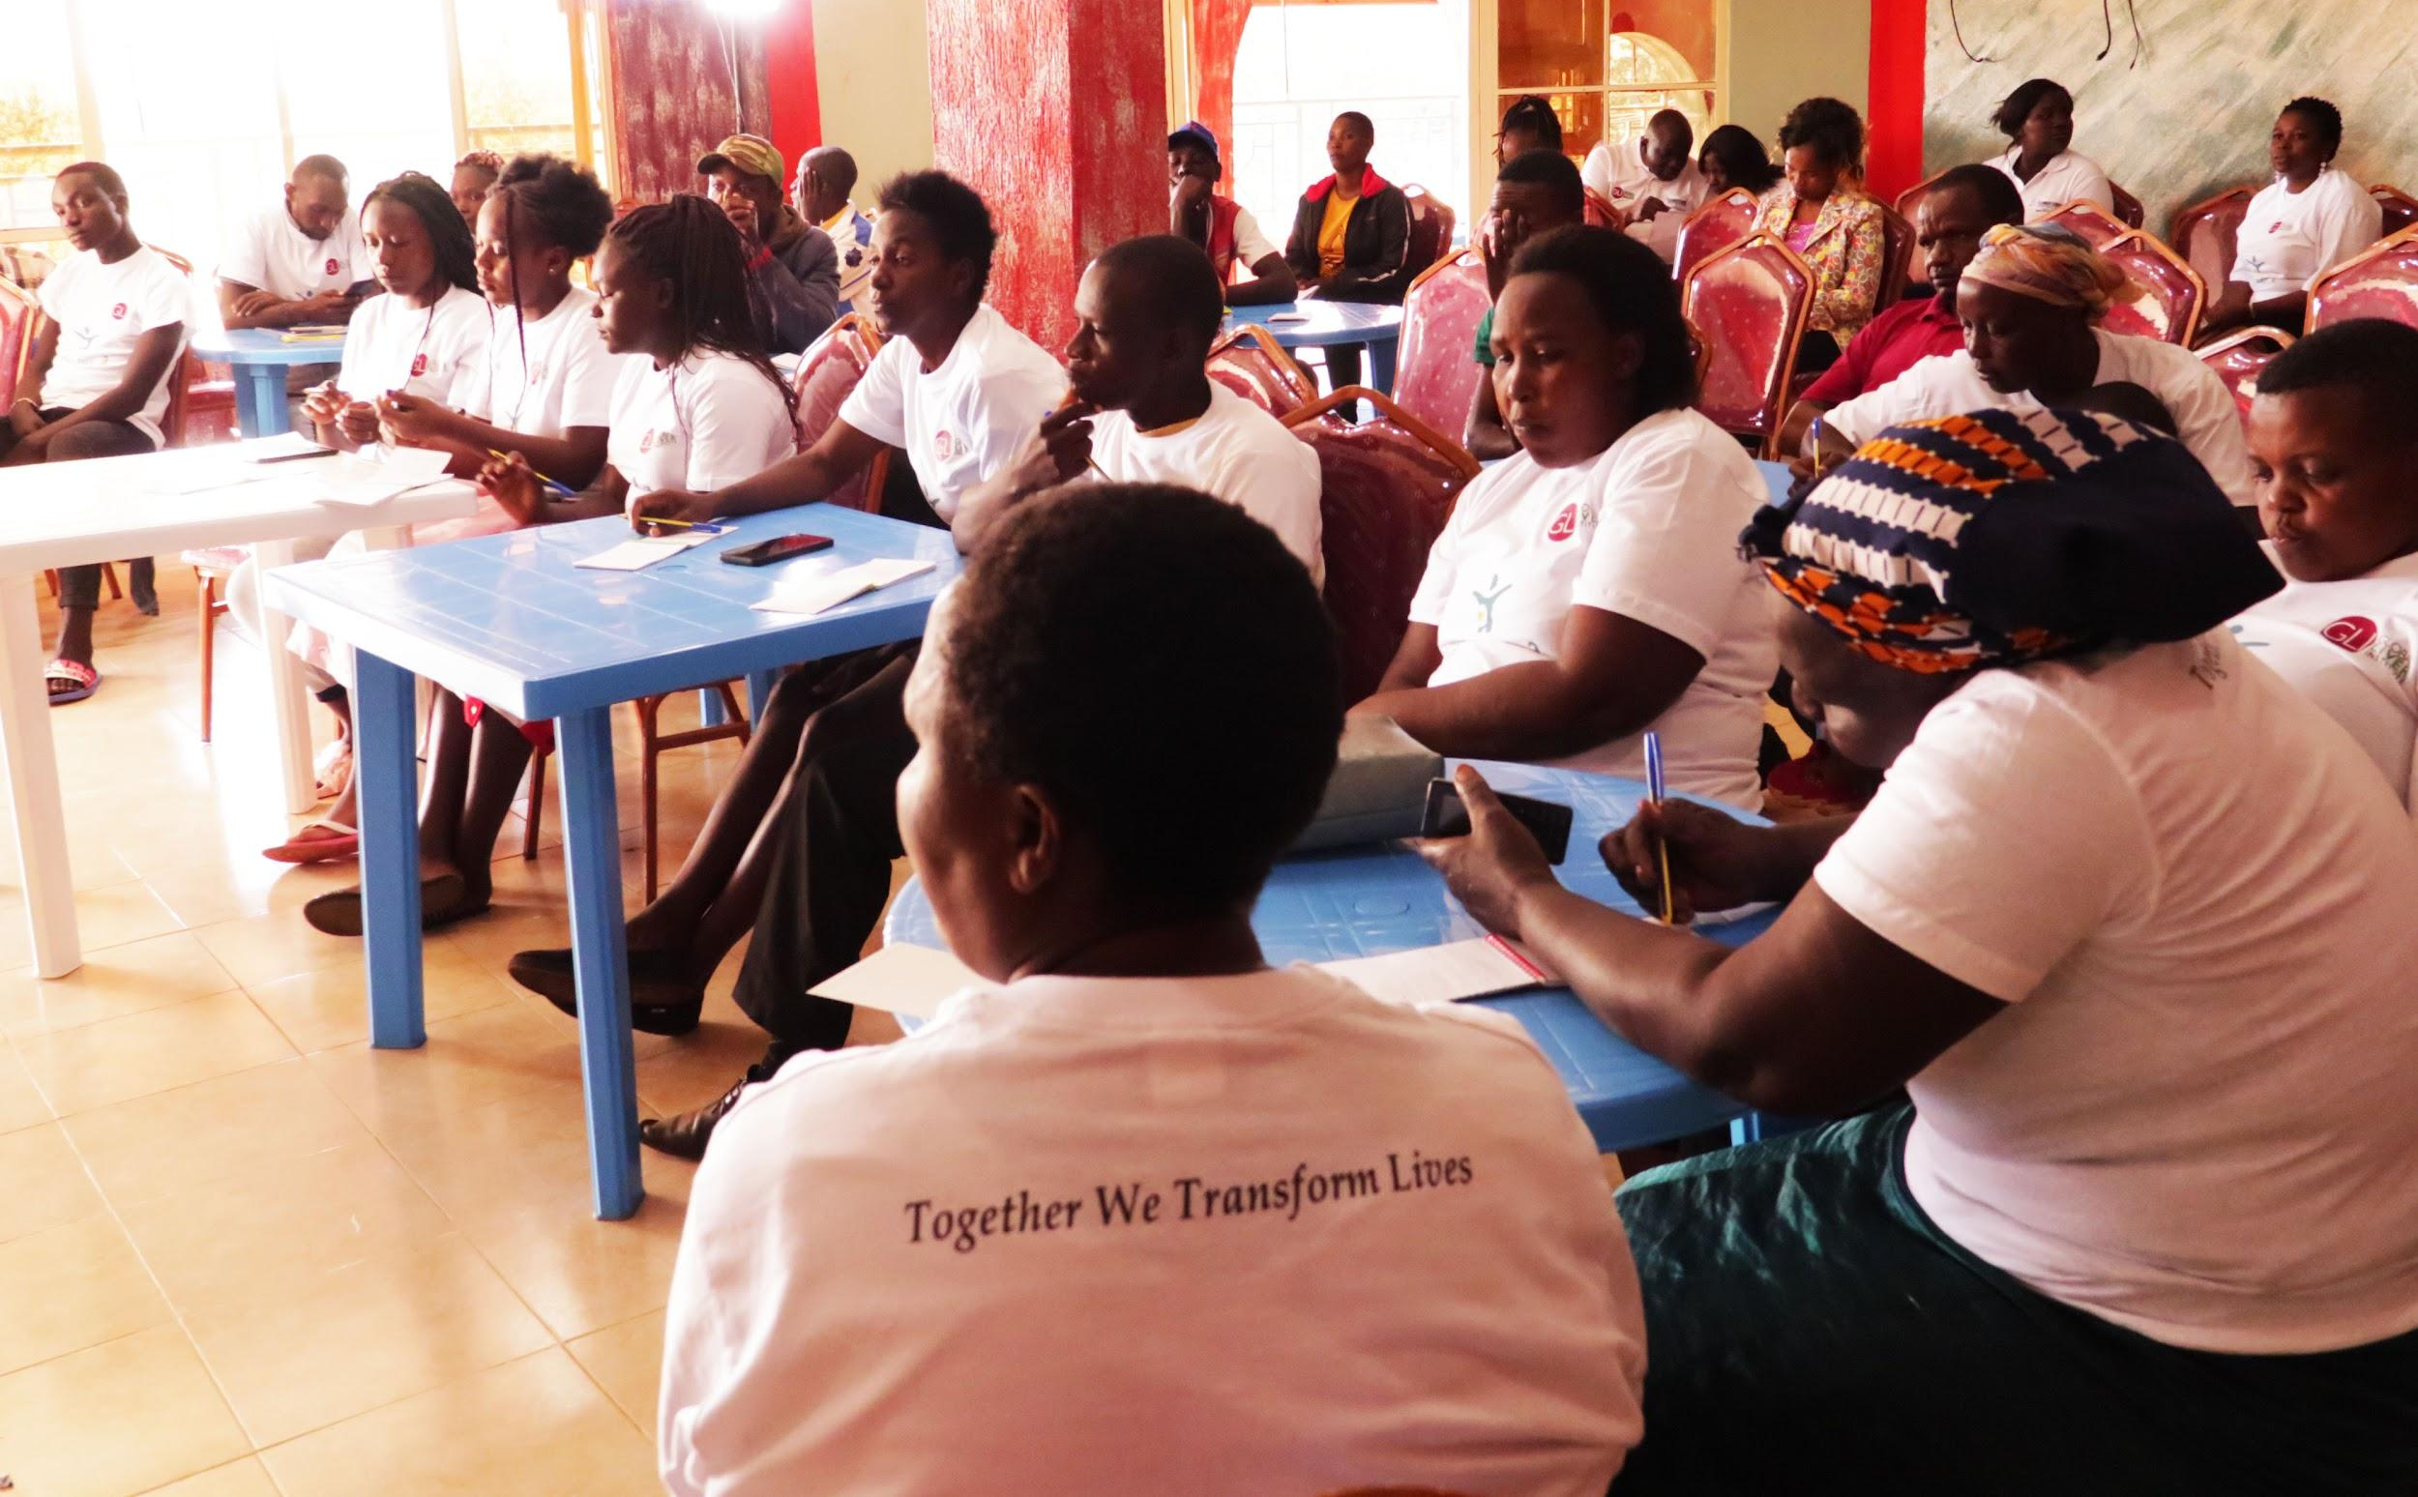
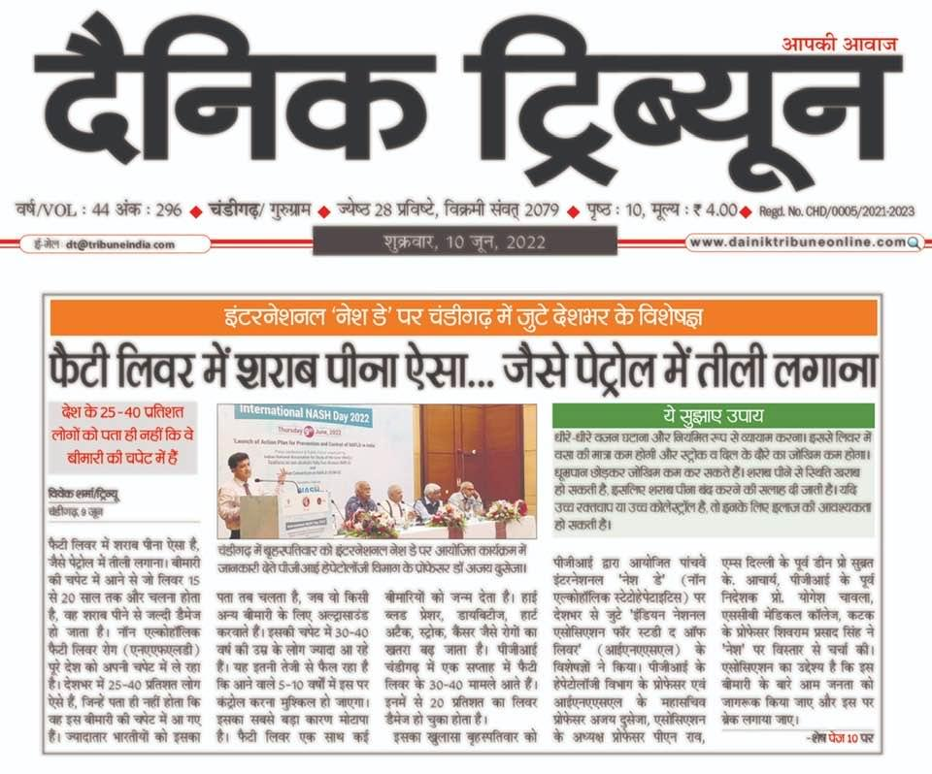
International #NASHDay.
NASH, non-alcoholic steatohepatitis

Slide 9
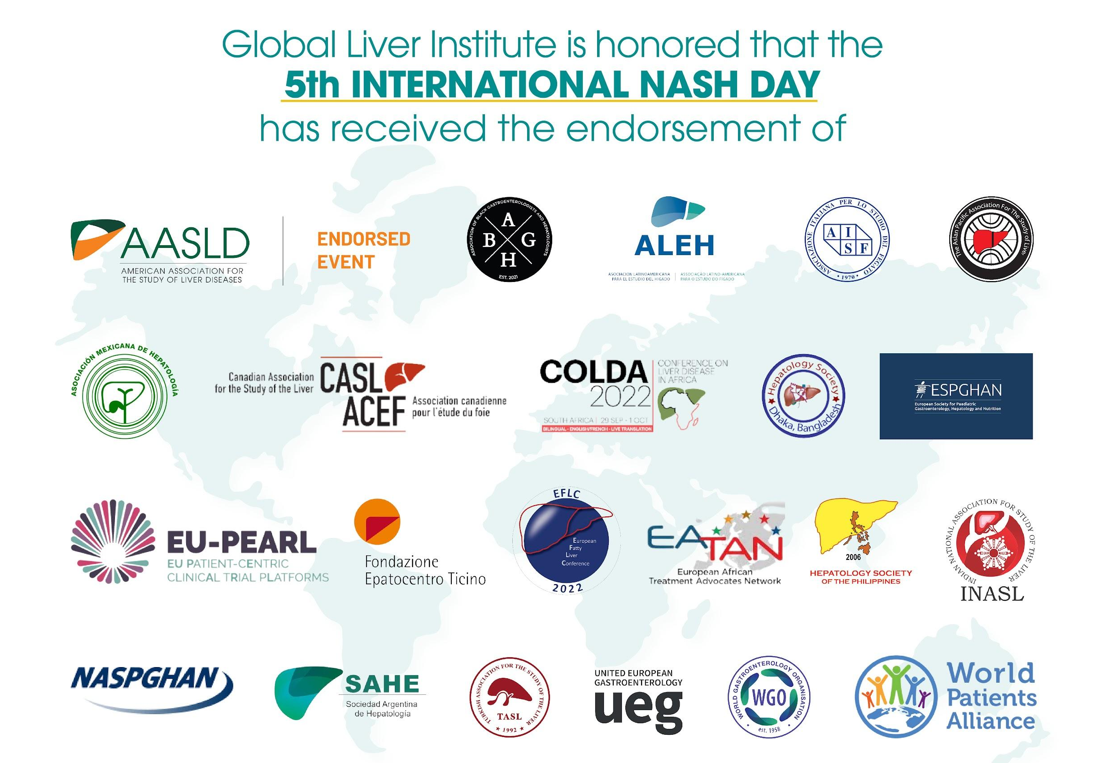

Slide 10
Beyond the Biopsy.
GLI’s Beyond the Biopsy program is a multifaceted awareness campaign dedicated to accelerating the acceptance and adoption of non-invasive diagnostics (NID) as an alternative to liver biopsy.
Campaign Goals
Shift share of voice and positive mentions of NID vs. biopsy
Highlight innovation and value of NID (to patients, providers, and payers)
Identify and address barriers to NID adoption
Support integration of NID in best practices and guidelines
GLI, global liver institute; NID, non-invasion diagnostics

Slide 11
Beyond the Biopsy GLI Program Integration.
International NASH Day
Global Partner Events
Global Conferences & Summits
Liver Health is Public Health
Liver Health Policy Update
Advanced Advocacy Academy (A3) Annual Symposium
A3 Continued Education Events
Global Events
Policy & Advocacy
GLI’s Communications
Councils & Boards
GLI LIVE
GLI’s social media accounts
Globalliver.org
NASH-Day.com
NASH News
GLI Podcast *coming soon
NASH Council
Pediatric and Rare Diseases Council
External Patient Advisory Boards
GLI, global liver institute; NASH, non-alcoholic steatohepatitis

Slide 12



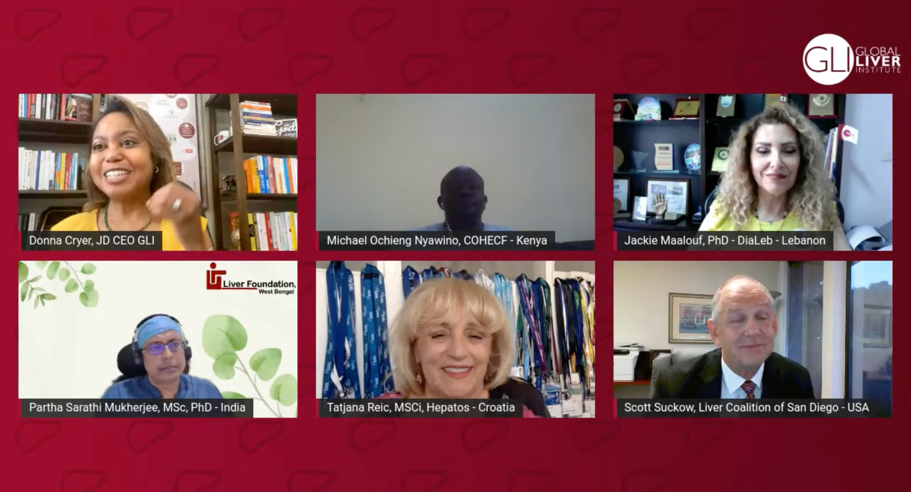
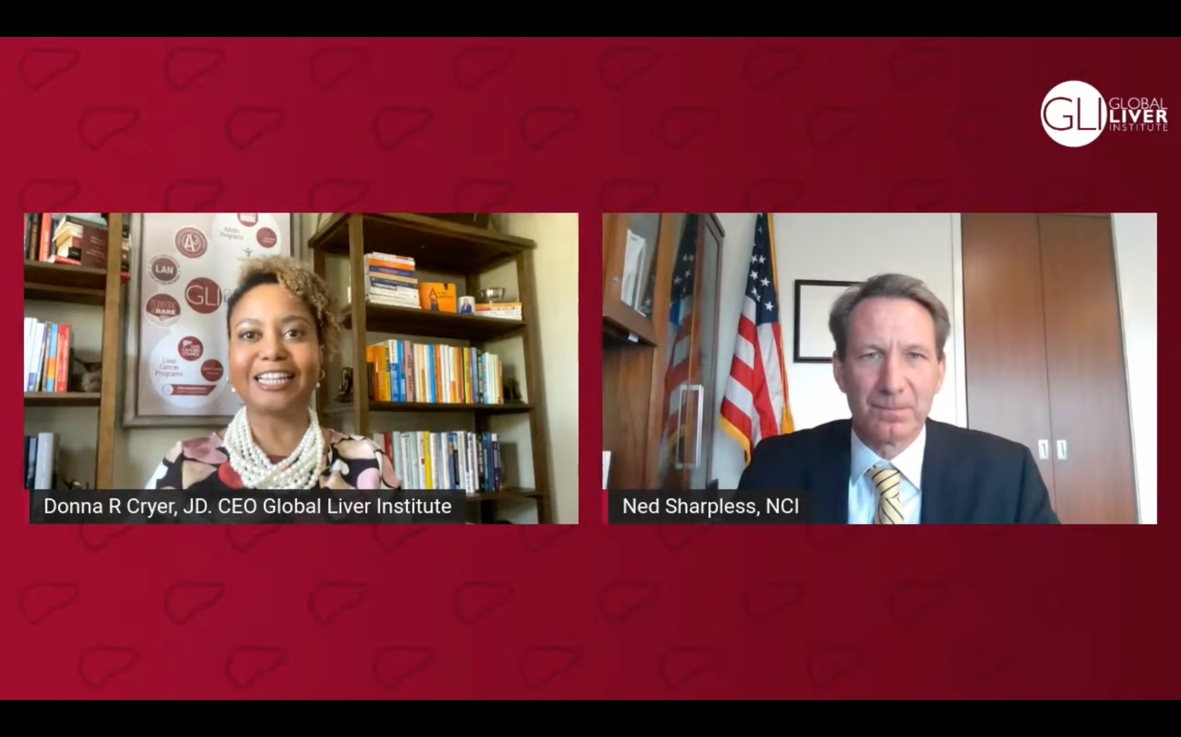
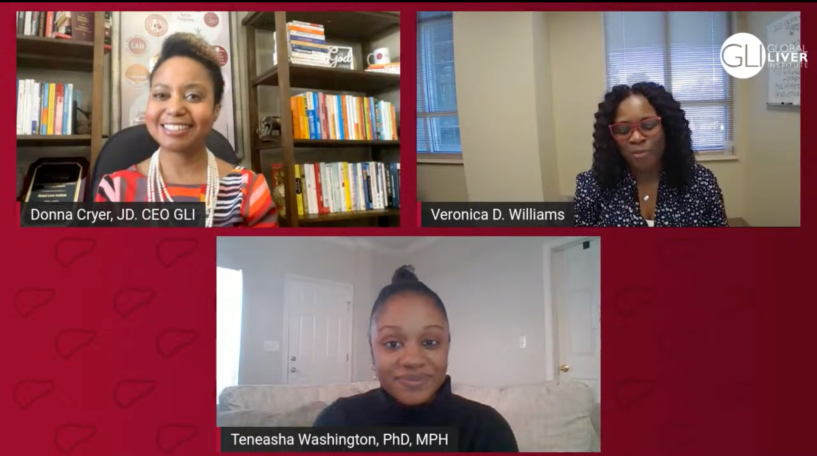
GLI LIVE.
Broadcasted live every Wednesday at 12:00pm ET
Emerged as a COVID-19 response program
GLI LIVE is our stage to discuss timely topics in liver health and share expert insights with the patients who might benefit most.
Almost 100 episodes to date
Guests include experts ranging from members of Congress to leading physicians to patient advocates to performers from Broadway.
COVID-19, coronavirus disease; GLI, global liver institute

Slide 13
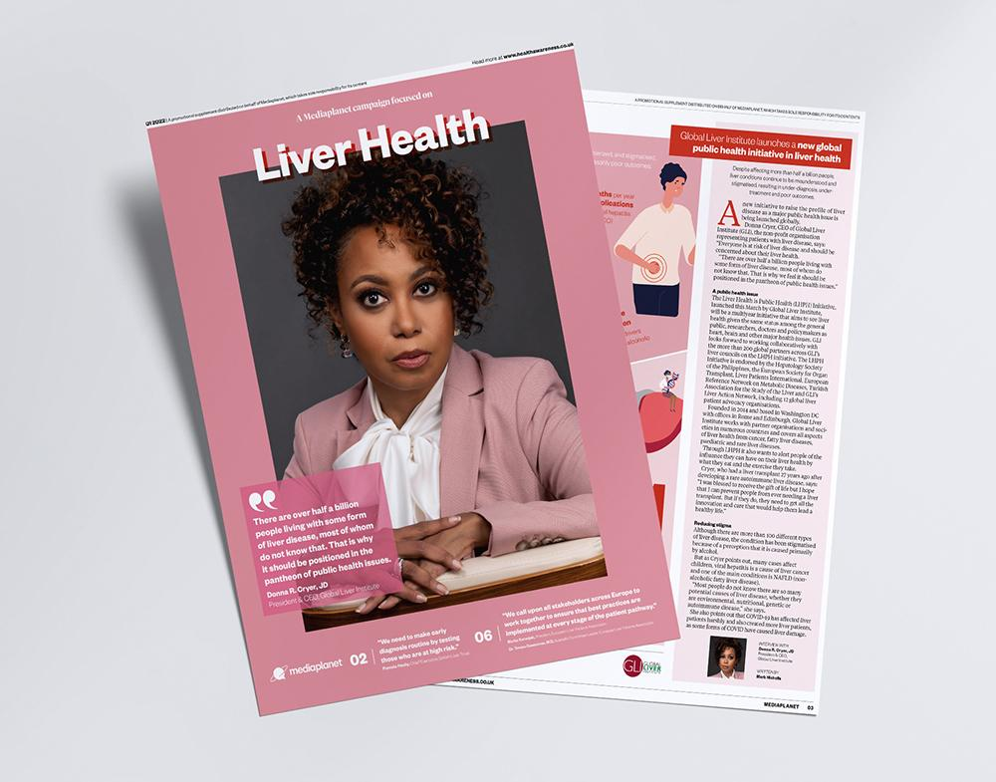
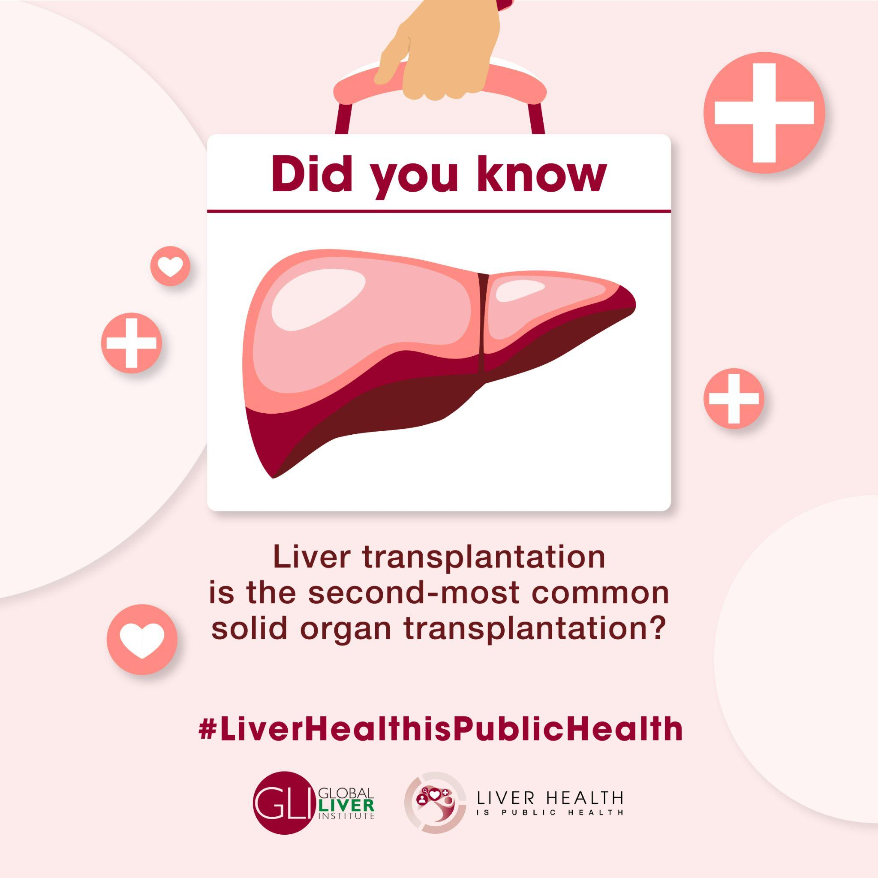

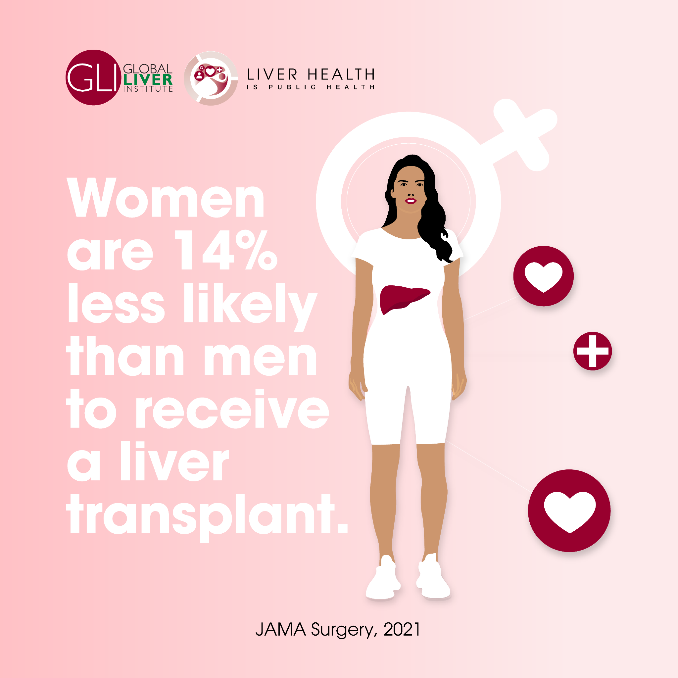
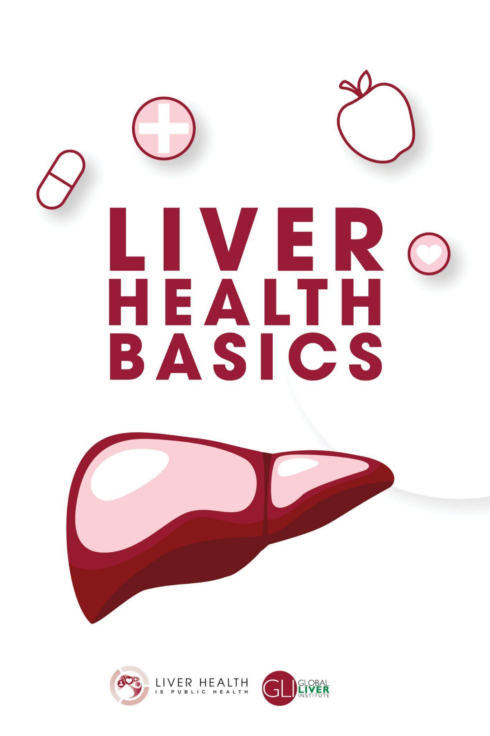
Liver Health is Public Health.
Campaign Goals
Educate patients, providers, payers, and policymakers; and the media that reaches them
Disseminate educational resources and stimulate a dialogue about liver health
Advocate for policies that support liver health best practices

Slide 14
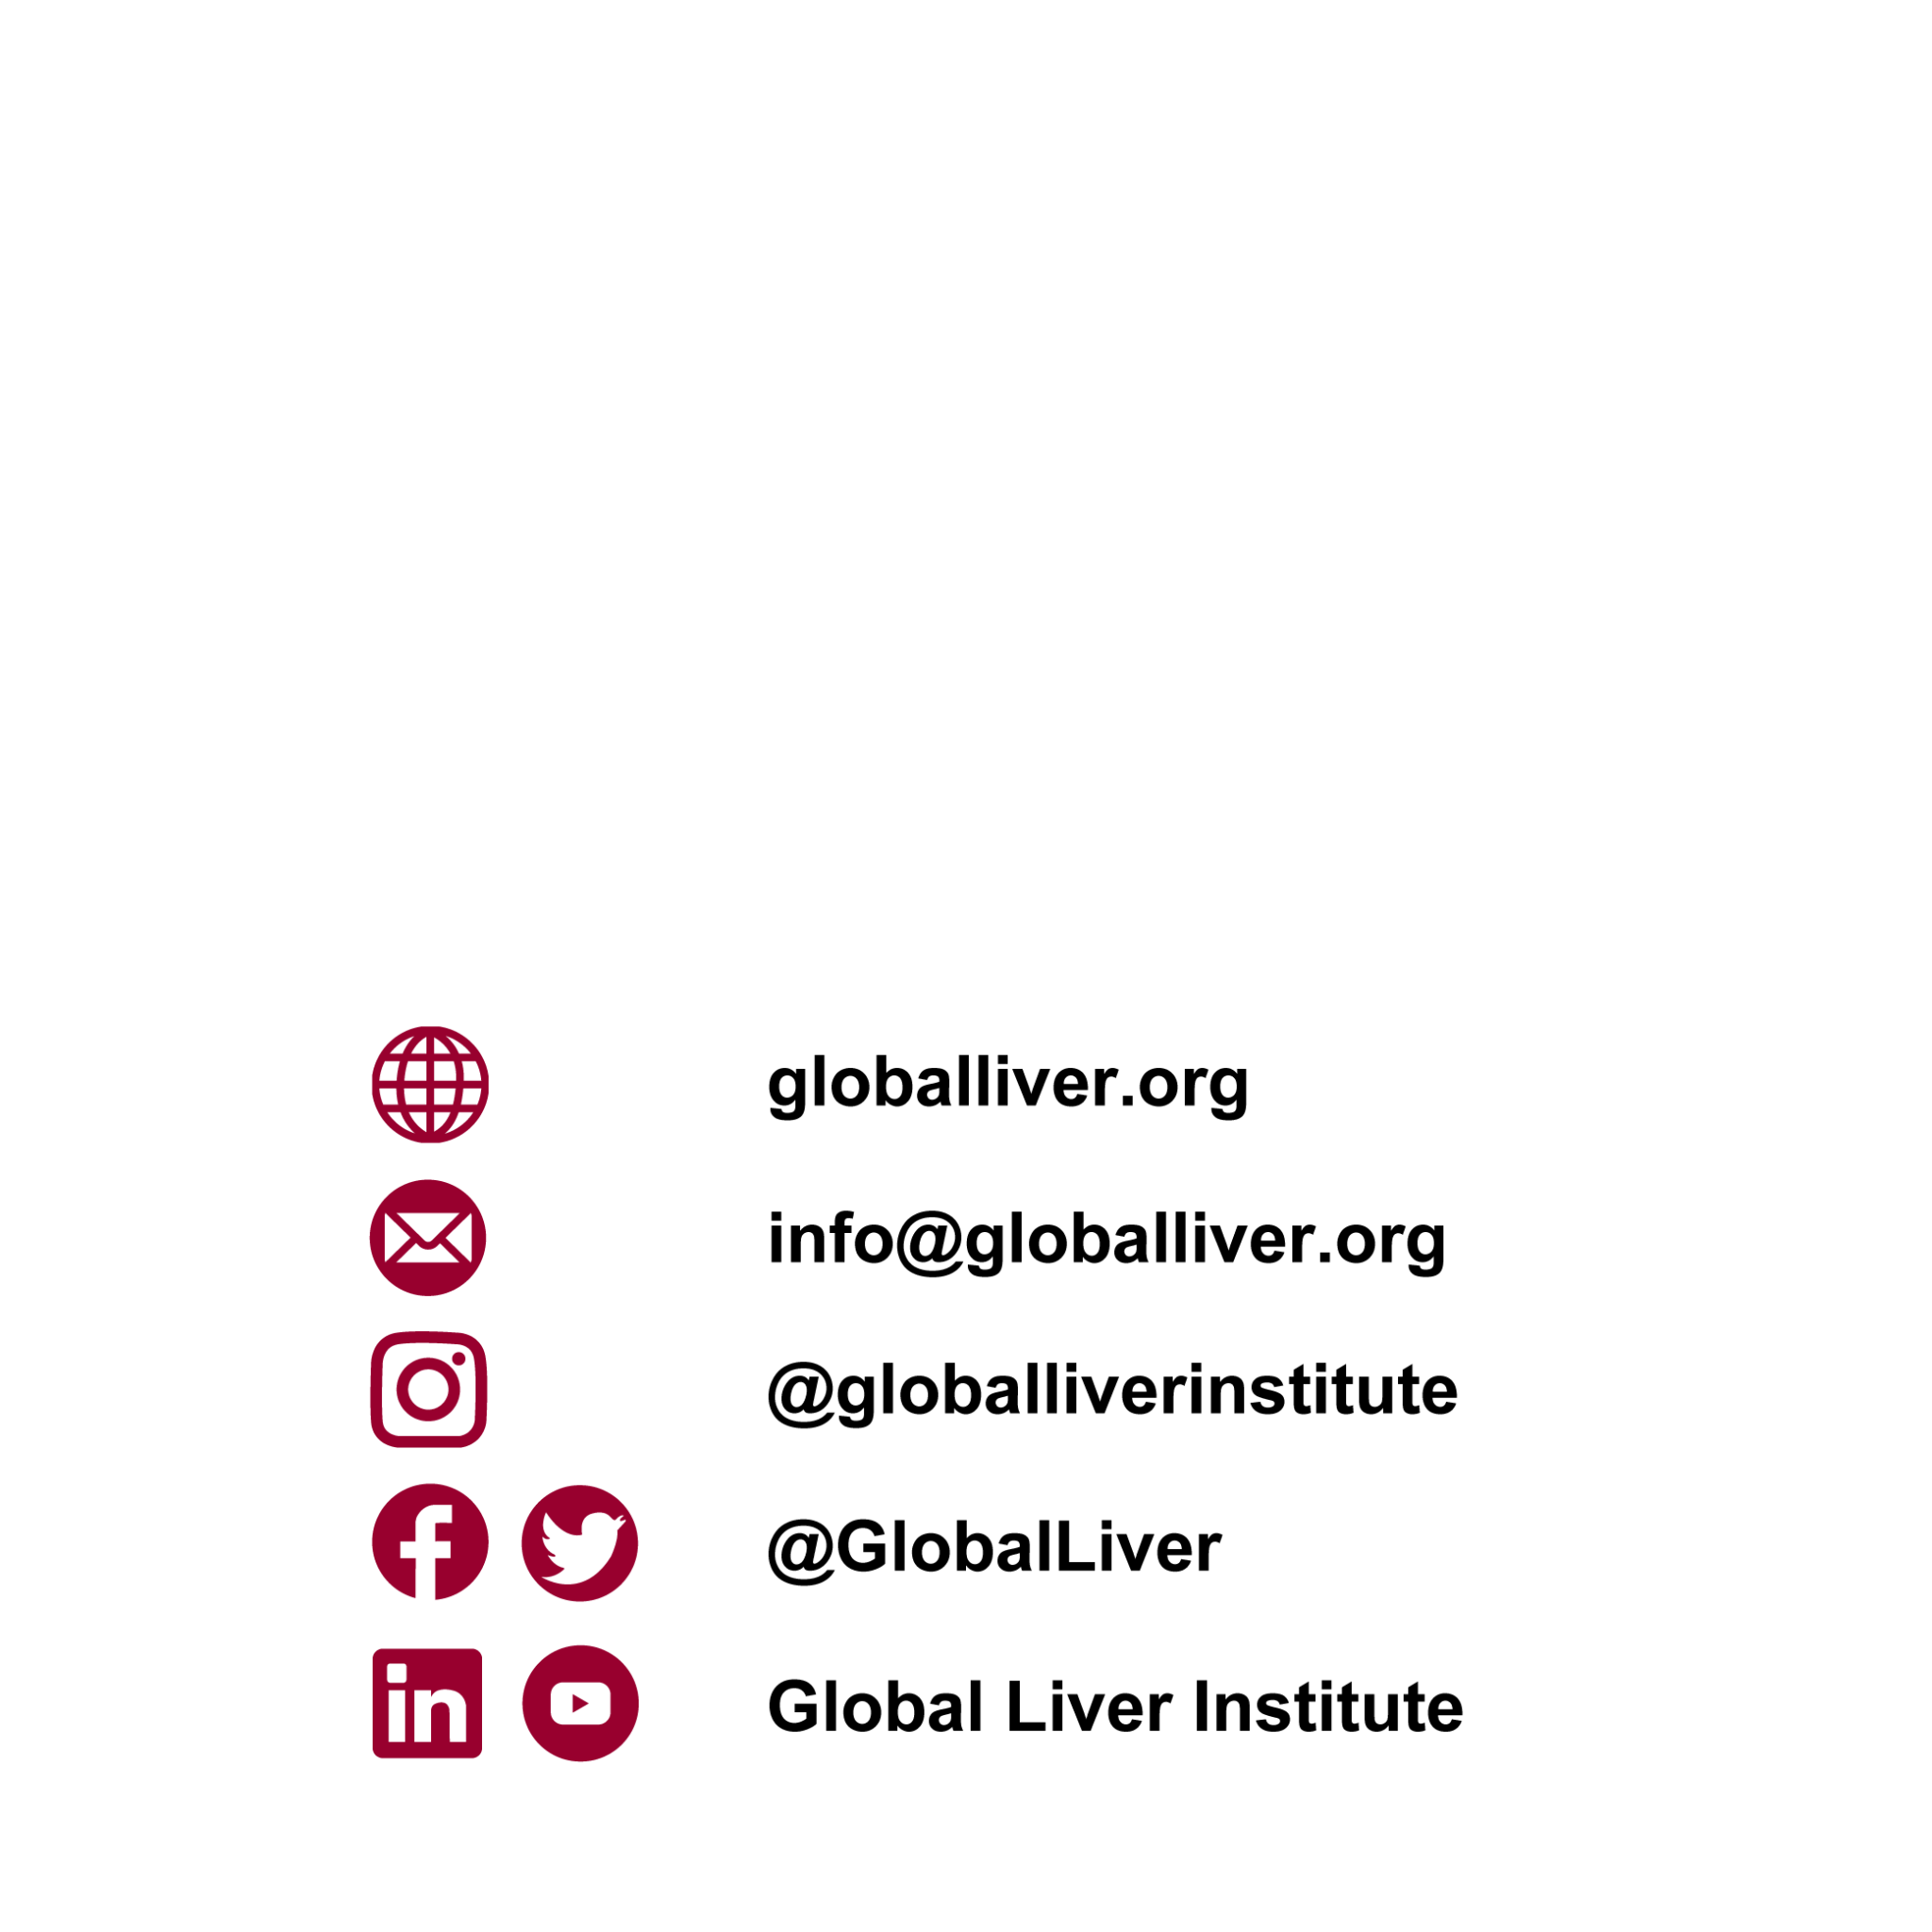
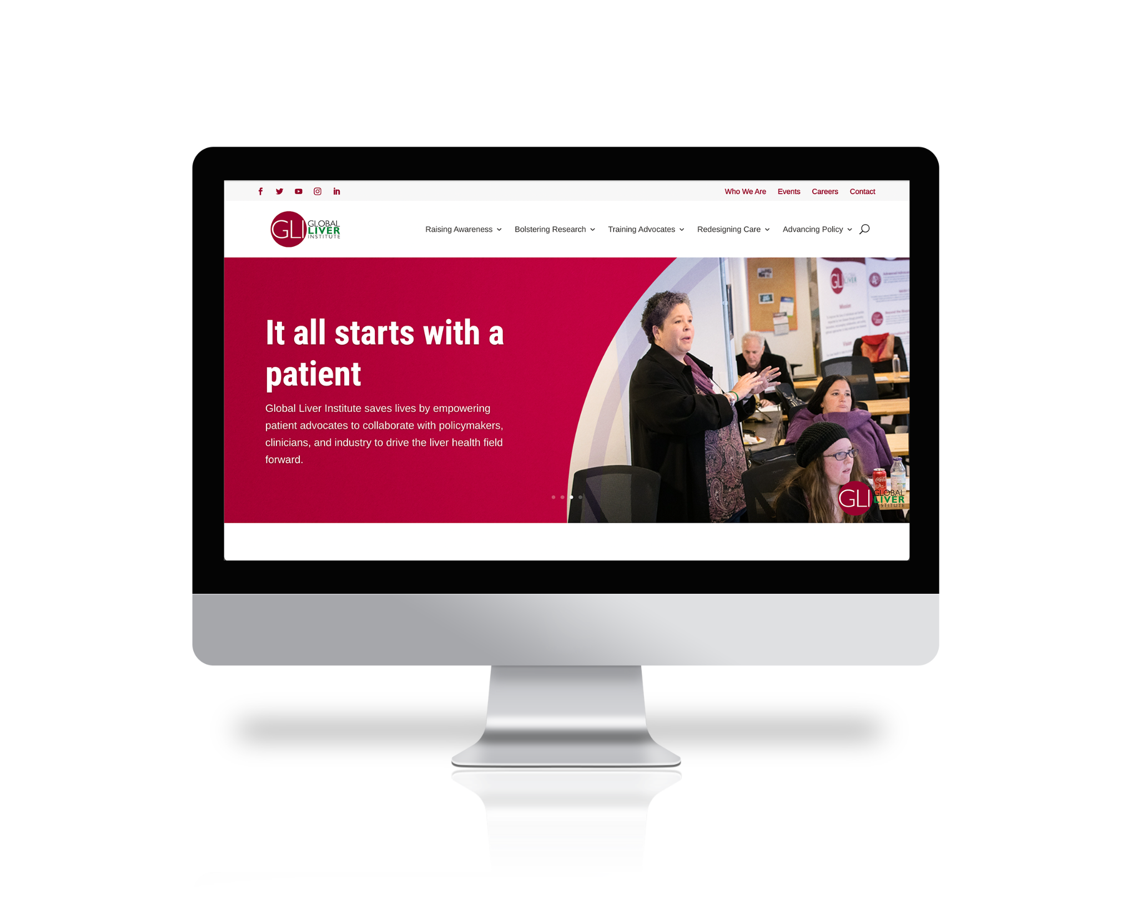

Thank you!

