Slide 1

MAT-GLB-2406369-v1.0
Date of approval: September 2024
Post event book

Slide 2












Global Liver Health Forum 2024
Post-event summary
Meeting overview
7th June 2024,
Friday
Online and Onsite
Milan, Italy
12:45-13:45
CEST
What?
A Sanofi-sponsored Industry Satellite Symposium that consisted of a variety of face-to-face plenary sessions and live audience Q&As.
Presentations delivered by four international KOLs
Why?
To enhance knowledge on the identification and intervention strategies for management of MAFLD/MASLD and associated metabolic risks; and to highlight the importance of early detection of MASLD and early intervention with hepatoprotective treatments.
KPI’s
12000
HCPs reached
44+
Countries reached
52%
General practitioners
90%
NPS score
HCPs, healthcare professionals; KOLs, key opinion leaders; MAFLD, metabolic dysfunction-associated fatty liver disease; MASLD, metabolic-dysfunction associated steatotic liver disease; NPS, net promoter score; Q&As, questions and answers.

Slide 3












Global Liver Health Forum 2024
Meeting agenda
Symposium
7th June 2024 | 12:45 pm
Prof. W. Lai
Dr. A. Dajani
Prof. M. Hartleb
Prof. P. Luciani
MAFLD in Focus: Unveiling Insights from China’s RELIEF Study – Insights from APASL 2024
Metabolic and Toxic Liver Damage in Focus: MANPOWER’s Latest Breakthroughs Revealed
Metabolic Comorbidities Unmasked: Redefining MASLD/MASH Impact
Shedding Light on Genomic, Metabolic, and Phenotypic Effects of Essential Phospholipids
on HepaRG
Training at Sanofi booth
5^{th-}8th June 2024 | 10.00-12.00 and 14.00-16.00 pm
Prof. Sollano
Early Screening for MASLD
Prof. Cozma-Petrut
Hepatoprotective Treatment Environment
EASL Studio Roundtable
5th June 2024 | 16:45-17.15 pm
Dr. A. Dajani
MASLD anno 2024: A rapidly Changing Landscape
APASL, Asian Pacific Association for the Study of the Liver; MASH, metabolic dysfunction-associated steatohepatitis; MAFLD, metabolic dysfunction-associated fatty liver disease.

Slide 4
Global Liver Health Forum 2024
Executive summaries
The webinar was led by a prestigious international faculty
Professor Lai Wei
Beijing Tsinghua Changgung Hospital, Tsinghua University, Beijing, China
MAFLD in Focus: Unveiling Insights from RELIEF Study! Insight from APASL 2024
Following a brief welcome and introduction from Professor Dajani, Professor Wei took over the stage to deliver the first session of the afternoon. During this 10-minute session, Professor Wei unveiled insights from China's RELIEF study. By reviewing key real-world evidence data from China, Professor Wei clearly demonstrated the beneficial effects of EPL on reducing fibrosis risk; and improving ALT/AST levels, and lipid levels among patients with MAFLD. The session also discussed the clinical implications, research gaps, and potential translational applications of the insights gained from the RELIEF study.
Dr. A Dajani
Medcare and Saudi German Hospital, Sharjah, United Arab Emirates
Metabolic and Toxic Liver Damage in Focus: MANPOWER’s Latest Breakthroughs Revealed
Following an insightful presentation from Professor Wei Lai, Professor Dajani took to the stage to share groundbreaking insights on “Metabolic and Toxic Liver Damage in Focus: MANPOWER’s Latest Breakthroughs Revealed.” During this 10-minute session, Professor Dajani delved into the potential role of EPLs as hepatoprotectors by demonstrating how PPC, the main active ingredient of EPL, holds a promising role in the management of MAFLD, its extrahepatic manifestations and drug-induced liver injury, emphasizing the key findings from the MANPOWER study.
ALT, alanine aminotransferase; APASL, Asian Pacific Association for the Study of the Liver; AST, aspartate aminotransferase; EPL, essential phospholipids; MAFLD, metabolic dysfunction-associated fatty liver disease; PPC, polyenyl phosphatidylcholine.

Slide 5
Global Liver Health Forum 2024
Executive summaries
Professor Paola Luciani
Director of Study of the Bachelor in Pharmaceutical Sciences, University of Bern, Switzerland
Shedding Light on Genomic, Metabolic, and Phenotypic Effects of Essential Phospholipids on HepaRG
Moving the conversation onwards, Professor Luciani focused on the mechanism of action of EPL through the presentation titled “Shedding light on genomic, metabolic, and phenotypic effects of EPL on HepaRG”. In this session, she discussed the effect of EPL on lipid distribution and accumulation in an in vitro model replicating human steatosis. The study findings indicated the mechanism of action of EPL in effective lipid droplet size reduction in HepaRG cells, thereby emphasizing the promising role of EPL in steatosis treatment. The session also highlighted the main process involved in lipid degradation and the upregulation of steatosis predictor genes after treatment with EPL.
Professor Marek Hartleb
Head of the Department of Gastroenterology and Hepatology, Medical University of Silesia, Katowice, Poland
Metabolic Comorbidities Unmasked: Redefining MASLD/MASH Impact
Professor Hartleb, discussed the recent shift in nomenclature from NAFLD to MASLD, emphasizing its diagnostic criteria now based on cardio-metabolic risks rather than exclusion of alcohol use. A study showed that clinical profiles and mortality rates were similar between NAFLD and MASLD, suggesting their interchangeability. MASLD, seen as a systemic disorder, significantly impacts multiple organs and exhibits a bidirectional relationship with T2DM.
Professor Hartleb highlighted that MASLD increases CVD risk, linked to metabolic dysfunction. Therapeutic approaches focus on lifestyle changes, antidiabetic agents, and liver-directed therapies, with a call for multidisciplinary guidelines to manage MASLD and related comorbidities.
CVD, cardiovascular disease; EPL, essential phospholipids; MASH, metabolic dysfunction-associated steatohepatitis; MASLD, metabolic-dysfunction associated steatotic liver disease; NAFLD, non-alcoholic fatty liver disease; T2DM, type 2 diabetes mellitus.

Slide 6
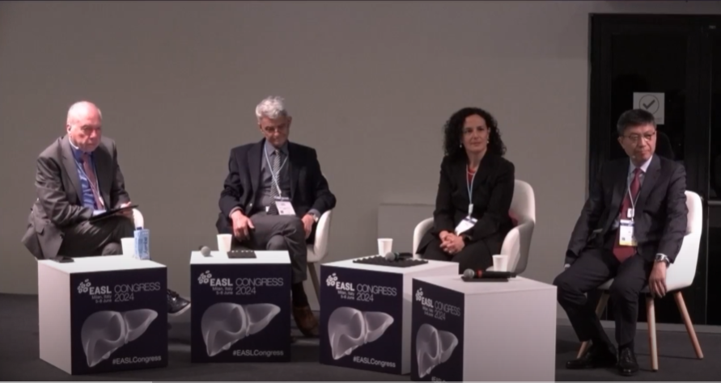
Global Liver Health Forum 2024
Interactive Q&A Session
After the four plenary sessions, the faculty gathered for an open-forum Q&A session to interact with the audience. The faculty engaged in a discussion focusing on the measurement and impact of different biomarkers and treatments on liver diseases.
Questions were asked about the reduction in total bilirubin levels upon phospholipids treatment in RELIEF study. Prof. Wei responded that though the exact mechanism remains unknown, the beneficial role of EPL might be related to the treatment's effects on active end hepatitis and bilirubin levels elevated by various aetiologies. However, the data based on a real-world study, necessitates further analysis to understand the treatment's broader impact.
Regarding use of EPL in ALD and DILI, Prof. Hartleb and Dr. Dajani emphasized on lifestyle modifications and reduction of alcohol intake as the first-line approach, suggesting use of hepatoprotective agents if alcohol consumption continued.
Questions were asked about origin (plant vs animal) and constituents of EPL and its impact. Prof. Luciani emphasized the beneficial effects of plant-based EPLs. These complex mixtures of unsaturated fatty acids play a role in modulating membrane fluidity, contributing to their hepatoprotective function.
ALD, alcoholic liver disease; DILI, drug-induced liver injury; EPL, essential phospholipids; Q&A, questions and answers.

Slide 7
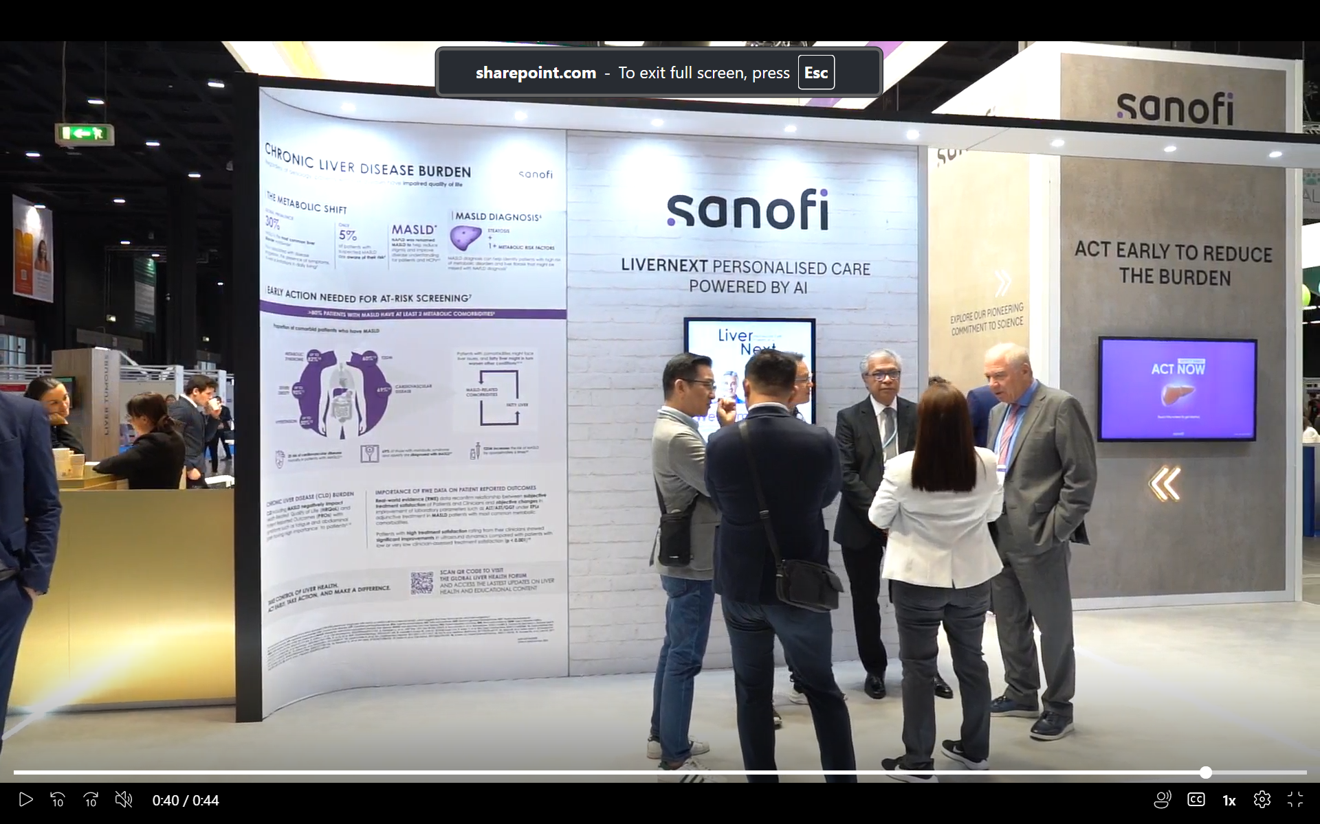
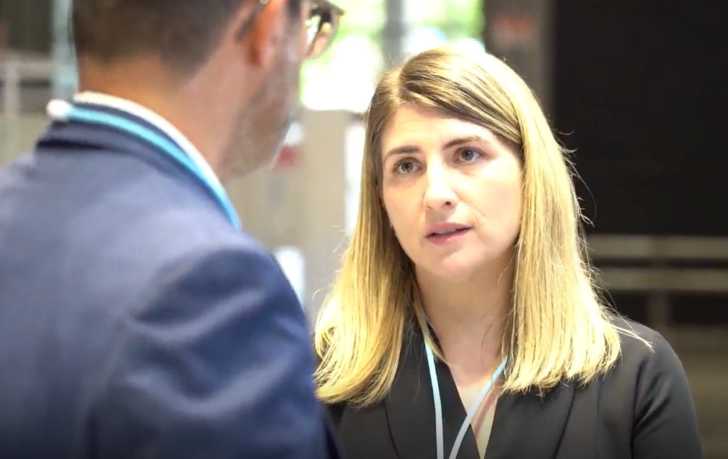


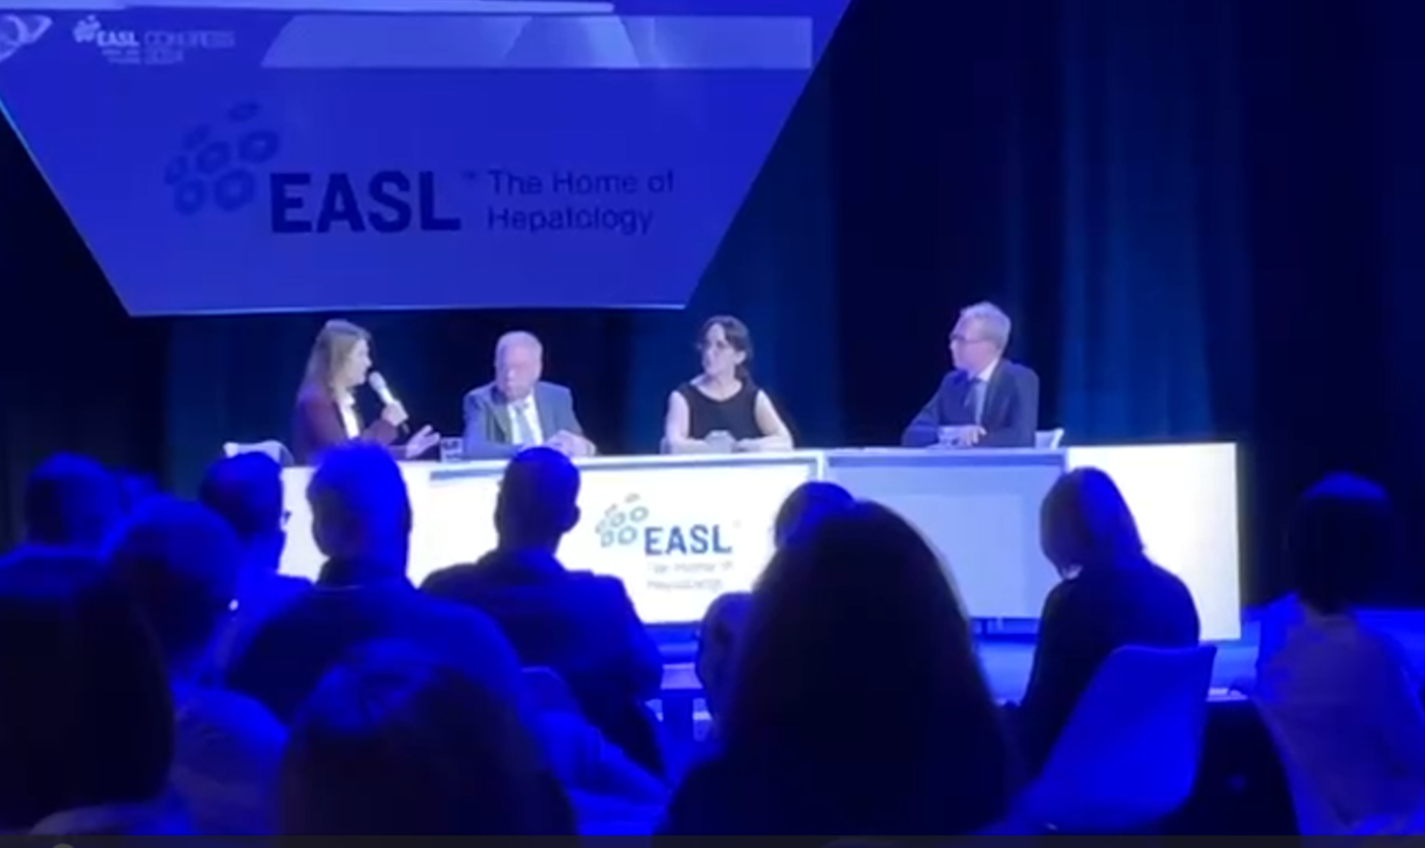
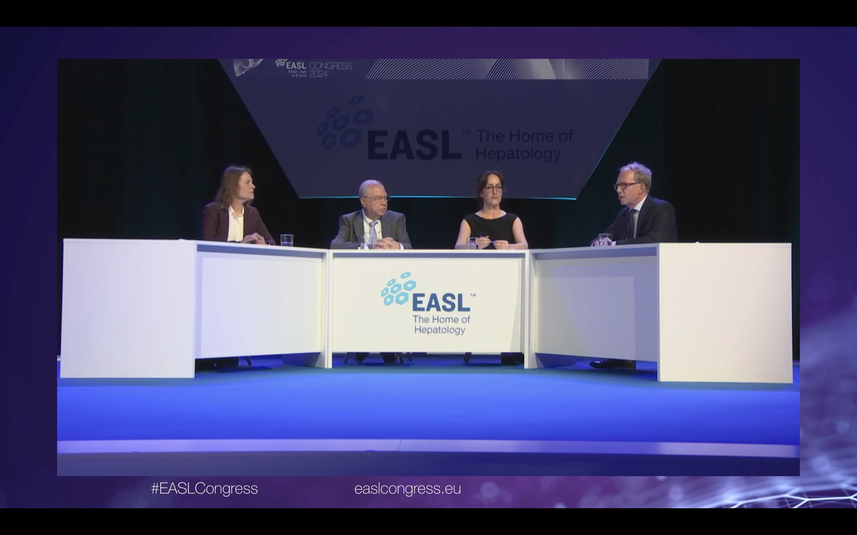
Global Liver Health Forum 2024
Training at Sanofi booth
Including community pharmacist to highlight the importance
of a multidisciplinary approach in MAFLD/NAFLD management
Highlighted the importance of early detection and intervention for MASLD
Discussed current treatment landscape, including hepatoprotective agents and their effectiveness in prevention of MASLD progression
EASL Studio Roundtable
MASLD anno 2024: A rapidly changing landscape
165 On-site participants
190 Online participants
Highlighted importance of NIT in place of biopsy for early detection
Lifestyle intervention with balanced diet and exercise remains the mainstay for MASLD management
MASLD is a multi-system disorder – collaboration of multiple specialists are recommended for management of associated comorbidities
MAFLD, metabolic dysfunction-associated fatty liver disease; MASLD, metabolic-dysfunction associated steatotic liver disease; NAFLD, non-alcoholic fatty liver disease; NIT, non-invasive testing.

Slide 8















MAFLD in Focus: Unveiling Insights from China's RELIEF Study; Insight from APASL 2024
Professor Lai Wei
Beijing Tsinghua Changgung Hospital, Tsinghua University, Beijing, China
MAFLD treatment recommendations: Chinese guidelines¹
Behavioral
therapy + Sport therapy
Drug therapy
Surgical
treatment
Liver
transplantation
Lifestyle modifications
Glucose-lowering drugs;
Lipid-lowering drugs;
Antiplatelet aggregation drugs; Hepatoprotective drugs: EPL; Antihypertensive drugs;
Weight-loss drugs
In patients with obesity and other risk factors
In patients with early-stage steatosis and comorbid conditions
In patients with cirrhosis and end stage liver failure
RELIEF study was design to evaluate the effectiveness of EPL and its association in delaying progression of liver fibrosis
Study design
Study outcomes
Retrospective, observational RWE study in China
Primary: Beneficial effect of EPL in reducing liver fibrosis (FIB-4) at W24
1 Jan 2020 → 31 Dec 2022
Secondary: Improved AST (significant: W12), ALT (non-significant) and total bilirubin (significant: W12 & 24) levels with EPL
Patients with MAFLD
(RELIEF DATA)
Exploratory: LDL-C levels reduced with EPL (W12)
EPL vs control (non-hepatoprotective group)
Early intervention with EPL delays liver fibrosis/cirrhosis progression; reduces fibrosis improving liver function
EPL therapy is suitable for MAFLD patients with high AST/ALT, significant fibrosis, particularly with T2DM or CV risk factors
1. Chinese Society of Hepatology, Chinese Medical Association. Chinese J of Hepatol; 2024:32(5):418-434.
ALT, alanine transaminase; AST, aspartate transaminase; CV, cardiovascular; EPL, essential phospholipids; FIB-4, fibrosis-4; LDL-C, low-density lipoprotein cholesterol; MAFLD, metabolic dysfunction-associated fatty liver disease; RWE, real-world evidence; T2DM, type 2 diabetes mellitus.

Slide 9




Shedding light on genomic, metabolic, and phenotypic effects of essential phospholipids on HepaRG
Professor Paola Luciani
Department of Chemistry, University of Bern, Switzerland
In vitro study in human steatosis model: The effects of EPL, rich in PC, was analyzed on steatosis induced human HepaRG® cell by fatty acids
Causes of steatosis¹
Role of phosphatidylcholine^{2,3}
Increased FFA flux in liver
Increased lipogenesis
Decreased breakdown of FFA in liver
As a surfactant, prevents the coalescence and reduces LD size
PC inhibition increases LD size, leading to lipid load in hepatocytes
Impact of EPL treatment⁴
EPL was protective against oxidative stress: no damage to cell membrane integrity or mitochondrial cytotoxicity
Lipolysis identified as the main process involved in lipid degradation
Upregulated expression of PLIN2, ANGPTL4, and PDK4 genes – indicating their role as steatosis predictor
Decreased lipid droplet size with both 1.5 and 3.8 mg/mL EPL in steatotic HepaRG® cells exposed to fatty acids, OA and PA
Differentiated HepaRG® cells replicated human steatosis –
a promising in vitro model³
EPL treatment reduced LD size – beneficial role in fatty liver disease management
1. Robinson KE, et al. Transl Gastroenterol Hepatol. 2020;5:49; 2. Wang B, et al. Annu Rev Physiol. 2019;81:165-188;
3. Krahmer N, et al. Cell Metab. 2011;14(4):504-515; 4. Valentino G et al. The Liver Meting AASLD; 2023, Boston, USA. Poster.
ANGPTL4, angiopoietin-like 4; EPL, essential phospholipids; LD, lipid droplets; OA, oleic acid; PA, palmitic acid; PC, phosphatidylcholine; PDK4, pyruvate dehydrogenase lipoamide kinase isozyme; PLIN2, perilipin 2.

Slide 10




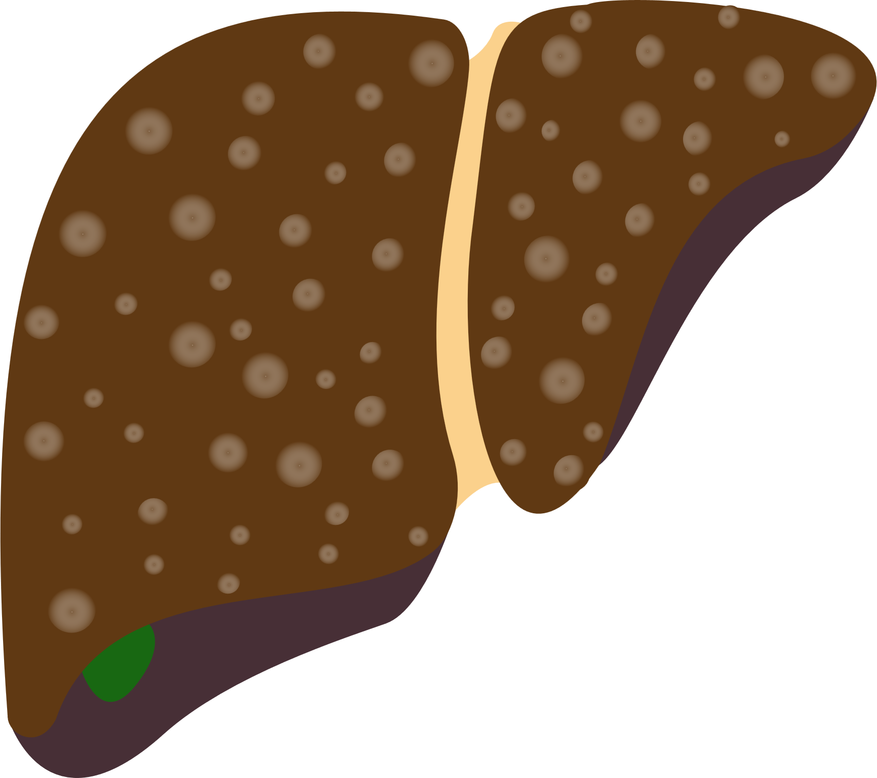




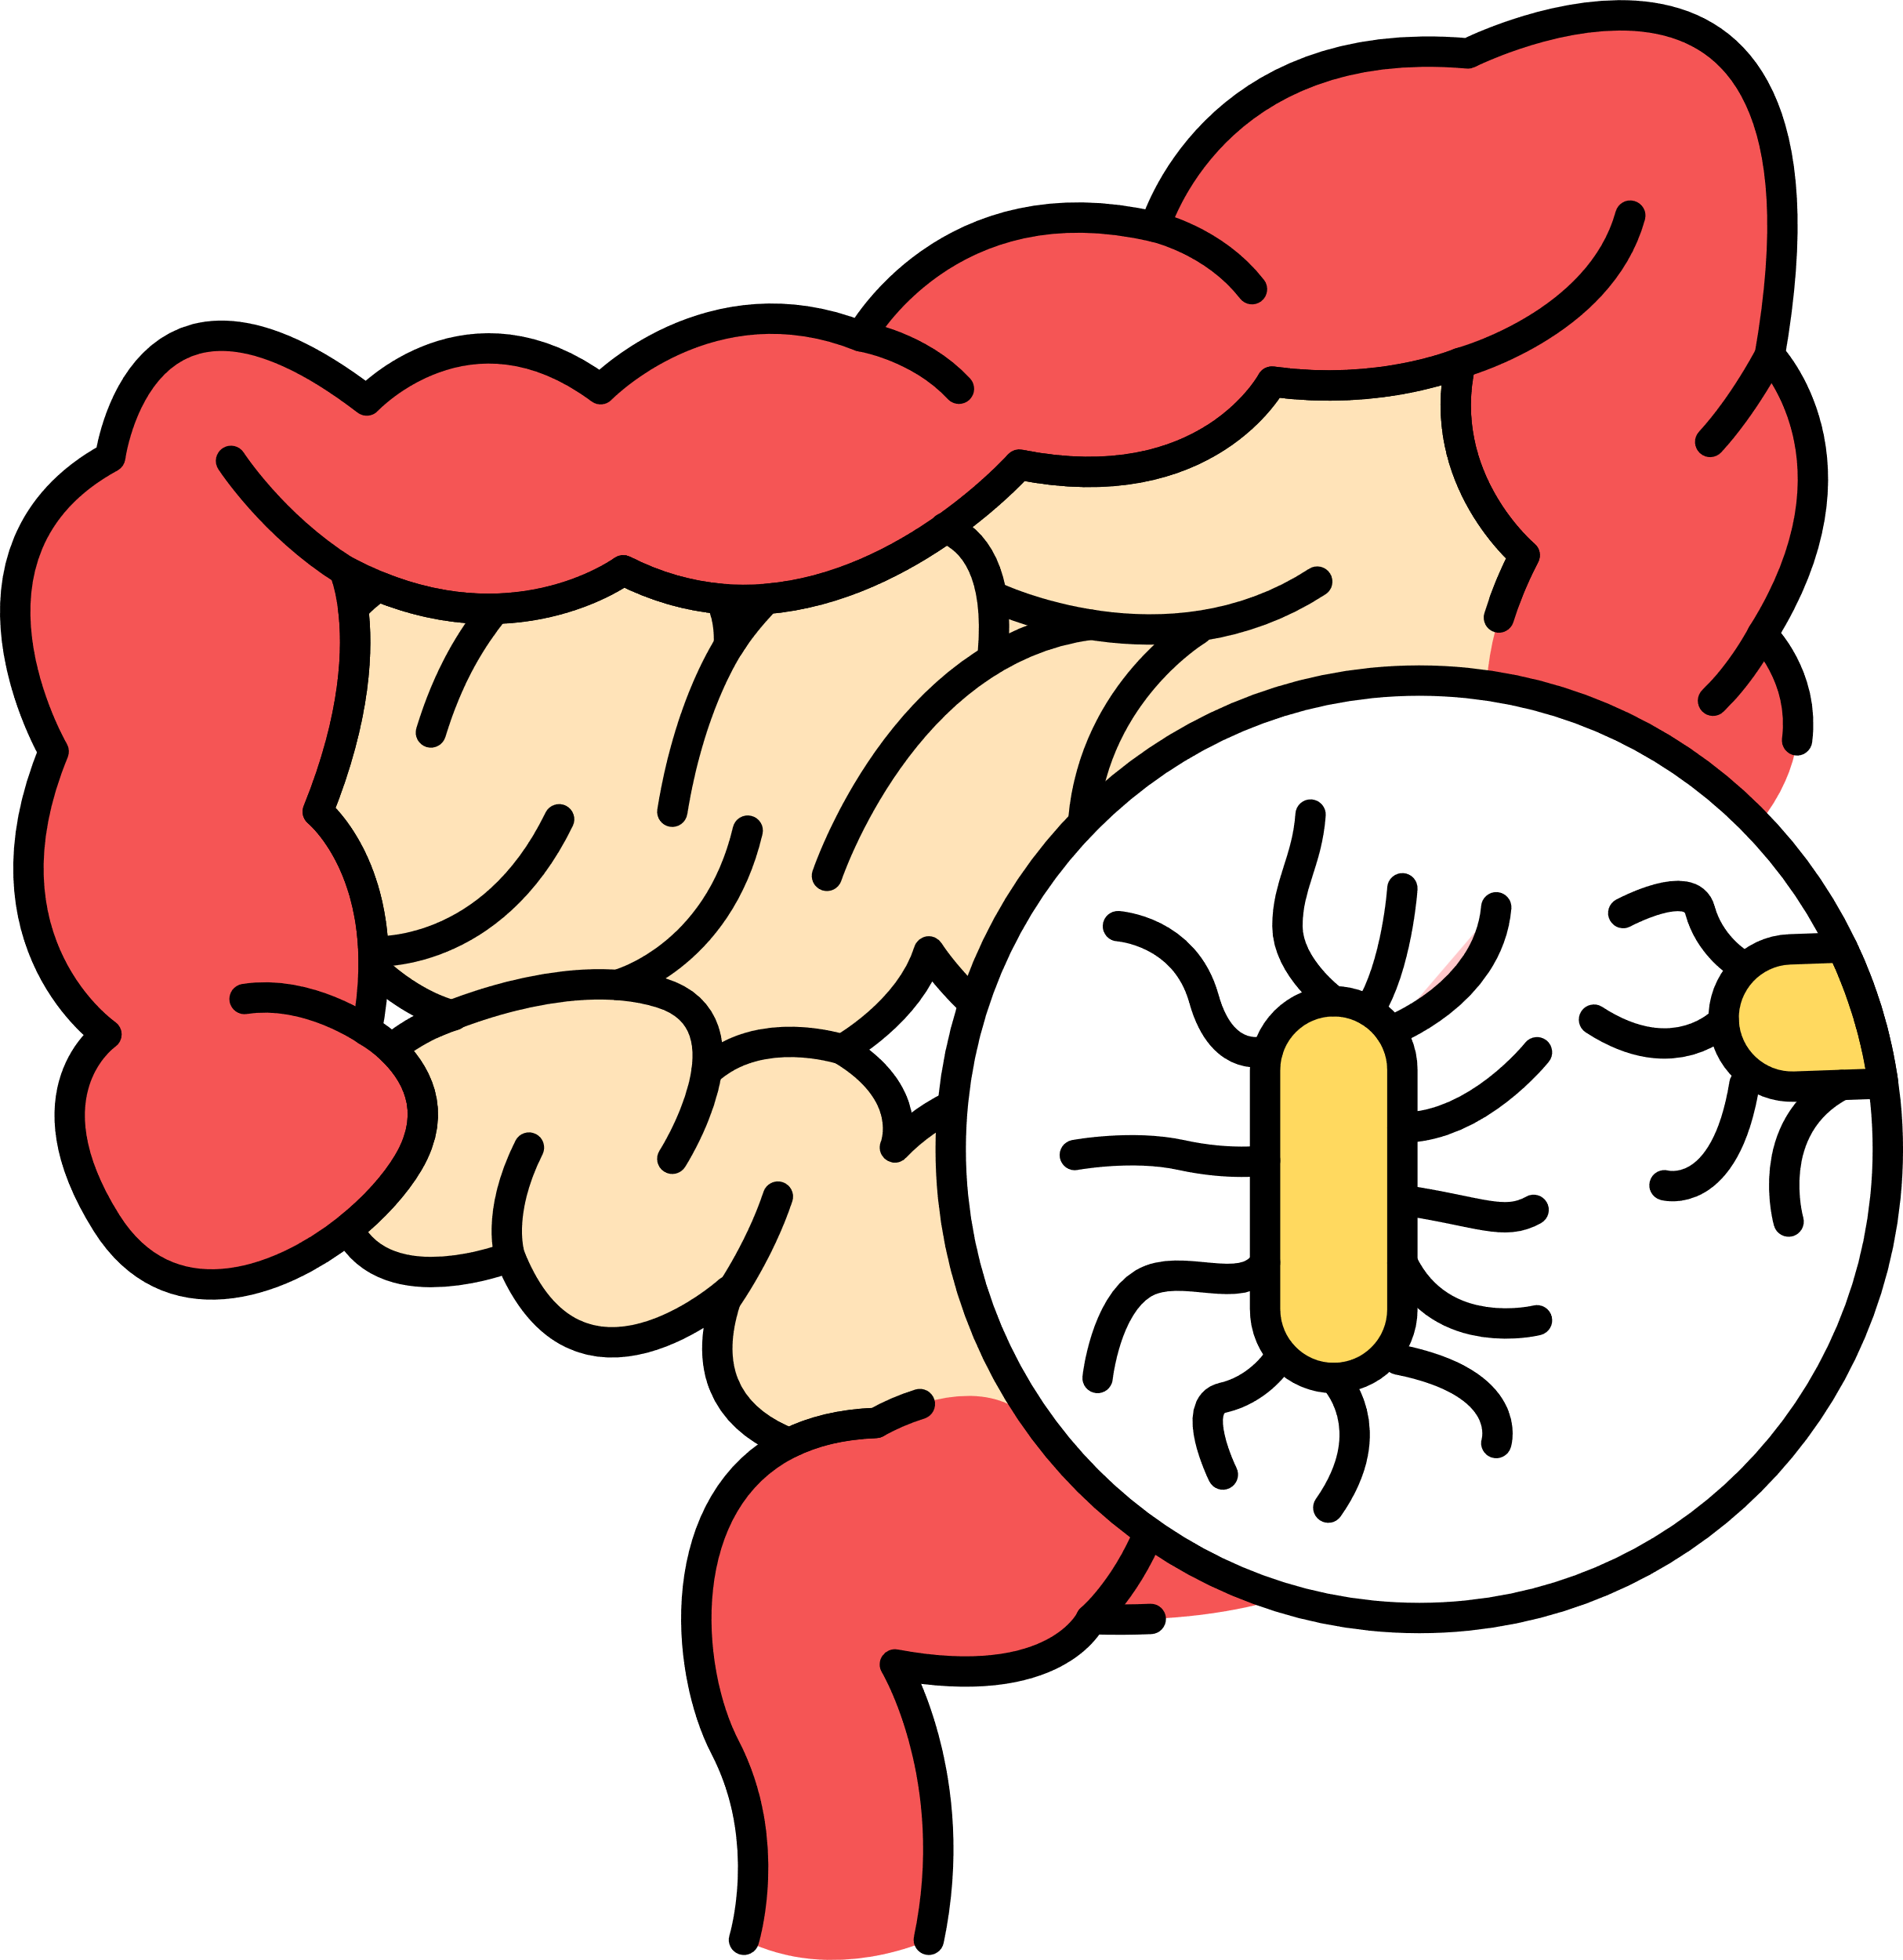
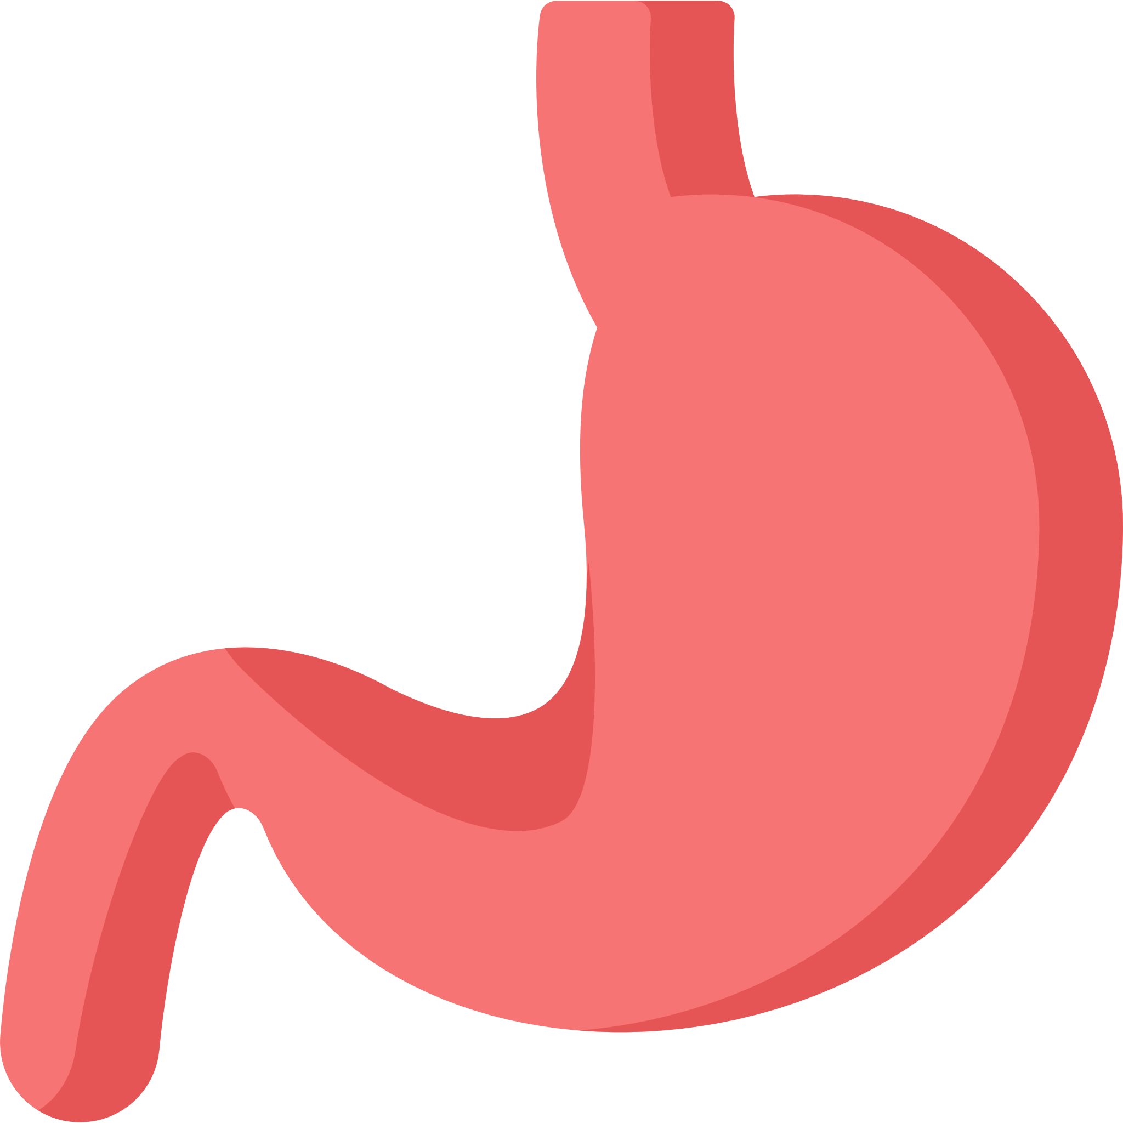


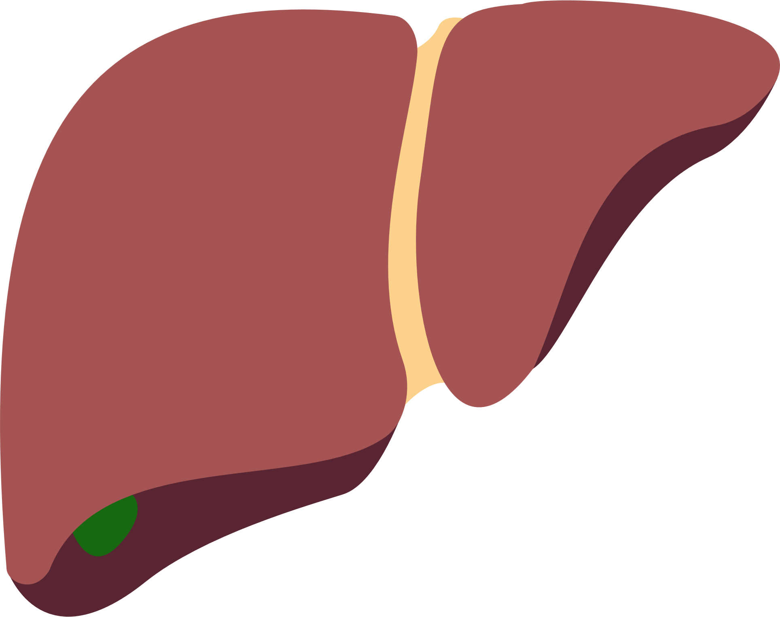

Metabolic and Toxic Liver Damage in Focus: MANPOWER's Latest Breakthroughs Revealed
Professor Asad Dajani
Saudi German Hospital, and ADSC Clinic Sharjah, United Arab Emirates
Liver function inhibition is a consequence of reduced phospholipids and altered phospholipid composition¹.
MAFLD ranges from simple steatosis to NASH and cirrhosis and can predispose to hepatotoxicity induced by certain drugs².
Treatment landscape of MAFLD–associated comorbidities
MAFLD
Anti-obesity
agents³
Insulin
sensitizers⁴
1
2
Lipid-lowering agents⁵
Vitamin E⁶
and D⁷
Genetics
Lipotoxicity
Lifestyle
modification
1
Gut microbiota
Liver supporting agents (EPLs)^{8,9}
3
2
Bariatric surgery
3
Pharmaco-therapy
4
Insulin resistance
Improve cellular membrane fluidity¹⁰
Act as anti-fibrogenic agent¹
Regulate abnormal liver enzyme and lipid levels¹¹
Increase collagen breakdown¹²
4
Innovative treatment
Healthy Liver
Polyenyl phosphatidylcholine (PPC): Active ingredient of EPL
Improves
Liver enzyme levels (ALT, AST, GGT)¹¹
Lipid parameters in patients on/not
on lipid-lowering therapy¹¹
Patient and clinician satisfaction¹⁴
Ultrasonographic findings and fibroscan scores¹³
Reduces
Patient-reported symptom
frequency¹⁴
Disease burden¹³
DILI^{5,6}
PPC has a promising role in the management of MAFLD and its extrahepatic manifestations
It is a potential hepatoprotective drug for DILI
1. Gundermann K et al. Pharmacol Rep. 2011;63:643-659; 2. Caballano-Infantes E et al. Biomedicines. 2022;10:55; 3. Tak YJ et al. Curr Obes Rep. 2021;10:14–30; 4. Kothari S, et al. J Clin Exp Hepatol 2019;9:723-730; 5. Ahsan F et al. Cureus. 2020;12:e10446; 6. Perumpail BJ et al. Diseases. 2018;6:86; 7. Hariri M et al. Int J Prev Med. 2019;10:14; 8. Lei X et al. J Int Med Res. 2021;49:1-14; 9. Liu Y et al. J Prac Hepatol. 2021;24:228–231; 10. Minto RE et al. Chem Phys Lipids. 2004;132:55–64; 11. Maev IV et al. BMJ Open Gastroenterol. 2020;7:e000368; 12. Brady LM et al. Biochem Biophys Res Commun. 1998;248:174–179; 13. Dajani A et al. Arab J Gastroenterol. 2015;16:99–104; 14. Ivashkin VT et al. Drugs Real World Outcomes. 2021;8:369–382.
ALT, alanine aminotransferase; ASH, alcoholic steatohepatitis; AST, aspartate aminotransferase; DILI, drug-induced liver injury; EPL, essential phospholipid; GGT, gamma glutamyltransferase; MAFLD, metabolic dysfunction-associated fatty liver disease; mRNA, messenger ribonucleic acid; NASH, non-alcoholic steatohepatitis; TGF, transforming growth factor;
Notes:
Next graph:: only labels and the lipid droplets %
Crop out the rest
RNA: See-saw arrangement;

Slide 11













Metabolic Comorbidities Unmasked:
Redefining MASLD/MASH Impact
Professor Marek Hartleb
Department of Gastroenterology and Hepatology, Faculty of Medicine, Medical University of Silesia, Katowice, Poland
The nomenclature of NAFLD/MAFLD is changed to MASLD where the diagnosis is based on inclusion of cardio-metabolic risk factors such as overweight/obesity, T2DM and metabolic disorders¹
MASLD diagnostic criteria²
BMI >25 kg/m² OR waist circumference >94 cm/80 cm
Fasting glucose level >100 mg/dL OR >140 mg/dL at 2 hr in OGTT
TG level
>150 mg/dL)
HDL-C level
<40/50 mg/dL
Blood pressure >130/85 mmHg
Cardiometabolic Risk in MASLD^{3,4}
Management of MASLD and associated comorbidities⁶
Risk of T2DM, CVD, and all-cause mortality is higher in patients with MASLD
Control obesity
Diet & physical activity; GLP-1RA
& SGLT2i; Bariatric surgery
MASLD to CVD⁵
Reduce CVD risk
GLP-1RA & SGLT2i; Statins, ACEi/sartans; Smoking cessation; Antiplatelet drugs
MASLD is linked to MetS, obesity, and CVD development due to dyslipidaemia, insulin resistance, and subclinical inflammation.
Reduce end-stage complications
Statin (reducing portal hypertension); Metformin (decrease of HCC risk)
EPL improves lipid parameters (MANPOWER trial)⁷
All lipid parameters were significantly improved at 12 and 24 weeks, in both subgroups.
Target NASH
Vitamin E; Pioglitazone; Semaglutide; Resmetirom
MASLD is multi-systemic disease that increases risk of CVD and T2DM, and the diagnostic criteria better identify population with cardio-metabolic risks.
Renaming NAFLD to MASLD enhances disease awareness and encourages a multidisciplinary approach involving various internal medicine specialists.
1. EASLTM The home of hepatology. Available athttps://easl.eu/news/new_fatty_liver_disease_nomenclature-2; 2. AASLD. Available at https://www.aasld.org/new-masld-nomenclature; 3. Budd J, et al. Current Diabetes Reports 2020;20:59; 4. Simon TG, et al. Gut 2021;70:1375-1382; 5. Lomonaco R, et al. Ther Adv Metab. 2011;2:211-225; 6. Manikat R and Nguyen MH. Clin Mol Hepatol 2023;29(Suppl):s86–s102; 7. Maev IV et al. BMJ Open Gastroenterol 2020;7(1):e000368.
ACEi, angiotensin-converting enzyme inhibitors; BMI, body mass index; CVD, cardiovascular disease; GLP-1RA, Glucagon like peptide-1 receptor agonist; HCC, hepatocellular carcinoma; HDL, high density lipoprotein; HDL-C, HDL- cholesterol; MAFLD, metabolic dysfunction-associated fatty liver disease; MASH, metabolic dysfunction-associated steatohepatitis; MASLD, metabolic dysfunction-associated steatotic liver disease; MetS, metabolic syndrome; NAFLD, non-alcoholic fatty liver disease; OGTT, oral glucose tolerance testing; SGLT2i; sodium-glucose co-transporter-2 inhibitor; T2DM, type-2 diabetes mellitus; TG, triglyceride.

Slide 12

Latest bibliography
MAFLD in Focus: Unveiling Insights from China's RELIEF Study; Insight from APASL 2024 (Prof. Lai Wei)
Chinese Society of Hepatology, Chinese Medical Association. Chinese J of Hepatol; 2024:32(5):418-434.
Shedding light on genomic, metabolic, and phenotypic effects of essential phospholipids on HepaRG (Prof. Paula Luciani)
Krahmer N, et al. Cell Metab. 2011;14(4):504-515.
Robinson KE, et al. Transl Gastroenterol Hepatol. 2020;5:49
Valentino G, et al. The Liver Meting AASLD; 2023, Boston, USA. Poster.
Wang B, et al. Annu Rev Physiol. 2019;81:165-188.
Metabolic and Toxic Liver Damage in Focus: MANPOWER's Latest Breakthroughs Revealed (Prof. Asad Dajani)
Ahsan F, et al. Cureus. 2020;12:e10446.
Brady LM, et al. Biochem Biophys Res Commun. 1998;248:174–179.
Caballano-Infantes E, et al. Biomedicines. 2022;10:55.
Dajani A, et al. Arab J Gastroenterol. 2015;16:99–104.
Gundermann K, et al. Pharmacol Rep. 2011;63:643-659.
Hariri M, et al. Int J Prev Med. 2019;10:14.
Ivashkin VT, et al. Drugs Real World Outcomes. 2021;8:369–382.
Kothari S, et al. J Clin Exp Hepatol. 2019;9:723-730.
Lei X, et al. J Int Med Res. 2021;49:1-14.
Liu Y, et al. J Prac Hepatol. 2021;24:228–231.
Maev IV, et al. BMJ Open Gastroenterol 2020;7(1):e000368.
Minto RE, et al. Chem Phys Lipids. 2004;132:55–64.
Perumpail BJ, et al. Diseases. 2018;6:86.
Tak YJ, et al. Curr Obes Rep. 2021;10:14–30.
Metabolic Comorbidities Unmasked: Redefining MASLD/MASH Impact
(Prof. Marek Hartleb)
AASLD. Available at https://www.aasld.org/new-masld-nomenclature.
Budd J, et al. Current Diabetes Reports. 2020;20:59.
EASLTM The home of hepatology. Available at https://easl.eu/news/new_fatty_liver_disease_nomenclature-2.
Lomonaco R, et al. Ther Adv Metab. 2011;2:211-225.
Maev IV, et al. BMJ Open Gastroenterol 2020;7(1):e000368.
Manikat R and Nguyen MH. Clin Mol Hepatol. 2023;29(Suppl):s86–s102.
Simon TG, et al. Gut. 2021;70:1375-1382

