Slide 1
Early risk identification of liver disease and MASLD and place of hepatoprotective adjunctive treatment options
I
Milan, Italy
Associate Prof. Anamaria Cozma-Petruţ, Pharm., PhD
’’Iuliu Hațieganu” University of Medicine and Pharmacy Cluj-Napoca (RO)
Meeting Date: 5th June to 7th June 2024

Slide 2
Disclosures
Co-owner of a community pharmacy in the city of Cluj-Napoca (Romania)
Lecturer for pharmaceutical companies nationally and internationally

Slide 3
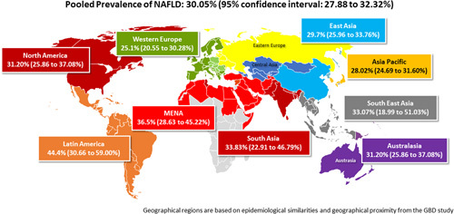
MASLD/MAFLD epidemiology
Pooled Prevalence of MASLD/MAFLD: 30.05%(95% CI: 27.88 to 32.32%)
Approximately 30% of the general population^{1,2}, 95% of people with severe obesity undergoing bariatric surgery and 33–66% of people with T2DM are affected by MASLD/MAFLD^{3,4}
MASLD/MAFLD is already a leading cause of liver-related death worldwide; however, the global burden of MASLD/MAFLD is expected to grow in the coming decades^{5,6}
The prevalence of MASLD is projected to reach 55.7% by 2040⁷
CI, confidence interval; MASLD/MAFLD, metabolic dysfunction-associated steatotic liver disease/metabolic associated fatty liver disease; T2DM, type 2 diabetes mellitus.
1. Younossi ZM, et al. Hepatology 2023;77:1335–47; 2. Golabi et al. Clin. Liv. Disorders 2023, 27(2) 173 – 186; 3. Younossi Z, et al. Hepatology 2016;64(1):73–84; 4. Chalasani N, et al. Hepatology 2018;67(1):328–357; 5. GDB 2017 cirrhosis collaborators. Lancet Gastroenterol Hepatol 2020;5:245–66; 6. Estes C, et al. J Hepatol 2018;69:896–904; 7. Le MH, et al. Clin Mol Hepatol 2022;28(4):841–850.

Slide 4
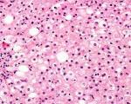
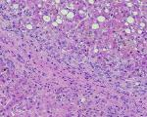
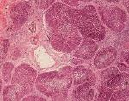
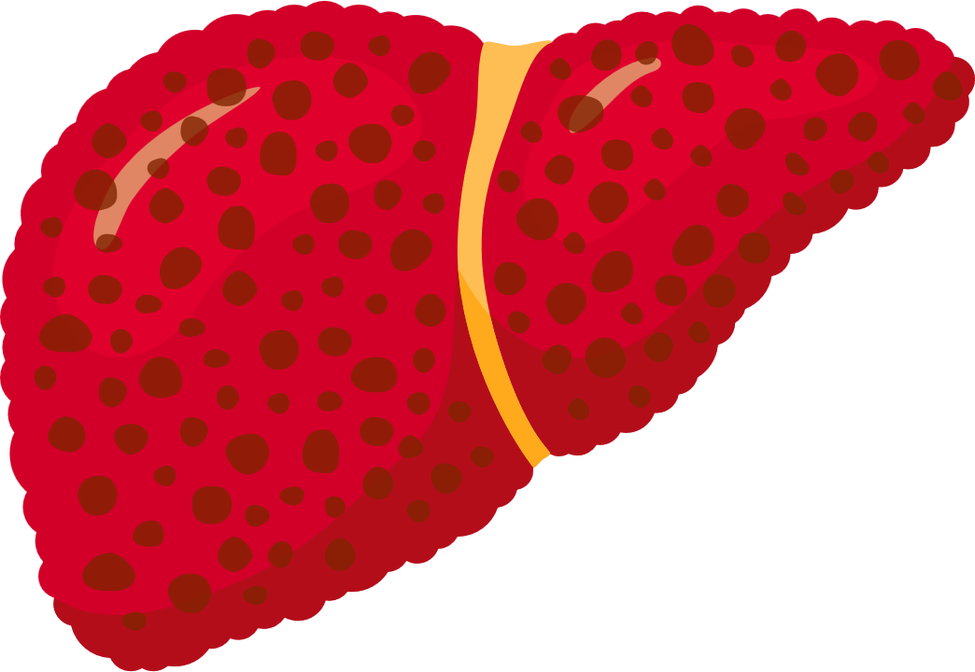
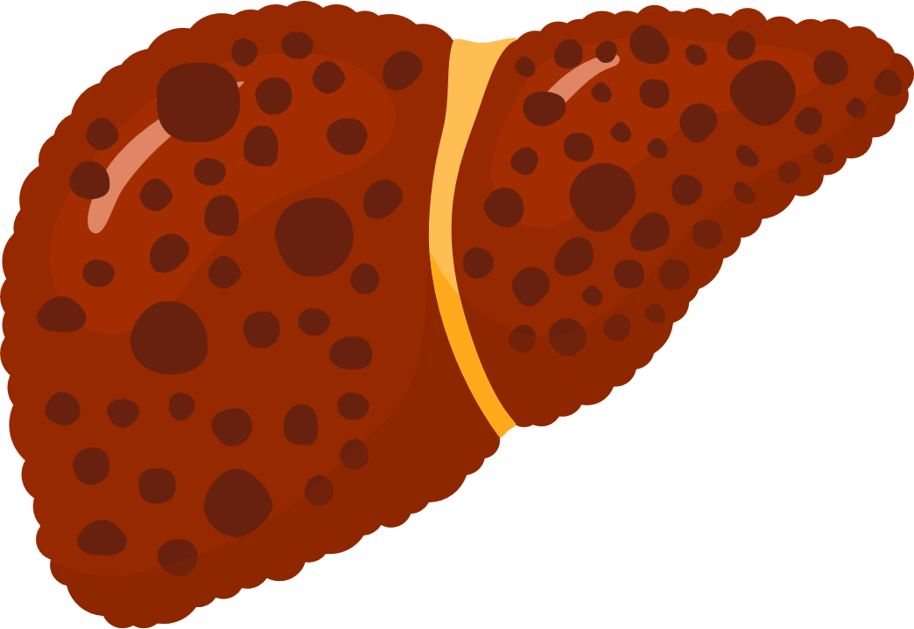
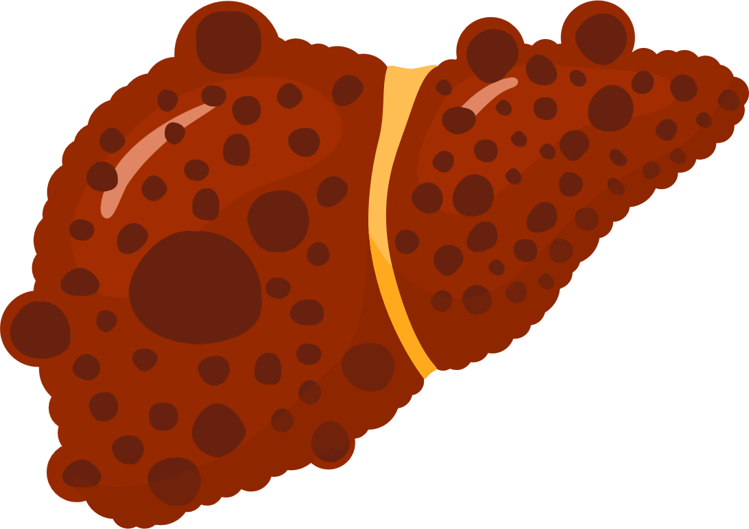
MASLD/MAFLD: a dynamic disease
Metabolic dysfunction-associated steatotic liver disease or
Metabolic associated fatty liver disease
Steatosis (MAFL)
Steatohepatitis (MASH)
Fibrosis/cirrhosis
Dynamic process
MASH, metabolic dysfunction-associated steatohepatitis; MASLD/MAFLD, metabolic dysfunction-associated steatotic liver disease/metabolic associated fatty liver disease.
Figure adapted from: 1. Bertot LC and Adams LA. Int J Mol Sci 2016;17:774; 2. Pais R and Maurel T. J Clin Med 2021;10:1161

Slide 5








Natural history of MASLD/MAFLD
Fibrosis progression rate in MASH: 1 stage per 7 years
20% of patients progress rapidly to cirrhosis in 10 years
20%
20% -30%
over 3 years
20% F3
over 2 years
30- 40%
die from liver disease
MASLD/MAFLD
MASH
Fibrosis F1-F3
Cirrhosis
20%
over 2 years
1.5-2% per year
Liver failure
Liver death
Risk of death in MASH:
1st CVD
2nd Cancer
3rd Liver
HCC
Liver transplant
CVD, cardiovascular disease; HCC, hepatocellular carcinoma; MASH, metabolic dysfunction-associated steatohepatitis; MASLD/MAFLD, metabolic dysfunction-associated steatotic liver disease/metabolic associated fatty liver disease.
Figure adapted from: 1. Bertot LC and Adams LA. Int J Mol Sci 2016;17:774; 2. Pais R and Maurel T. J Clin Med 2021;10:1161

Slide 6

MASLD/MAFLD is part of a multi-system disorder
Diet-induced obesity
Metabolic stress
Insulin resistance
Systemic inflammation and fibrosis
Arteries Heart Liver Pancreas Kidney
(HTN, CVD, CAD) (heart failure) (MASLD/MAFLD) (T2DM) (CKD)
CAD, coronary artery disease; CKD, chronic kidney disease; CVD, cardiovascular disease; HTN, hypertension; MASLD/MAFLD, metabolic dysfunction-associated steatotic liver disease/metabolic associated fatty liver disease; T2DM, type 2 diabetes mellitus.
Friedman SL, et al. Nat Med 2018;24:908–22.

Slide 7







Risk factors for MASLD/MAFLD
Gender
Ethnicity
The development and progression of MASLD/MAFLD is associated with a number of risk factors, including:¹
Age
BMI
Co-morbidities*
WAIST CIRCUMFERENCE
BASAL GLUCOSE
Metabolic burden is associated with higher risk of MASLD/MAFLD²
For patients with mild MASLD/MAFLD, the OR of having
metabolic burden was 3.64 (95% CI: 1.5–8.8) vs
people without MASLD/MAFLD²
For patients with moderate-to-severe MASLD/MAFLD, the OR was 9.4 (95% CI: 3.5–25.0)²
BLOOD PRESSURE
INSULIN RESISTANCE
HIGH-DENSITY
LIPOPROTEIN
TRIGLYCERIDES
MASLD/MAFLD SEVERITY
*Co-morbidities include Type 2 diabetes, hypercholestrolemia and hypertension.
BMI, body mass index; CI, confidence interval; MASLD/MAFLD, metabolic dysfunction-associated steatotic liver disease/metabolic associated fatty liver disease; OR, odds ratio.
1. Younossi Z, et al. Gut 2020;69:564–68; 2. Yang KC, et al. Sci Rep 2016;6:27034.

Slide 8








Increased risk of MASLD/MAFLD among patients with psoriasis
Psoriasis is an immune-mediated inflammatory skin disease characterised by painful or itchy scaly erythematous plaques, and its clinical phenotypes include vulgaris, pustular, erythrodermic and arthropathic forms.¹
It is associated with many co-morbidities such as metabolic syndrome, diabetes, MASLD/MAFLD.¹
Shared risk factors between psoriasis and MASLD/MAFLD²
The ER of MASLD/MAFLD among psoriatic patients belonging to different races²
Smoking
Metabolic syndrome
Peripheral insulin
resistance
Asian patients
28.7%
Caucasian patients
37.9%
Patients of
mixed ethnicity
20.6%
Alcohol use
Chronic low-grade
inflammation
Elevated
oxidative stress
The ER of MASLD/MAFLD for patients with PsA was 39.1%, for patients with CPP was 42.6%, and for patients with MSP was 14.3%.²
Patients suffering from psoriasis are 1.5 to 3 times more likely to develop MASLD/MAFLD.²
CPP, chronic plaque psoriasis; EPLs, essential phospholipids; ER, event rate; MASLD/MAFLD, metabolic dysfunction-associated steatotic liver disease/metabolic associated fatty liver disease; MSP, moderate to severe psoriasis; PsA, psoriatic arthritis; SAEs, serious adverse events.
1. Li H, et al. Clin Cosmet Investig Dermatol. 2023:16:3291–3294; 2. Hu J, et al. Medicine. 2024;103:18(e38007).

Slide 9
Prevalence of MASLD/MAFLD in patients with impaired metabolic health
Metabolically healthy (MH)
Metabolically unhealthy (MUH)
100
§
90
§
80
§
69%
§
§
70
39%
§
60
*
#
Percentage
§
50
19%
§
#
40
30
#
*
#
20
10
0
Visceral obesity
Insulin resistance
High cIMT
Visceral obesity
Insulin resistance
High cIMT
Visceral obesity
Insulin resistance
High cIMT
MASLD/MAFLD
Low cardioresp fitness
MASLD/MAFLD
Low cardioresp fitness
MASLD/MAFLD
Low cardioresp fitness
Low sc. Leg fat mass (%)
Low sc. Leg fat mass (%)
Low sc. Leg fat mass (%)
High sc. abd. Fat mass (%)
High sc. abd. Fat mass (%)
High sc. abd. Fat mass (%)
impaired IS capacity
impaired IS capacity
Imp. Insulin secr. capacity
Prevalence
MH: 82%, MUH: 18%
MH: 62%, MUH: 38%
MH: 48%, MUH: 52%
Normal weight
(N=181)
Overweight
(N=358)
Obesity
(N=442)
*P<0.05; #p<0.01; §p<0.001.
abd, abdominal; cardioresp, cardiorespiratory; Cimt, carotid intima-media thickness; IS, insulin secretion; MASLD/MAFLD, metabolic dysfunction-associated steatotic liver disease/metabolic associated fatty liver disease; sc., subcutaneous.
Stefan N, et al. Cell Metab 2017;26(2):292–300.

Slide 10
Efforts to mitigate MASLD/MAFLD burden are needed
MASLD/MAFLD is a global public health problem¹
Normal liver
Simple steatosis
NASH ± fibrosis
Cirrhosis
1
MASLD/MAFLD is associated with higher risk of cirrhosis, hepatocellular carcinoma, liver failure, CVD and extrahepatic malignancies²
2
MASLD/MAFLD is a growing cause of liver-related death worldwide³
3
MASLD/MAFLD may be associated with fatigue, anxiety, depression, cognitive impairment and loss of self-esteem – all of which contribute to impairment of health-related quality of life⁴
4
MASLD/MAFLD is associated with substantial health-care costs¹
CVD, cardiovascular disease; MASLD/MAFLD, metabolic dysfunction-associated steatotic liver disease/metabolic associated fatty liver disease.
1. Lazarus JV, et al. Nat Rev Gastroenterol Hepatol 2022;19:60–78; 2. Pipitone RM, et al. Ther Adv Endocrinol Metab 2023;14:20420188221145549; 3. Estes C, et al. J Hepatol 2018;69:896–904; 4. Golabi P, et al. Health Qual Life Outcomes 2016;14:18.

Slide 11
Identification and quantification of steatosis
● Conventional B-mode ultrasound (first line tool)¹
• Lacks sensitivity for lesser degrees of steatosis
• Provides a subjective semi-quantitative assessment of steatosis severity
● Controlled Attenuation Parameter (CAP)²
• Promising point-of care technique for the assessment of steatosis: >275dB/m; Se 90%
• Not suitable for accurate quantification or monitoring of changes in liver fat
● MRI-Proton Density Fat Fraction (PDFF)²
• Accurate, reproductible and precise MRI-based biomarker for fat quantification
• Limitations: cost, patient acceptance, not a point-of care technique
1. Saadeh S, et al. Gastroenterol 2002;123:745-50. 2. Park CC, et al. Gastroenterol 2017;152:598–607.
For clinical guidance on non-invasive tests for liver disease, please see: EASL, J Hepatol. 2021;75:659–689

Slide 12
Liver Biopsy: the imperfect gold standard
Not always required,
and should be tailored
to the patient
  Confirm diagnosis/exclude alternative pathology
  Stage disease
  Stratify progression risk
  Impractical
  Expensive
  Invasive
  Prone to sampling and reading variability
Liver biopsy to classify such a large population is:
World Gastroenterology Organisation 2012. WGO Global Guidelines NAFLD/NASH (long version); Available at: http://www.worldgastroenterology.org/guidelines/global-guidelines/nafld-nash [last accessed June 2023]

Slide 13
A key component to improving the diagnosis and treatment of metabolic liver disease is understanding the symptoms
Many patients with abnormal liver function tests, indicating potential metabolic liver disease diagnosis, are categorized as asymptomatic¹
Although NAFLD and MALFD are often described as asymptomatic, patients frequently report experiencing non-specific symptoms, such as:^{2–4}
Fatigue
Anxiety
Abdominal discomfort
Hepatomegaly
Malaise
Experiencing non-specific symptoms can impact patient-reported outcomes, contributing to the burden of metabolic liver disease²
Patient-reported outcomes may provide direct insights into health outcomes of metabolic liver disease,
including common symptoms, from the people who experience them
1. Gao E, et al. Transl Gastroenterol Hepatol 2021;6:28; 2. Yamamura S, et al. J Gastroenterol Hepatol 2021;36:629–36; 3. Muhummad A. Integr Med (Encinitas) 2019:18;42–9;
4. Sangro P, et al. J Physiol Biochem 2023 [online ahead of print].

Slide 14
Patients report symptoms of MASLD/MAFLD
In an observational, cross-sectional, real-world survey (RESTORE) the top five most common symptoms of MASLD/MAFLD reported by GEs and GPs using patients’ language were:
GEs n=95 |  |  | GPs n=115
Symptom | GEs (%) |  | Symptom | GPs (%)
Bloating | 62 |  | Bloating | 57
Weakening | 33 |  | Pain* | 47
Tiredness/fatigue | 31 |  | Weakening | 21
Pain* | 28 |  | Feeling of fullness | 27
Feeling of fullness | 24 |  | Stomach aches | 26
*Right upper quadrant pain/below right ribs/in the right side/in liver area, p<0.01 (Mann-Whitney U test).
GEs, gastroenterologists; GPs, general practitioners; MASH, metabolic dysfunction-associated steatohepatitis; MASLD/MAFLD, metabolic dysfunction-associated steatotic liver disease/metabolic associated fatty liver disease.
Hartleb M, et al. Eur J Gastroenterol Hepatol 2022;34:426–34.

Slide 15
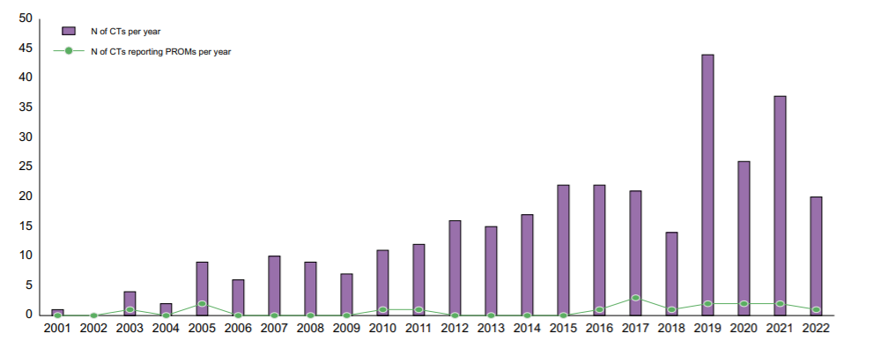
Further inclusion of PROs in clinical trial protocols could provide data on symptoms to support patient-centered care
Number of NAFLD trial protocols including PROs per year (2001–2022)
Despite an increase in MASLD/MAFLD clinical trials in recent years, PRO inclusion in clinical trial protocols has remained relatively unchanged
PROs offer insights into the wider impact of a disease from the patient perspective, including evaluation of symptoms, functioning and HRQoL
These insights may support the identification of novel diagnostic and therapeutic strategies for metabolic liver diseases, such as MASLD/MAFLD
CT, clinical trials; HRQoL, health-related quality of life; MASLD/MAFLD, metabolic dysfunction-associated steatotic liver disease/metabolic associated fatty liver disease; PROs, patient-reported outcomes.
Sena E, et al. JHEP Reports 2023;5:100597.

Slide 16
There is an association between MASH and metabolic dysfunction
Dysregulated
metabolism
MASH is a progressive
metabolic disease, which
has systemic effects
throughout the body
MASLD/
MAFLD
MASH
T2DM
Figure not intended to show prevalence of disorders; for illustration purposes only.
MASH, metabolic dysfunction-associated steatohepatitis; MASLD/MAFLD, metabolic dysfunction-associated steatotic liver disease/metabolic associated fatty liver disease; T2DM, type 2 diabetes mellitus.

Slide 17
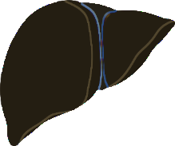

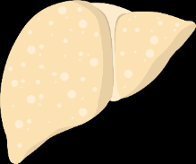
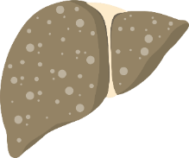
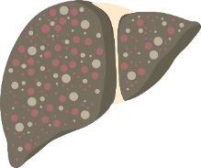
Patients with MASLD/MAFLD are associated with increased risk of comorbidity
Long-term outcomes for patients with MASLD/MAFLD and MASH:
Increased overall mortality vs people without MASLD/MAFLD and MASH^{1,2}
Increased risk of cardiovascular disease vs traditional
risk factors^{2–4}
Together with T2DM pose a greater risk of hypertension⁵
May be a risk factor for chronic kidney disease, colorectal cancer, endocrinopathies (including thyroid dysfunction, and osteoporosis)^{6,7}
Have an increased rate of liver-related mortality^{1,2}
Risk factors including obesity and an excess of insulin can result in advanced fibrosis and cirrhosis, which increases the risk for hepatocellular carcinoma⁸
MASLD/MAFLD disease progression
Rapid
progressors
F1
F2
F3
F4
Slow progressors
Steatosis
Steatosis + lobular inflammation
NASH ± portal inflammation
Early fibrosis
Advanced fibrosis
and cirrhosis
‘Dynamic’ steatotic/steatohepatitic phase
‘Non-linear’ fibrotic phase
Disease progression
MASH, metabolic dysfunction-associated steatohepatitis; MASLD/MAFLD, metabolic dysfunction-associated steatotic liver disease/metabolic associated fatty liver disease; T2DM, type 2 diabetes mellitus.
1. Adams LA, et al. Gastroenterology 2005;129:113–21; 2. Söderberg C, et al. Hepatology 2010;51:595–602; 3. Wójcik-Cichy K, et al. Clin Exp Hepatol 2018;4:1–6; 4. Schwimmer JB, et al. PLoS ONE 2014;9:e112569; 5. Ding X, et al. Int J Endocrinol 2017;2017:5262560; 6. Velarde-Ruiz Velasco JA, et al. Rev Gastroenterol Mex 2019;84:472–81; 7. Armstrong MJ, et al. Hepatology 2014;59:1174–97; 8. Dhamija E, et al. Indian J Med Res 2019;149(1):9–17.

Slide 18
There is an increased risk of cardiovascular events in patients with MASLD/MAFLD and T2DM
2.2-fold increased in risk
MASLD/MAFLD promotes:
Worsening of IR
Risk of T2DM
(difficulty to manage)
⇧ Risk of atherogenic
dyslipidemia
Risk of CVD
Diabetes promotes:
⇧ Risk of MASH
⇧ Risk of cirrhosis
⇧ Risk of HCC
MASLD/MAFLD
T2DM
2- to 6-fold increased in risk
(liver fibrosis)
CVD, cardiovascular disease; HCC, hepatocellular carcinoma; IR, insulin resistance; MASH, metabolic dysfunction-associated steatohepatitis; MASLD/MAFLD, metabolic dysfunction-associated steatotic liver disease/metabolic associated fatty liver disease; T2DM, type 2 diabetes mellitus.
Budd J, Cusi K. Curr Diab Rep 2020;20:59.

Slide 19
Treatment plan for MASLD/MAFLD
Targeting comorbid disease: diabetes, hyperlipidemia, obesity²
Lifestyle modification: diet & exercise¹
Liver supportive agents³
Liver directed pharmacotherapy³
Bariatric surgery⁴
Managing
complications⁵
MASLD/MAFLD, metabolic dysfunction-associated steatotic liver disease/metabolic associated fatty liver disease.
1. Kwak MS, et al. Korean J Intern Med 2018;33(1):64–74; 2. Finck BN. Diabetes 2018;67(12):2485–93; 3. Dajani A, et al. Saudi J Gastroenterol 2016;22(2):91–105; 4. Laursen TL, et al. World J Hepatol 2019;11(2):138–49; 5. Vanni E, et al. Semin Liver Dis 2015;35(3):236–49.

Slide 20






Treatment Landscape of MASLD/MAFLD
Controlled diet and physical exercise
Standard treatment¹
Metformin
PPAR-γ agonists
PPAR-α agonists, statins
and ezetimibe
DPP-4 inhibitors
GLP-1 agonists
Traditional and herbal¹
N-Acetyl Cysteine
R-alpha lipoic acid
Choline Bitartrate
Artichoke extract
Dandelion root
Turmeric (curcumin)
Liv. 52 (Himalaya plants)
Gansu (Ganoderma)
Hepatoprotectives¹
Milk thistle extract (Silymarin)
EPL (essential phospholipids)
Ursodeoxycholic acid
Vitamin E (antioxidant)
Glutathione
SAMe
Investigational treatments¹
Elafibrinor
Semaglutide
Vonafexor
Cenicriviroc
Pioglitazone
Firsocostat
Resmetirom has been approved by the USA FDA, in March 2024, for the treatment of noncirrhotic non-alcoholic steatohepatitis with moderate to advanced liver fibrosis.²

Slide 21
EPLs for alcoholic fatty liver disease
  Clinical efficacy is based on remission of symptoms, signs, and biochemical variables.
  Treatment vs control groups:
    Response rate: 21/24 vs 3/12 patients.
    Efficacy rate: 83.5% vs 41.7% (P=0.03).
  Only one study reported on mortality rates.
  Mortality in treatment vs control groups: 22.6% vs 39.2%.
Mortality
Clinical
Efficacy
  No SAEs were reported.
  EPL-treated patients had better survival trends compared to placebo (not significant).
  Patients with Child Pugh B score had a higher death risk.
Safety
and
Survival
Histology
  EPL did not improve patients’ histology significantly (P=0.07).
  However, it prevented histological worsening (P=0.02).
EPL did not significantly differ from placebo in its effect on fibrosis stage.
Unexpectedly reduced alcohol intake in both groups limited the ability to test EPL’s impact on fibrosis progression.
EPL-treated patients showed fewer cases of ascites (a secondary clinical measure of liver disease).
Improvements in aminotransferases and bilirubin were observed in specific subgroups.
EPLs, essential phospholipids; SAEs, serious adverse events
1. Gundermann K-J, et al. Clin Exp Gastroenterol. 2016;9:105-17.

Slide 22
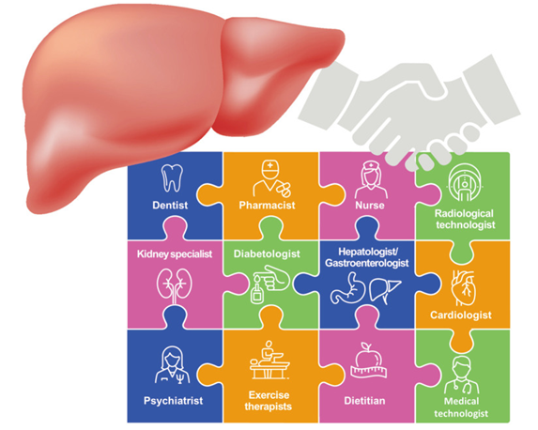
Multidisciplinary care of MASLD/MAFLD
Multidisciplinary collaboration is needed for MASLD/MAFLD treatment¹
MASLD/MAFLD, metabolic dysfunction-associated steatotic liver disease/metabolic associated fatty liver disease.
1. Yoneda M, et al. Gut Liver. 2023;17(6):843–852.

Slide 23

MASLD/MAFLD: the role of community pharmacists
Pharmacists act as first line in the screening and primary/secondary prophylaxis of MASLD/MAFLD
1
Pharmacists are among the most frequently visited healthcare professionals¹
2
Pharmacists are the patients’ first point of contact with the healthcare system²
3
Pharmacists are a trusted source of advice¹
MASLD/MAFLD, metabolic dysfunction-associated steatotic liver disease/metabolic associated fatty liver disease.
Image provided by speaker.
1. Sendekie AK, et al. Arch Public Health 2023;81:31; 2. Bui TNT, et al. BMJ Open. 2022;12:e059573

Slide 24


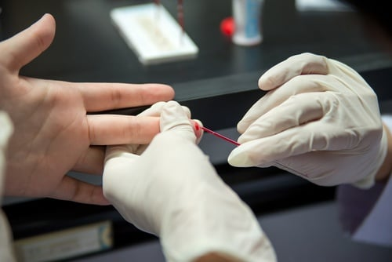
Pharmacists are able to screen for MASLD/MAFLD risk factors in patients
Pharmacists can identify metabolic abnormalities
Identification of central adiposity/obesity by visual assessment, measurement of WC, height and weight and calculation of BMI^{1,2,3}
Identification of elevated blood pressure by the measurement of blood pressure^{1,3}
Identification of elevated blood glucose by the measurement of blood glucose^{4,5}
Identification of dyslipidemia by the measurement of blood levels of TC, HDL-C, LDL-C, TG^{1,5}
BMI, body mass index; HDL-C, high-density lipoprotein cholesterol; LDL-C, low-density lipoprotein cholesterol; MASLD/MAFLD, metabolic dysfunction-associated steatotic liver disease/metabolic associated fatty liver disease; TC, total cholesterol; TG, triglycerides; WC, waist circumference. Images provided by speaker.
1. Alzubaidi HT, et al. BMJ Open 2019;9:e031246; 2. Peletidi A and Kayyali R. Pharmacy 2019;7:82; 3. Peletidi A and Kayyali R. J of Pharm Policy and Pract 2021;14:54;
4. Krass I, et al. BMJ Open 2017;7:e017725. 5. Zaninotto M, et al. Clin Chem Lab Med 2016;54:1745–1751.

Slide 25
Pharmacists are able to use scoring systems for MASLD/MAFLD screening, following specialized training
Fatty liver index¹
MASLD/MAFLD liver fat score²
Hepatic steatosis index³
St-index⁴
An algorithm based on waist circumference, body mass index (BMI),
triglyceride, and
gamma-glutamyl-transferase
Calculated using the presence of the metabolic syndrome, T2DM, fasting serum insulin, fasting serum AST and the AST/ALT ratio
Calculated using the patient’s sex, BMI, ALT and AST levels and diagnosis of T2DM
A non-invasive tool that is calculated using the patient’s age,
diagnosis of T2DM and
waist-to-height ratio
ALT, alanine aminotransferase; AST, aspartate aminotransaminase; MASLD/MAFLD, metabolic dysfunction-associated steatotic liver disease/metabolic associated fatty liver disease; St-index, steatosis index; T2D, type 2 diabetes mellitus.
1. Bedongi G, et al. GMC Gastroenterol 2006;6:33; 2. Kotronen A, et al. Gasteronterology 2009;137:865–72; 3. Lee HJ, et al. Dig Liver Dis 2010;42:503–8; 4. Maev IV, et al. Adv Ther 2020;37:4627–4640.

Slide 26

The utility of screening for MASLD/MAFLD and associated metabolic risk factors in the community pharmacy
Pharmacists can identify patients at high risk for MASLD/MAFLD or potentially having the disease, thus contributing to the prevention, early detection and management of MASLD/MAFLD¹
Identification of patients at high risk for MASLD/MAFLD (or potentially having MASLD/MAFLD) in the community pharmacy enables:
    Referral for a review by the general practitioner and/or specialist^{1,2}
    Early interventions to prevent MASLD/MAFLD development and/or progression^{1,2}
MASLD/MAFLD, metabolic dysfunction-associated steatotic liver disease/metabolic associated fatty liver disease
1. Lazarus JV, et al. Nat Rev Gastroenterol Hepatol 2021;18:717–729. 2. Wong VWS, et al. Liver Int 2022;42:2377–2389.

Slide 27
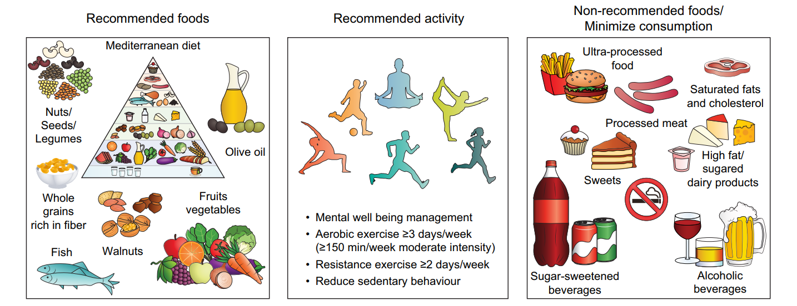
Pharmacists are able to provide healthy lifestyle advice
Lifestyle pattern to prevent and control MASLD/MAFLD
and metabolic comorbidities (obesity, T2D, dyslipidaemia, CVD):^{1,2,3}
Adequate
daily
calorie intake
CVD, cardiovascular disease; MASLD/MAFLD, metabolic dysfunction-associated steatotic liver disease/metabolic associated fatty liver disease; T2D, Type 2 diabetes.
1. Younossi ZM, et al. Gastroenterology 2021;160:912–918. 2. Francque SM, et al. JHEP Rep 2021;3:100322; 3. Montemayor S, et al. Nutrients 2022;14:3186

Slide 28
Pharmacists are able to recommend hepatoprotective treatment
Guidelines for the prevention and/or treatment of MASLD/MAFLD recommend the use of hepatoprotective agents as a potential treatment to limit hepatic damage^{1,2,3}
Very high
UDCA
Vitamin E* (+ Vitamin C)
High
Vitamin D
Level of existing scientific evidence
Resveratrol
EPLs
Pharmacists must raise awareness about the importance of using hepatoprotective therapy that has evidence-based efficacy⁴
Medium
Phyllanthus
Garlic
Glycyrrhizic acid
Coenzyme
Q10
Metadoxine
Low
Ademetionine
Artichoke
EPL are one of the most promising adjunctive therapy for MASLD/MAFLD⁵
Silymarin
Lack of improvement
or deterioration
Low probability
of improvement
Medium probability
of improvement
High probability
of improvement
Very high probability
of improvement
Likelihood of improvement of clinically meaningful parameters
Level of existing data supporting the efficacy/effectiveness and safety of various hepatoprotective agents in MASLD/MAFLD⁵
MASLD/MAFLD, metabolic dysfunction-associated steatotic liver disease/metabolic associated fatty liver disease.
1. Fan JG, et al. J Dig Dis 2019;20:163–173; 2. Russian Scientific Liver Society, 2015. Available from: http://www.rsls.ru/files/Guidelines-RSLS-NASH-2016-01-03.pdf (Accessed: May 2023); 3. Society of Digestive Diseases (Latvia), 2020. Available from: https://www.globalliverforum.com/dam/jcr:a0028500-2820-4ad0-b5db-7b2bdbb69c82/Vadlinijas_en-GB.pdf (Accessed: May 2023). 4. Romanian Society of Gastroenterology and Hepatology, 2020. Available from: https://www.globalliverforum.com/dam/jcr:c32f220a-9045-4825-a1db-825810e7a7ff/Position%20paperNAFLD%20treatment12.pdf (Accessed: May 2023). 5. Dajani AI and Abuhammour A. Drug Ther Perspect 2021;37:249–264.

Slide 29

Pharmacists are able to recommend hepatoprotective treatment
Adjunctive hepatoprotectors, such as EPL, can alleviate symptoms and may be recommended without prescription
EPL have been recommended by several national practice guidelines (For e.g., Chinese MAFLD guidelines, Russian National NAFLD guidelines, Polish NAFLD guidelines and Romania position statement on NAFLD) as supportive treatment for patients with MASLD/MAFLD¹:
      1800 mg/day: 2 × 300 mg capsules, 3 times/day
      12–24 weeks of treatment
EPL, essential phospholipids; MASLD/MAFLD, metabolic dysfunction-associated steatotic liver disease/metabolic associated fatty liver disease.
1. Dajani AI and Abuhammour A. Drug Ther Perspect 2021;37:249–264.

Slide 30
Prevalence of MASLD/MAFLD in patients with prediabetes
Normal glucose regulation
Prediabetes
100
90
70%
80
46%
70
60
50
Percentage
40
11%
30
20
10
0
IR
IR
IR
IS Failure
IS Failure
IS Failure
MASLD/MAFLD
MASLD/MAFLD
MASLD/MAFLD
Visceral obesity
Visceral obesity
Visceral obesity
Percentage
IFG
IGT
Normal weight
(N=185)
Overweight
(N=363)
Obesity
(N=455)
IFG + IGT
IFG, impaired fasting glucose; IGT, impaired glucose tolerance; IR, insulin resistance; IS, insulin secretion; MASLD/MAFLD, metabolic dysfunction-associated steatotic liver disease/metabolic associated fatty liver disease.
Stefan N, et al. Lancet Diabetes Endocrinol 2016;4(9):789–798.

Slide 31




Efficacy of PPC in Anti-tuberculosis Agents-induced
Liver Injury¹
Study design: Retrospective controlled study
N=78
Mar 2018 – Mar 2019
Inclusion: Patients with DILI during anti-tuberculosis therapy for pulmonary tuberculosis
Diammonium glycyrrhizinate vs. PPC orally for 12 weeks
Endpoints: Serum IL-6, IL-1β, TNF-ɑ, serum HO-1, GSH-Px and SOD levels
Results
Parameter | PPC | Control group
ALT (U/L) | 28.1 ± 20.5 | 59.4 ± 22.7
AST (U/L) | 345.1 ± 17.3 | 45.1 ± 17.3
TNF-ɑ (pg/mL) | 7.4 ± 1.5 | 10.3 ± 1.8
IL-1β (ng/mL) | 13.7 ± 2.1 | 34.2 ± 4.8
HO-1 (U/L) | 294.1 ± 16.9 | 198.8 ± 17.2
SOD (U/L) | 544.2 ± 13.3 | 421.0 ± 12.8
At the end of 12 weeks, PPC group experienced significantly (P<0.05) higher serum HO-1 and SOD levels and lower oxidative stress response.
Data are expressed as mean±SD
ALT, alanine aminotransferase; AST, asparagine aminotransferase; DILI, drug induced liver injury; GSH-Px, glutathione peroxidase; HO-1 heme oxygenase-1;
IL, interleukin; PPC, polyenyl phosphatidylcholine; SD, standard deviation; SOD, superoxide dismutase; TNF-ɑ, tumor necrosis factor-α.
1. Liu Y et al. J Prac Hepatol. 2021;24(2):228–31.

Slide 32

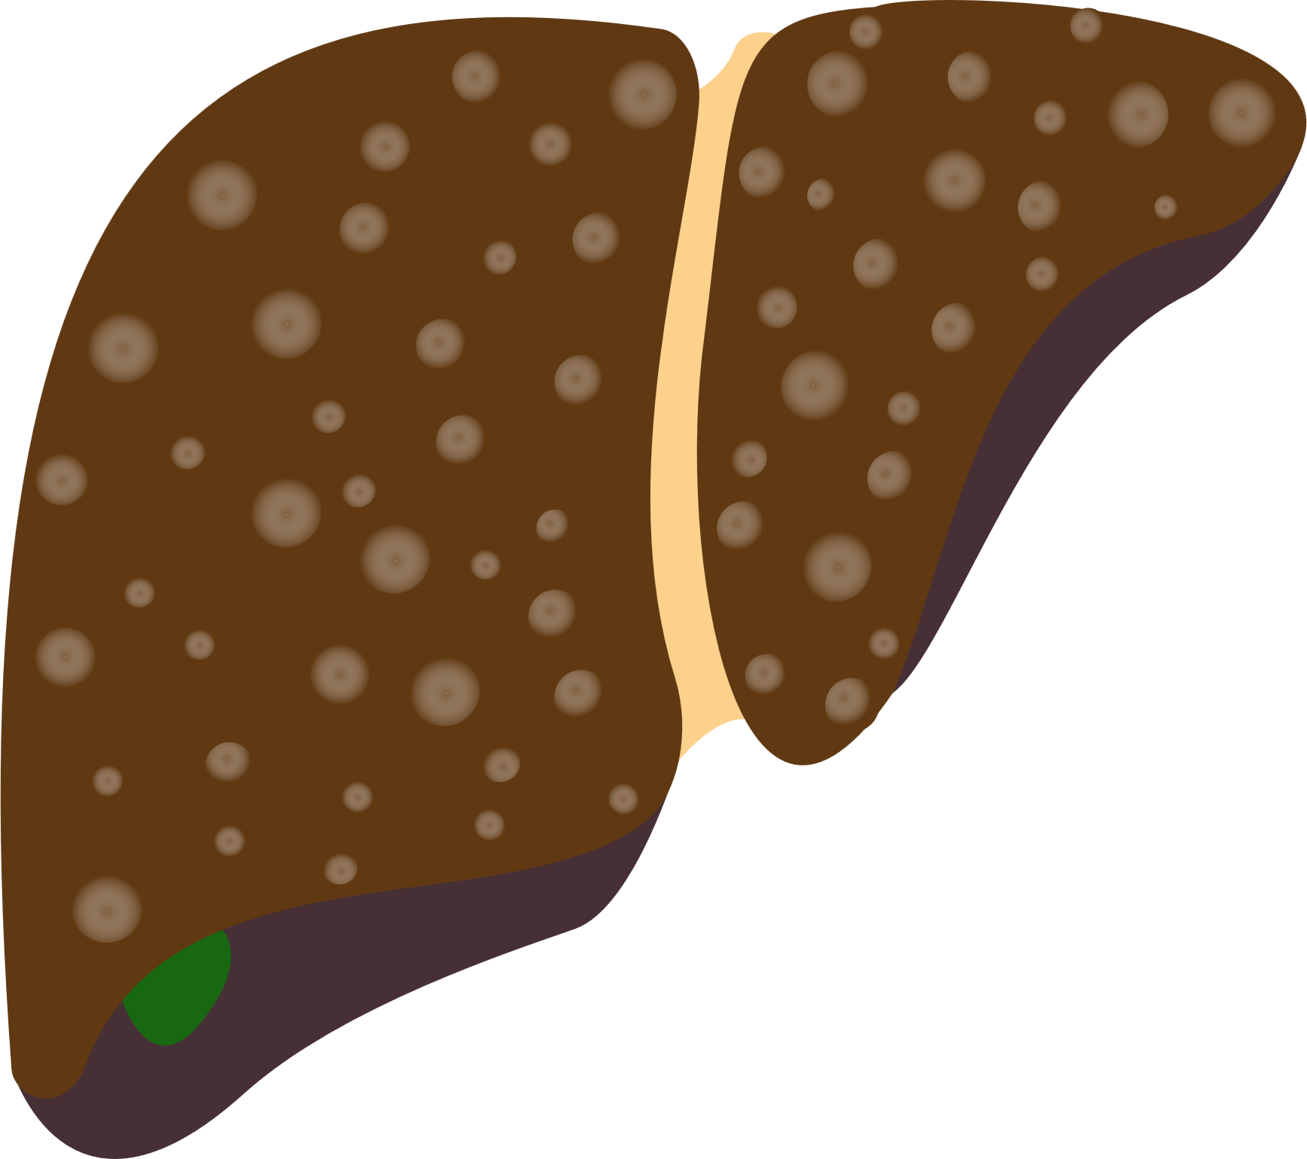

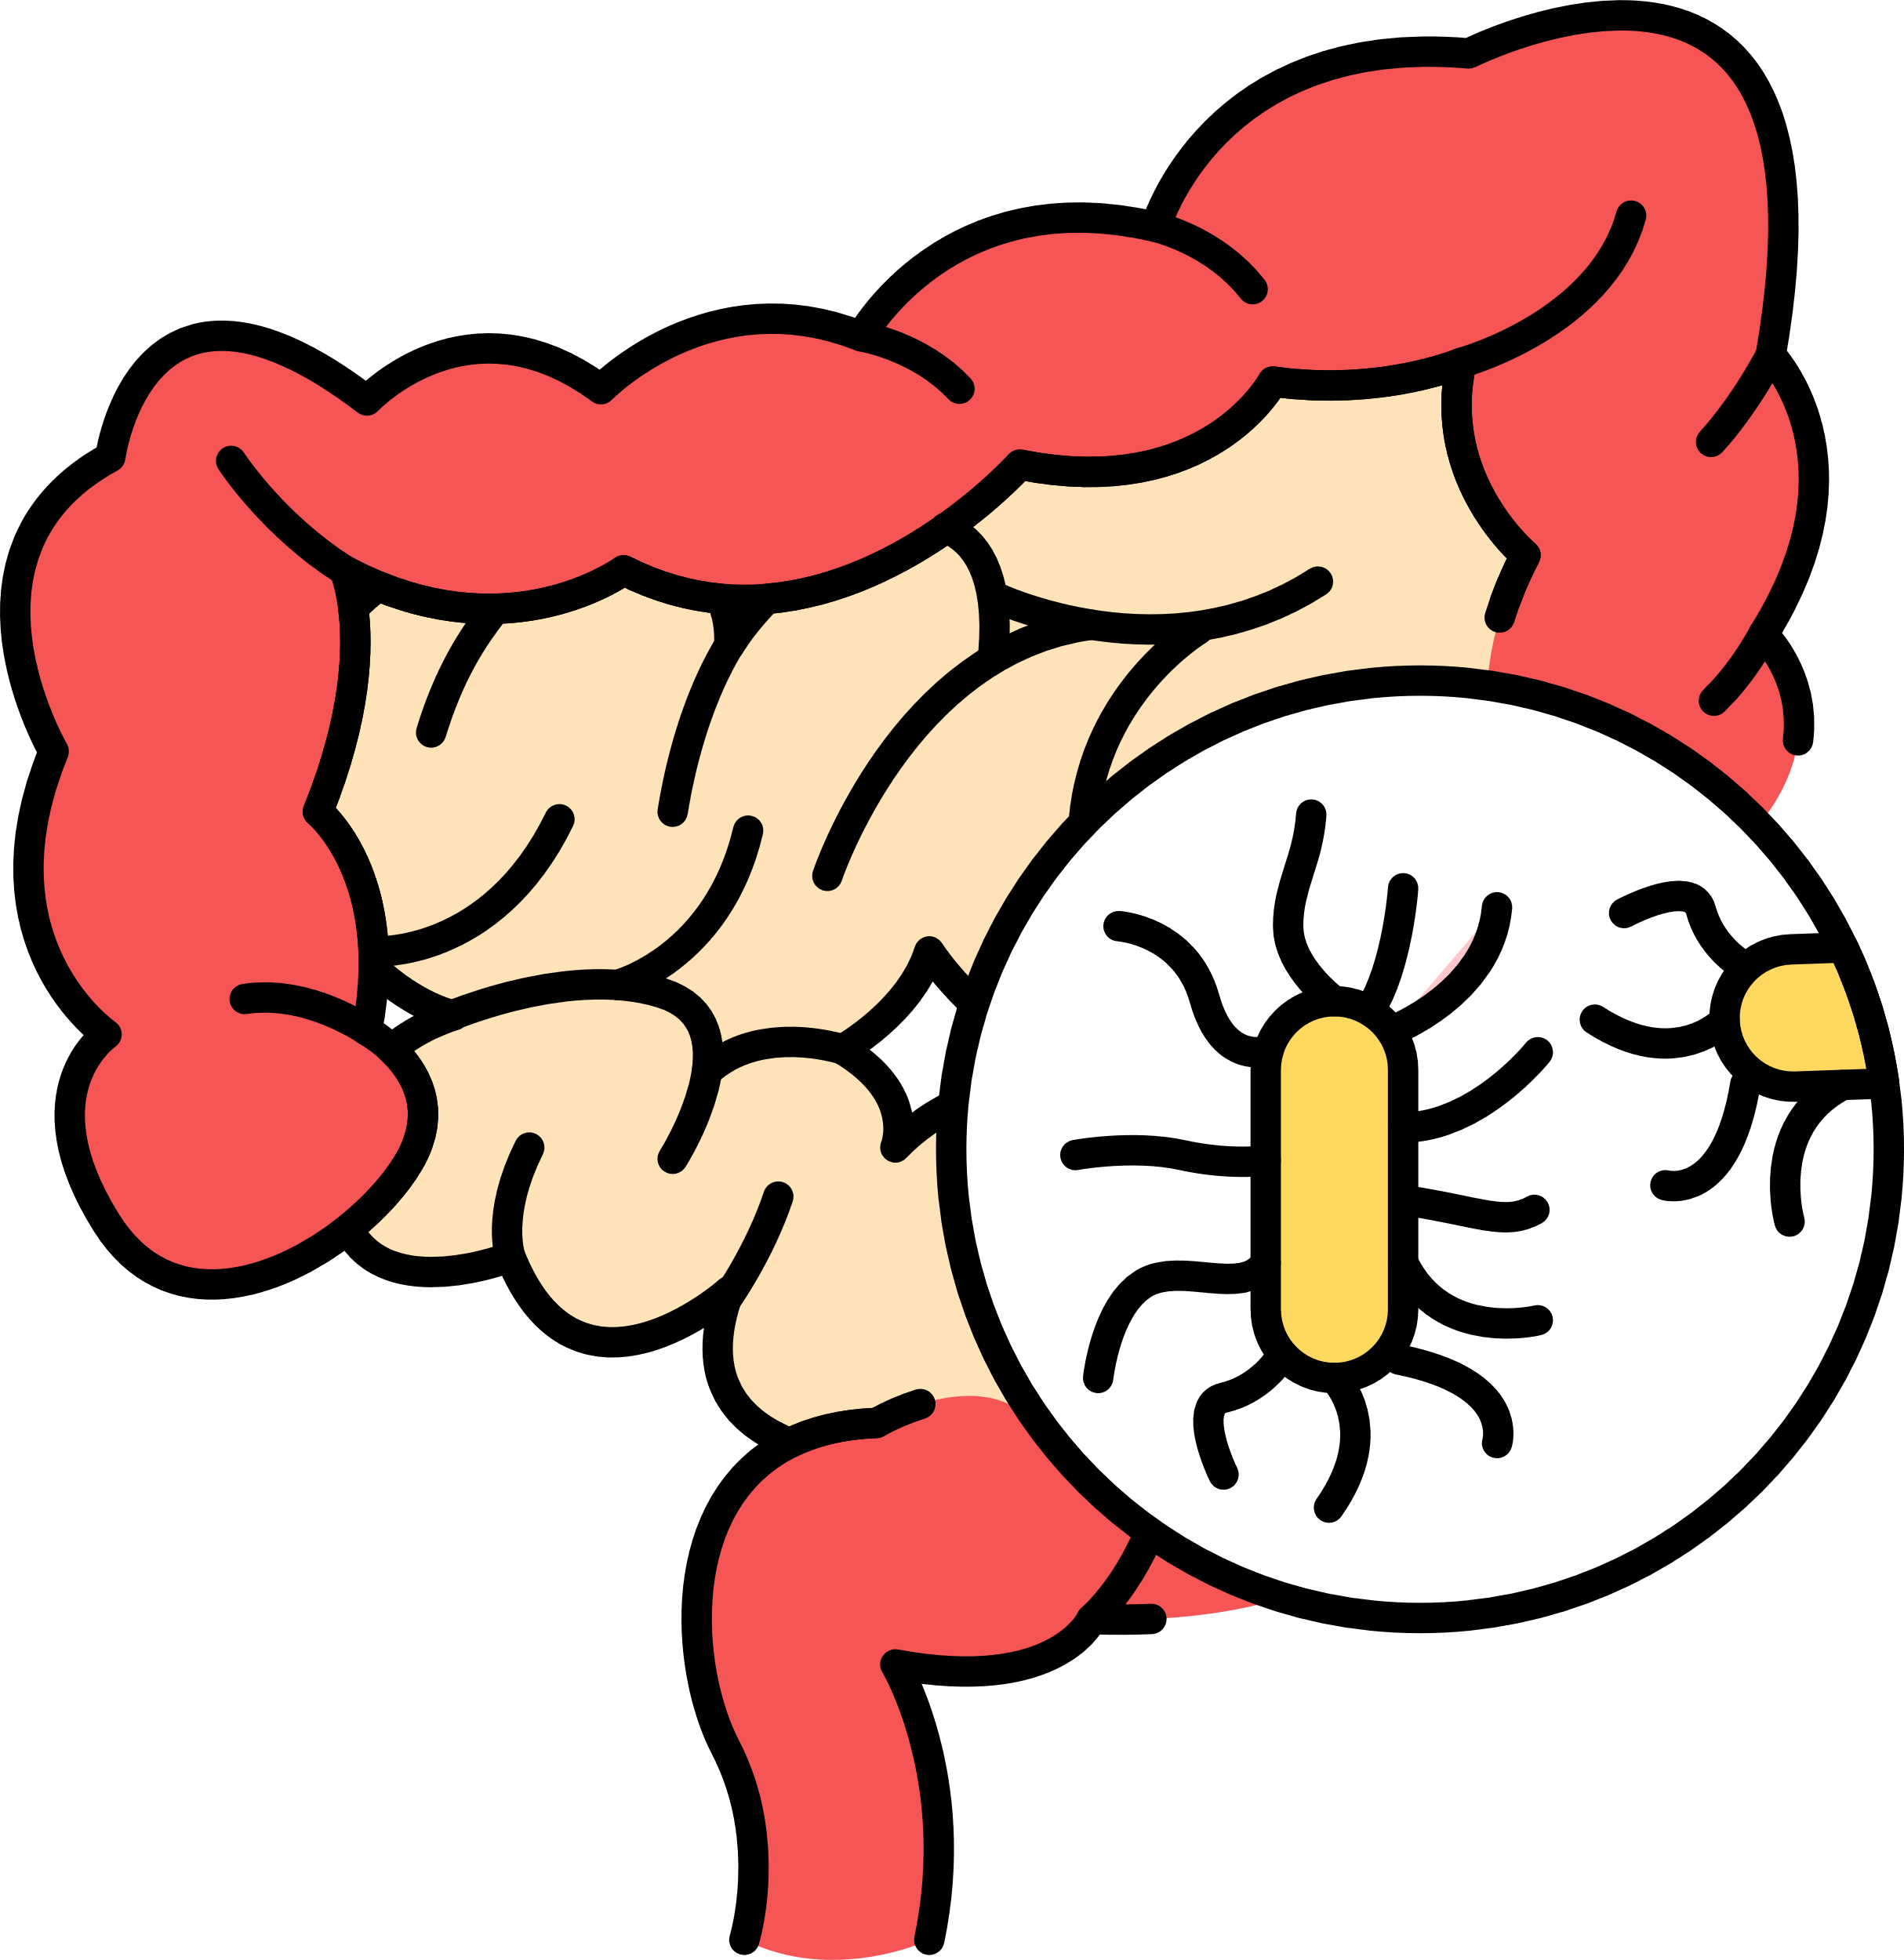
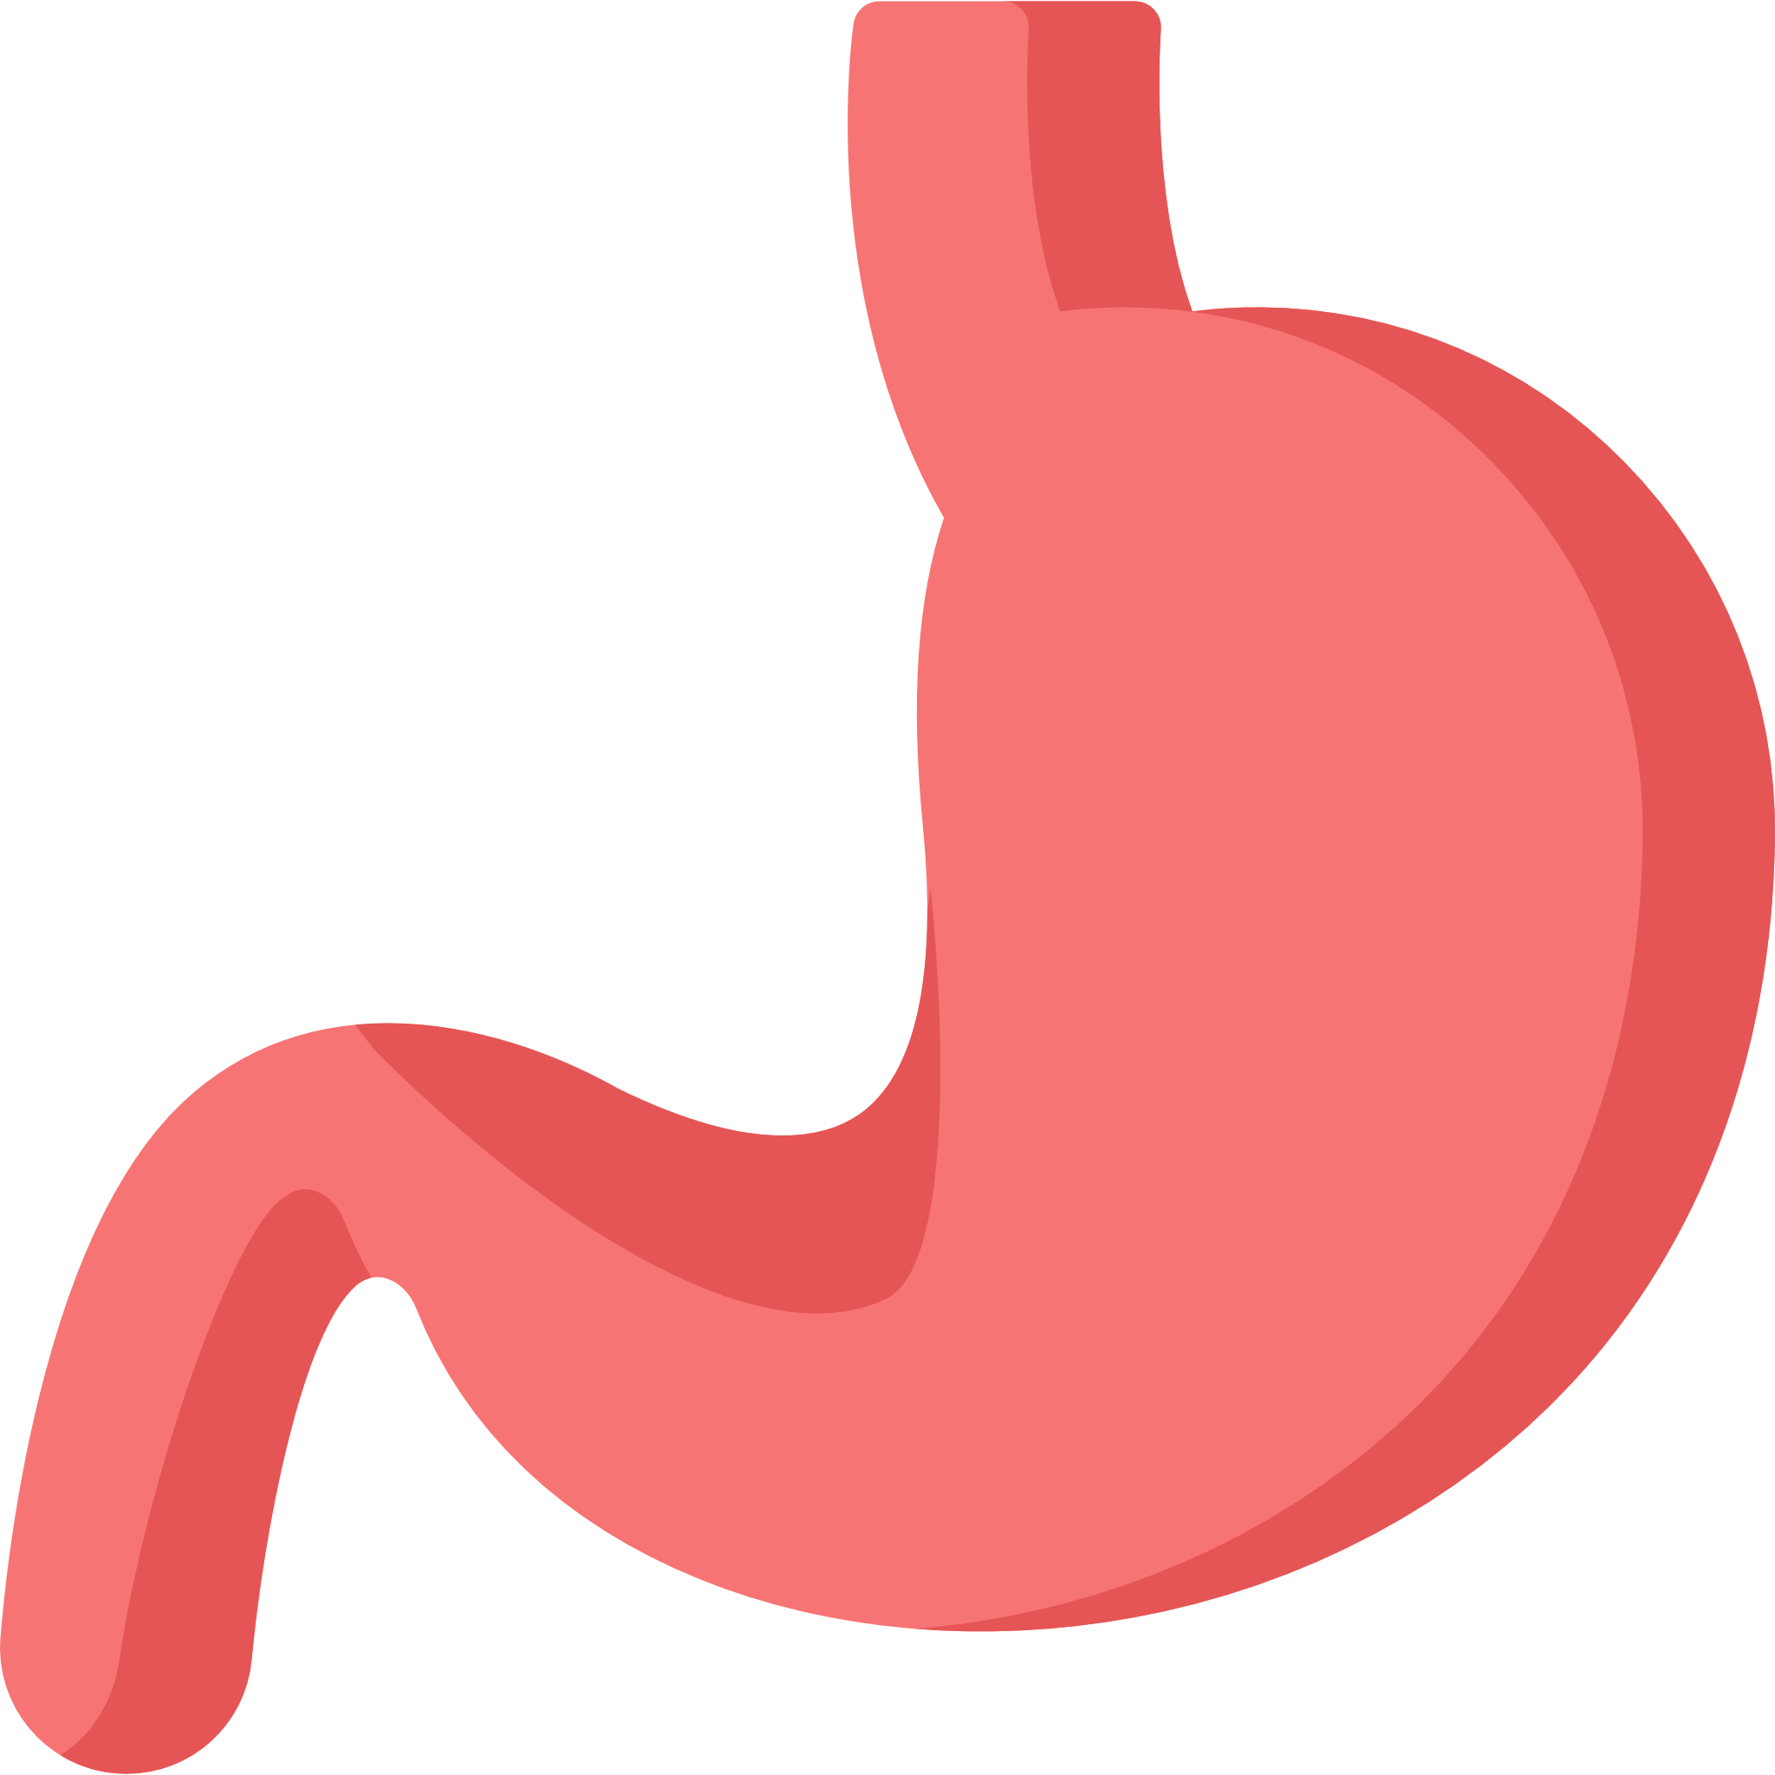



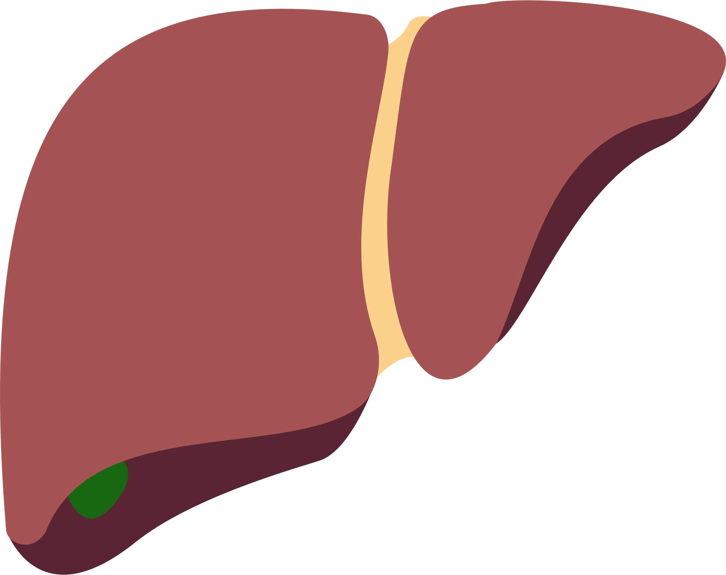
Treatment Landscape of Comorbidities Associated With MASLD/MAFLD
Anti-obesity agents^{1,2}
Genetics
(PNPLA3, TM6SF2 and MBOAT7)
Lipid lowering agents
The USFDA ordered the withdrawal of lorcaserin in 2020.
The anti-obesity drugs approved for long-term use:
  Orlistat,
  Naltrexone ER/bupropion ER,
  Phentermine/topiramate CR,
  Liraglutide
Statins have a beneficial effect on MASLD/MAFLD, in terms of liver enzyme reduction and ultrasonographic amelioration⁴
Statin treatment halved CVD morbidity and mortality in statin-treated MASLD/MAFLD patients⁴
Statin treatment had a protective effect on steatosis, steatohepatitis and fibrosis⁴
Statins have favorable effects on adiponectin levels and can reduce the risk of cardiovascular morbidity and mortality due to their antioxidant properties⁵
1
2
1
MAFLD
Lipotoxicity
(FFAs, proinflammatory
cytokines and adiponectin)
Lifestyle
modification
(dietary change, weight loss and structured exercise intervention)
Gut microbiota
(dysbiosis, increased gut permeability, small intestinal bacterial overgrowth and
gut-derived metabolities)
3
Insulin sensitizers³
2
Bariatric surgery
Sleeve gastrectomy
3
Pharmacotherapy
(anti-obesity drugs, insulin sensitizers, new antidiabetic agents, lipid-lowering agents, vitamin D and vitamin E)
4
Vitamin E and D
Pioglitazone have an established effect on the histology of MASH with T2DM.
Metformin improves liver functions and body composition of non-diabetic patients with MASLD/MAFLD.
GLP-1RAs improve liver histology and reduce high cardiovascular risks in MASLD/MAFLD patients
SGLT2 inhibitors reverse liver diseases and metabolic abnormalities in MASLD/MAFLD.
Insulin resistance
(hepatic tissue, adipose tissue
and muscle)
Guidelines have recommended the use of vitamin E in patients with biopsy-proven MASLD/MAFLD and without diabetes⁶
Vitamin E has antioxidant, anti-inflammatory and anti-apoptotic effect in patients with MASLD/MAFLD⁶
Lower serum 25-hydroxy vitamin D in patients with MASLD/MAFLD might contribute to the progression of the condition⁷
Vitamin D supplementation might improve lipid profile and inflammatory mediators⁷
4
Innovative treatment
(reduce sympathetic activation, programmed cell death, nanotechnology and targeting macrophages)
Healthy Liver
Liver supporting agents: EPL, silymarin and others
CVD, cardiovascular disease; EPL, essential phospholipids; GLP-1RA, glucagon-like peptide-1 receptor agonists; MASH, metabolic dysfunction-associated steatohepatitis; MASLD/MAFLD, metabolic dysfunction-associated steatotic liver disease/metabolic associated fatty liver disease; SGLT2, sodium-glucose cotransporter-2; T2DM, type 2 diabetes mellitus; USFDA, United States Food and Drug Administration.
1. Tak YJ et al. Curr Obes Rep 2021;10(1):14–30; 2. Son JW et al. Diabetes Metab J. 2020;44(6):802-18; 3. Kothari S, Dhami-Shah H, et al. J Clin Exp Hepatol 2019;9(6):723-30; 4. Athyros VG et al. Curr Vasc Pharmacol. 2018;16(3):246–53; 5. Ahsan F et al. Cureus. 2020;12(9):e10446; 6. Perumpail BJ et al. Diseases. 2018;6(4):86; 7. Hariri M et al. Int J Prev Med. 2019;10:14.

