Slide 1
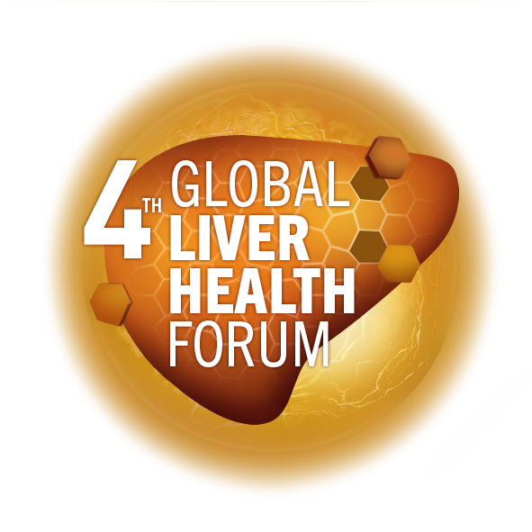
Early screening of metabolic risk
The pharmacists’ perspective
Assoc. Prof. Anamaria Cozma-Petruţ, Pharm., PhD „Iuliu Hațieganu” University of Medicine and Pharmacy Cluj-Napoca (RO)
MAT-GLB-2302800-v-1.0 │ Date of approval: June 2023

Slide 2
Disclosures
Co-owner of a community pharmacy in the city of Cluj-Napoca (Romania)
Lecturer for pharmaceutical companies nationally and internationally

Slide 3
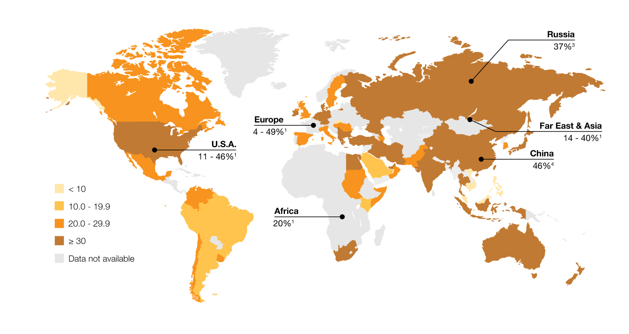
Non-alcoholic fatty liver disease (NAFLD)
NAFLD epidemiology
Russia
37.3%³
About 25% of the general population, 95% of people with severe obesity undergoing bariatric surgery and 33–66% of people with T2DM are affected by NAFLD^{1,2}
Europe
4.0–49.6%¹
Asia
14.8–43.9%¹
USA
11.0–46.0%¹
China
46.5%⁴
<10
10.00–19.9
Africa
8.7–20.0%¹
20.00–29.9
≥30
Data not available
The global burden of NAFLD is expected to grow in the coming decades with the epidemics of obesity and T2D⁵
NAFLD, non-alcoholic fatty liver disease; T2D, Type 2 diabetes
1. Younossi Z, et al. Hepatology 2016;64:73–84; 2. Chalasani N, et al. Hepatology 2018;67:328–357; 3. Ivashkin VT, et al. Russian Journal of Gastroenterology, Hepatology, Coloproctology 2015;25:31–38; 4. Lu ZY, et al. World J Gastroenterol 2016;22:3663–3669; 5. Estes C, et al. J Hepatol 2018;69:896–904
Notes:
NAFLD represents a large and growing public health problem
NAFLD is a leading cause of liver disease worldwide https://www.journal-of-hepatology.eu/article/S0168-8278(18)32121-4/fulltext

Slide 4
Efforts to mitigate NAFLD burden are needed
NAFLD is a global public health problem¹
1
NAFLD is associated with higher risk of cirrhosis, hepatocellular carcinoma, liver failure, CVD and extrahepatic malignancies²
Normal liver
Simple steatosis
NASH ± fibrosis
Cirrhosis
2
NAFLD is a growing cause of liver-related death worldwide³
3
NAFLD may be associated with fatigue, anxiety, depression, cognitive impairment and loss of self-esteem – all of which contribute to impairment of health-related quality of life⁴
4
NAFLD is associated with substantial health-care costs¹
CVD, cardiovascular disease; NAFLD, non-alcoholic fatty liver disease
1. Lazarus JV, et al. Nat Rev Gastroenterol Hepatol 2022;19:60–78; 2. Pipitone RM, et al. Ther Adv Endocrinol Metab 2023;14:20420188221145549;
3. Estes C, et al. J Hepatol 2018;69:896–904; 4. Golabi P, et al. Health Qual Life Outcomes 2016;14:18

Slide 5

NAFLD: the role of community pharmacists
Pharmacists act as first line in the screening and primary/secondary prophylaxis of NAFLD
1
Pharmacists are among the most frequently visited healthcare professionals¹
2
Pharmacists are the patients’ first point of contact with the healthcare system²
3
Pharmacists are a trusted source of advice¹
NAFLD, non-alcoholic fatty liver disease. Image provided by speaker.
1. Sendekie AK, et al. Arch Public Health 2023;81:31; 2. Bui TNT, et al. BMJ Open. 2022;12:e059573

Slide 6







Pharmacists are able to screen for NAFLD risk
factors in patients
Gender
Ethnicity
The development and progression of NAFLD is associated with a number of risk factors, including metabolic comorbidities¹:
Age
BMI
Co-morbidities*
Waist circumference
Basal glucose
Blood pressure
Insulin resistance
Metabolic burden is associated with
higher risk of NAFLD²
Patients with MetS have >4-fold higher risk of developing NAFLD than patients without MetS⁴
High-density lipoprotein
Triglycerides
Features of MetS NAFLD development and progression^{2,3}
*Co-morbidities include Type 2 diabetes, hypercholesterolemia and hypertension.
BMI, body mass index; MetS, metabolic syndrome; NAFLD, non-alcoholic fatty liver disease
1. Younossi Z, et al. Gut 2020;69:564–568; 2. Yang KC, et al. Sci Rep 2016;6:27034; 3. Pipitone RM, et al. Ther Adv Endocrinol Metab 2023;14:20420188221145549; 4. Dajani AI and Popovic B. World J Clin Cases 2020;8:5235–5249

Slide 7


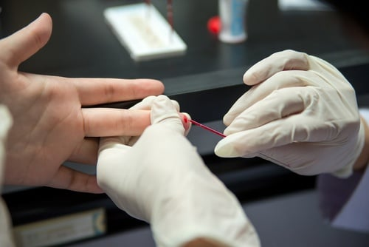
Pharmacists are able to screen for NAFLD risk
factors in patients
Pharmacists can identify metabolic abnormalities
Identification of central adiposity/obesity by visual assessment, measurement of WC, height and weight and calculation of BMI^{1,2,3}
Identification of elevated blood pressure by the measurement of blood pressure^{1,3}
Identification of elevated blood glucose by the measurement of blood glucose^{4,5}
Identification of dyslipidemia by the measurement of blood levels of TC, HDL-C, LDL-C, TG^{1,5}
BMI, body mass index; HDL-C, high-density lipoprotein cholesterol; LDL-C, low-density lipoprotein cholesterol; NAFLD, non-alcoholic fatty liver disease; TC, total cholesterol; TG, triglycerides; WC, waist circumference. Images provided by speaker.
1. Alzubaidi HT, et al. BMJ Open 2019;9:e031246; 2. Peletidi A and Kayyali R. Pharmacy 2019;7:82; 3. Peletidi A and Kayyali R. J of Pharm Policy and Pract 2021;14:54;
4. Krass I, et al. BMJ Open 2017;7:e017725. 5. Zaninotto M, et al. Clin Chem Lab Med 2016;54:1745–1751.

Slide 8
Pharmacists are able to use scoring systems for NAFLD screening, following specialized training
Fatty liver index¹
NAFLD liver fat score²
Hepatic steatosis index³
St-index⁴
An algorithm based on waist circumference, body mass index (BMI),
triglyceride, and
gamma-glutamyl-transferase
Calculated using the presence of the metabolic syndrome, T2DM, fasting serum insulin, fasting serum AST and the AST/ALT ratio
Calculated using the patient’s sex, BMI, ALT and AST levels and diagnosis of T2DM
Calculated using the patient’s age, diagnosis of T2DM and
waist-to-height ratio
ALT, alanine aminotransferase; AST, aspartate aminotransaminase; NAFLD, non-alcoholic fatty liver disease; St-index, steatosis index; T2D, Type 2 diabetes mellitus.
1. Bedongi G, et al. GMC Gastroenterol 2006;6:33; 2. Kotronen A, et al. Gasteronterology 2009;137:865–872; 3. Lee HJ, et al. Dig Liver Dis 2010;42:503–508;
4. Maev IV, et al. Adv Ther 2020;37:4627–4640

Slide 9



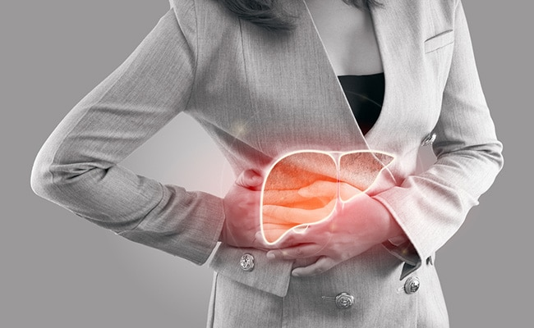

Pharmacists are able to screen for symptoms of
NAFLD in patients
The most common symptoms of NAFLD reported by gastroenterologists/general practitioners using patients’ language¹:
Abdominal discomfort
Abdominal bloating
Tiredness/fatigue
Lack of energy
Abdominal pain
(in the upper right side
of the abdomen)
NAFLD, non-alcoholic fatty liver disease. Images provided by speaker.
1. Hartleb et al. Eur J Gastroenterol Hepatol. 2022;34:426–434
Notes:
The various symptoms that patients present to the pharmacy with can be the expression of a liver pathology, such as NAFLD

Slide 10
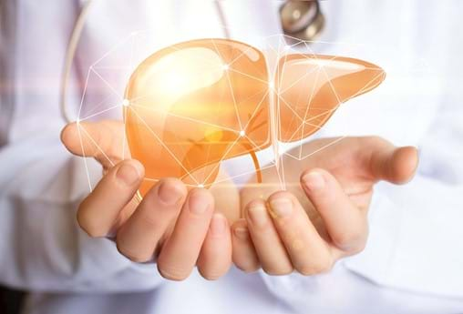
The utility of screening for NAFLD and associated metabolic risk factors in the community pharmacy
Pharmacists can identify patients at high risk for NAFLD or potentially having the disease, thus contributing to the prevention, early detection and management of NAFLD¹
Identification of patients at high risk for NAFLD (or potentially having NAFLD) in the community pharmacy enables:
    Referral for a review by the general practitioner and/or specialist^{1,2}
    Early interventions to prevent NAFLD development and/or progression^{1,2}
NAFLD, non-alcoholic fatty liver disease
1. Lazarus JV, et al. Nat Rev Gastroenterol Hepatol 2021;18:717–729. 2. Wong VWS, et al. Liver Int 2022;42:2377–2389.

Slide 11
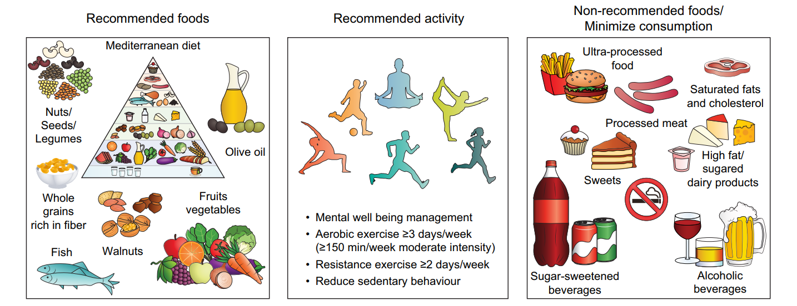
Pharmacists are able to provide healthy lifestyle advice
Lifestyle pattern to prevent and control NAFLD
and metabolic comorbidities (obesity, T2D, dyslipidaemia, CVD):^{1,2,3}
Adequate
daily
calorie intake
CVD, cardiovascular disease; NAFLD, non-alcoholic fatty liver disease; T2D, Type 2 diabetes.
1. Younossi ZM, et al. Gastroenterology 2021;160:912–918. 2. Francque SM, et al. JHEP Rep 2021;3:100322; 3. Montemayor S, et al. Nutrients 2022;14:3186

Slide 12
Pharmacists are able to recommend
hepatoprotective treatment
Guidelines for the prevention and/or treatment of NAFLD recommend the use of hepatoprotective agents as a potential treatment to limit hepatic damage^{1,2,3}
Very high
UDCA
Vitamin E* (+ Vitamin C)
High
Vitamin D
Level of existing scientific evidence
Resveratrol
EPLs
Medium
Pharmacists must raise awareness about the importance of using hepatoprotective therapy that has evidence-based efficacy⁴
Phyllanthus
Garlic
Glycyrrhizic acid
Coenzyme
Q10
Metadoxine
Low
Ademetionine
Artichoke
Silymarin
According to a recent publication, essential phospholipids (EPL) are one of the most promising adjunctive therapy for NAFLD⁵
Lack of improvement
or deterioration
Low probability
of improvement
Medium probability
of improvement
High probability
of improvement
Very high probability
of improvement
Likelihood of improvement of clinically meaningful parameters
Level of existing data supporting the efficacy/effectiveness and safety of various hepatoprotective agents in NAFLD⁵
NAFLD, non-alcoholic fatty liver disease
1. Fan JG, et al. J Dig Dis 2019;20:163–173; 2. Russian Scientific Liver Society, 2015. Available from: http://www.rsls.ru/files/Guidelines-RSLS-NASH-2016-01-03.pdf (Accessed: May 2023); 3. Society of Digestive Diseases (Latvia), 2020. Available from: https://www.globalliverforum.com/dam/jcr:a0028500-2820-4ad0-b5db-7b2bdbb69c82/Vadlinijas_en-GB.pdf (Accessed: May 2023). 4. Romanian Society of Gastroenterology and Hepatology, 2020. Available from: https://www.globalliverforum.com/dam/jcr:c32f220a-9045-4825-a1db-825810e7a7ff/Position%20paperNAFLD%20treatment12.pdf (Accessed: May 2023). 5. Dajani AI and Abuhammour A. Drug Ther Perspect 2021;37:249–264

Slide 13

Pharmacists are able to recommend
hepatoprotective treatment
EPL are a highly purified extract of the semen of soybeans with standardized contents of 72%–96% (3-sn-phosphatidyl)choline¹
EPL restore hepatocyte membrane structure and fluidity and improve hepatic restoration^{,2}
EPL have shown clinical efficacy in NAFLD ⇨ EPL treatment in patients with NAFLD and T2D and/or obesity was associated with significant symptom improvement, reductions in ALT, TG and TC and improved disease severity (measured by ultrasonography)³
EPL are generally well tolerated with longer-term use^{2,4}
ALT, alanine aminotransferase; EPL, essential phospholipids; NAFLD, non-alcoholic fatty liver disease; TC, total cholesterol; T2D, Type 2 diabetes mellitus; TG, triglycerides
1. Gundermann KJ, et al. Clin Exp Gastroenterol 2016;9:105–117; 2. Dajani AI and Abuhammour A. Drug Ther Perspect 2021;37:249–264; 3. Dajani AI and Popovic B. World J Clin Cases 2020;8:5235–5249; 4. Petcu L and Popovic B. Evid Self Med 2022;2:220121

Slide 14

Pharmacists are able to recommend
hepatoprotective treatment
Adjunctive hepatoprotectors, such as EPL, can alleviate symptoms and may be recommended without prescription
EPL have been recommended by several national practice guidelines as supportive treatment for patients with NAFLD¹:
      1800 mg/day: 2 × 300 mg capsules, 3 times/day
      12–24 weeks of treatment
EPL, essential phospholipids; NAFLD, non-alcoholic fatty liver disease
Dajani AI and Abuhammour A. Drug Ther Perspect 2021;37:249–264

Slide 15
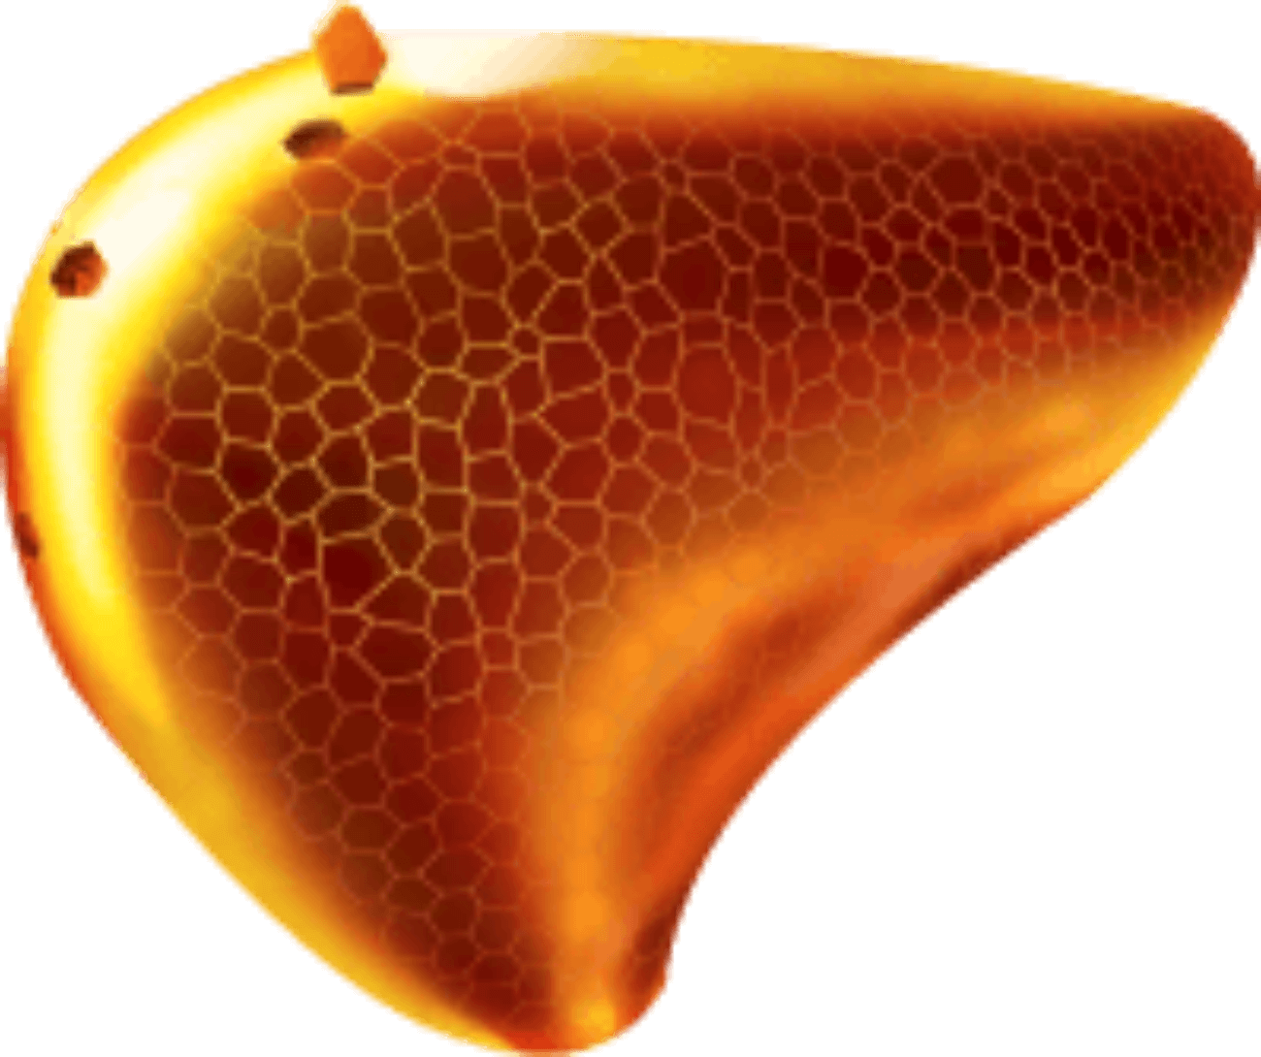
Main take aways
NAFLD is a growing public health problem that requires attention from healthcare professionals, including pharmacists.
Pharmacists play an essential role in the prevention, screening and management of NAFLD and metabolic comorbidities.
Pharmacists can engage in the delivery of care for patients with NAFLD or at high risk for NAFLD, by providing lifestyle advice and recommending hepatoprotective agents with proven clinical efficacy.
NAFLD, non-alcoholic fatty liver disease

Slide 16
Audience Q&A

