Slide 1
Reducing the burden of liver disease
New evidence revealed

Slide 2


Shedding light on genomic, metabolic, and phenotypic effects of essential phospholipids on HepaRG
Professor Paola Luciani
Department of Chemistry, Biochemistry and Pharmaceutical Sciences, University of Bern, Switzerland
MAT-GLB-2402365-v-1.0 │ Date of approval: May 2024

Slide 3

Disclosures
Consulted and received grants from Lipoid GmbH, Sanofi-Aventis and DSM Nutritional Products Ltd; received grants from PPM Services SA.
Currently Specialist for Pharmaceutical Quality in the Human and Veterinary Medicines Expert Committee at Swissmedic, the Swiss Agency for Therapeutic Products, and expert of the NANO Working Party (Nanomedicine) by the EDQM European Pharmacopoeia Commission

Slide 4
Outline
1
Human HepaRG® cells – a suitable alternative to primary human hepatocytes – serve as a promising in vitro model to study the development of steatosis, and subsequent progression to severe disease stage
2
The effects of EPL on lipid droplet size distribution and accumulation is evaluated in this in vitro model
3
The impact of EPL treatments on the transcriptional activity of steatotic HepaRG® cells is explored through next-generation Illumina RNA sequencing
EPL, essential phospholipid

Slide 5








MASLD and importance of phospholipid in steatosis
MASLD, formerly known as NAFLD¹ is a major cause of liver dysfunction; Global prevalence: 25%.²
PC, as a surfactant, prevents LD coalescence and regulates LD size.⁵
During LD expansion, novel PC synthesis occurs via activation of enzyme, CTP.^{6,7}
Causes of steatosis in liver:³
↑ Flux of FFA in liver
↑ Lipogenesis
↓ Breakdown of FFA in liver
Inhibition of PC biosynthesis → increase in LD size, since apparently, larger droplets require less amount of phospholipid to cover their surface area than smaller droplets.⁷
In presence of FFA, de novo LD synthesis may switch to enforced lipid loading to already existing LDs → LD size increases instead of new small LDs.⁴
1. Eslam M et al. J Hepatol. 2020; 73: 202–209; 2. Ye Q et al. Lancet Gastroenterol Hepatol. 2020; 5: 739–752; 3. Robinson KE et al. ransl Gastroenterol Hepatol. 2020;5: doi: 10.21037/tgh.2019.12.05.; 4. Wallstab C et al. FEBS J. 2017;284(19):3245-3261; 5. Wang B et al. Annu Rev Physiol. 2019;81:165-188; 6. Nassir F et al. Gastroenterol Hepatol (N Y). 2015; 11(3):167-75; 7. Krahmer N et al. Cell Metab. 2011;14(4):504-515.
CTP, phosphocholine cytidylyltransferase; FFAs, free fatty acids; LD, lipid droplet; MASLD, metabolic dysfunction-associated steatotic liver disease; NAFLD, non-alcoholic fatty liver disease; PC, phosphatidylcholine.

Slide 6


Study objective and rationale
PC-induced steatosis regression in hepatocytes can result from:
↑ Fatty acids’ beta-oxidation
↓ Liponeogenesis, or
↑ Fatty acids evacuation followed by their uptake and utilization in muscles.
The exact mechanism through which an EPL exerts effects on clinically observed steatosis improvement has not been investigated sufficiently.
This study aimed to analyze the effects of the EPL, rich in PC, on steatosis induced by incubation with fatty acids (oleic acid and palmitic acid) in differentiated human HepaRG® cell.
EPL, essential phospholipid; PC, phosphatidylcholine.

Slide 7
Phases of the study¹
Phase 2
Phase 4
Fat overaccumulation in HepaRG® cells induced with PA, OA, or their combinations (OA:PA)
Detailed biochemical and metabolic investigation to establish a clinically relevant improvement upon EPL treatment
Biochemical/metabolic profiling of steatotic HepaRG® cells
Evaluation of the impact of EPL on hepatic lipid turnover via immunofluorescence
Phase 1
Phase 3
Objective: To evaluate the effects of EPL on lipid droplet size distribution and accumulation in an in vitro model of steatosis (phase 4) using differentiated human HepaRG® cells.¹
1. Valentino G et al. The Liver Meting AASLD; Nov 2023, Boston, USA. Poster.
EPL, essential phospholipid; OA, oleic acid; PA, palmitic acid.

Slide 8

Different HepaRG® treatments with EPL
Treatments¹
Treatment Approaches |  | Day 1 | Day 2
Method 1 | EPL after steatosis (no OA:PA) | OA:PA=2:1; total concentration: 0.75 mM | EPL liposomes 1.5 mg/mL or 3.8 mg/mL in GM or SFM
Method 2 | EPL after steatosis in presence of OA:PA | OA:PA=2:1; total concentrations of 0.75 mM | EPL liposomes 1.5 or 3.8 mg/mL in presence of OA:PA (2:1); total concentrations of 0.75 mM (GM)
Method 3 (Prophylaxis) | EPL with OA:PA while inducing steatosis | EPL liposomes 1.5 mg/mL or 3.8 mg/mL in presence of OA:PA (2:1); total concentrations of 0.75 mM (GM) | —
1. Valentino G et al. The Liver Meting AASLD; Nov 2023, Boston, USA. Poster.
EPL, essential phospholipid; GM, growth medium; mM, milli molar; OA, oleic acid; PA, palmitic acid; SFM, serum-free medium.

Slide 9
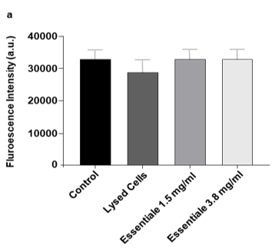
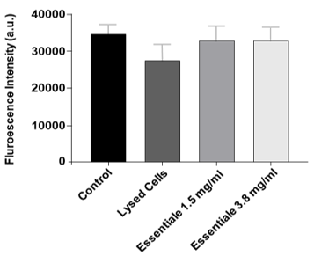
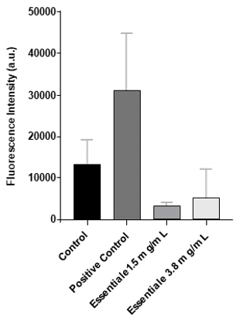
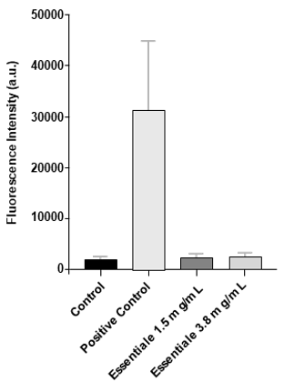
Impact of EPL treatment on cytotoxicity
TMRM activity as percentage of viable mitochondria (a) HepaRG cells exposed to EPL in SFM and (b) HepaRG cells exposed to EPLs in GM.
ROS production in HepaRG cells exposed to (a) EPLs in SFM and (b) EPLs in GM.
a
b
a
b
Treatment with EPL at concentrations 1.5 and 3.8 mg/mL in SFM or GM led to¹:
No cytotoxicity or damage to cell membrane integrity.
No mitochondria-related cytotoxicity. In general, the percentages of viable mitochondria of treated cells were comparable to control cells in GM or SFM.
Low levels of ROS were detected with EPL treatment in SFM suggesting a protective function of EPL towards oxidative stress¹.
1. Valentino G et al. The Liver Meting AASLD; Nov 2023, Boston, USA. Poster.
EPL, essential phospholipid; GM, growth medium; ROS, reactive oxygen species; SFM, serum-free medium; TMRM, tetramethylrhodamine methyl ester.

Slide 10
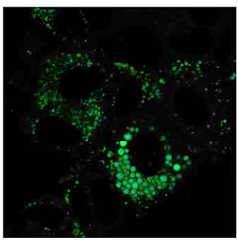
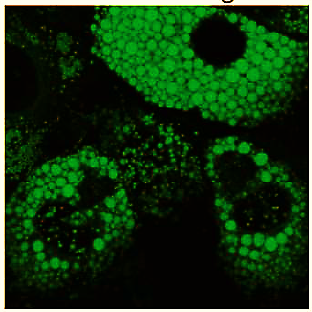
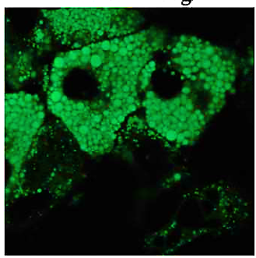
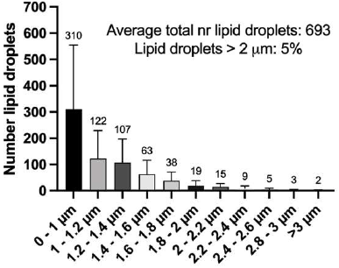
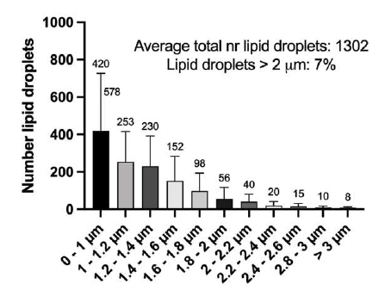
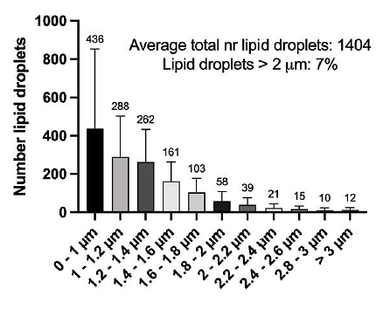
Profiling of lipid droplet size distribution
Control cells
HepaRG cells + EPL 1.5 mg/ml
HepaRG cells + EPL 3.8 mg/ml
Representative microscopy images
Avg total lipid droplets: 693
Lipid droplets >2µm: 5%
Avg total lipid droplets: 1302
Lipid droplets >2µm: 7%
Avg total lipid droplets: 1404
Lipid droplets >2µm: 7%
Representative lipid droplet size distribution plot
Size distribution of lipid droplets, stained with Bodipy(493/503), was profiled by means of confocal microscopy¹
1. Valentino G et al. The Liver Meting AASLD; Nov 2023, Boston, USA. Poster.
EPL, essential phospholipid

Slide 11
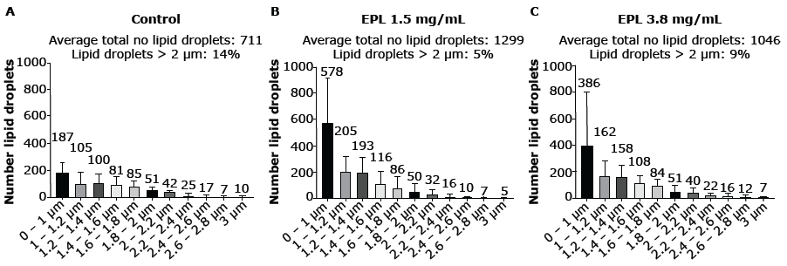
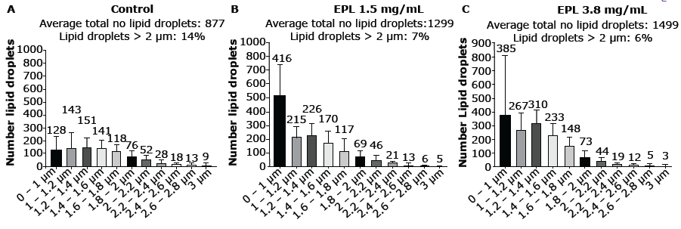
Effect of EPL treatment on lipid droplet size reduction
Method 2: Steatotic HepaRG® exposed to OA:PA after treatment with EPLs at 1.5 and 3.8 mg/mL
Percentage of lipid droplets ≥2 mM decreases with EPL treatment at both 1.5 and 3.8 mg/mL¹
Method 3 (Prophylaxis): Naïve HepaRG® treatments with EPLs at 1.5 and 3.8 mg/mL in the presence of OA:PA
1. Valentino G et al. The Liver Meting AASLD; Nov 2023, Boston, USA. Poster.
EPL, essential phospholipid; FBS, fetal bovine serum; LD, lipid droplet; OA, oleic acid; PA, palmitic acid.

Slide 12
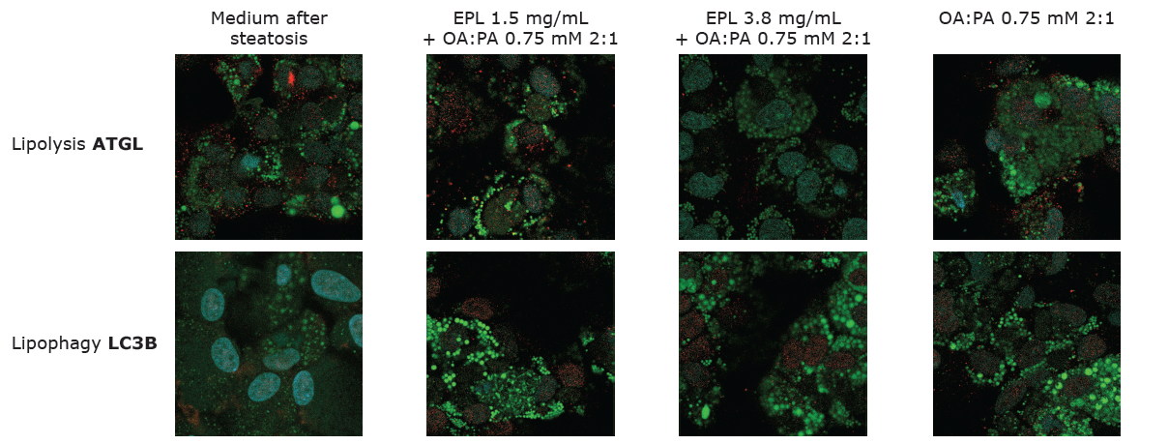
Immunofluorescence to understand prevalent process in lipid catabolism
Lipolysis and lipophagy – two processes that control lipid droplet’s catabolism in hepatocytes. Immunofluorescence was performed for the presence of ATGL, an enzyme involved in lipolysis and LC3B, an autophagic marker.
The presence of ATGL instead of LC3B detected after EPL treatments support lipolysis as the main process involved in fat deposit reduction¹
1. Valentino G et al. The Liver Meting AASLD; Nov 2023, Boston, USA. Poster.
ATGL, adipose triglyceride lipase; EPL, essential phospholipid; OA, oleic acid; PA, palmitic acid; LC3B, light chain-3B; ROS, reactive oxygen species; SFM, serum-free medium.

Slide 13
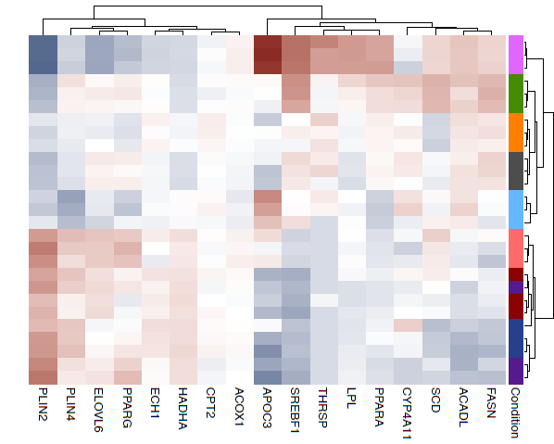
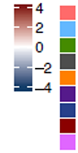
Illumina RNA sequencing – RNA transcriptomic analysis on EPL treatment
Heatmap and hierarchical clustering based on the read counts of the selected differentially expressed genes in either direction, i.e., both positive and negative log fold changes, across the sample groups.
VST
Condition
Prophylaxis:EPLs (5mM)+OA:PA
Steatotic
Steatotic control: no FBS
Steatotic control: with FBS
Steatotic: day 2
Steatotic: EPLs (5mM)+OA:PA
Steatotic: EPLs (5mM) no FBS
Steatotic: EPLs (5mM) with FBS
Untreated
EPL treatments showed upregulation of PLIN2, ANGPTL4, and PDK4 genes which are downregulated in steatotic cells, thereby indicating their potential role as steatosis predictors.¹
1. Valentino G et al. The Liver Meting AASLD; Nov 2023, Boston, USA. Poster.
ACADL, acyl-CoA dehydrogenase long chain; ANGPTL4, angiopoietin-like 4; EPL, essential phospholipid; FASN, fatty acid synthase; LC3B, light chain-3B; LPL, lipoprotein lipase; OA, oleic acid; PA, palmitic acid; PDK4, pyruvate dehydrogenase lipoamide kinase isozyme; PLIN4, perilipin 4; PPARα, peroxisome proliferator-activated receptor alpha; ROS, reactive oxygen species; SFM, serum-free medium; THRSP, thyroid hormone responsive; SREBF1, sterol regulatory element-binding transcription factor 1.

Slide 14
Key takeaways
Differentiated HepaRG® cells replicated human steatosis and hence provided a promising in vitro model for this study.
Treatment with EPL demonstrated clinically relevant protective effects on oxidative stress and a reduction in LD size with the movement of LD size distribution toward smaller-sized LDs, thereby supporting its beneficial role in the management of fatty liver diseases.
Lipolysis was identified as the main process involved in lipid degradation since ATGL were more prominent than LC3B.
RNA transcriptomic analysis revealed upregulation of PLIN2, ANGPTL4, and PDK4 in EPLs-treatments and downregulation in steatotic cells.
ANGPTL4, angiopoietin-like 4; ATGL, adipose triglyceride lipase; EPL, essential phospholipid; LC3B, light chain-3B; LD, lipid droplet; PDK4, pyruvate dehydrogenase lipoamide kinase isozyme; 4PLIN4, perilipin 4.

Slide 15
Thank you

