Slide 1

SIRIUS Project
Insights from a
population-wide liver
disease screening program in Slovakia
Lubomir Skladany
Hepatology, Gastroenterology and Liver Transplantation (HEGITO), Department of Internal Medicine 2, Slovak Medical University, F.D. Roosevelt University Hospital, Slovakia
MAT-GLB-2302799 │ Date of approval: June 2023

Slide 2
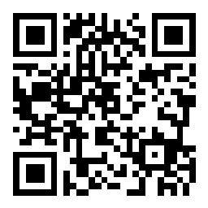

Interactive polling question
Access via this QR code, or
via Slido.com and enter:
# EASL-sanofi
?
a
A liver condition characterized by the accumulation of fat in the liver, usually seen in people with metabolic comorbidities
b
The last stage of alcoholic cirrhosis
Which of the following statements most accurately describes NAFLD?
c
An umbrella term for a range of liver conditions affecting people who drink little to no alcohol

Slide 3
Disclosures
Conflict of interest: Sanofi

Slide 4
Outline
1
2
3
4
Why
Who
How
What

Slide 5
1
Why we do it

Slide 6
Slovakia: regional intro
Prevalence of decompensated cirrhosis:
Slovakia is number 1 in the world¹
Mortality:
Liver is the number 1 cause of death in 25–54 year olds in Slovakia²

Slide 7
2
Who

Slide 8
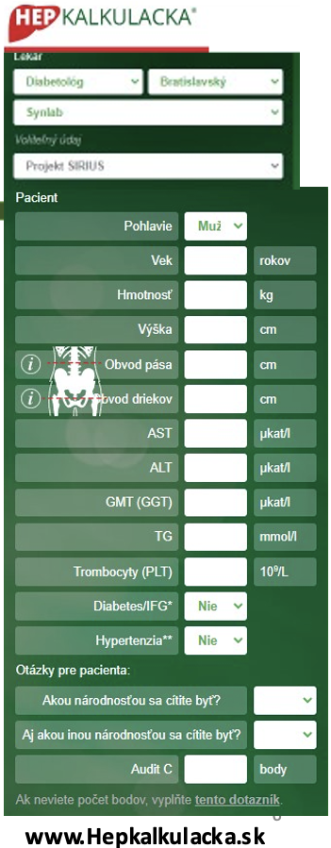
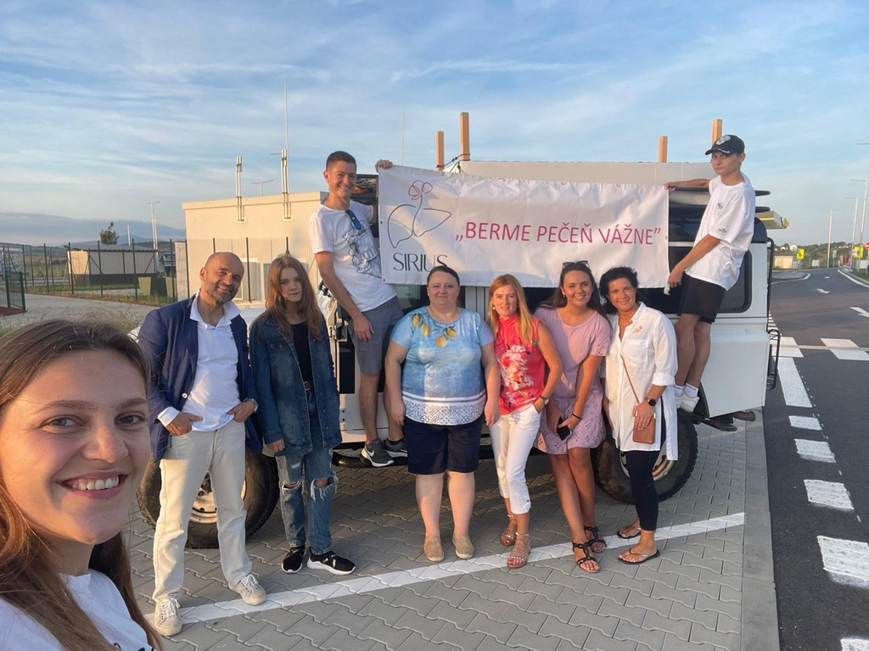
Opportunistic screening of adults
1. SIRIUS Outpatient Clinics
2. SIRIUS Community
SIRIUS Amb
SIRIUS Com

Slide 9
3
How

Slide 10
SIRIUS Amb
Preventive
or
Regular pre-planned
Check-ups in stable health
Stool sample for microbiome analysis

Slide 11
SIRIUS Amb
HEPCalculator
  Type of output clinic (14)
  Region
  Sex
  Age
  Anthropometry (including WHR)
  Lab (LFI, FIB-4)
  MetSy
  Ethnicity
  AUDIT-C
vs
Stool sample for microbiome analysis

Slide 12
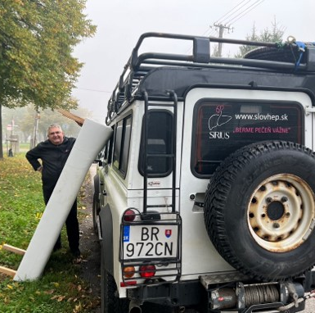
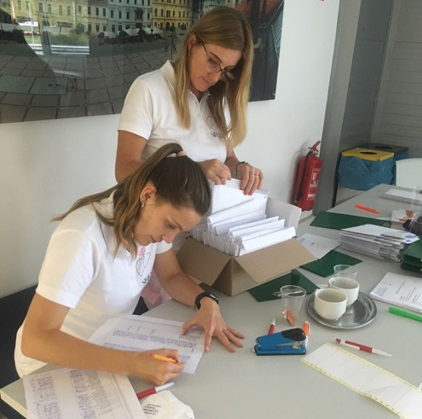
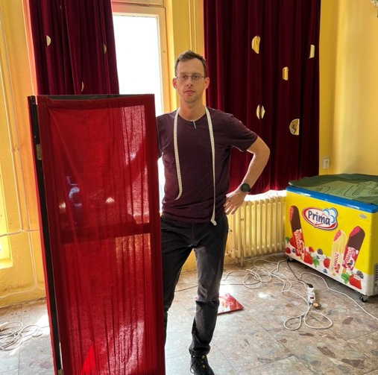
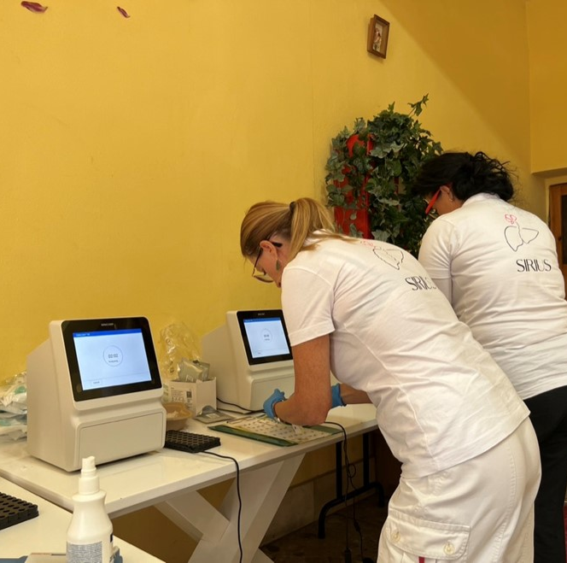
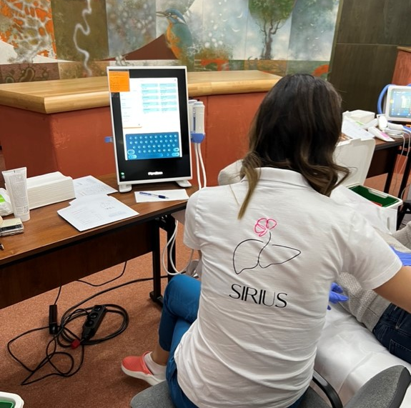
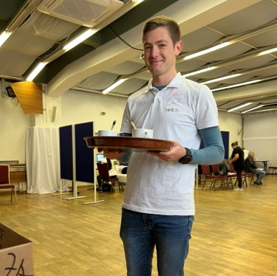
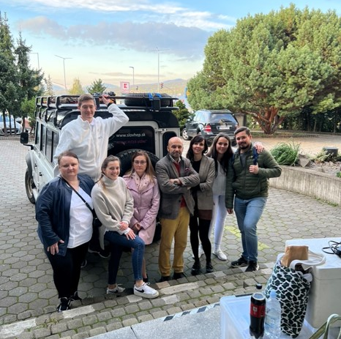
SIRIUS Com
We travel to three regions & six sociomes
We record SIRIUS envelope
We measure anthropometry
Labs from capillary blood
Transient elastography
& CAP
Coffee
Picture & go
Stool sample
for microbiome analysis

Slide 13
4
What we have

Slide 14
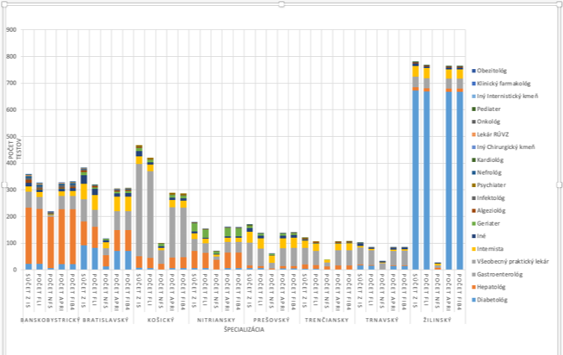
SIRIUS Amb
Number of uploaded HEPCalculator
Fibrosis (FIB-4>)
Steatosis (LFI>)
Microbiome samples

Slide 15
SIRIUS Com
Number of visited sites
Number of examinees
Fibrosis (TE>kPa)
Steatosis (CAP>)
Microbiome samples

Slide 16
Interim results SIRIUS Community
27 sites covering
  Regions
  6 Sociomes (City size 1&2, Village size 1&2, Remote territory, Roma secluded community)
2470 subjects x 100 recorded variables ^{(paperpencil)}
  Lifestyle, social context & health questionnaires
  Demography
  Anthropometry
  Labs
  Fibroscan (TE & CAP)
  Microbiome

Slide 17
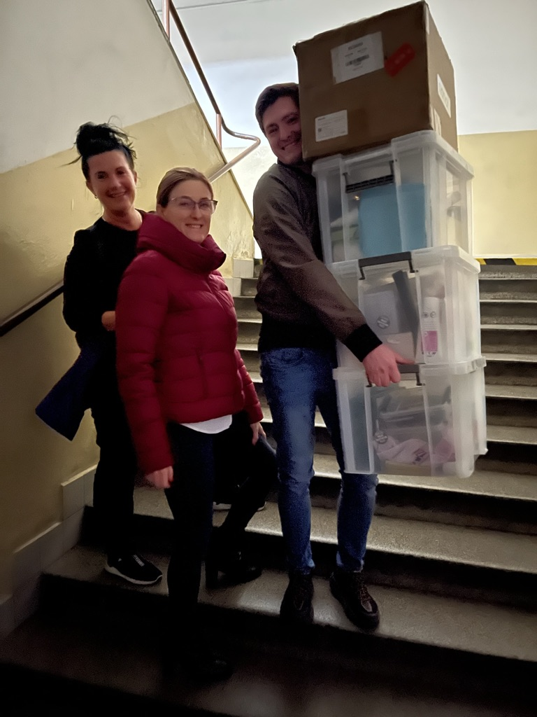
Liver enzymes elevated 20%

Slide 18
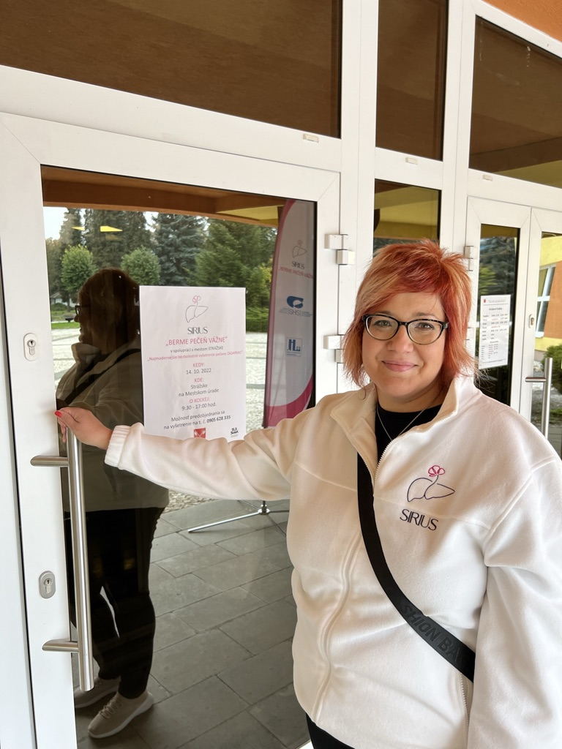
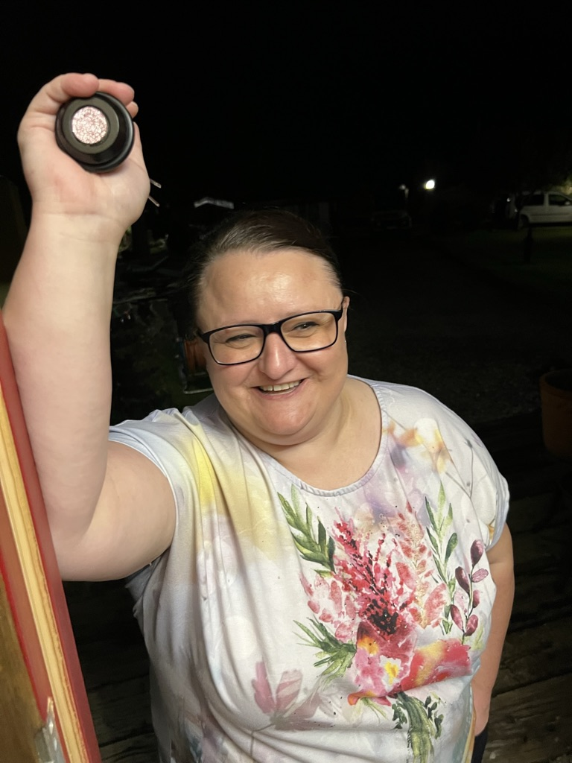
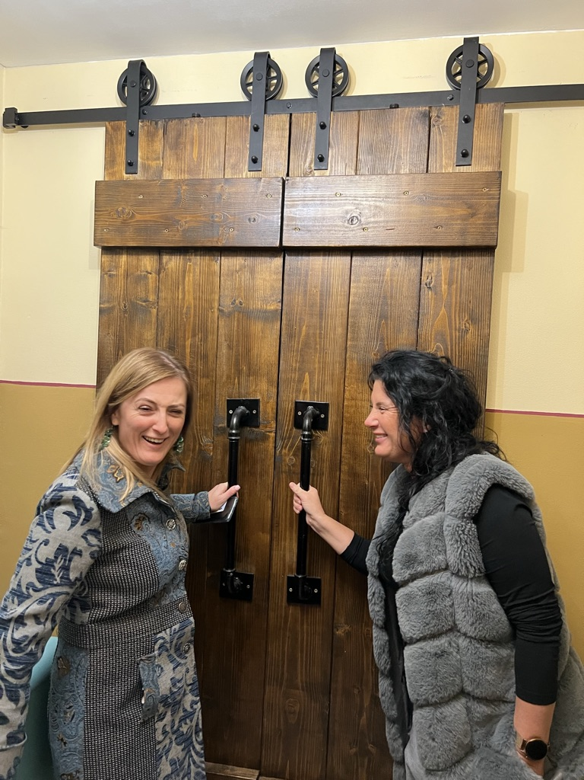
GGT & ALT associations

Slide 19
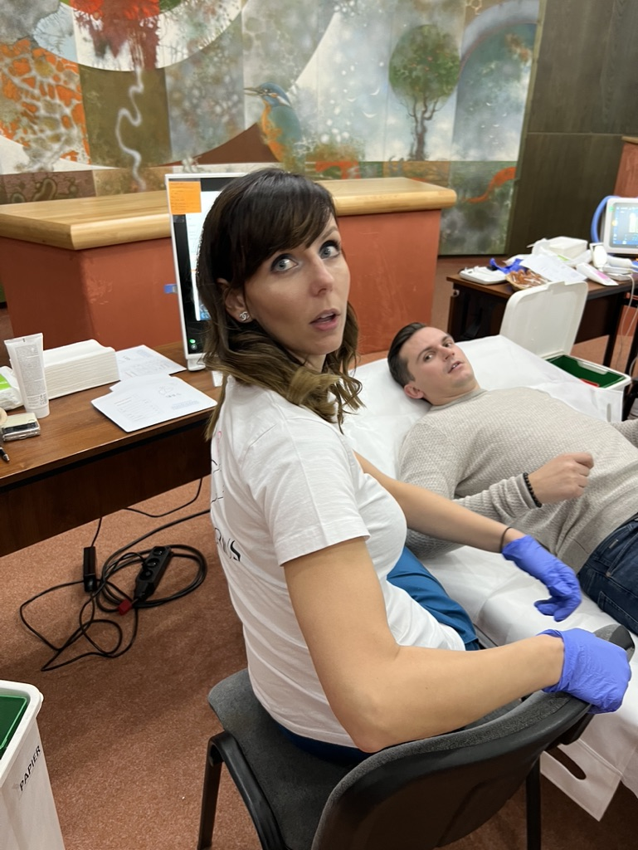
Steatosis (CAP>250 dB/m) > 50%

Slide 20
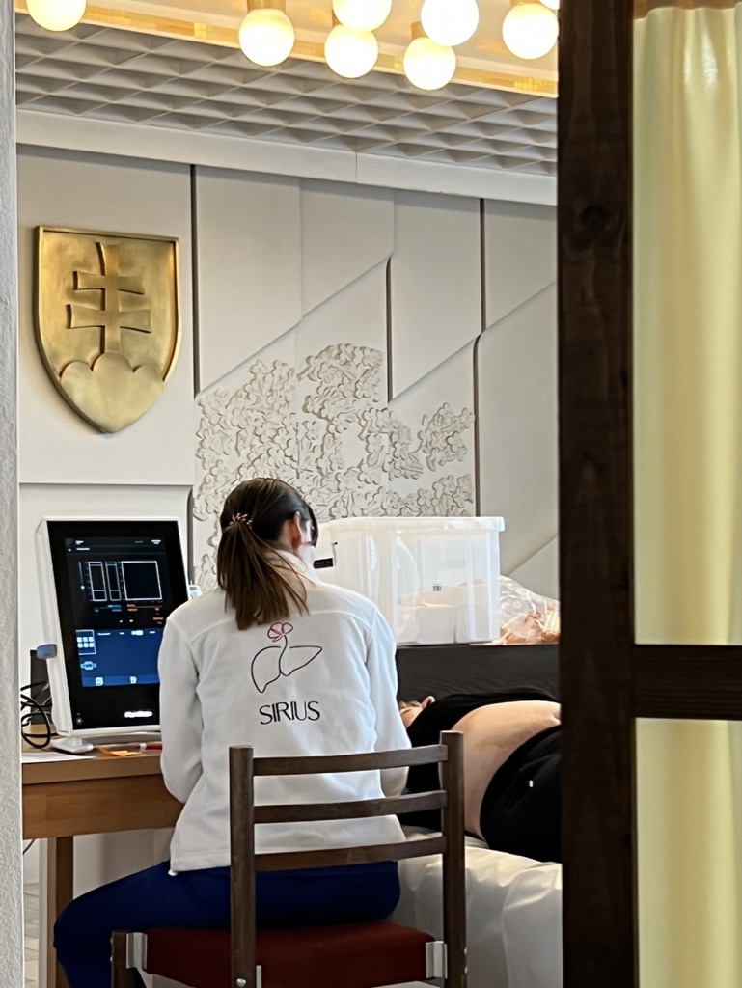
Fibrosis (TE>8kPa) > 12%

Slide 21
Summary
1
SIRIUS Project has been in operation for 2 years / planned to be continued
S
2
SIRIUS Project has two arms/methodologies for fibrosis
W
3
SIRIUS Project provides data and power for WHO criteria: universal screening
O
4
Enthusiasm
T

Slide 22


Q&A and
Panel Discussion

