Slide 1
Reducing the burden of liver disease
New evidence revealed

Slide 2

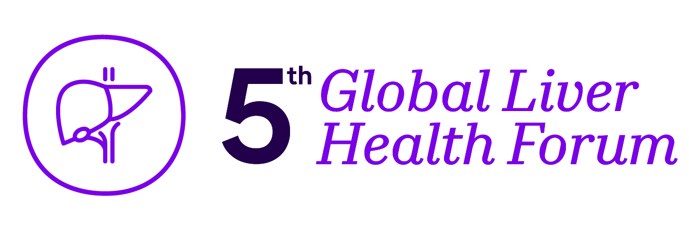
MAFLD in Focus: Unveiling Insights from China's RELIEF Study;
Insight from APASL 2024
Professor Wei Lai
Director
Hepatopancreatobiliary Center, Beijing Tsinghua Changgung Hospital
Tsinghua University, China
MAT-GLB-2402702-v-1.0 │ Date of approval: May 2024

Slide 3


Disclosures
Research grant: Abbvie, Bristol-Myers Squibb, Gilead, Pfizer and Sanofi
Consulting: Abbvie, Bristol-Myers Squibb, Gilead, MSD, Novartis, Novo Nordics, Pfizer, Roche and VirsiRNA

Slide 4

Outline
Treatments aim to achieve hard efficacy endpoints in fibrosis and remain a focus in treatment strategies of MAFLD
1
Synthesize and integrate key findings from RELIEF study into the broader context of MAFLD
2
Discussion on the clinical implications, research gaps, and potential translational applications of the insights gained from the RELIEF study
3
MAFLD, metabolic dysfunction-associated fatty liver disease.

Slide 5

MAFLD is a multisystemic disease characterized by hepatic steatosis in the presence of metabolic risk factors
The term steatohepatitis was felt to be an important pathophysiological concept that should be retained
In 2023, international experts achieved a consensus to replace the stigmatising term NAFLD by MASLD and NASH by MASH⁵
NAFLD, introduced to a broader audience in 1980, is clinical entity from fatty liver disease that is not caused by increased alcohol intake¹
In 2020, a panel of experts suggested adopting MAFLD over NAFLD to describe liver conditions linked to dysmetabolic diseases, irrespective of alcohol intake or other contributing factors²⁻⁴
Steatotic Liver Disease (SLD)⁵
MASLD
ALD
Specific aetiology SLD
Cryptogenic SLD
MetALD
(MASLD and increased alcohol intake
MASLD
predominant
ALD
predominant
DILI
MASH
140/210
210
280
350/420
Weekly alcohol intake (g)
Monogenic diseases
MASLD
predominant
ALD
predominant
Miscellaneous
20/30
30
40
50/60
Average daily alcohol intake (g)
NAFLD and MAFLD are used interchangeably in the given context.
1) Alsawat K et al. J Clin Transl Hepatol. 2020;8(3):354–355; 2) Pipitone RM et al. Ther Adv Endocrinol Metab. 2023;14:20420188221145549;
3) García-Compeán D et al. Ann Hepatol. 2022;27(6):100765; 4) Eslam M et al. Gastroenterol. 2020;158(7):1999–2014; 5) Rinella ME et al. Hepatol. 2023;78(6):1966-1986.
ALD, alcohol related liver disease; DILI, drug-induced liver injury; MAFLD, metabolic dysfunction-associated fatty liver disease; MASH, metabolic-dysfunction associated steatohepatitis; NASH, nonalcoholic steatohepatitis; MASLD, metabolic-dysfunction associated steatotic liver disease; NAFLD, non-alcoholic fatty liver disease; SLD, steatotic liver disease.

Slide 6

Diagnosis and management for MAFLD
Management by multidisciplinary team: Hepatologist, diabetologist, dietician, endocrinologist, cardiologist
High-risk groups
for the development
of MAFLD
Prevention of CV disease
Lifestyle intervention
Structured weight loss programs
CV risk reduction
Diabetes care
Atherogenic dyslipidemia
Hypertension care
Prediabetes or T2DM
MAFLD
Obesity and/or
≥2 cardiometabolic risk factors
Hepatic steatosis
(on imaging) or ↑AST or ALT
(>30 IU/L)
Prevention of cirrhosis
Fibrosis Risk Stratification
Low risk
Indeterminate risk
High risk
Cusi K et al. Endocr Pract. 2022;28:528–562.
ALT, alanine aminotransferase; AST, aspartate aminotransferase; CV, cardiovascular; IU, international units; MAFLD, metabolic dysfunction-associated fatty liver disease;
T2DM, type 2 diabetes mellitus.

Slide 7
Should we pay attention to FIB-4?
The FIB-4 index, a NIT is the first triaging tool for excluding advanced fibrosis because of its accuracy and simplicity¹
The FIB-4 index must help in establishing a referral pathway from primary care clinicians to hepatologists
Fibrosis detection²
FIB-4
Scoreª | Severity
<1.3 | Advanced fibrosis excluded
1.3–2.67 | Further investigation
>2.67 | F3–F4
F3–F4 severity indicates the presence of advanced fibrosis
ªFIB-4 scores for 36–64-year-olds; an alternative scoring system is available for patients aged ≥65 years.
1) Sumida Y et al. Life (Basel). 2021;11(2):143; 2) Binet Q et al. Acta Gastroenterol Belg. 2022;85(2):346–357.
FIB-4, fibrosis-4; NIT, non-invasive test.

Slide 8
Treatment plan for MAFLD
Rx⁶
Bariatric
surgery⁵
Liver-directed
pharmacotherapy⁴
Liver injury agents³
(EPL, Silymarin bicyclol,
glycyrrhizin preparations, others)
Targeting comorbid diseases:
diabetes, hyperlipidemia, obesity²
Lifestyle modification:
diet & exercise¹
1) Park YE et al. Korean J Intern Med. 2018;33:64–74; 2) Finck BN. Diabetes. 2018;67(12):2485–2493;
3) Chinese Society of Hepatology, Chinese Medical Association. Chinese J of Hepatol; 2024:32(5); 4) Dajani A et al. Saudi J Gastroenterol. 2016;22(2):91–105;
5) Laursen TL et al. World J Hepatol. 2019;11:138–149; 6) Kingma JS et al. Br J Clin Pharmacol. 2021;87(12):4560-4576.
EPL, essential phospholipids; MAFLD, metabolic dysfunction-associated fatty liver disease; Rx, prescription medicine(s).

Slide 9



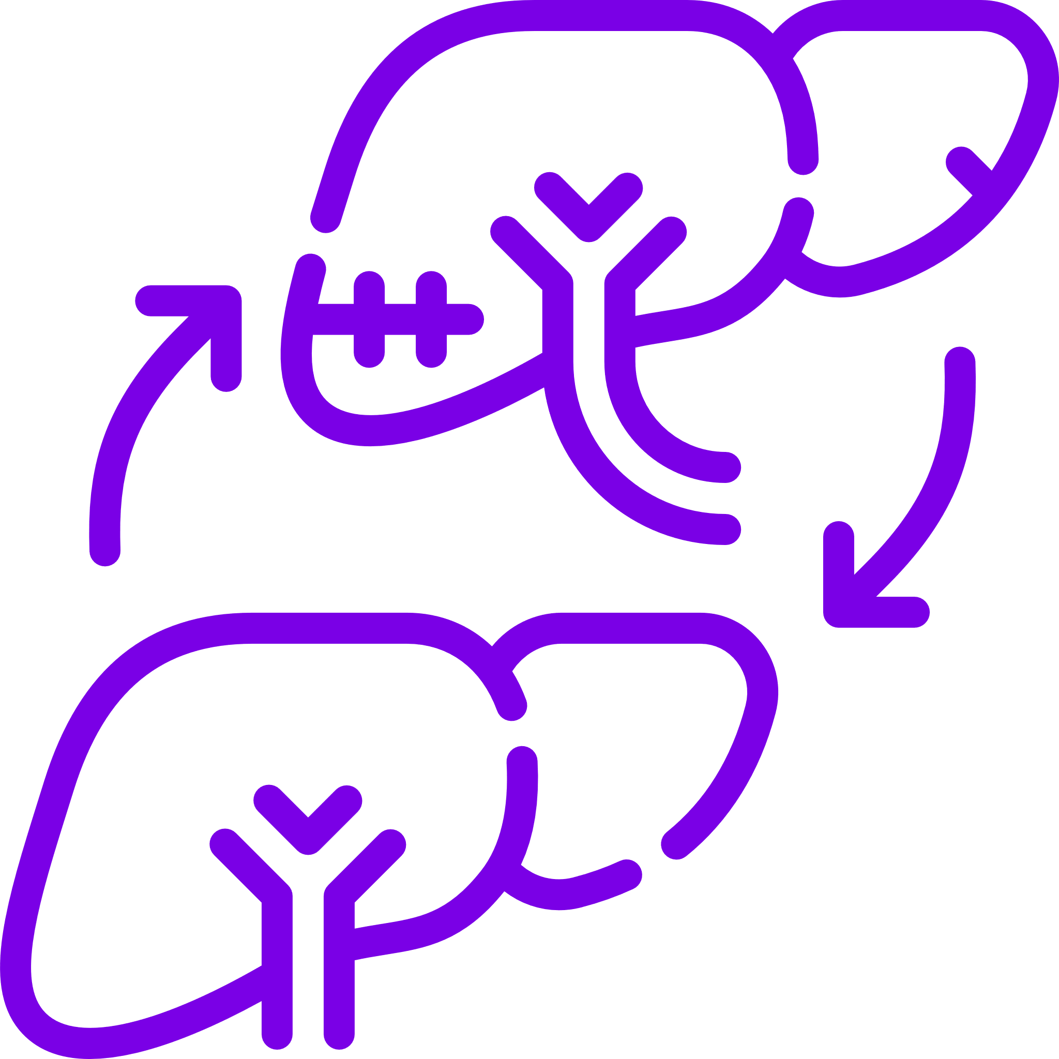

MAFLD treatment recommendations: Chinese guidelines
Lifestyle modifications
Cornerstones of the treatment
of MAFLD
Pharmacological treatment for MAFLD
We can consider therapy for liver injury in patients with the following MAFLD types:
MASH and/or significant fibrosis confirmed by liver biopsy
Persistently elevated liver function enzyme or NIT indicating progressive
fibrosis risk
Concomitant drug-induced liver injury, autoimmune hepatitis, chronic viral hepatitis, or other liver injury
Hepatoprotective drugs may be considered for steatohepatitis and fibrosis therapy like silymarin (bin), EPL, bicyclol, glycyrrhizin preparations, etc
Surgical treatment
For obesity (metabolic surgery such gastric bypass, sleeve gastric surgery, duodenal translocation and adjustable gastric lacing), MetS and T2DM is effective to improve liver histopathology in patients with MASH
Hepatoprotective drugs
EPL
Liver transplantation
MASH-related cirrhosis, HCC, and chronic acute liver failure
Behavioral therapy
(diet, avoid smoking, alcohol, sedentary lifestyle)
Glucose-lowering drugs
Lipid-lowering drugs
Drug
therapy
Antihypertensive drugs
Sport therapy (exercise)
Antiplatelet
aggregation drugs
Weight-loss drugs
Chinese Society of Hepatology, Chinese Medical Association. Chinese J of Hepatol; 2024:32(5).
EPL, essential phospholipids; HCC, hepatocellular carcinoma; MAFLD, metabolic dysfunction-associated fatty liver disease; MASH, metabolic dysfunction-associated steatohepatitis; MetS, metabolic syndrome; NIT, noninvasive test; EPL, essential phospholipids; T2DM, type 2 diabetes mellitus.

Slide 10
Reduction in ALT and AST from baseline has been seen with EPL
Liver enzyme levels and aminotransferase activity are insensitive tools to follow changes in liver histological features in NAFLD¹
A significantly greater reduction in ALT and AST levels was achieved with EPL + AD therapy compared with AD therapy alone²
Change in ALT (IU/L) levels from baseline²
Change in AST levels from baseline (U/L)²
Author (year)
Mean difference
MD [95% CI]
Author (year)
Mean difference
MD [95% CI]
Wu Y. (2009)
–12.00 [–17.50, –6.50]
Wu Y. (2009)
–17.00 [–19.63, –14.37]
Yin D. (2000)
–15.36 [–16.33, –14.39]
Sas E. (2013)
–12.50 [–13.54, –11.46]
Li Z. (2013)
–3.84 [–11.17, 3.49]
RE Model (Chi²=9.75,
df=1, p<0.00001,
I²=90%)
RE Model (Chi²=10.55, df=2, p=0.0003, I²=81.0%)
–11.28 [–17.33, –5.23]
–14.58 [–18.98, –10.18]
– 20
–15
–10
–5
0
5
– 20
–18
–16
–14
–12
–10
0
10
Total n=371
Mean treatment
duration: 1.97 months
Total n=202
Mean treatment
duration: 4.76 months
Favours EPL
Favours control
Favours EPL
Favours control
1) Charatcharoenwitthaya P et al. Dig Dis Sci. 2012;57(7):1925–1931; 2) Dajani A et al. World J Clin Cases. 2020;8:5235–1949.
AD, anti-diabetic treatment; ALT, alanine aminotransferase; AST, aspartate aminotransferase; CI, confidence interval; df, degrees of freedom; EPL, essential phospholipids;
MAFLD, metabolic dysfunction-associated fatty liver disease; MD, mean difference; NAFLD, non-alcoholic fatty liver disease; RE, random effects.

Slide 11
RWE: Highlights from the China RELIEF study

Slide 12

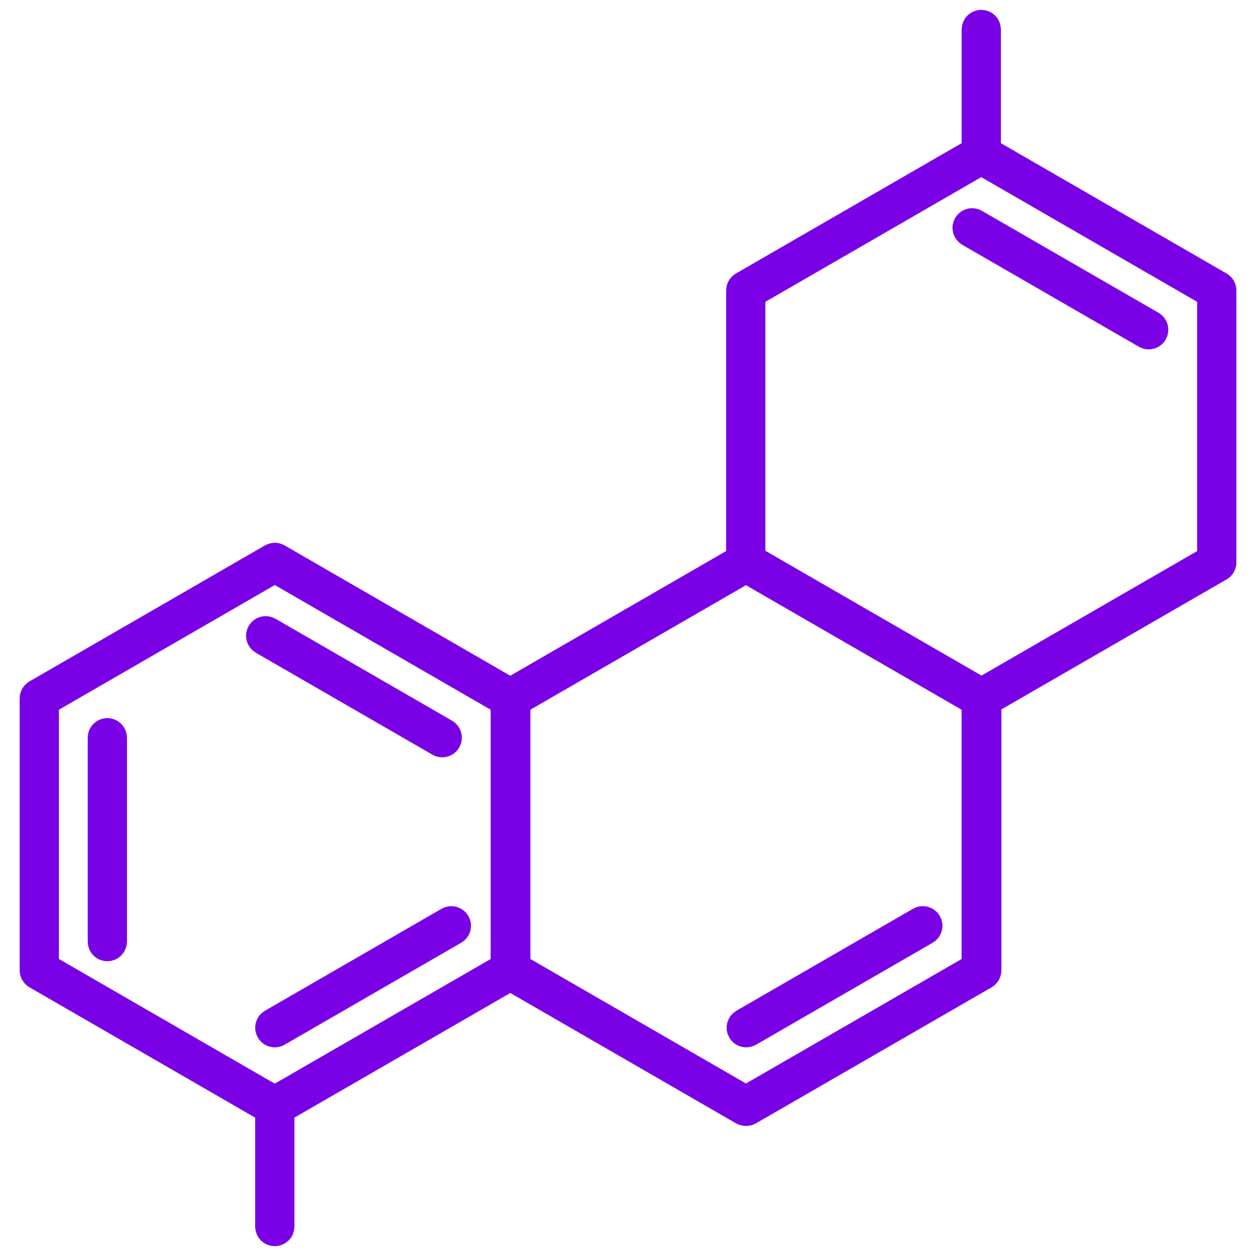



RELIEF study
MAFLD is highly prevalent in China and is more often linked to metabolic disorders¹
Number of NAFLD patients are predicted to reach ~315 million by 2030 in China²
Unfortunately, facing such a severe public health burden, MAFLD as a new concept still lacks direct and strong evidence for effective pharmacotherapy in China
EPL (essential phospholipids) has a role in protecting liver function, stabilizing glucose control, and lowering blood lipids^{3,4}
However, no clinical evidence supporting its role in delaying progression of liver fibrosis among MAFLD patients
Hence there is a huge unmet need to prevent liver damage by delaying progression of liver fibrosis and thereby reduce liver failure
and death
Study objective⁵
To evaluate the effectiveness of EPL capsule and its association in delaying progression of liver fibrosis of patients with MAFLD in China
1) Eslam M et al. J Hepatol. 2020;73(1):202–209; 2) Estes C et al. J Hepatol. 2018;69(4):896–904; 3) Maev IV et al. BMJ Open Gastro. 2020;7:e000368;
4) Dajani AI et al. World J Clin Cases. 2020;8(21):5235-5249;
5) Yi Pan et al. Clinical features and real-world treatment patterns of MAFLD patients in China. Hepatol Int. 2024;18(S555):P-0318.
EPL, essential phospholipids; MAFLD, metabolic dysfunction-associated fatty liver disease.

Slide 13

Study design: Multicenter, retrospective observational (BRAINPOWER database)
Patients diagnosed as MAFLD
(N = 82,908)
Eligible MAFLD
Patients
(n = 70,488)
EPL (mono-therapy group)
PSM (1:1) matching by age, sex, T2DM, hypertension, hyperlipidaemia and CVD
Inclusion criteria
Age ≥18 years
Diagnosed as T2DM
Or had 2 or more risk factors for metabolic abnormalities
BP: ≥130/85 mmHg
TG: ≥1.7 mmol/L
HDL-C: Men <1.0 and women
<1.3 mmol/L
Prediabetes: FPG 5.6-6.9 mmol/L or PPG 7.8-11.0 mmol/L or HbA1c 5.7%-6.4%
hs-CRP: >2mg/L
HOMA-IR score: ≥2.5
Exclusion criteria
Patients with liver cirrhosis, viral hepatitis, liver cancer, extrahepatic malignancies
Control (Non-hepatoprotective treatment group)
Endpoints
Primary: Change of FIB-4 scoreª from baseline at 12 weeks and 24 weeks, respectively between the
two groups
Secondary: Change of liver enzyme from baseline at 12 weeks and 24 weeks, respectively between the two groups
Exploratory: Change of parameters of blood lipids from baseline at 12 weeks and 24 weeks respectively between the two groups in subgroup of patients with hyperlipidaemia
January 1st, 2020
Study period
December 31st, 2022
Baseline period
Index date^{b}
12 weeks ± 18 day
24 weeks ± 36 days
Follow-up period 24 weeks ± 36 days
ªFIB-4 score is recommended by guidelines for evaluating liver fibrosis of MAFLD patients. ^{b}Tested-drugs group: The date of firstly prescribed of tested drugs; Non-hepatoprotective treatment group: the index date was selected as the first eligible patients encounter/service/visit dates that meet the inclusion and exclusion criteria.
Yi Pan et al. Clinical features and real-world treatment patterns of MAFLD patients in China. Hepatol Int. 2024;18(S555):P-0318.
BP, blood pressure; CVD, cardiovascular disease; EPL, essential phospholipids; FIB-4, fibrosis-4; FPG, fasting plasma glucose; HDL-C, high-density lipoprotein cholesterol;
HOMA-IR, Homeostatic Model Assessment for Insulin Resistance; hs-CRP, high-sensitivity C-reactive protein; MAFLD, metabolic dysfunction-associated fatty liver disease;
PPG, postprandial plasma glucose; PSM, propensity score matching; TG, triglycerides; T2DM, type 2 diabetes mellitus.

Slide 14
According to the 2020 APASL diagnostic criteria for MAFLD¹ a total of 82,908 were identified²
Demographic characteristics | MAFLD patients （N=82,908）
Age, year n (%)
<30 | 4059 (4.90)
30-39 | 11499 (13.87)
40-49 | 16543 (19.95)
50-59 | 24332 (29.35)
60-69 | 16196 (19.53)
≥70 | 10279 (12.40)
Sex, n (%)
Female | 29626 (35.73)
Male | 53282 (64.27)
Extrahepatic manifestations | MAFLD patients （N=82,908), n (%)
CVD | 43580 (52.56)
Ischemic Heart Disease | 15,917 (19.20)
Stroke | 9,041 (10.90)
Heart Failure | 7,359 (8.88)
T2DM | 39591 (47.75)
CKD | 7166 (8.64)
Cholelithiasis | 6874 (8.29)
Extrahepatic malignancies | 5421 (6.54)
Osteoporosis | 4239 (5.11)
Thyroid dysfunction | 2708 (3.27)
Obstructive sleep apnea | 1366 (1.65)
Cognitive disorders | 472 (0.57)
Polycystic ovarian syndrome | 272 (0.33)
Psoriasis | 12 (0.01)
1) Eslam M et al. Hepatol In. 2020;14(6):889–919; 2) Yi Pan et al. Clinical features and real-world treatment patterns of MAFLD patients in China. Hepatol Int. 2024;18(S555):P-0318.
APASL, Asian Pacific Association for the Study of the Liver; CKD, chronic kidney disease; CVD, cardiovascular disease; MAFLD, metabolic dysfunction-associated fatty liver disease;
T2DM, type 2 diabetes mellitus.

Slide 15
MAFLD with high burden of liver fibrosis, 45.7% patients at intermediate to high risk
Median FIB-4 index is 1.22
(IQR, 0.83–1.85) of total patients with MAFLD
Nearly, 45.7% of patients were at intermediate-high risk, as determined by liver fibrosis (≥F2) assessed using FIB-4
In the T2DM, hypertension, and hyperlipidaemia subgroups, the proportion of patients at intermediate- high risk were 50.14%, 52.91%, and 32.17%, respectively
Comorbidities
Yi Pan et al. Clinical features and real-world treatment patterns of MAFLD patients in China. Hepatol Int. 2024;18(S555):P-0318
FIB-4, fibrosis-4; IQR, Interquartile range; MAFLD, metabolic dysfunction-associated fatty liver disease; T2DM, type 2 diabetes mellitus.

Slide 16
EPL significantly reduced the FIB-4 index after 24 weeks of treatment
  Primary endpoint
  Variables for PSM analysis matching: age, sex, T2DM, hypertension, hyperlipidaemia and CVD
  The FIB-4 index adjusted for covariates was significantly reduced in the EPL-treated group than control
  (non-hepatoprotective-treated) group by using ANCOVA
  (-0.12±0.62 for EPL vs. 0.11±0.50 for control, P = 0.034)
FIB – 4 index
P = 0.034
N=42*
These findings indicate the probable beneficial effects of EPL on fibrosis risk reduction among the patients with MAFLD
*Data were compared using analysis of covariance (ANCOVA) between EPL and control groups.
Yi Pan et al. Clinical features and real-world treatment patterns of MAFLD patients in China. Hepatol Int. 2024;18(S555):P-0318.
CVD, cardiovascular disease; EPL, essential phospholipids; FIB-4, fibrosis-4; PSM, propensity score matching; T2DM, type 2 diabetes mellitus.

Slide 17
Decrease in ALT/AST at 12 weeks with EPL monotherapy
  Secondary endpoint
  Variables for PSM analysis matching: age, sex, T2DM, hypertension, hyperlipidaemia and CVD
  The AST adjusted for covariates was significantly reduced in the EPL-treated group than control (non-hepatoprotective-treated) group by using ANCOVA (-6.25 ± 15.18 for EPL vs. -2.41 ± 15.40 for control, P = 0.0392)
  EPL showed a decreasing trend in ALT levels from baseline to 12- and 24-weeks vs. control group, although not statistically significant
Change of AST
Change of ALT
12 weeks
24 weeks
12 weeks
24 weeks
P = 0.0392
N=106*
P = 0.3254
N=58*
P = 0.2696
N=107*
P = 0.2888
N=61*
*Data were compared using analysis of covariance (ANCOVA) between EPL and control groups.
Yi Pan et al. Clinical features and real-world treatment patterns of MAFLD patients in China. Hepatol Int. 2024;18(S555):P-0318.
ALT, alanine transaminase; AST, aspartate transaminase; CVD, cardiovascular disease; EPL, essential phospholipids; LFT, liver function tests; PSM, propensity score matching; T2DM, type 2 diabetes mellitus.

Slide 18
Reduction in blood lipid levels at 12 and 24 weeks and TBil levels at 12 weeks with EPL monotherapy
  Exploratory endpoint
  Variables for PSM analysis matching: age, sex, T2DM, hypertension, hyperlipidaemia and CVD
  The TBil adjusted for covariates was significantly reduced in the EPL-treated group than control (non-hepatoprotective-treated) group by using ANCOVA (12 weeks: -1.97±5.93 for EPL vs. 0.23±6.12 for control, P = 0.0122; 24 weeks: -3.39±5.65 for EPL vs. 1.24±3.94 for control, P = 0.0010)
  During the 12-week treatment period, EPL group had a significantly larger reduction of LDL-C levels compared to control
  (12 weeks: -0.23±0.71 for EPL vs. 0.13±0.67 for control, P = 0.0442)
Change of TBil
Change of LDL-C
12 weeks
24 weeks
12 weeks
24 weeks
P = 0.0122
N=98*
P = 0.0010
N=52*
P = 0.0442
N=71*
P = 0.4444
N=42*
*Data were compared using analysis of covariance (ANCOVA) between EPL and control groups.
Yi Pan et al. Clinical features and real-world treatment patterns of MAFLD patients in China. Hepatol Int. 2024;18(S555):P-0318.
CVD, cardiovascular disease; EPL, essential phospholipids; LDL-C, low-density lipoprotein cholesterol; PSM, propensity score matching; T2DM, type 2 diabetes mellitus;
TBil; total bilirubin.

Slide 19





Clinical implications
Early Screen: Screen for fibrosis risk earlier in MAFLD patients, and FIB-4 is the first non-invasive examination index recommended by AACE/AASLD guideline
Long-term use: The improvement of liver fibrosis needs long-term intervention, and clinical observation takes at least 6 months to 1 year
Decrease lipids: Treatment with EPL for 3 months could decrease lipids in MAFLD patients
Early intervention: Early intervention could reverse or delay the progression of liver fibrosis/cirrhosis
High risk: Diabetes, cardiovascular disease will accelerate the progression of fatty liver to hepatitis and cirrhosis (the risk will increase by more than 2-fold)
AACE, American Association of Clinical Endocrinologists; AASLD, American Association for the Study of Liver Diseases; EPL, essential phospholipids; FIB-4, fibrosis-4;
MAFLD, metabolic dysfunction-associated fatty liver disease.

Slide 20
Thank you

Slide 21
Back up slide

Slide 22
Patients with EPL mono-therapy enrolled for analysis
MAFLD patients identified
n=82,908
Non-hepatoprotective (control group)
MAFLD patients received EPL
n=7,093
MAFLD patients received DG
n=2,753
MAFLD patients received silymarin
n=3,819
Exclude
Inclusion MAFLD patients received EPL
n=5,862
Patients with liver cirrhosis, viral hepatitis, liver cancer, extrahepatic malignancies
n=1,231
EPL monotherapy more than 12 weeks
n=1,127
EPL monotherapy more than 24 weeks
n=523
Follow-up 12 wks ± 18 days
Follow-up 24 wks ± 36 days
With complete records of tested indicators
FIB-4: n=56
AST: n=106
ALT: n=107
With complete records of tested indicators
FIB-4: n=42
AST: n=58
ALT: n=61
ALT, alanine transaminase; AST, aspartate transaminase; DG, diammonium glycyrrhizinate; EPL, essential phospholipids; FIB-4, fibrosis-4; MAFLD, metabolic dysfunction-associated fatty liver disease.

