Slide 1
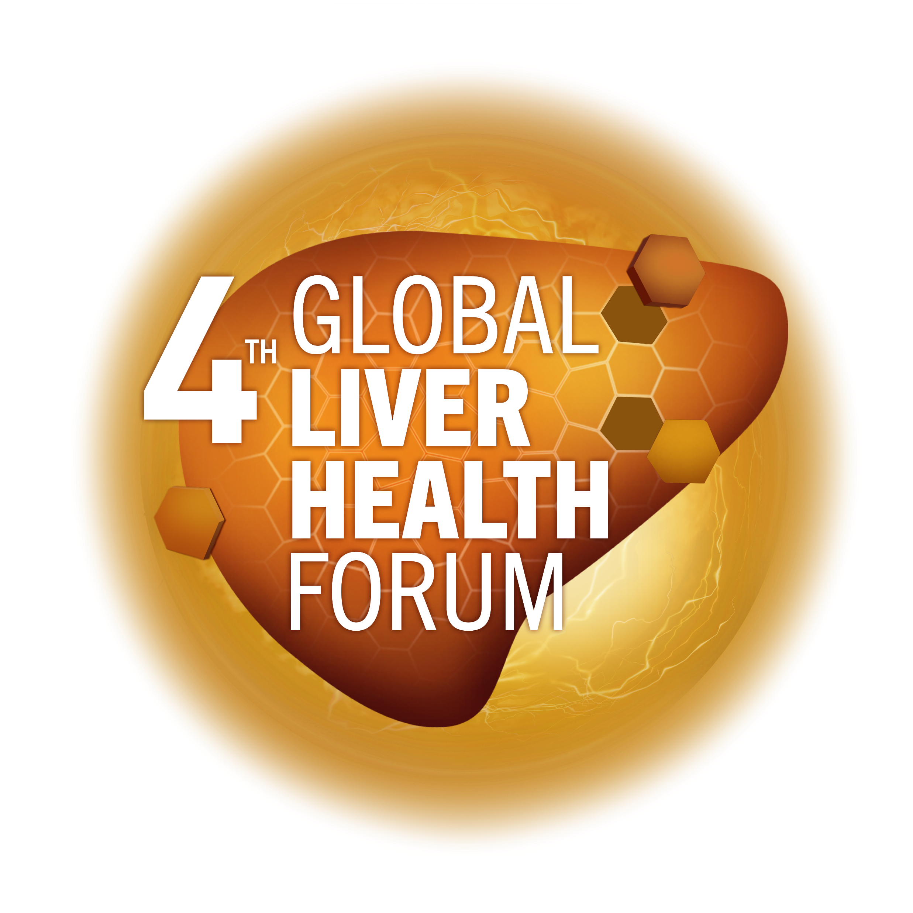
Tools for early
detection of metabolic risk in MAFLD
Prof Jose Sollano
MAT-GLB-2302798-v-1.0 │ Date of approval: June 2023

Slide 2
Disclosures
Speaker Bureau of Abbott, A. Menarini, Eisai, Ferring, J&J, Sanofi, Takeda
Research grant from Cristcot

Slide 3
MAFLD increases the risk of subclinical atherosclerosis, CAD and cardiovascular events
Meta-analysis (14 studies; N=2,932)¹
Aim: To evaluate MAFLD influence on subclinical atherosclerosis and CAD*
10 studies evaluated patients with subclinical atherosclerosis
4 studies evaluated patients with CAD†
Results:
In patients with MAFLD vs those without MAFLD,‡ ,there was a higher prevalence of:
CIMT: (35.1% vs 21.8%; p<0.0001), OR 2.04 (95% CI: 1.65–2.51)
Carotid plaques: OR 2.82 (95% CI: 1.87–4.27)
CAD: (80.4% vs 60.7%; p<0.0001), OR 3.31 (95% CI: 2.21–4.95)
Cross-sectional study (N=5,121)²
Aim: To evaluate coronary plaques by coronary CT angiography in asymptomatic population with no history of coronary artery disease
US-diagnosed MAFLD in 38.6% of participants
Results:
In patients with MAFLD vs those without MAFLD, after adjustment for cardiovascular risk factors, there was a higher prevalence of:
Any atherosclerotic plaque:
OR 1.18 (95% CI: 1,03-1.3%; p=0.016)
Non-calcified plaque:
OR 1.27 (95% CI: 1.08-1.48; p=0.003)
*Diagnosis of MAFLD was defined using US liver biopsy; †Defined as when patients showed at least 50% stenosis at one or more coronary artery; ‡Patients with diagnosis of MAFLD using US or biopsy, CIMT, presence of plaques, and fatty liver. CAD, coronary artery disease; CI, confidence interval; CIMT, carotid intima-media thickness; HR, hazard ratio; MAFLD, metabolic-associated fatty liver disease; OR, odds ratio; US, ultrasound
1. Ampuero J, et al. Rev Esp Enferm Dig 2015;107:10–16; 2. Lee SB, et al. J Hepatol 2018;68:1018–1024.

Slide 4
Increased mortality is also observed in patients with MAFLD vs those without MAFLD
Medical records were used to identify patients diagnosed with MAFLD (N=420) between 1980–2000
Overall survival was compared with the general population of the same sex and age
Mean follow-up was 7.6 ± 4.0 years (range, 0.1–23.5); 3,192 person-years follow-up
100
General
population
80
MAFLD
3 major causes of death in MAFLD | Patients, % (n=53)
Cancers | 28
Cardiovascular events* | 25
Liver disease including HCC† | 13
60
Survival (%)
40
10-year survival
General population: 87%
MAFLD population: 77%
Log-rank p<0.005
20
0
2
4
6
8
10
12
14
16
Years
*Specifically ischemic heart disease. †Other diseases included in “liver disease” were liver failure and variceal haemorrhage. HCC, hepatocellular carcinoma; MAFLD, metabolic-associated fatty liver disease
Adams LA, et al. Gastroenterology 2005;129:113–21
Notes:
NAFLD, nonalcoholic fatty liver disease.

Slide 5
Decreased survival has been observed in patients with NAFLD/NASH versus those without
Cohort study re-evaluating survival and cause of death in patients diagnosed with NAFLD (n=129)* compared with a matched reference population (n=44,745) of the same age and sex.
Median follow-up (SD) 13.7 (1.3) years; 25 deaths (19.4%) during follow-up
Cause of death (%) | Patients with NASH (n=71) | Reference population (n=44,745) | p value
Liver failure/HCC (n=7) | 2.8 | 0.2 | p=0.04
CVD (n=14) | 15.5 | 7.5 | p=0.04
Extrahepatic cancers (n=5) | 5.6 | – | –
Overall survival compared with reference population (%)
100
Ref. population
100
Ref. population
100
Ref. population
80
NAFLD
80
80
Non-NASH
60
60
NASH
60
40
40
40
20
20
20
0
0
0
0
5
10
15
20
0
5
10
15
20
0
5
10
15
20
Time (years)
Time (years)
Time (years)
*NAFLD was diagnosed by biopsy. ALT, alanine transferase; CVD, cardiovascular disease; HCC, hepatocellular carcinoma; MAFLD, metabolic-associated fatty liver disease; NAFLD, non-alcoholic fatty liver disease; NASH, non-alcoholic steatohepatitis; USG, ultrasonography; SD, standard deviation
Ekstedt M, et al. Hepatology 2006;44:865–73

Slide 6
Patients with MAFLD have a higher risk of fatal and/or non-fatal CVD events than those without MAFLD
Meta-analysis of 16 observational, prospective and retrospective studies¹
N=34,043 adults (36.3% with NAFLD) and approximately 2,600 CVD outcomes (>70% CVD deaths) over a median period of 6.9 years¹
Incidence for progression of MAFLD and NASH (OR 2.58)²
Incidence rate per 1,000 person-years | CVD mortality | Liver-specific mortality | All-cause mortality | Incidence HCC
MAFLD | 4.79 | 0.77 | 15.44 | 0.44
NASH | – | 11.77 | 25.56 | 5.29
CVD, cardiovascular disease; HCC, hepatocellular carcinoma; MAFLD, metabolic-dysfunction-associated fatty liver disease; NASH, non-alcoholic steatohepatitis; OR, odds ratio
1. Targher G, et al. J Hepatol 2016;65:589–600; 2. Younossi Z, et al. Hepatology 2016;64:73–84

Slide 7
Tools for the diagnosis of MAFLD
Method | Sensitivity (%) | Specificity (%) | Comments
Liver enzymes GGT¹ | 63 | 65 | Not reliable for diagnosis
Ultrasound² Any degree³ Cut-off ≥20%³ | 85 61 100 | 94 100 90 | Inexpensive and accessible, but cannot distinguish fibrosis/steatosis
CT without contrast⁴ Cut-off >30% | 79 | 97 | Better in morbid obesity, but affected by iron, fibrosis, and less accurate with less steatosis
MRI⁵ Cut-off PDFF 6.4%, grade ≥1 Cut-off PDFF 17.4%, grade ≥2 | 86 64 | 83 96 | Detects mild steatosis, quantifies hepatic fat most accurately
MRS⁶ Cut-off ≥5% Cut-off >33% | 90–96 92–100 | 87–100 92–97
Liver biopsy⁷ |  |  | Gold standard, but invasive and subject to sampling error
CT, computed tomography; GGT, gamma-glutamyl transferase; MRI, magnetic resonance imaging; MRS, magnetic resonance spectroscopy; MAFLD, metabolic associated fatty liver disease; PDFF, proton density fat fraction
1. Alam S, et al. BSMMU J 2015;8:61–7; 2. Hernaez R, et al. Hepatology 2011;54:1082–90; 3. Dasarathy S, et al. J Hepatol 2009;51:1061–7; 4. Rogier J, et al. Liver Transpl 2015;21:690–5; 5. Tang A, et al. Radiology 2015;274:416–25; 6. McPherson S, et al. J Hepatol 2009;51:389–97; 7. Sumida Y, et al World J Gastroenterol 2014;20:475–85

Slide 8
Diagnostic accuracy of transient elastography for fibrosis in patients with MAFLD
A systematic review and meta-analysis
VCTE (kPa) | Studies, n (patients; n) | Prevalence, % (95% CI) | Cut-off range | sAUC (95% CI) | sSe, % (95% CI) | sSp, % (95% CI)
F≥1 | 14 (1064) | 67 (23–94) | 5.3–8.2 | 0.82 (0.78–0.85) | 78 (73–82) | 72 (65–79)
F≥2 | 37 (2763) | 45 (5–77) | 3.8–10.2 | 0.83 (0.80–0.87) | 80 (76–83) | 73 (68–77)
F≥3 | 44 (4219) | 25 (5–54) | 6.8–12.9 | 0.85 (0.83–0.87) | 80 (77–83) | 77 (74–80)
F=4 | 22 (337) | 9 (3–31) | 6.9–19.4 | 0.89 (0.84–0.93) | 76 (70–82) | 88 (85–91)
MAFLD, metabolic associated fatty liver disease; CI, confidence interval; sAUC, specificity and area under the curve; sSe, summary sensitivity; sSp, summary specificity; TE, transient elastography; VCTE, vibration-controlled transient elastography
Selvaraj EA, et al. J Hepatol 2021;75:770–85

Slide 9
Quantitative assessment of liver fat by TE with CAP
(FibroScan®)
TE-CAP: S0–2 vs S3
HSROC with confidence and predictive ellipses
1.0
x
x
Observed data
1.0
x
x
Observed data
x
x
Summary operating point
Sensitivity 0.79 (0.72–0.84)
Specificity 0.62 (0.47–0.75)
x
x
Summary operating point
Sensitivity 0.85 (0.75–0.92)
Specificity 0.57 (0.47–0.66)
x
x
x
x
x
x
x
x
x
x
x
x
SROC curve
AUC 0.75 (0.71–0.79)
SROC curve
AUC 0.80 (0.76–0.83)
0.5
0.5
Sensitivity
Sensitivity
95% confidence ellipse
95% confidence ellipse
95% prediction ellipse
95% prediction ellipse
0
AUROC 0.75 (0.71–0.79)
0
AUROC 0.80 (0.76–0.83)
1.0
0.5
0
1.0
0.5
0
Specificity
Specificity
TE with CAP had the highest diagnostic accuracy for detecting the stage of steatosis ≥S1, with a total sensitivity of 0.82 (95% CI: 0.79–0.84), specificity 0.83 (0.80–0.86) and HSROC 0.85
The diagnostic accuracy was relatively low for S3 detection, with an overall sensitivity of 0.79 (0.77–0.81), a specificity of 0.56 (0.53–0.58), and an HSROC 0.79
AUC, area under the curve; AUROC, area under the receiver operating curve; CAP, controlled attenuation parameter; CI, confidence interval; HSROC, hierarchical summary receiver operating characteristic curves; SROC, summary receiver operating characteristic curves; TE, transient elastography
Gu Q et al. Eur J Clin Invest 2021;51:e13446

Slide 10
Quantitative assessment of liver fat by MRI-PDFF
Imaging-derived proton density fat fraction
MRI-PDFF had the highest diagnostic accuracy for stage 1 detection,
with an overall sensitivity of
0.91 (95% CI: 0.80–0.97), a specificity of 0.93 (0.90–0.96), and HSROC 0.97
MRI-PDFF: S0–2 vs S3
SROC with confidence and predictive ellipses
1.0
x
x
x
x
x
Observed data
x
Summary operating point
Sensitivity 0.71 (0.62–0.79)
Specificity 0.89 (0.86–0.92)
x
x
x
x
SROC curve
AUC 0.90 (0.87–0.92)
0.5
x
Sensitivity
The diagnostic accuracy was the same for detecting ≥S2 and ≥S3 with HSROC values ​​of 0.93 and 0.91, respectively
95% confidence ellipse
95% prediction ellipse
AUROC 0.90 (0.87–0.92)
0
1.0
0.5
0
Specificity
AUC, area under the curve; AUROC, area under the receiver operating curve; CI, confidence interval; HSROC, hierarchical summary receiver operating characteristic curves; MRI-PDFF, magnetic resonance imaging-proton density fat fraction
Gu Q, et al. Eur J Clin Invest 2021;51:e13446

Slide 11
EPL for MAFLD associated with metabolic syndrome
A systematic review and network meta-analysis
Results of a direct meta-analysis of RCTs comparing the effect of treatment with EPL + AD vs AD therapy alone¹:
Change in ALT: three studies^{2–4} (N=371); mean treatment duration, 1.97 months
A
Author (year)
ALT (U/I)
MD (95% CI)
A
Wu Y. (2009)²
–12.00 (–17.50, –6.50)
Yin D. (2000)³
–15.36 (–16.33, –14.39)
Li Z. (2013)⁴
–3.84 (–11.17, 3.49)
RE Model (Q=10.55, df=2, p=0.01, I²=81.0%)
–11.28 (–17.33, –5.23)
p<0.0003
–20
–15
–10
–5
0
5
Mean difference
Change in TG levels: four studies^{2–5} (N=445);
mean treatment duration, 2.1 months
B
Author (year)
TG (mg/dl)
MD (95% CI)
Sun C. (2008)⁵
–33.63 (–46.94, –20.32)
B
Wu Y. (2009)²
–46.90 (–60.30, –33.50)
Yin D. (2000)³
–73.45 (–101.66, –45.24)
Li Z. (2013)⁴
–77.88 (–144.66, –11.09)
RE Model (Q=7.69, df=3, p=0.05, I²=61.0%)
–49.29 (–66.38, –32.20)
p<0.0001
–150
–100
–50
0
Mean difference
Change in total cholesterol levels: three studies^{2,3,5} (N=359); mean treatment duration, 2.27 months
C
Author (year)
Cholesterol (mg/dl)
MD (95% CI)
C
Sun C. (2008)⁵
–23.20 (–34.22, –12.19)
Wu Y. (2009)²
–35.58 (–39.31, –31.84)
Yin D. (2000)³
–26.68 (–36.49, –16.87)
RE Model (Q=6.40, df=2, p=0.04, I²=68.8%)
–29.74 (–36.02, –21.45)
p<0.0001
–40
–35
–30
–25
–20
–15
–10
Favours EPL + AD
Mean difference
Favours AD alone
AD, anti-diabetic; ALT, alanine aminotransferase; CI, confidence interval; EPL, essential phospholipids; MD, mean difference; NAFLD, non-alcoholic fatty liver disease; RCT, randomised controlled trial; RE, random effects; TG, triglycerides
1. Dajani A, et al. World J Clin Cases 2020;8:5235–5249; 2. Wu Y. J TCM Univ Hunan 2009;29:41–42; 3. Yin D, Kong L. Med JQ Illu 2000;15:277–8;
4. Li Z. J Tradit Chinese Med 2013;31:10–1; 5. Sun C, et al. Clin Focus 2008;23:1272–3

Slide 12
Additional data of interest from studies of EPL in patients with NAFLD/MAFLD and cardiometabolic diseases¹
In an RCT trial of EPL + sibutramine (n=50) vs sibutramine alone (n=30) in patients with NAFLD and obesity, treatment with EPL + sibutramine resulted in a numerical reduction of blood glucose from baseline*
Treatment with EPL + sibutramine also resulted in reductions of HOMA-IR compared with baseline²
In an RTC of EPL + metformin (n=43) vs metformin alone (n=43) in patients with NAFLD and diabetes, treatment with both regimens resulted in satisfactory glucose control; however, treatment with EPL + metformin resulted in greater improvements in ALT, triglycerides and ultrasonography findings compared with metformin alone (p<0.05)³
In an RCT of patients with NAFLD due to diabetes randomized to receive EPL + SOC† (n=125) vs SOC alone (n=60), patients who received EPL had reduced triglycerides, total cholesterol, LDL-C (p<0.05 for all), and ALT (p<0.01) along with increased
HDL-C (p<0.05) compared with baseline⁴
In an observational study of patients with NAFLD and ≥1 cardiometabolic comorbidity‡ who received EPL in combination with SOC* (n=2843), treatment with EPL resulted in reduced ALT, AST, GGT (p<0.001 for all), LDL-C, triglycerides and total cholesterol, increased HDL-C and improved ultrasonography findings (p<0.05 for all) from baseline^{5–7}
*Data not reported for sibutramine alone. †SOC is defined as basic diet and exercise. ‡Defined as overweight/obesity, hypertension, Type 2 diabetes or hypercholesterolemia. ALT, alanine transaminase; AST, alanine aspartate; EPL, essential phospholipids; GGT, gamma glutamyl transferase; HDL-C, high-density lipoproteins; HOMA-IR, homeostatic model assessment of insulin resistance; LDL-C, low-density lipoprotein; NAFLD, non-alcoholic fatty liver disease; RCT, randomized controlled trial; SOC, standard of care
1. Dajani et al. Drugs Ther Perspect 2021;37:249–64; 2. Sas E et al. Gut 2012;61:A216–7; 3. Li et al. Inner Mongol J Tradition Chin Med 2013;31:10–1; 4. Yin D et al. Med J Q 2000;15:227–8; 5. Maev IV et al. BMJ Open Gastroenterol 2019;6:e000307; 6. Maev IV et al. BMJ Open Gastroenterol 2020;7:e000368; 7. Maev IV et al. BMJ Open Gastroenterol. 2020;7:e000341.

Slide 13
Audience Q&A

