Slide 1
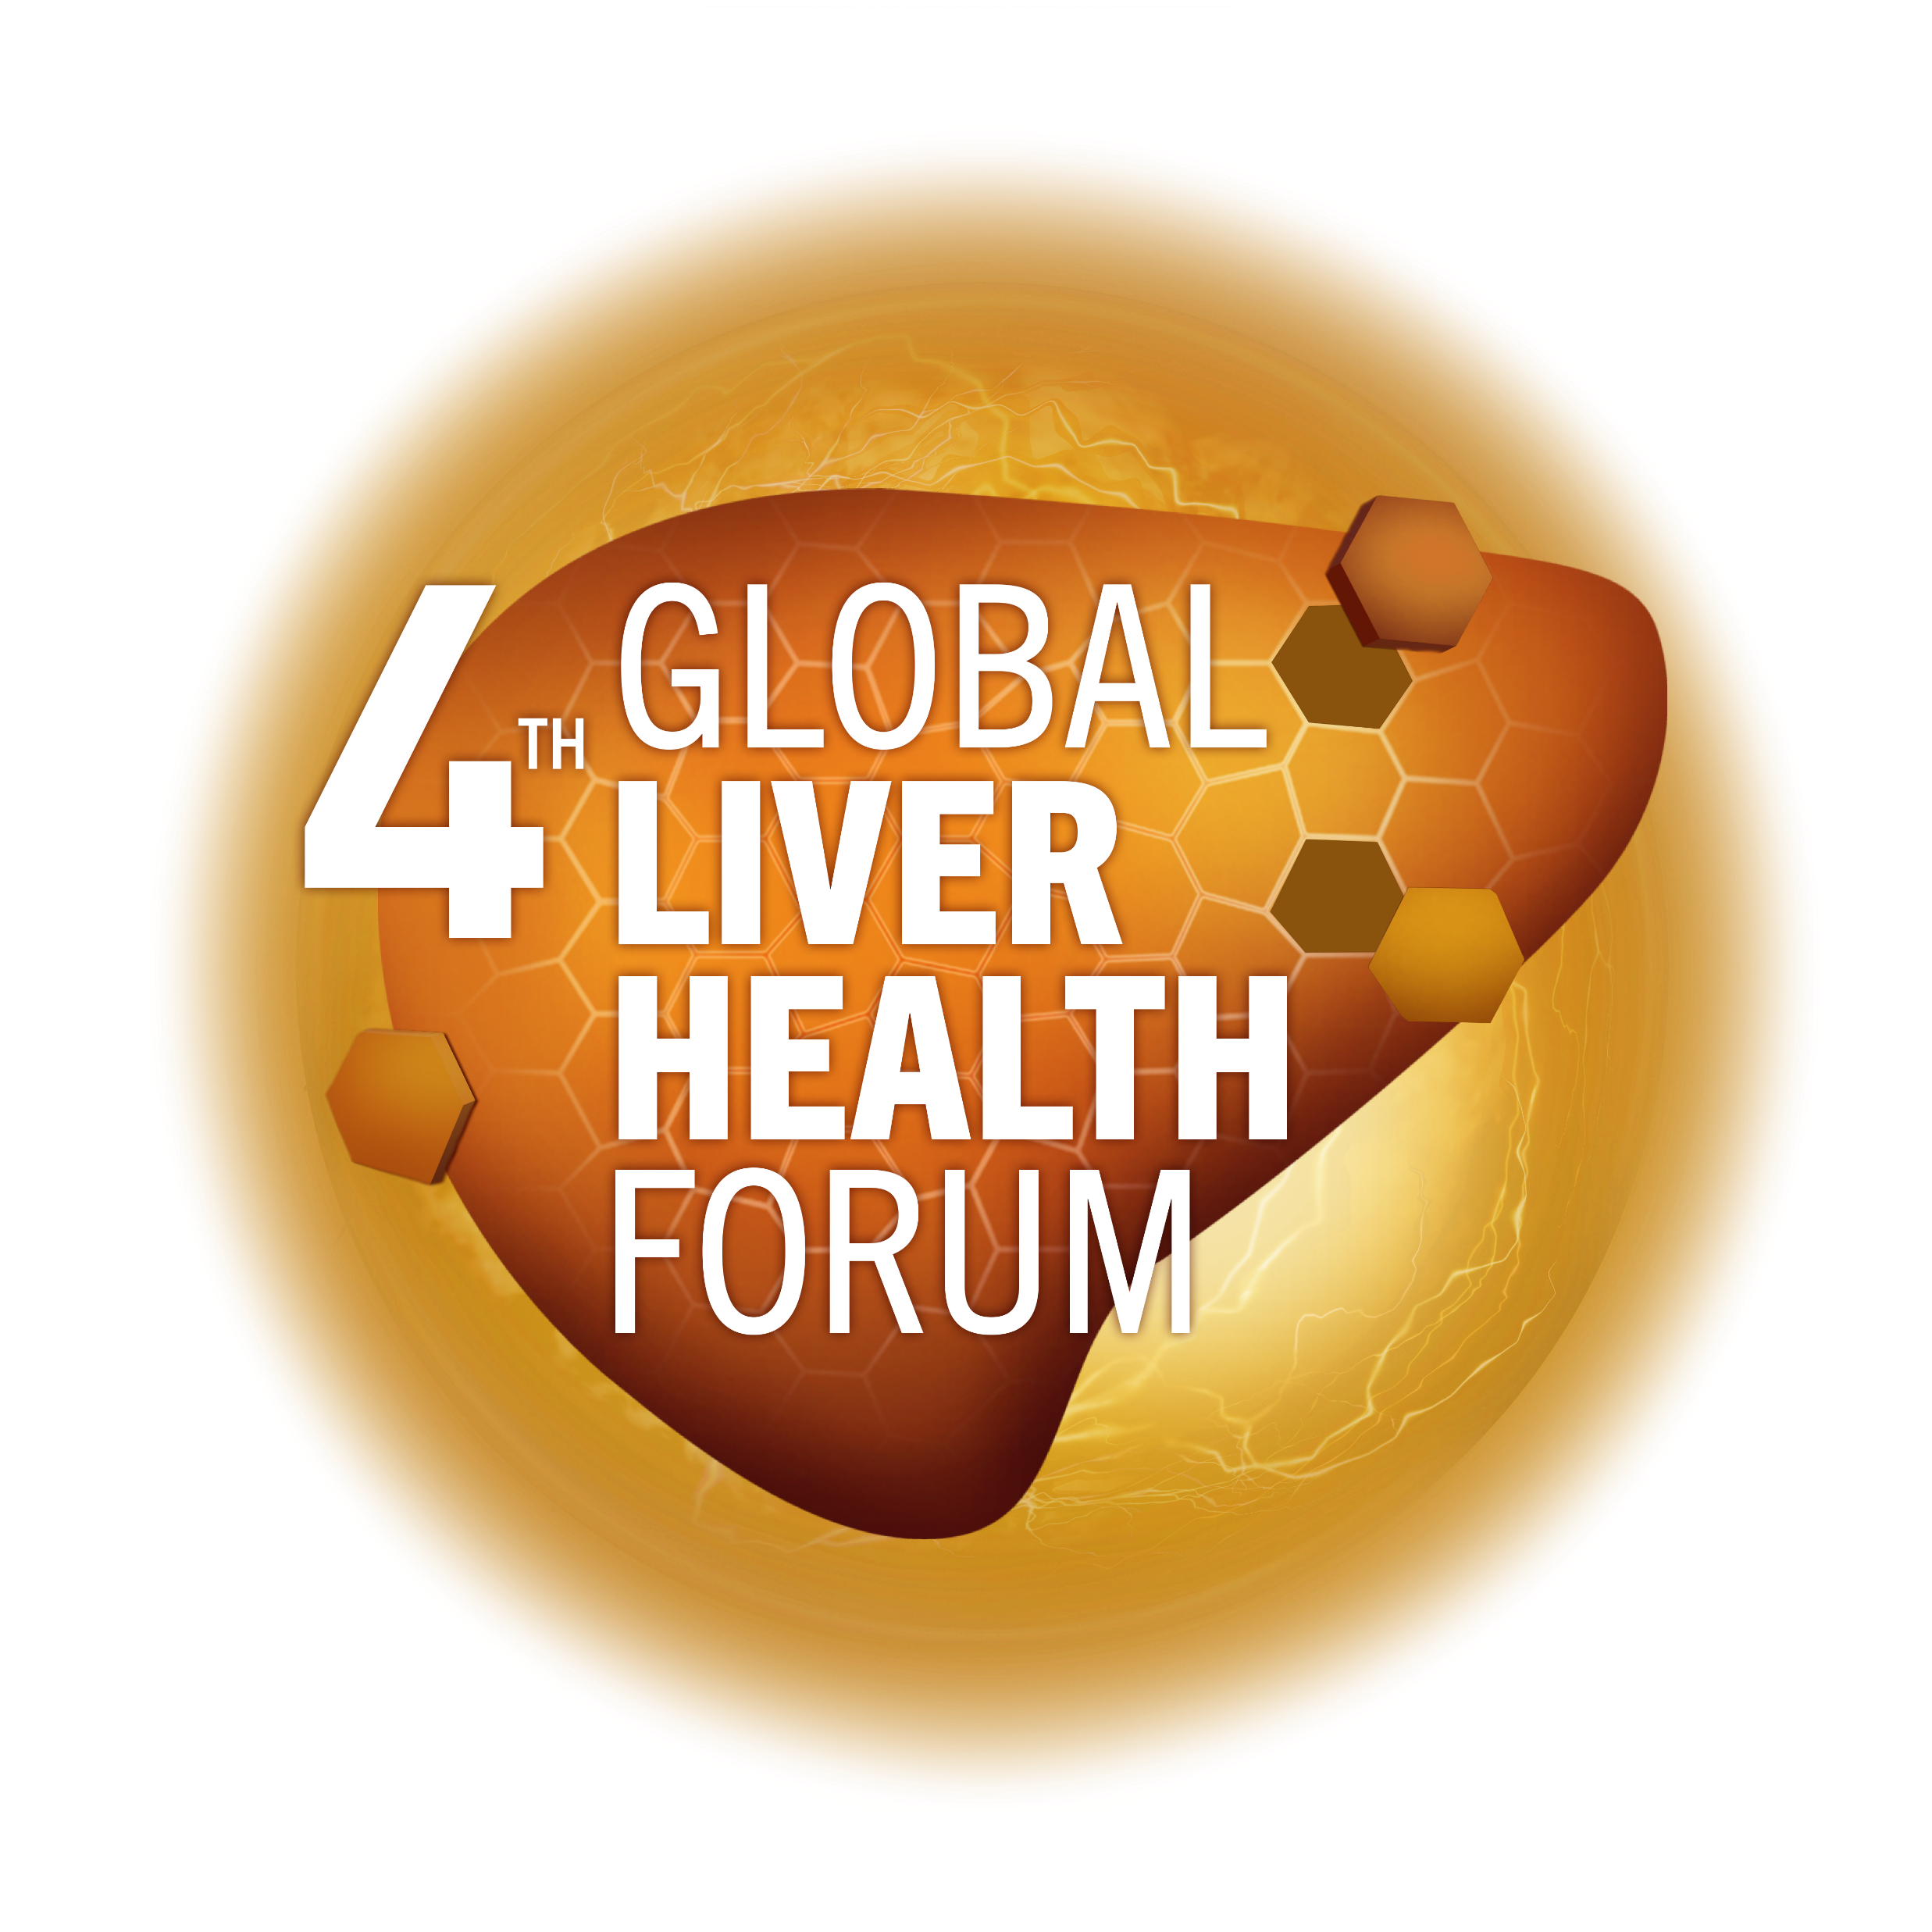
MAFLD: The importance of early identification and intervention
Professor Carmen Fierbinteanu-Braticevici (MD, PhD, AGAF)
Head of Gastroenterology Department, University Hospital Bucharest, Romania
MAT-GLB-2302796-v-1.0 │ Date of approval: June 2023

Slide 2
Disclosures
Consultant to pharmaceutical companies: KRKA, Vedra International, Alfasigma, Sanofi, Neola Pharma, Sun Wave Pharma, Biessen Pharma, Sun Pharma Terapia
Member of advisory boards: Sanofi, Neola, Takeda
Lecturer for many pharmaceutical companies locally and internationally

Slide 3
Outline
1
Global prevalence of MAFLD/NAFLD
2
Natural history of MAFLD/NAFLD
3
Identification of patients with MAFLD/NAFLD at risk for
disease progression
4
Algorithms used for MAFLD/NAFLD screening in specific
populations and for primary care follow-up
MAFLD, metabolic - associated fatty liver disease; NAFLD, Non-alcoholic fatty liver disease

Slide 4
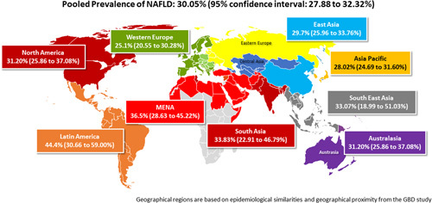
Note for PM team: Figure will be redrawn in final version
Global prevalence of MAFLD
Younossi ZM, et al. Hepatology 2023;77:1335–47
Notes:
NAFLD represents a large and growing public health problem
NAFLD is a leading cause of liver disease worldwide https://www.journal-of-hepatology.eu/article/S0168-8278(18)32121-4/fulltext

Slide 5
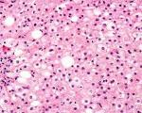
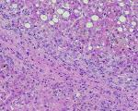
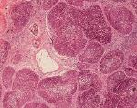
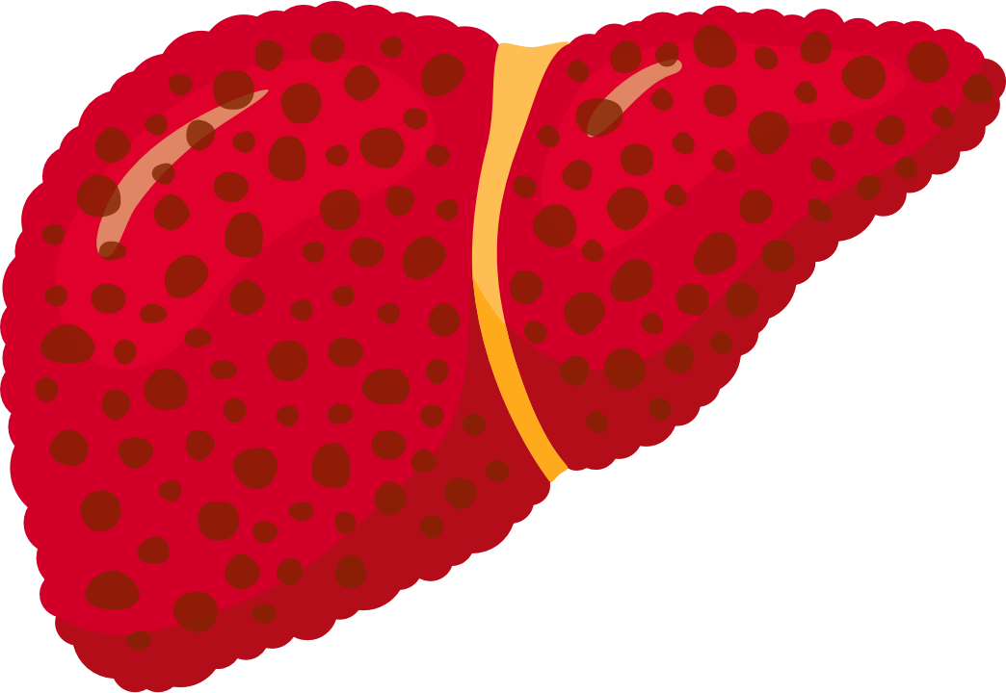
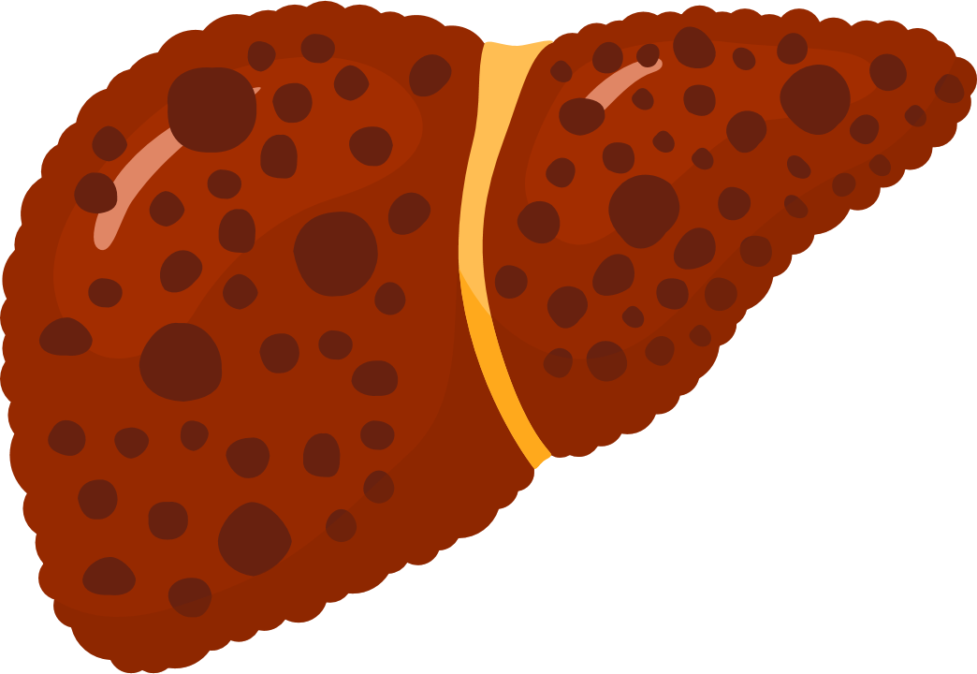
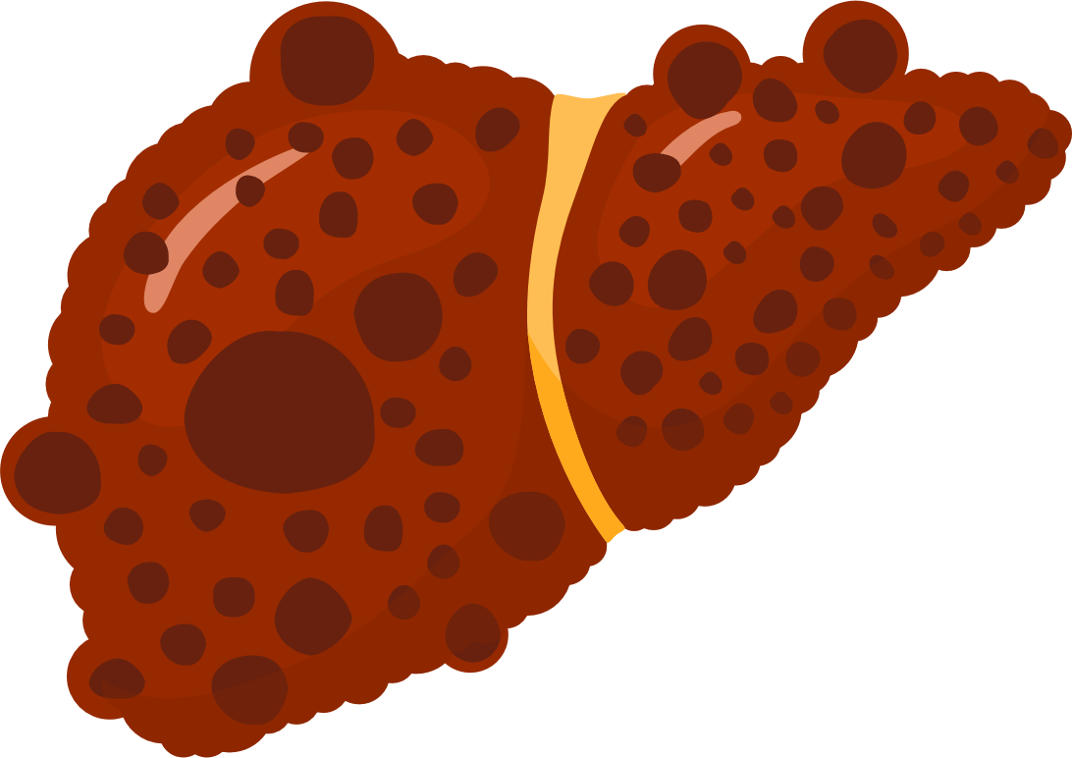
MAFLD: a dynamic disease
Nonalcoholic Fatty Liver Disease
Steatosis (NAFL)
Steatohepatitis (NASH)
Fibrosis/cirrhosis
Dynamic process
Figure adapted from: 1. Bertot LC and Adams LA. Int J Mol Sci 2016;17:774; 2. Pais R and Maurel T. J Clin Med 2021;10:1161

Slide 6








Natural history of MAFLD
Fibrosis progression rate in NASH: 1 stage per 7 years
20% of patients progress rapidly to cirrhosis in 10 years
20%
20% -30%
over 3 years
20% F3
over 2 years
30- 40%
die from liver disease
NAFLD
NASH
Fibrosis F1-F3
Cirrhosis
20%
over 2 years
1.5-2% per year
Liver failure
Liver death
Risk of death in NASH:
1st CVD
2nd Cancer
3rd Liver
HCC
Liver transplant
CVD, cardiovascular disease; HCC, hepatocellular carcinoma; MAFLD, metabolic-dysfunction associated fatty liver disease; NASH, non-alcoholic steatohepatitis. Figure adapted from: 1. Bertot LC and Adams LA. Int J Mol Sci 2016;17:774; 2. Pais R and Maurel T. J Clin Med 2021;10:1161

Slide 7

MAFLD: a multisystemic disease
Chronic Kidney Disease
Type 2 Diabetes
Obstructive Sleep Apnea
Cardiovascular Disease
Gallstone Disease
Sarcopenia
Polycystic Ovary Syndrome
Cancer
Younossi Z, et al. Hepatology 2019;69:2672.

Slide 8
Identification and quantification of steatosis
● Conventional B-mode ultrasound (first line tool)¹
• Lacks sensitivity for lesser degrees of steatosis
• Provides a subjective semi-quantitative assessment of steatosis severity
● Controlled Attenuation Parameter (CAP)²
• Promising point-of care technique for the assessment of steatosis: >275dB/m; Se 90%
• Not suitable for accurate quantification or monitoring of changes in liver fat
● MRI-Proton Density Fat Fraction (PDFF)²
• Accurate, reproductible and precise MRI-based biomarker for fat quantification
• Limitations: cost, patient acceptance, not a point-of care technique
1. Saadeh S, et al. Gastroenterol 2002;123:745-50. 2. Park CC, et al. Gastroenterol 2017;152:598–607.
For clinical guidance on non-invasive tests for liver disease, please see: EASL, J Hepatol. 2021;75:659–689

Slide 9
Liver Biopsy: the imperfect gold standard
Not always required,
and should be tailored
to the patient
  Confirm diagnosis/exclude alternative pathology
  Stage disease
  Stratify progression risk
  Impractical
  Expensive
  Invasive
  Prone to sampling and reading variability
Liver biopsy to classify such a large population is:
World Gastroenterology Organisation 2012. WGO Global Guidelines NAFLD/NASH (long version); Available at: http://www.worldgastroenterology.org/guidelines/global-guidelines/nafld-nash [last accessed June 2023]

Slide 10
Liver fibrosis is associated with negative outcomes in
patients with MAFLD
Retrospective survival analysis of 646
patients with NAFLD and matched controls
Liver fibrosis is the most important histological feature associated
with liver-related mortality and
liver-related complications
Presence of fibrosis, rather than the histological diagnosis of NASH, is associated with long-term overall mortality, liver transplantation, and
liver-related events
1.00
0.75
Proportion Alive
F0, F1
0.50
Non-NAFLD
0.25
F2
F3
Log-rank p<0.001
F4 (cirrhosis)
0
0
10
20
30
40
Years of follow-up
NAFLD, non-alcoholic fatty liver disease; NASH, non-alcoholic steatohepatitis
Hagström H, et al. J Hepatol 2017;67(6):1265–1273

Slide 11

Predictors of MAFLD progression to fibrosis
Factors | Details
Gender | Men and post-menopausal women have a higher risk of fibrosis vs pre-menopausal women; estrogen inhibits stellate cell activation and fibrogenesis^{1,2}
Age | Increase in age is associated with more severe fibrosis in patients with NASH¹
T2DM | The emergence of T2DM parallels fibrosis progression¹
BMI | An increase or decrease in BMI has been associated with progression or resolution of liver fibrosis, respectively, in patients with NAFLD¹
First-degree relative with NAFLD cirrhosis | Hepatic steatosis and hepatic fibrosis are heritable traits, and have significant shared gene effects
Inflammation | The degree of inflammation is associated with progression to advanced fibrosis¹
AST/ALT ratio | Ratio>1 is a risk factor for progression³
Hepatic iron deposits, or hemochromatosis | Iron accumulation in hepatocytes is linked to mild NAFLD³
Polymorphisms in the PNPLA3 and TM6SF2 genes | These genes code for proteins responsible for the production and breakdown of fats¹
ALT, alanine transaminase; AST, aspartate aminotransferase; BMI, body mass index; NAFLD, non-alcoholic fatty liver disease; NASH, non-alcoholic steatohepatitis; PNPLA3, patatin-like phospholipase domain-containing protein 3; T2DM, Type 2 diabetes mellitus; TM6SF2, transmembrane 6 superfamily 2
1. Bertot LC & Adams LA. Int J Mol Sci 2016;17:774; 2. Yang JD, et al. Hepatology 2014;59:1406–14; 3. Croke B & Sampson D. Journal for Nurse Practitioners 2012;8:45–50

Slide 12
Non-invasive tests in MAFLD
Clinical or laboratory scores
Fibrosis-4 (FIB-4) index
NAFLD fibrosis score (NFS)
AST/platelet ratio index
Simple
Enhanced liver fibrosis panel (ELF)
NIS4*
FibroSURETM
Hepascore
Proprietary
Transient elastography (FibroScanTM)
Shear wave elastography: point, 2D
Magnetic resonance elastography
Corrected T1 (Liver MultiScan)
FAST Score
Imaging
*A blood-based biomarker panel. Alkhouri N, et al. Gastroenterol Hepatol 2012;8:661; Daniels SJ, et al. Hepatology 2019;69:1075; EASL. J Hepatol. 2015;63:237; Idilman IS, et al. Radiology 2013;267:767; Jayaswal A, et al. AASLD 2018; Abstr 1042, Available at: https://ora.ox.ac.uk/objects/uuid:1373441b-a98c-45f6-9fa5-0d1086540f3e [last accessed June 2023]; Jayaswal ANA, et al. Liver Int 2020;40:3071; Newsome PN, et al. Lancet Gastroenterol Hepatol 2020;5:362; Sigrist RMS, et al. Theranostics 2017;7:1303; Harrison SA, et al. Lancet Gastroenterol Hepatol 2020;5:970.

Slide 13
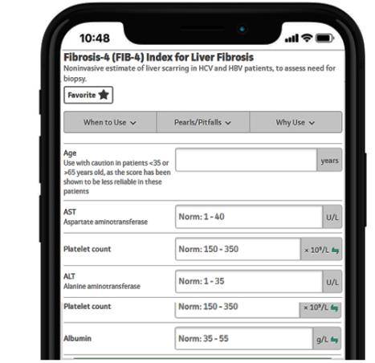
Scores for identifying advanced fibrosis in MAFLD:
NFS and FIB-4
FIB-4 Score^{2,3}
NFS¹
Parameter
Age
AST
ALT
Platelet count
BMI
Albumin
Impaired fasting glucose/diabetes
FIB-4 Score | Effect | NPV or PPV, %
<1.30 | Rules out fibrosis | 95
>3.25 | Predicts fibrosis | 75
NFS | Effect | NPV or PPV, %
<–1.455 | Rules out fibrosis | 88–93
>0.676 | Predicts fibrosis | 82–90
Low Cutoff (NPV)
High Cutoff (PPV)
Low Probability of F3/4
Indeterminate
High Probability of F3/4
ALT, alanine transaminase; AST, aspartate aminotransferase; BMI, body mass index; FIB-4, Fibrosis-4 Index; NAFLD, non-alcoholic fatty liver disease; NFS, MAFLD, metabolic-dysfunction associated fatty liver disease; NAFLD Fibrosis Score; NPV, negative predictive value; PPV, positive predictive value
1. Angulo P, et al. Hepatology 2007;45:846–854; 2. Sterling R, et al. Hepatology 2006;43:1317–1325; 3. McPherson S, et al. Gut 2010;59:1265–1269

Slide 14
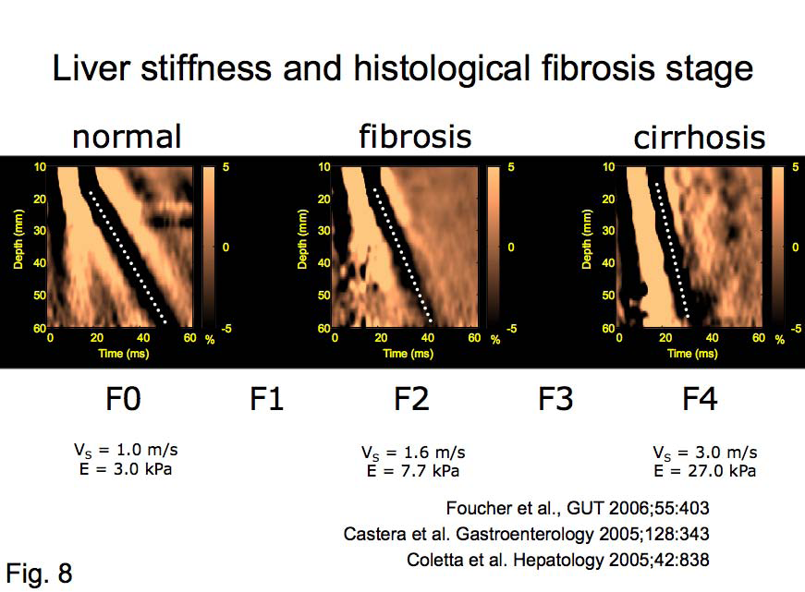
VCTE (FibroScanTM)
(Vibration Controlled Transient Elastography)
Fibrosis classification:
1
(F0/1)
2
(F1±1)
3
(F1/2)
4
(F2/3)
5
(F3±1)
6
(F3/4)
7
(F4)
LSM:
2.0
4.6
6.1
8.8
12.0
18.0
38.6
75.0 kPa
● Accurate in detecting advanced fibrosis and correlates with portal pression
● Predicts risk of decompensation and complications
● <8kPa ruled out advanced fibrosis, 8-12 kPa: fibrotic NASH, >12 kPa - advanced fibrosis (low PPV)
● An increase of liver stiffness of 20% may be associated with disease progression and worsened
long-term clinical outcomes
Boursier J, et al. Hepatol 2016;65:570; Loomba R, et al. Gut 2023;72:581–589

Slide 15
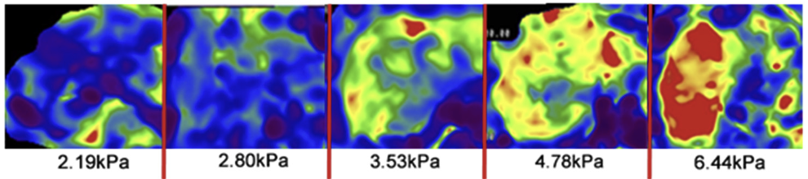
MRE: detecting fibrosis in MAFLD
3.6kPa
5 kPa
Stage 0
Stage 1
Stage 2
Stage 3
Stage 4
2.19kPa
2.80kPa
3.53kPa
4.78kPa
6.44kPa
    ● MRE ≥3.6kPa is used for detection advanced fibrosis F≥3, AUROC:0.924
    ● MRE ≥5kPa is suggestive of cirrhosis (AUROC:0.89–0.94)
    ● 19% increase in MRE associated with liver-related outcomes
MRE, magnetic resonance elastography. Loomba, R et al. Hepatology 2014;60:1920–8; Loomba R, et al. Gut 2023;72:581–589

Slide 16
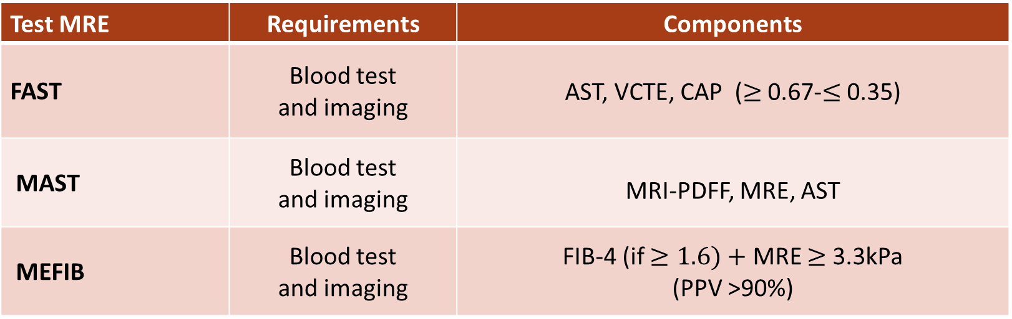
Tests for detection of “high-risk” NASH
Test MRE | Requirements | Components
FAST | Blood test and imaging | AST, VCTE, CAP ($≥$ 0.67-$≤$ 0.35)
MAST | Blood test and imaging | MRI-PDFF, MRE, AST
MEFIB | Blood test and imaging | FIB-4 (if $≥1.6)+$ MRE $≥$ 3.3kPa (PPV >90%)
AST, aspartate aminotransferase; CAP, Controlled attenuation parameter; FAST, FibroScan-AST; FIB-4, fibrosis-4 index; MAST, magnetic resonance imaging-aspartate aminotransferase; MEFIB, magnetic resonance elastography plus FIB-4; MRE, magnetic resonance elastography; MRI-PDFF, Magnetic Resonance Imaging-Proton Density Fat Fraction; NASH, non-alcoholic steatohepatitis; PPV, Positive Predictive Value; VCTE, vibration controlled transient elastography. Anstee QM, et al. J Hep. 2022;76:1362

Slide 17
Sequential non-invasive tests
Test 1
Absence of advanced fibrosis
Indeterminate
Presence of advanced fibrosis
Test 1 + Test 2
Absence of advanced fibrosis
Indeterminate
Presence of advanced fibrosis
The sequential use of NIT maintains sensitivity and specificity
while enabling the classification of a larger proportion of patients
NIT, non-invasive tests
Younossi, AASLD, 2018, Abstr.LB-10

Slide 18
1.Patients with NAFLD at risk for fibrosis
Screening for
advanced fibrosis
in MAFLD
>2 metabolic risk factors
Type 2 diabetes
Steatosis (imaging) or cytolysis
● MAFLD Clinical Care Pathway: combines screening with diagnosis because of the overlap between these two steps
2. Medical history and lab tests (e.g. alcohol intake, liver tests)
3. Non-invasive testing for fibrosis: FIB-4
FIB-4<1.3
FIB-4:1.3–2.67
FIB-4 >2.67
Indeterminate Risk
4. Liver stiffness measurement, ELF
VCTE <8kPa
MRE <2.6kPa
ELF <7.7
VCTE: 8–12 kPa
MRE: 2.6–3.6 kPa,
ELF: 7.7–9.8
VCTE >12 kPa
MRE >3.6 kPa,
ELF >9.8
Low Risk
Repeat NIT in 2–3 years
unless clinical features change
Intermediate Risk
Refer to hepatologist
High Risk
Refer to hepatologist
ELF, enhanced liver fibrosis score; FIB-4, fibrosis-4 index; MAFLD, metabolic-dysfunction associated fatty liver disease; MRE, magnetic resonance elastography; NAFLD, non-alcoholic fatty liver disease; NASH, non-alcoholic steatohepatitis; NIT, non-invasive test; VCTE, vibration controlled transient elastography.
Kanwal F, et al. Gastroenterology 2021;161:1657–1669; Ajmera V, et al. Molec Metab 2021;50:101167

Slide 19

Management algorithm for MAFLD
Management by multidisciplinary team:
Hepatologist, dietician, endocrinologist, cardiologist
High-risk groups
for the development
of NAFLD
● Lifestyle intervention
● Structured weight loss
programs
● CV risk reduction
● Diabetes care
● Atherogenic dyslipidemia
● Hypertension care
Prediabetes
or
T2DM
Prevention of CV disease
Obesity
and/or
≥2 cardiometabolic risk factors
NAFLD
Prevention of cirrhosis
Hepatic steatosis
(on imaging)
or
↑AST or ALT
(>30 IU/L)
Fibrosis Risk Stratification
Low risk
Intermediate risk
High risk
ALT, alanine aminotransferase; AST, aspartate aminotransferase; CV, cardiovascular; IU, international units; MAFLD, metabolic-dysfunction associated fatty liver disease; NAFLD, non-alcoholic fatty liver disease; T2DM, Type 2 diabetes mellitis. Cusi K, et al. Endocr Pract. 2022;28:528

Slide 20
EPL for MAFLD associated with metabolic syndrome: A systematic review and network meta-analysis
Results of a direct meta-analysis of RCTs comparing the effect of treatment with EPL + AD vs AD therapy alone¹:
  A: Change in ALT: three studies^{2–4} (N=371); mean treatment duration, 1.97 months
  B: Change in TG levels: four studies^{2–5} (N=445); mean treatment duration, 2.1 months
  C: Change in total cholesterol levels: three studies^{2,3,5} (N=359); mean treatment duration, 2.27 months
A
Author (year)
ALT (U/I)
MD (95% CI)
Wu Y. (2009)²
–12.00 (–17.50; –6.50)
Yin D. (2000)³
–15.36 ( –6.33; –14.39)
Li Z. (2013)⁴
–3.84 (–11.17; 3.49)
RE Model (Q=10.55, df=2, p=0.01, I²=81.0%)
–11.28 (–17.33; –5.23)
p<0.0003
–20
–15
–10
–5
0
5
Mean difference
B
Author (year)
TG (mg/dl)
MD (95% CI)
Sun C. (2008)⁵
–33.63 (–46.94; –20.32)
Wu Y. (2009)²
–46.90 (–60.30; –33.50)
Yin D. (2000)³
–73.45 (–101.66; –45.24)
Li Z. (2013)⁴
–77.88 (–144.66; –11.09)
RE Model (Q=7.69, df=3, p=0.05, I²=61.0%)
–49.29 (–66.38; –32.20)
p<0.0001
–150
–100
–50
0
Mean difference
C
Author (year)
Cholesterol (mg/dl)
MD (95% CI)
Sun C. (2008)⁵
–23.20 (–34.22; –12.19)
Wu Y. (2009)²
–35.58 (–39.31; –31.84)
Yin D. (2000)³
–26.68 (–36.49; –16.87)
RE Model (Q=6.40, df=2, p=0.04, I²=68.8%)
–29.74 (–36.02; –21.45)
p<0.0001
–40
–35
–30
–25
–20
–15
–10
Mean difference
AD, anti-diabetic; ALT, alanine aminotransferase; CI, confidence interval; EPL, essential phospholipids; MD, mean difference; MAFLD, metabolic-associated fatty liver disease; RCT, randomised controlled trials RE, random effects; TG, triglycerides
1. Dajani A, et al. Poster presented at APASL 2020; PO-7-84; 2. Wu Y. J TCM Univ Hunan 2009;29:41–42; 3. Yin D, Kong L. Med JQ Illu 2000;15:277–278; 4. Li Z. J Tradit Chinese Med 2013;31:10–1; 5. Sun C, et al. Clin Focus 2008;23:1272–3

Slide 21

Effects of EPLs on blood lipid level show improvements in patients with NAFLD and cardiometabolic comorbidities
In an observational, multicentre, prospective trial (MANPOWER) with patients with NAFLD and cardiometabolic comorbidities*, N=2843
3 months of EPL treatment
6 months of EPL treatment
VLDL12
TG12
LDL12
HDL12
Cholesterol12
-0.29
VLDL12
TG12
LDL12
HDL12
Cholesterol12
-0.43
-0.14
-0.22
-0.42
-0.66
-0.19
-0.38
Blood lipid profile
-0.77
Blood lipid profile
-1.19
-0.42
-0.68
0.11
0.16
0.05
0.07
-0.93
-1.73
-0.33
-0.81
-0.75
-0.50
-0.25
0.00
-1.5
-1.0
-0. 5
0.0
Mean concentration change
Mean concentration change
EPL + hypolipidemic treatment (n=766)
EPL only (n=2077)
EPL + hypolipidemic treatment (n=766)
EPL only (n=2077)
Significant improvement of lipid profile in patients receiving EPL + hypolipidemic treatment
and EPL alone (p<0.05) was seen after 3 months of treatment
EPL, essential phospholipids; HDL, high-density lipoprotein; LDL, low-density lipoprotein; TG, triglycerides; VLDL; very-low-density-lipoprotein.
Maev IV, et al. BMJ Open Gastro 2020;7:e000368

Slide 22
Take-home messages
1
MAFLD is considered as the hepatic component of metabolic syndrome and is recognised as part of the multi-system disease of the multi-system disease nsidered as the hepatic component of metabolic syndrome
2
Although the definitive diagnosis and staging of NASH remain linked to histology, non-invasive tools can be used to stratify the risk of disease progression and long - term clinical outcomes
3
Early identification of population at increased risk for advanced liver disease allows for interventions that may prevent future hepatic complications
MAFLD, metabolic-dysfunction associated fatty liver disease

