Slide 1
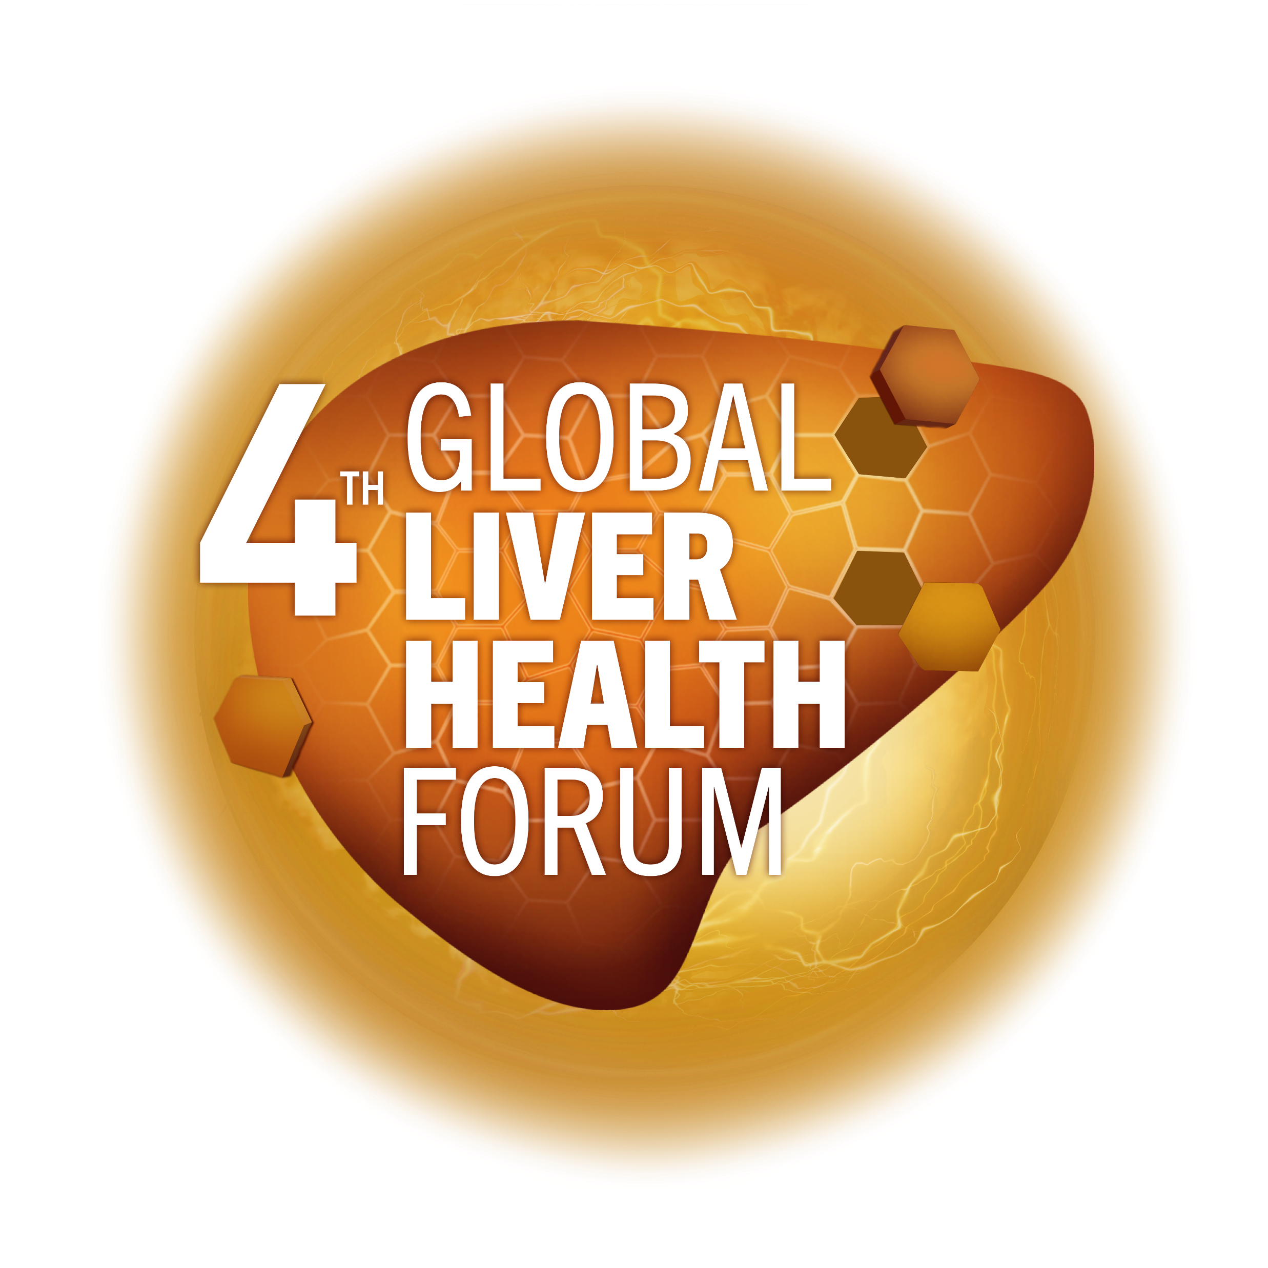
NAFLD-associated metabolic risks in obesity and diabetes – Insights from clinical practice
Marek Hartleb
Department of Gastroenterology and Hepatology
Medical University of Silesia
Katowice, Poland
MAT-GLB-2302794-v-1.0 │ Date of approval: June 2023

Slide 2
Disclosures
Lecture honoraria from Sanofi and ProMed

Slide 3
Classic comorbidities (cardiometabolic risk factors) in NAFLD include features of metabolic syndrome
Cardiometabolic disease (%) | General population (USA) | NAFLD (non-NASH) | NASH
Obesity | 39.8 | 51.3 | 81.8
T2DM | 14 | 22.5 | 43.6
Hypertension | 29 | 39 | 68
Hypertriglyceridemia | 25 | 40 | 83
Metabolic syndrome | 34 | 42.5 | 71
T2D, Type 2 diabetes; MAFLD, metabolic dysfunction-associated fatty liver disease; NAFLD, non-alcoholic fatty liver disease; NASH, non-alcoholic steatohepatitis; USA, United Stated of America.
Sanyal A. NASH in 2021: The Multi-System disease, webinar.
3

Slide 4
Decreased survival in patients with NAFLD/NASH
Cohort study re-evaluating survival and cause of death in patients diagnosed with NAFLD (n=129)* compared with a matched reference population (n=44,745) of the same age and sex.
Median follow-up (SD) 13.7 (1.3) years; 25 deaths (19.4%) during follow-up
Cause of death (%) | Patients with NASH (n=71) | Reference population (n=44,745) | p value
Liver failure/HCC (n=7) | 2.8 | 0.2 | p=0.04
CVD (n=14) | 15.5 | 7.5 | p=0.04
Extrahepatic cancers (n=5) | 5.6 | – | –
Overall survival compared with reference population (%)
100
Ref. population
100
Ref. population
100
Ref. population
80
NAFLD
80
80
Non-NASH
60
60
NASH
60
40
40
40
20
20
20
0
0
0
0
5
10
15
20
0
5
10
15
20
0
5
10
15
20
Time (years)
Time (years)
Time (years)

Slide 5
All cause-specific mortality rate amongst NAFLD patients:
Meta-analysis of 5 studies (n=19,340)
 | Studies with ultrasound or FLI (n=3) | Studies with ultrasound, FLI or biopsy (n=5)
 | Rate per 1000 person-years (95% CI)
Total NAFLD cases | 8153 | 19,340
Total person-years | 104,470 | 263,947
All cause mortality | 12.6 (6.68–23.67) | 17.05 (10.31–28.05)
Cause specific death
Cardiac specific | 4.20 (1.34–7.05) | 5.54 (2.72–8.35)
Extrahepatic cancer specific | 2.83 (0.78–4.88) | 4.21 (1.94–6.48)
Liver specific | 0.92 (0.00–2.21) | 1.75 (0.58–2.91)
This systematic review aimed to determine the global and regional prevalence, incidence and mortality of NAFLD using in-depth meta-analysis. Of the 2585 studies reviewed, 92 articles reporting prevalence (N=9,361,716), 12 articles reporting incidence (N=256,757) and 5 articles reporting mortality rates (N=19,340) met the inclusion criteria.
CI, confidence interval; FLI, fatty liver index; NAFLD, non-alcoholic fatty liver disease.
Younossi ZM, et al. Hepatology 2023;77:1335–47.

Slide 6
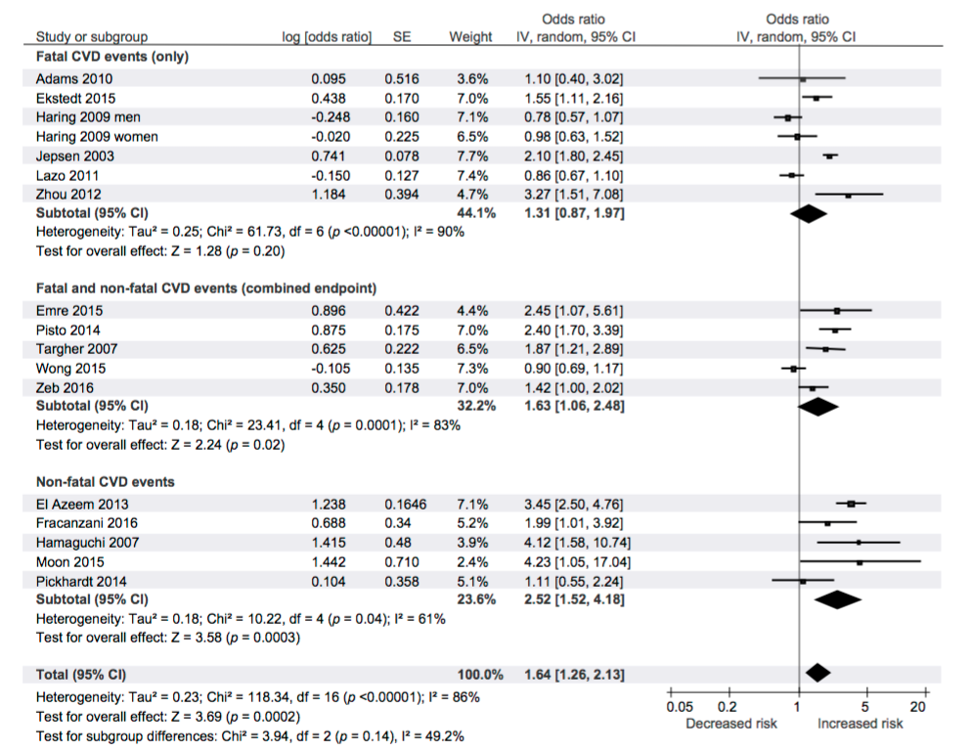
NAFLD increases risk of incident CVD events
(fatal, non-fatal or both)
Meta-analysis of the risk of incident CVD events associated with NAFLD
16 observational prospective or retrospective studies
34,043 adults (36.3% with NAFLD)
2,600 CVD outcomes (>70% CVD deaths) over a median period of 6.9 years
Total HR = 1.64 (95% CI 1.26–2.16)
This study performed a meta-analysis of articles investigating NALFD and the risk of CVD to quantify the magnitude of the association between NAFLD (and NAFLD severity) and risk of CVD events. The study searched PubMed, Google Scholar
and Web of Science databases and included observational studies conducted in adults, in which NAFDL was diagnosed on imaging or histology. Data was extracted from studies and meta-analysis was performed using random effects modelling. A total of 16 unique, observational prospective and retrospective studies with 34,043 adult individuals (36.3% with NAFLD) and approximately 2,600 CVD outcomes (>70% CVD deaths) over a median period of 6.9 years were included in the
final analysis.
CI, confidence intervals; CVD, cardiovascular disease; df, degrees of freedom; HR, hazard ratio; IV, inverse variance; NAFLD, non-alcoholic fatty liver disease; SE, standard error.
Targher G, et al. J Hepatol 2016;65:589–600.

Slide 7
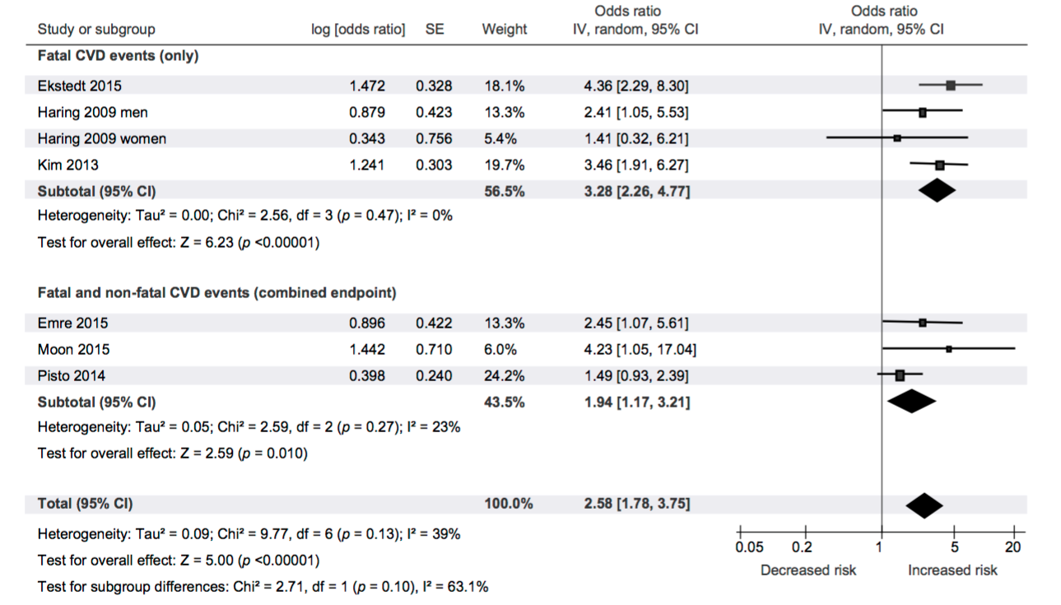
Meta-analysis of the risk of fatal and non-fatal CVD events associated with more severe NAFLD
Meta-analysis of the risk of incident CVD events associated with NAFLD
Total HR = 2.58 (95% CI 1.78–3.75)
This study performed a meta-analysis of articles investigating NALFD and the risk of CVD to quantify the magnitude of the association between NAFLD (and NAFLD severity) and risk of CVD events. The study searched PubMed, Google Scholar
and Web of Science databases and included observational studies conducted in adults, in which NAFDL was diagnosed on imaging or histology. Data was extracted from studies and meta-analysis was performed using random effects modelling. A total of 16 unique, observational prospective and retrospective studies with 34,043 adult individuals (36.3% with NAFLD) and approximately 2,600 CVD outcomes (>70% CVD deaths) over a median period of 6.9 years were included in the
final analysis.
CI, confidence intervals; CVD, cardiovascular disease; df, degrees of freedom; HR, hazard ratio; IV, inverse variance; NAFLD, non-alcoholic fatty liver disease; SE, standard error.
Targher G, et al. J Hepatol 2016;65:589–600.

Slide 8
Advanced fibrosis is associated with incident CVD in patients with MAFLD
285 patients with histological diagnosis
of MAFLD
Prospective follow-up (median 5.2 years)
At baseline, 26 patients (9.1%) had experienced a cardiovascular event
Results
Advanced fibrosis (stage 3–4) was predictor of incident CVD*
HR=2.86 (95% CI: 1.36‒6.04)
Cumulative incidence curves for incident CVD by advanced fibrosis status
40
p=0.004
Advanced fibrosis
50
p=0.02
NFS >0.676 (high-risk for advanced fibrosis)
40
p=0.002
30
40
30
NFS ≥‒1.455
Cumulative incidence of CVD (%)
30
Cumulative incidence of CVD (%)
20
Cumulative incidence of CVD (%)
20
20
NFS <‒1.455 (low-risk for advanced fibrosis)
10
No advanced
fibrosis
10
10
NFS ≤0.676
0
0
0
0
2
4
6
8
10
0
2
4
6
8
10
0
2
4
6
8
10
Time (years)
Time (years)
Time (years)
No. at risk:
NFS ≥‒1.455
NFS <‒1.455
No. at risk:
Advanced fibrosis
No adv. fibrosis
43
185
32
131
15
88
1
0
No. at risk:
NFS >0.676
NFS ≤0.676
108
120
75
88
46
57
1
0
26
202
18
145
9
94
1
0

Slide 9

Designs of studies on relationships between NAFLD and CVD
MAFLD
Subclinical atherosclerosis
(cIMT; CS)
Cross-sectional studies
MAFLD
Incident cardiovascular event
Prospective studies
Cardiovascular event
Proportion of patients with MAFLD
Retrospective studies
cIMT, carotid intima-media thickness; CS, carotid stiffness; CVD, cardiovascular disease; MAFLD, metabolic dysfunction-associated fatty liver disease; NAFLD, non-alcoholic fatty liver disease.

Slide 10
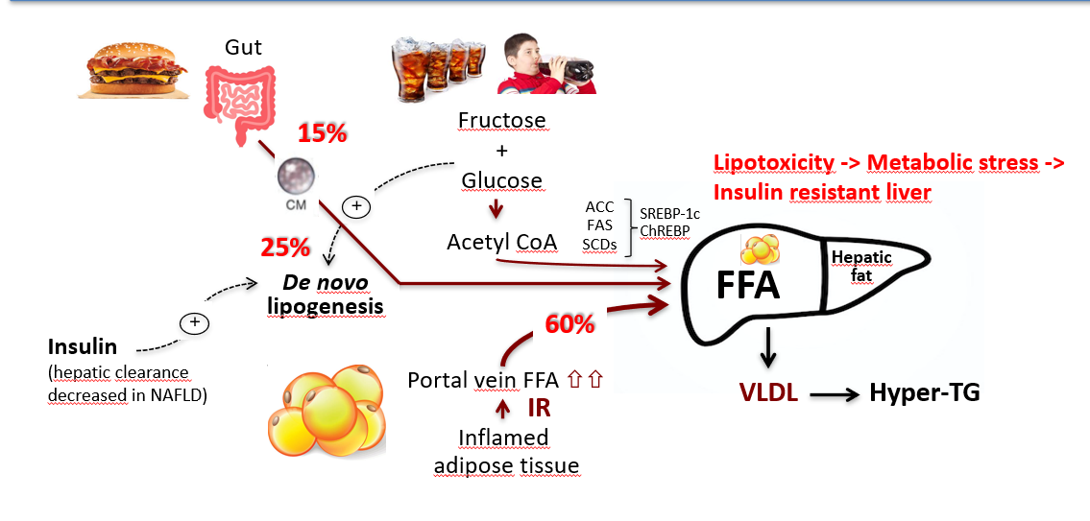
Processes leading to insulin-resistant liver
Ashfield to redraw figure
ACC, acetyl CoA carboxylase; acetyl CoA, acetyl coenzyme A; ChREBP, carbohydrate-responsive element-binding protein; CM, chylomicron; FAS, fatty acid synthase; FFA, free fatty acid; hyper-TG, hypertriglyceridemia; IR, insulin resistance; NAFLD, non-alcoholic fatty liver disease; SCDs, stearoyl-CoA desaturases; SREBP-1c, sterol regulatory element-binding protein 1; VLDL, very-low-density lipoprotein.
Figure adapted from Neushwander-Tetri B, et al. BMC Med 2017;15:451.

Slide 11
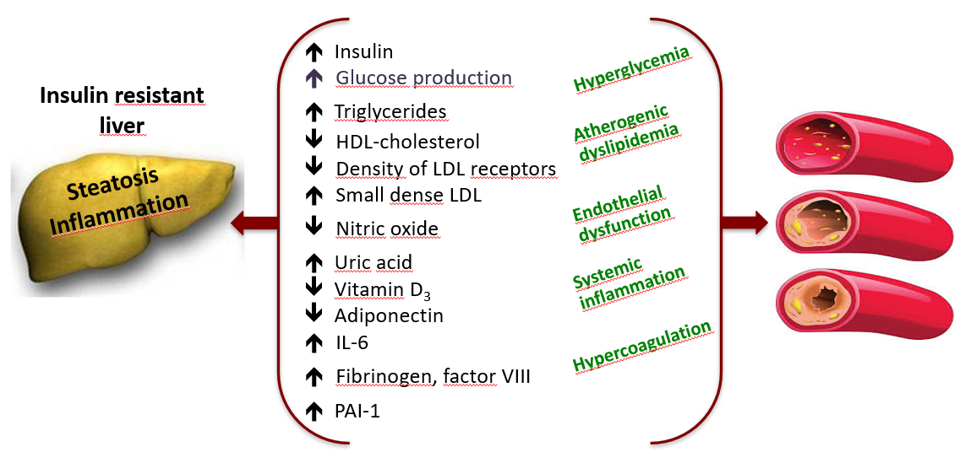
Atherogenic environment created by NASH
HDL, high-density lipoprotein; IL-6, interleukin-6; LDL, low-density lipoprotein; NASH, non-alcoholic steatohepatitis; PAI-1, plasminogen activator inhibitor-1.
Lonardo A, et al. J Hepatol 2018; 68: 335-352

Slide 12

Metabolic comorbidities associated with NAFLD
Metabolic comorbidities cause 32% of deaths in general population¹
Higher risk in NAFLD population²
NAFLD closely linked to CV events but causal relationship uncertain³
Peripheral
vascular
disease⁵
Cerebro-
vascular
disease²
Coronary
heart
Disease²
NAFLD
Question: Does NAFLD play an independent role or is it only a marker of other shared metabolic risk factors? (role of central adipose tissue,
gut microbiota)
Arterial
hypertesnion⁴
Arrythmias²
T2DM²
Cardiomyo-
pathies²
CV, cardiovascular; NAFLD, non-alcoholic fatty liver disease; T2DM, type 2 diabetes mellitus.
1. World health Organization 2021; Cardiovascular Disease Factsheet; Available at: https://www.who.int/news-room/fact-sheets/detail/cardiovascular-diseases-(cvds) [Last accessed June 2023]; 2. Wong CR, et al. Clinical Liver Disease 2018;12:39–44; 3. Manikat R and Nguyen MH Clin Mol Hepatol 2023;29(Suppl):s86–s102; 4. Oikonomou D, et al. Eur J Gastroenterol Hepatol 2018;30:979–985; 5. Zou Y, et al. Intern Med J 2017;47:1147–1153.

Slide 13

NAFLD is a multi-system disorder affecting many organs
Diet-induced obesity
Metabolic stress
Insulin resistance
Systemic inflammation and fibrosis
Arteries Heart Liver Pancreas Kidney
(HTN, CVD, CAD) (heart failure) (MAFLD) (T2DM) (CKD)
CAD, coronary artery disease; CKD, chronic kidney disease; CVD, cardiovascular disease; HTN, hypertension; NAFLD, non-alcoholic fatty liver disease, T2DM, type 2 diabetes mellitus.
Friedman SL, et al. Nat Med 2018;24:908.

Slide 14
NAFLD is a multi-system disorder affecting many organs
Diet-induced obesity
Metabolic stress
Insulin resistance
Systemic inflammation and fibrosis
+
+
+
+
NAFLD, non-alcoholic fatty liver disease.
Friedman SL, et al. Nat Med 2018;24:908.

Slide 15
NAFLD may precede and promote T2DM
2.2-fold increased in risk
NAFLD promotes:
Worsening of IR
Risk of T2DM
(difficulty to manage)
⇧ Risk of atherogenic
dyslipidemia
Risk of CVD
Diabetes promotes:
⇧ Risk of NASH
⇧ Risk of cirrhosis
⇧ Risk of HCC
T2DM
NAFLD
2- to 6-fold increased in risk
(liver fibrosis)
CVD, cardiovascular disease; HCC, Hepatocellular carcinoma; IR, insulin resistance; MAFLD, metabolic dysfunction-associated fatty liver disease; NAFLD, non-alcoholic fatty liver disease; NASH, non-alcoholic steatohepatitis; T2DM, type 2 diabetes mellitus.
Budd J, et al. Current Diabetes Reports 2020;20:59.

Slide 16
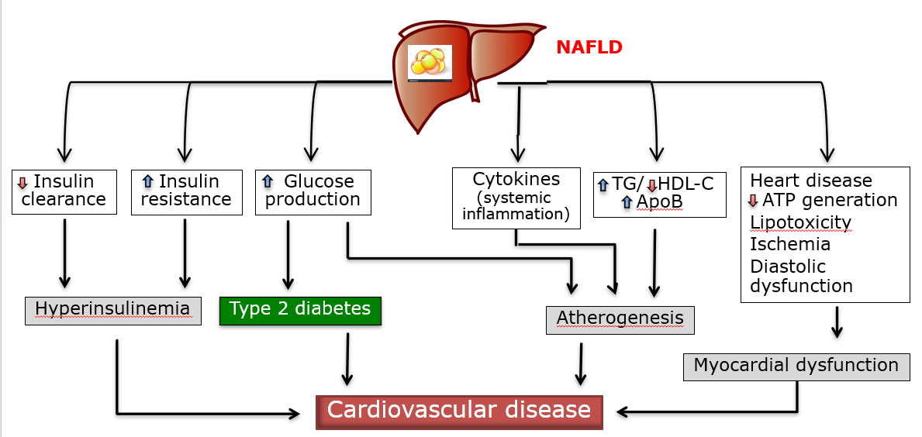
Pathophysiology of CVD in NAFLD and T2DM
ATP, adenosine triphosphate; ApoB, apolipoprotein B; CVD, cardiovascular disease; HDL-C, high-density lipoprotein cholesterol; NAFLD, non-alcoholic fatty liver disease; TG, tryglycerides; T2DM, type 2 diabetes mellitus.
Cusi K. Gastroenterology 2012;142:711–725.

Slide 17
There is an association between NASH and metabolic dysfunction
Dysregulated
metabolism
NASH is a progressive
metabolic disease, which
has systemic effects
throughout the body
NAFLD
NASH
T2DM
Figure not intended to show prevalence of disorders; for illustration purposes only. MAFLD, metabolic dysfunction-associated fatty liver disease; NASH, non-alcoholic steatohepatitis.
Figure adapted from Bhala N, et al. Pharma Des 2013;19:5169–5176; 1. Chakravarthy MV and Neuschwander-Tetri BA Endocrinol Diab Metab 2020;3:e00112.

Slide 18



Close monitoring for metabolic risk factors in NAFLD patients
Atherogenic dyslipidemia?
Non-HDL cholesterol > 130 mg/dL;
Apo B > 120 mg/dL
Prediabetes/Diabetes?
HbA1c > 6.4% ; fasting glucose > 100 mg/dL ; >140 mg/dL at 2 hours during OGTT
Arterial hypertension?
≥130/85 mmHg
Metabolic syndrome? (2/3 criteria)
Levels of TG to HDL-cholesterol ratio > 3
Shift of paradigm from elevated ALT to metabolic risk factors
Apo B, apolipoprotein; HbA1c, hemoglobin A1c; HDL, high-density lipoprotein; NAFLD, non-alcoholic fatty liver disease; OGTT, oral glucose tolerance testing; TG, triglyceride.

Slide 19
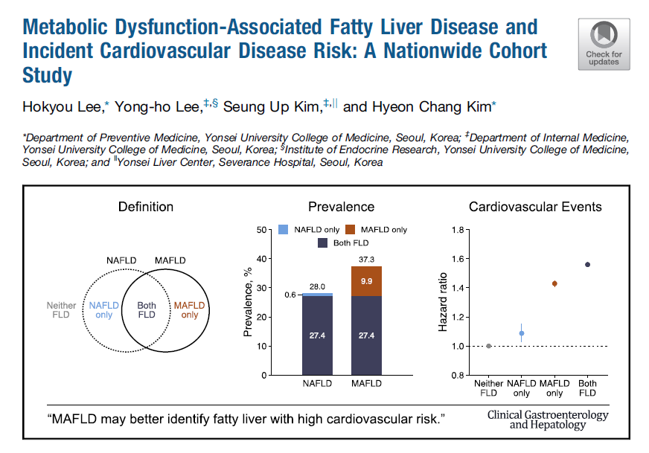
Diagnosis of MAFLD allows for the identification of cardiometabolic high-risk populations
In this study n = 9,584,399 participants (48.5% male) aged 40-64 years between 2009 and 2010 for cross-sectional analyses of the prevalence and characteristics of NAFLD and MAFLD.
FLD, fatty liver disease; MAFLD, metabolic dysfunction-associated fatty liver disease; NAFLD, non-alcoholic fatty liver disease.
Image and included figures taken from Lee H, et al. Clin Gastroenterol Hepatol. 2021;10:2138–2147.

Slide 20
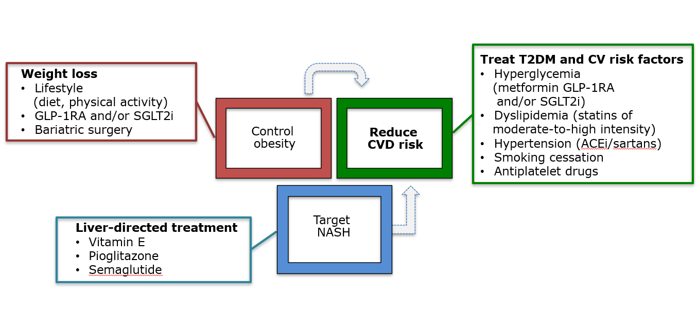
Management of cardiometabolic risk factors
ACEi, angiotensin-converting enzyme inhibitor; CVD, cardiovascular disease; GLP-1RA. Glucagon like peptide-1 receptor agonist; NASH, non-alcoholic steatohepatitis; SGLT2i; sodium-glucose co-transporter-2 inhibitor.
Manikat R and Nguyen MH Clin Mol Hepatol 2023;29(Suppl):s86–s102.

Slide 21
Conclusions
1
NAFLD is a multi-system disease that increases risk of T2DM and CVD due to insulin resistance and atherogenic lipoprotein phenotype
2
In patients with NAFLD the metabolic risk factors should be actively searched and monitored
3
Statins, anti-diabetic drugs and weight loss interventions are of proven efficacy in decreasing the metabolic risk factors of NAFLD and may have a beneficial effect on liver pathology¹
NAFLD needs a holistic multi-disciplinary approach extending far beyond the liver
4
CVD, cardiovascular disease; NAFLD, non-alcoholic fatty liver disease; T2DM, type 2 diabetes mellitus.
1. Manikat R and Nguyen MH Clin Mol Hepatol 2023;29(Suppl):s86–s102.

Slide 22
RESTORE study results: ranking of the five most commonly recommended adjunctive treatments by the top three criteria
GEs
GPs
Average score, n=95 GEs, scale 1–5
Average score, n=115 GPs, scale 1–5
2
3
4
5
2
3
4
5
Efficacy
Efficacy
Tolerability
Tolerability
Effect on the
improvement of the QoL
Effect on the
improvement of the QoL
Essentiale® (EPL)
Hepatil
Heparegen
Proursan
Sylimarol
EPL was regarded as having a good efficacy and tolerability
in comparison with other interventions
Physicians ranked each drug against each criterion using a scale of 1 (not relevant at all) to 5 (extremely relevant).
Essentiale® (EPL); Hepatil® (ornithine + choline); Heparegen® (timonacic); Proursan® (ursodeoxycholic acid); Sylimarol® (silybinin/silymarin)
EPL, essential phospholipids; GE, gastroenterologist; GP, general practitioner; QoL, quality of life
Hartleb M, et al. Eur J Gastroenterol Hepatol 2021;34(4):426–34

Slide 23
RESTORE study results: Ranking of the five most commonly recommended adjunctive treatments by the top three criteria
 | Essentiale (a) | Heparegen (b) | Hepatil (c) | Proursan (d) | Sylimarol (e)
GEs
Efficacy | 3.7 (c, e) | 3.6 (c, e) | 3.0 (a, b, d) | 3.9 (c, e) | 3.1 (a, b, d)
Tolerability | 4.5 (c, e) | 4.4 (d) | 4.3 | 4.1 | 4.4 (d)
Improvement of the QoL | 3.5 (c, e) | 3.5 (c, e) | 3.1 (a, b, d) | 3.6 (c, e) | 3.2 (a, b, d)
GPs
Efficacy | 4.2 (c, d, e) | 4.3 (c, d, e) | 3.3 (a, b, d, e) | 3.6 (a, b, c, e) | 2.7 (a, b, c, d)
Tolerability | 4.6 (d) | 4.4 (d) | 4.3 (d) | 3.6 (a, b, c, e) | 4.2 (d)
Physicians ranked each drug against each criterion using a scale of 1 (not relevant at all) to 5 (extremely relevant). Essentiale® (essential phospholipids); Hepatil® (ornithine + choline); Heparegen® (timonacic); Proursan® (ursodeoxycholic acid); Sylimarol® (silybinin/silymarin). The differences between each drug evaluation within a group of physicians are marked with letters. The letter below the average score indicates which drug the marked one significantly differs from. Kruskal -Wallis test p<0.05.
GEs, gastroenterologists; GPs, general practitioners; QoL, quality of life
Hartleb M, et al. Eur J Gastroenterol Hepatol 2021. [ePub ahead of print]. doi: 10.1097/MEG.0000000000002288

Slide 24
There exist several therapeutic approaches for managing MAFLD and associated comorbidities
Weight loss
Lifestyle (diet,
physical activity)
GLP-1RA and/or SGLT2i
Bariatric surgery
Treat T2DM and
cardiovascular risk factors
Hyperglycemia
(GLP-1RA and/or SGLT2i)
Dyslipidaemia (statin)
Hypertension (ACEi/sartans)
Smoking cessation
Antiplatelet drugs
Control
obesity
Reduce
CVD risk
Reduce
end-stage
complications
Target
NASH
Other approaches
Statin (reducing
portal hypertension)
Metformin (decrease of
HCC risk)
Liver-directed treatment
Vitamin E
Pioglitazone
Semaglutide
ACEi, angiotensin-converting enzyme inhibitors; CVD, cardiovascular disease; GLP-1RA, glucagon-like peptide-1 receptor agonist; HCC, hepatocellular carcinoma;
MAFLD, metabolic dysfunction-associated fatty liver disease; NASH, non-alcoholic steatohepatitis; SGLT2i, sodium/glucose cotransporter-2 inhibitor; T2DM, type 2 diabetes mellitus
Fu Y, et al. Front. Pharmacol 2022;13:973366; Shi Y, et al. Chin Med J (Engl) 2022;135:1009–1018; Passacquale G, et al. Br J Clin Pharmacol 2022;88:2686–2699.

