Slide 1
Reducing the burden of liver disease
New evidence revealed

Slide 2

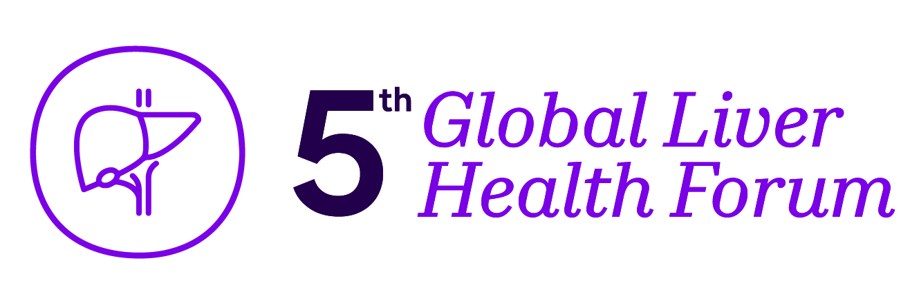
Metabolic and Toxic Liver Damage in Focus: MANPOWER's Latest Breakthroughs Revealed
Professor Asad Dajani
MD, DSM, JBD, FAMCP, FRCP (Glasgow)
MAT-GLB-2402750-v-1.0 │ Date of approval: May 2024

Slide 3
Disclosures
A member of advisory boards for Sanofi (UAE, Global), Abbott, Janssen, Lunatus, Synergy, Takeda, Novo Nordisk, Julphar. A lecturer for Sanofi (UAE, Global), Abbott, Janssen, Lunatus, Synergy, Dr Falk, Takeda, Spimaco, Julphar, Tabuk, Novo Nordisk

Slide 4







Clinical Spectrum of Metabolic Dysfunction-associated Fatty Liver Disease (MAFLD)/Metabolic Dysfunction-associated Steatotic Liver Disease (MASLD)
No alcohol
Obesity/overweight
NAFLD*
MAFLD*
Or
No viral hepatitis
> 2 metabolic abnormalities
Waist circumference > 102/88 cm in Caucasian men/women or > 90/80 cm in Asian men/women
BP > 130/85 mm Hg or specific treatment
Triglycerides > 150 mg/dL or specific
drug treatment
Plasma HDL < 40 mg/dL for men and < 50 mg/dL for women or specific drug treatment
Prediabetes (i.e., fasting glucose levels 100-125 mg/dL or 2-h post-load glucose levels 140-199 mg/dL) or HbA1c 5.7%-6.4%
Homeostasis Model Assessment of Insulin Resistance score > 2.5
Plasma CRP level > 2 mg/L
No genetic abnormality
Hepatic steatosis
No metabolic abnormality
Primary LD
No medications
VH
DILI
AIH
Others
Serious liver disorders may occur due to toxic, inflammatory, allergic, metabolic or immunological effects caused by various risk factors, leading to morphological damage to liver cells
Under chronic conditions, these changes manifest as fibrosis and cirrhosis¹
Adapted from Devi J, et al. World J Hepatol 2022;14(1):158-167

Slide 5
Metabolic and Toxic Liver Disease
MAFLD can predispose to hepatotoxicity induced by certain drugs¹
DILI is unpredictable liver damage caused by drugs or other non-pharmacological compounds¹
(>1100 drugs⁴)
Interplay of drug properties, genetic and non-genetic host, and environmental factors favors DILI¹
Diagnosed by a temporal relationship between drug administration and increased levels of liver enzymes⁵
MAFLD includes a wide spectrum of histological lesions ranging from simple steatosis to NASH and cirrhosis²
Hepatic manifestation of metabolic syndrome associated with cardiometabolic comorbidities²
Liver enzymes and medical imaging techniques such as ultrasonography help diagnose MAFLD³
DILI¹
MAFLD
1) Caballano-Infantes E et al. Biomedicines. 2022;10(1):55; 2) Abou Assi R et al. Pharmaceuticals. 2021;14(3):215; 3) Allan R et al. WJG. 2010;16:3510–3520;
4) Xu li et al. Biomed Res Int. 2019;2019:8764093; 5) Kolarić TO et al. J Clin Transl Hepatol 2021;9(5):731-737.
DILI, drug-induced liver injury; MAFLD, metabolic dysfunction-associated fatty liver disease; NASH, non-alcoholic steatohepatitis.

Slide 6
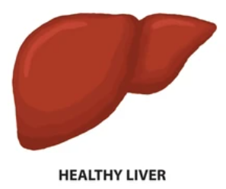
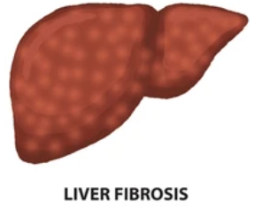
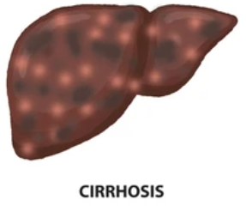
Overview of Metabolic Liver Injury
Support
Did you find these results useful?
RISK
Liver function inhibition is a consequence of reduced phospholipids, altered phospholipid composition and reduced membrane fluidity leading to impaired membrane-associated enzyme, receptor and carrier activities¹
Viruses, Organic solvents, Alcohol, Medication, Drugs,
Fatty food¹
Healthy Liver
Lipid peroxidation¹
Increased membrane rigidity
Cell membrane disruption¹
Noxious agents alter the fluidity of bio-membrane
Mitochondrial impairment²
Decreased activity of
membrane-bound enzymes (e.g., sodium pumps)
ER stress³
Imbalance between pro-oxidant and antioxidant species
Liver Fibrosis
Dysfunction or damage
to cells
Loss of protein synthesis sites due to reduction of moisture in the cells
Altered activity of membrane receptors
Oxidative damage of
cellular macromolecules
Promotes the progression of fibrosis and cirrhosis
Altered permeability
Promotes ROS production
Impaired detoxifying function of
liver cell
Accumulation of cytosolic
fatty acids
Enlargement and dysfunction of
the endoplasmic reticulum
Activation of alternative pathways for additional
ROS generation
Ca+ uptake/release disorders of
ER or protein processing/transport
cirrhosis

Slide 7
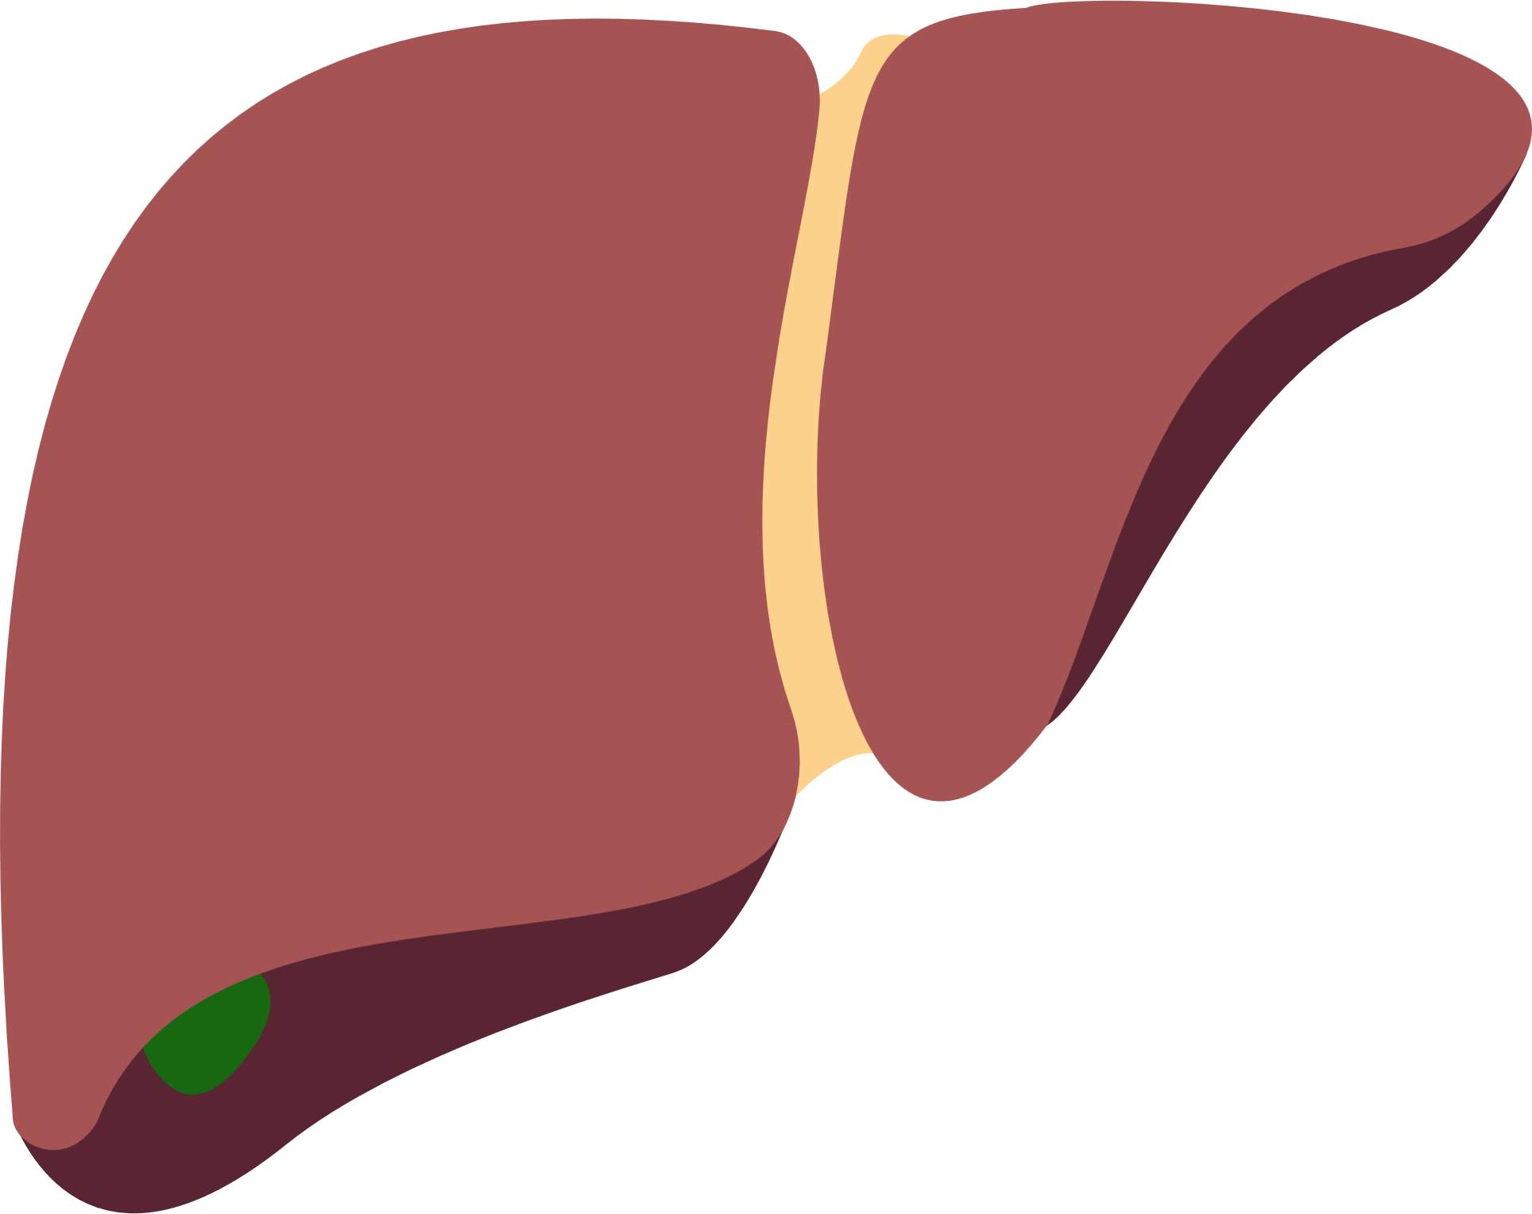
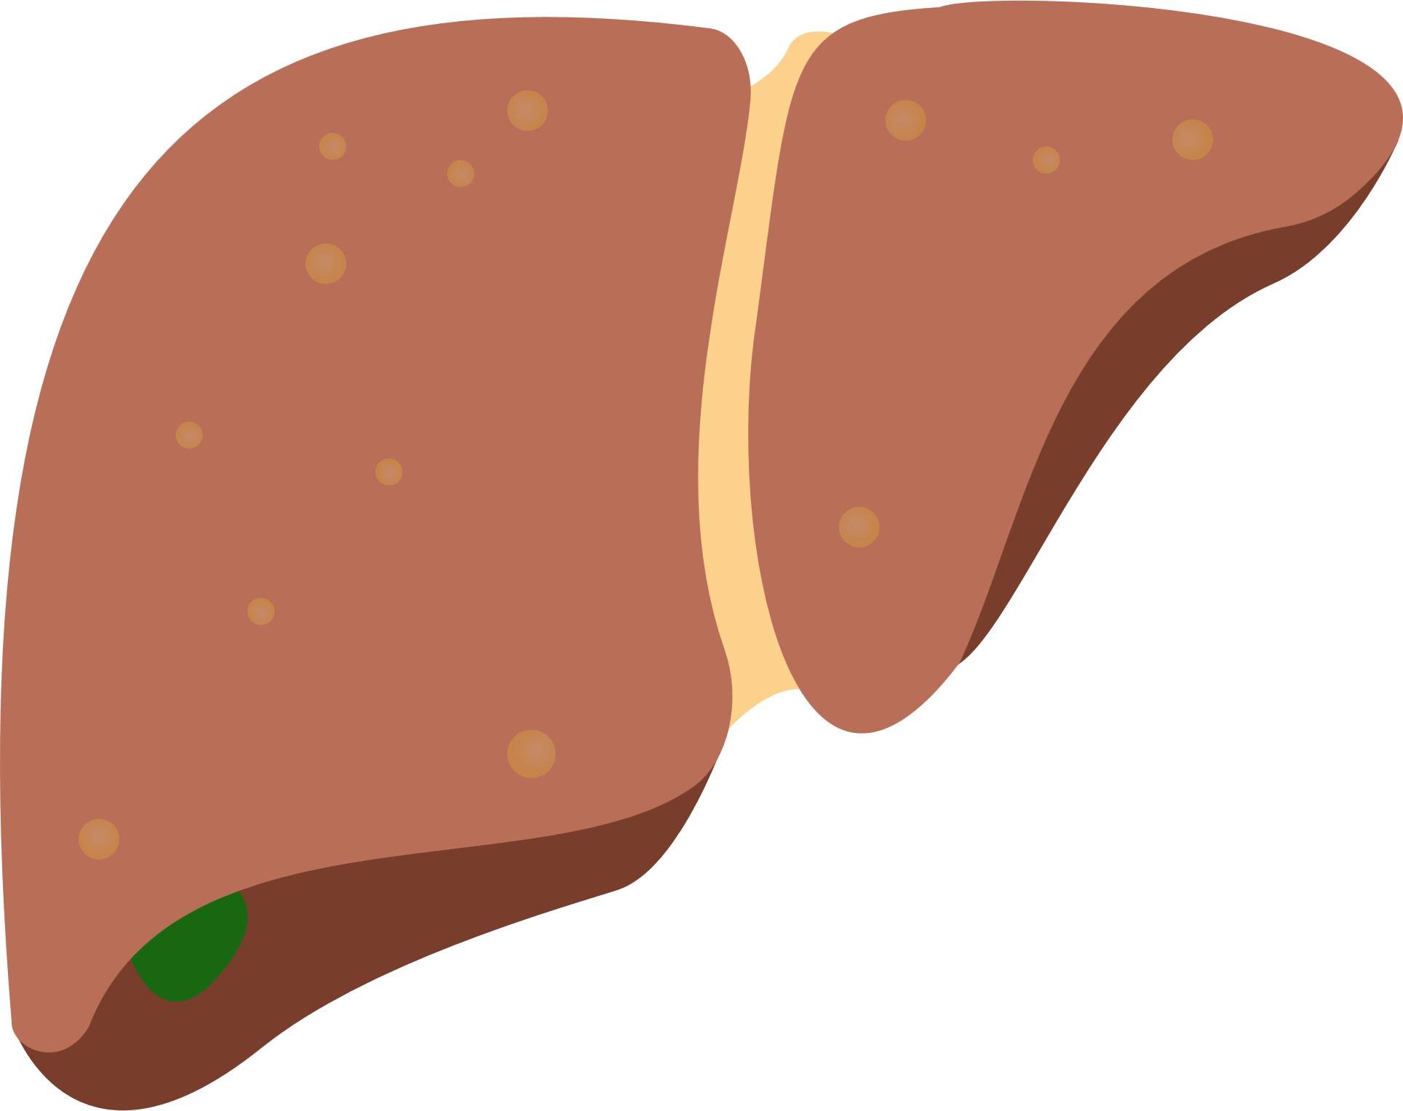

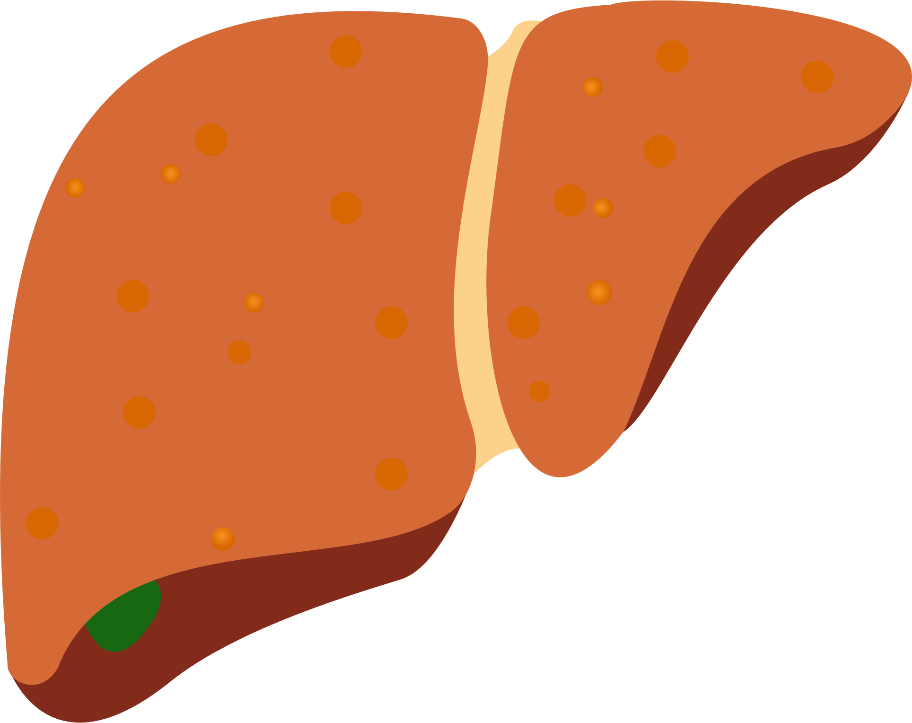
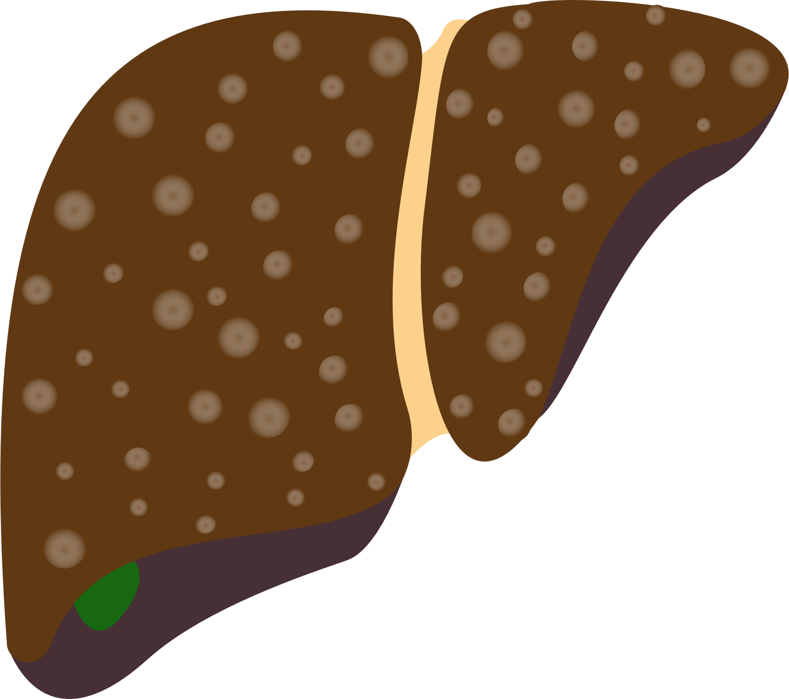
Fatty Liver Disease: Clinical Spectrum and its Burden
Mortality
Morbidity
Overall mortality vs control populations^{1,2} (HR 1.24)
Rapid progressors
T2DM & NAFLD pose a greater risk of hypertension⁵
CV events (HR 1.49)
Carotid atherosclerosis (HR 1.18)
Cardiovascular disease mortality^{2,3,4} (HR 1.28)
Slow progressors
Peripheral artery disease (HR 1.32)
Steatosis
Steatosis + lobular inflammation
NASH +/- portal inflammation
Early fibrosis
Advanced fibrosis and cirrhosis
Stroke (HR 1.55)
Cancer-related mortality⁵
(HR 1.28)
“Dynamic" steatotic/steatohepatitic phase
"Non-linear" fibrotic phase
Chronic kidney disease (HR 1.53)
A risk for endocrinopathies & osteoporosis^{6,7}
CRC x2, breast cancer x2
Liver-related mortality (HR 1.53)
Increased risk for HCC^{2,8}
DILI x4, COVID-19 x3
45% of males may have ED
1) Adams LA et al. Gastroenterology. 2005;129:113–121; 2) Söderberg C et al. Hepatology. 2010;51:595–602; 3) Wójcik-Cichy K et al. Clin Exp Hepatol. 2018;4:1–6; 4) Schwimmer JB et al. PLoS ONE. 2014;9:e112569; 5) Ding X et al. Int J Endocrinol. 2017;2017:5262560; 6) Velarde-Ruiz Velasco JA et al. Rev Gastroenterol Mex. 2019;84:472–481; 7) Armstrong MJ et al. Hepatology. 2014;59:1174–1197; 8) Yatsuji S et al. J Gastroenterol Hepatol. 2009;24:248–254; 8.Kim GA et al. J Hepatol. 2017;32294-32298.
COVID-19, Coronavirus disease 2019; CV, cardiovascular; DILI, drug indued liver injury; ED, erectile dysfunction; HCC, hepatocellular carcinoma; NAFLD, nonalcoholic fatty liver disease; NASH, non-alcoholic steatohepatitis; T2DM, type 2 diabetes mellitus.

Slide 8


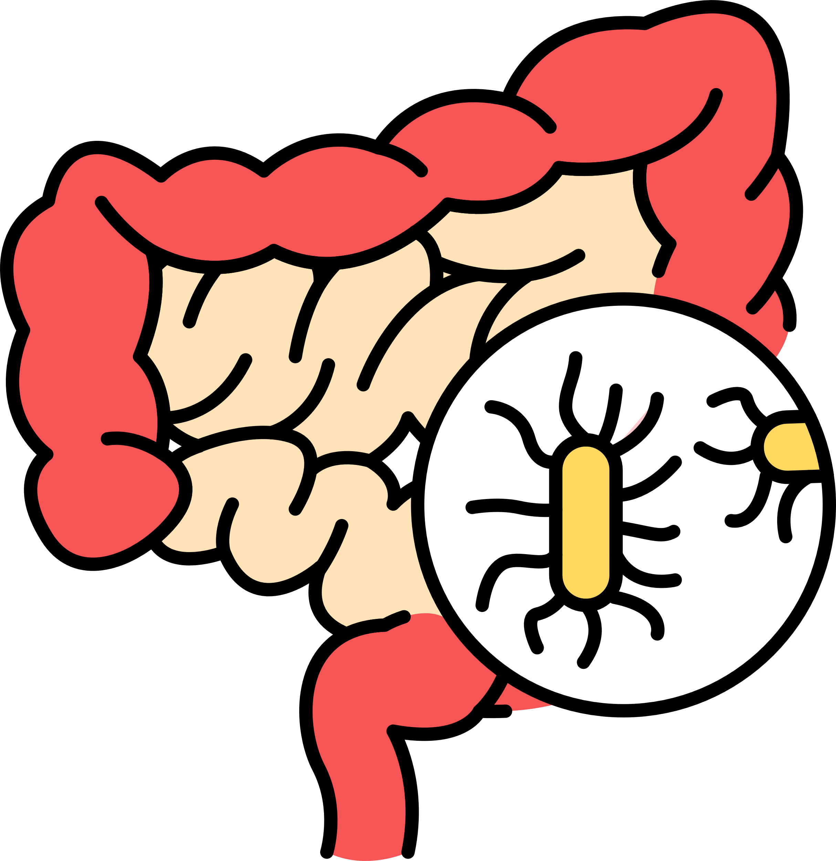
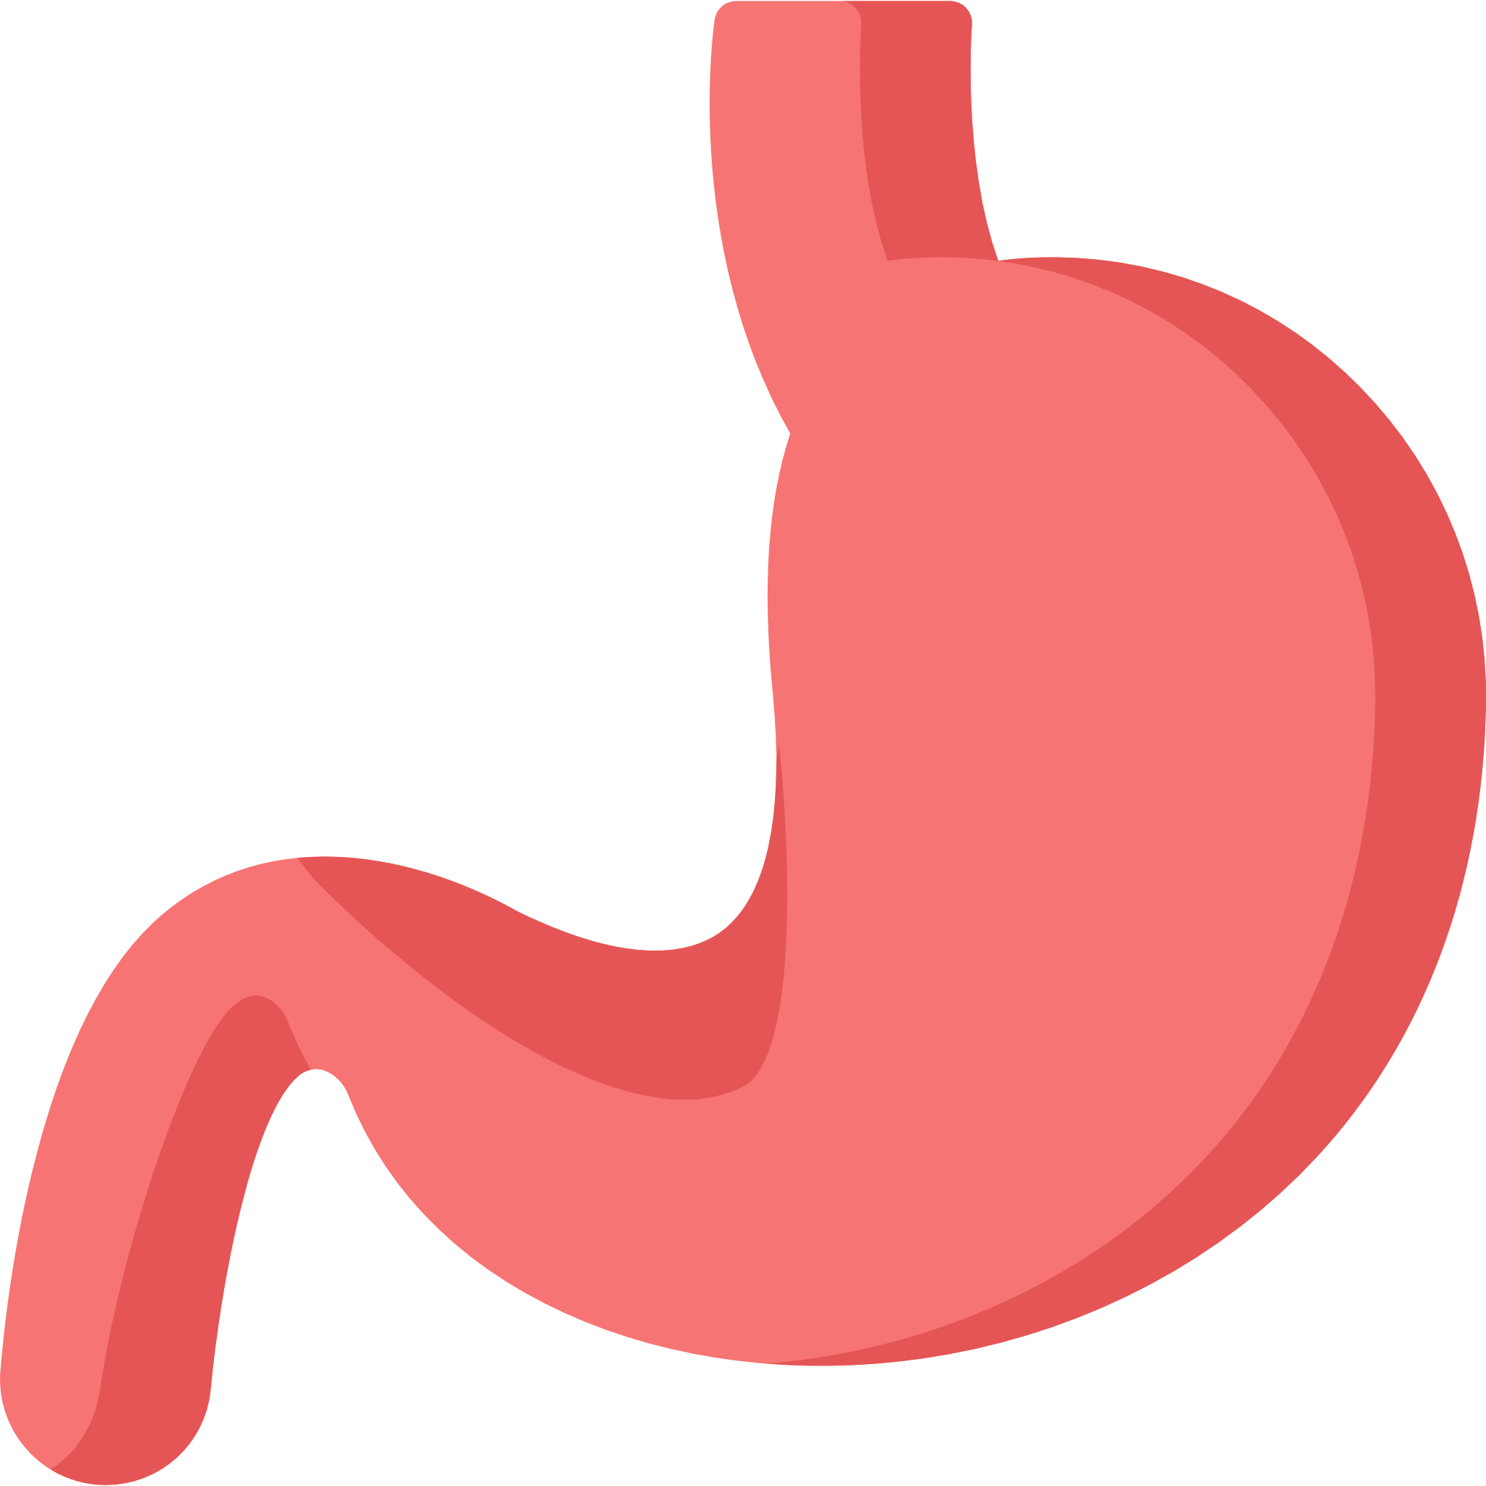


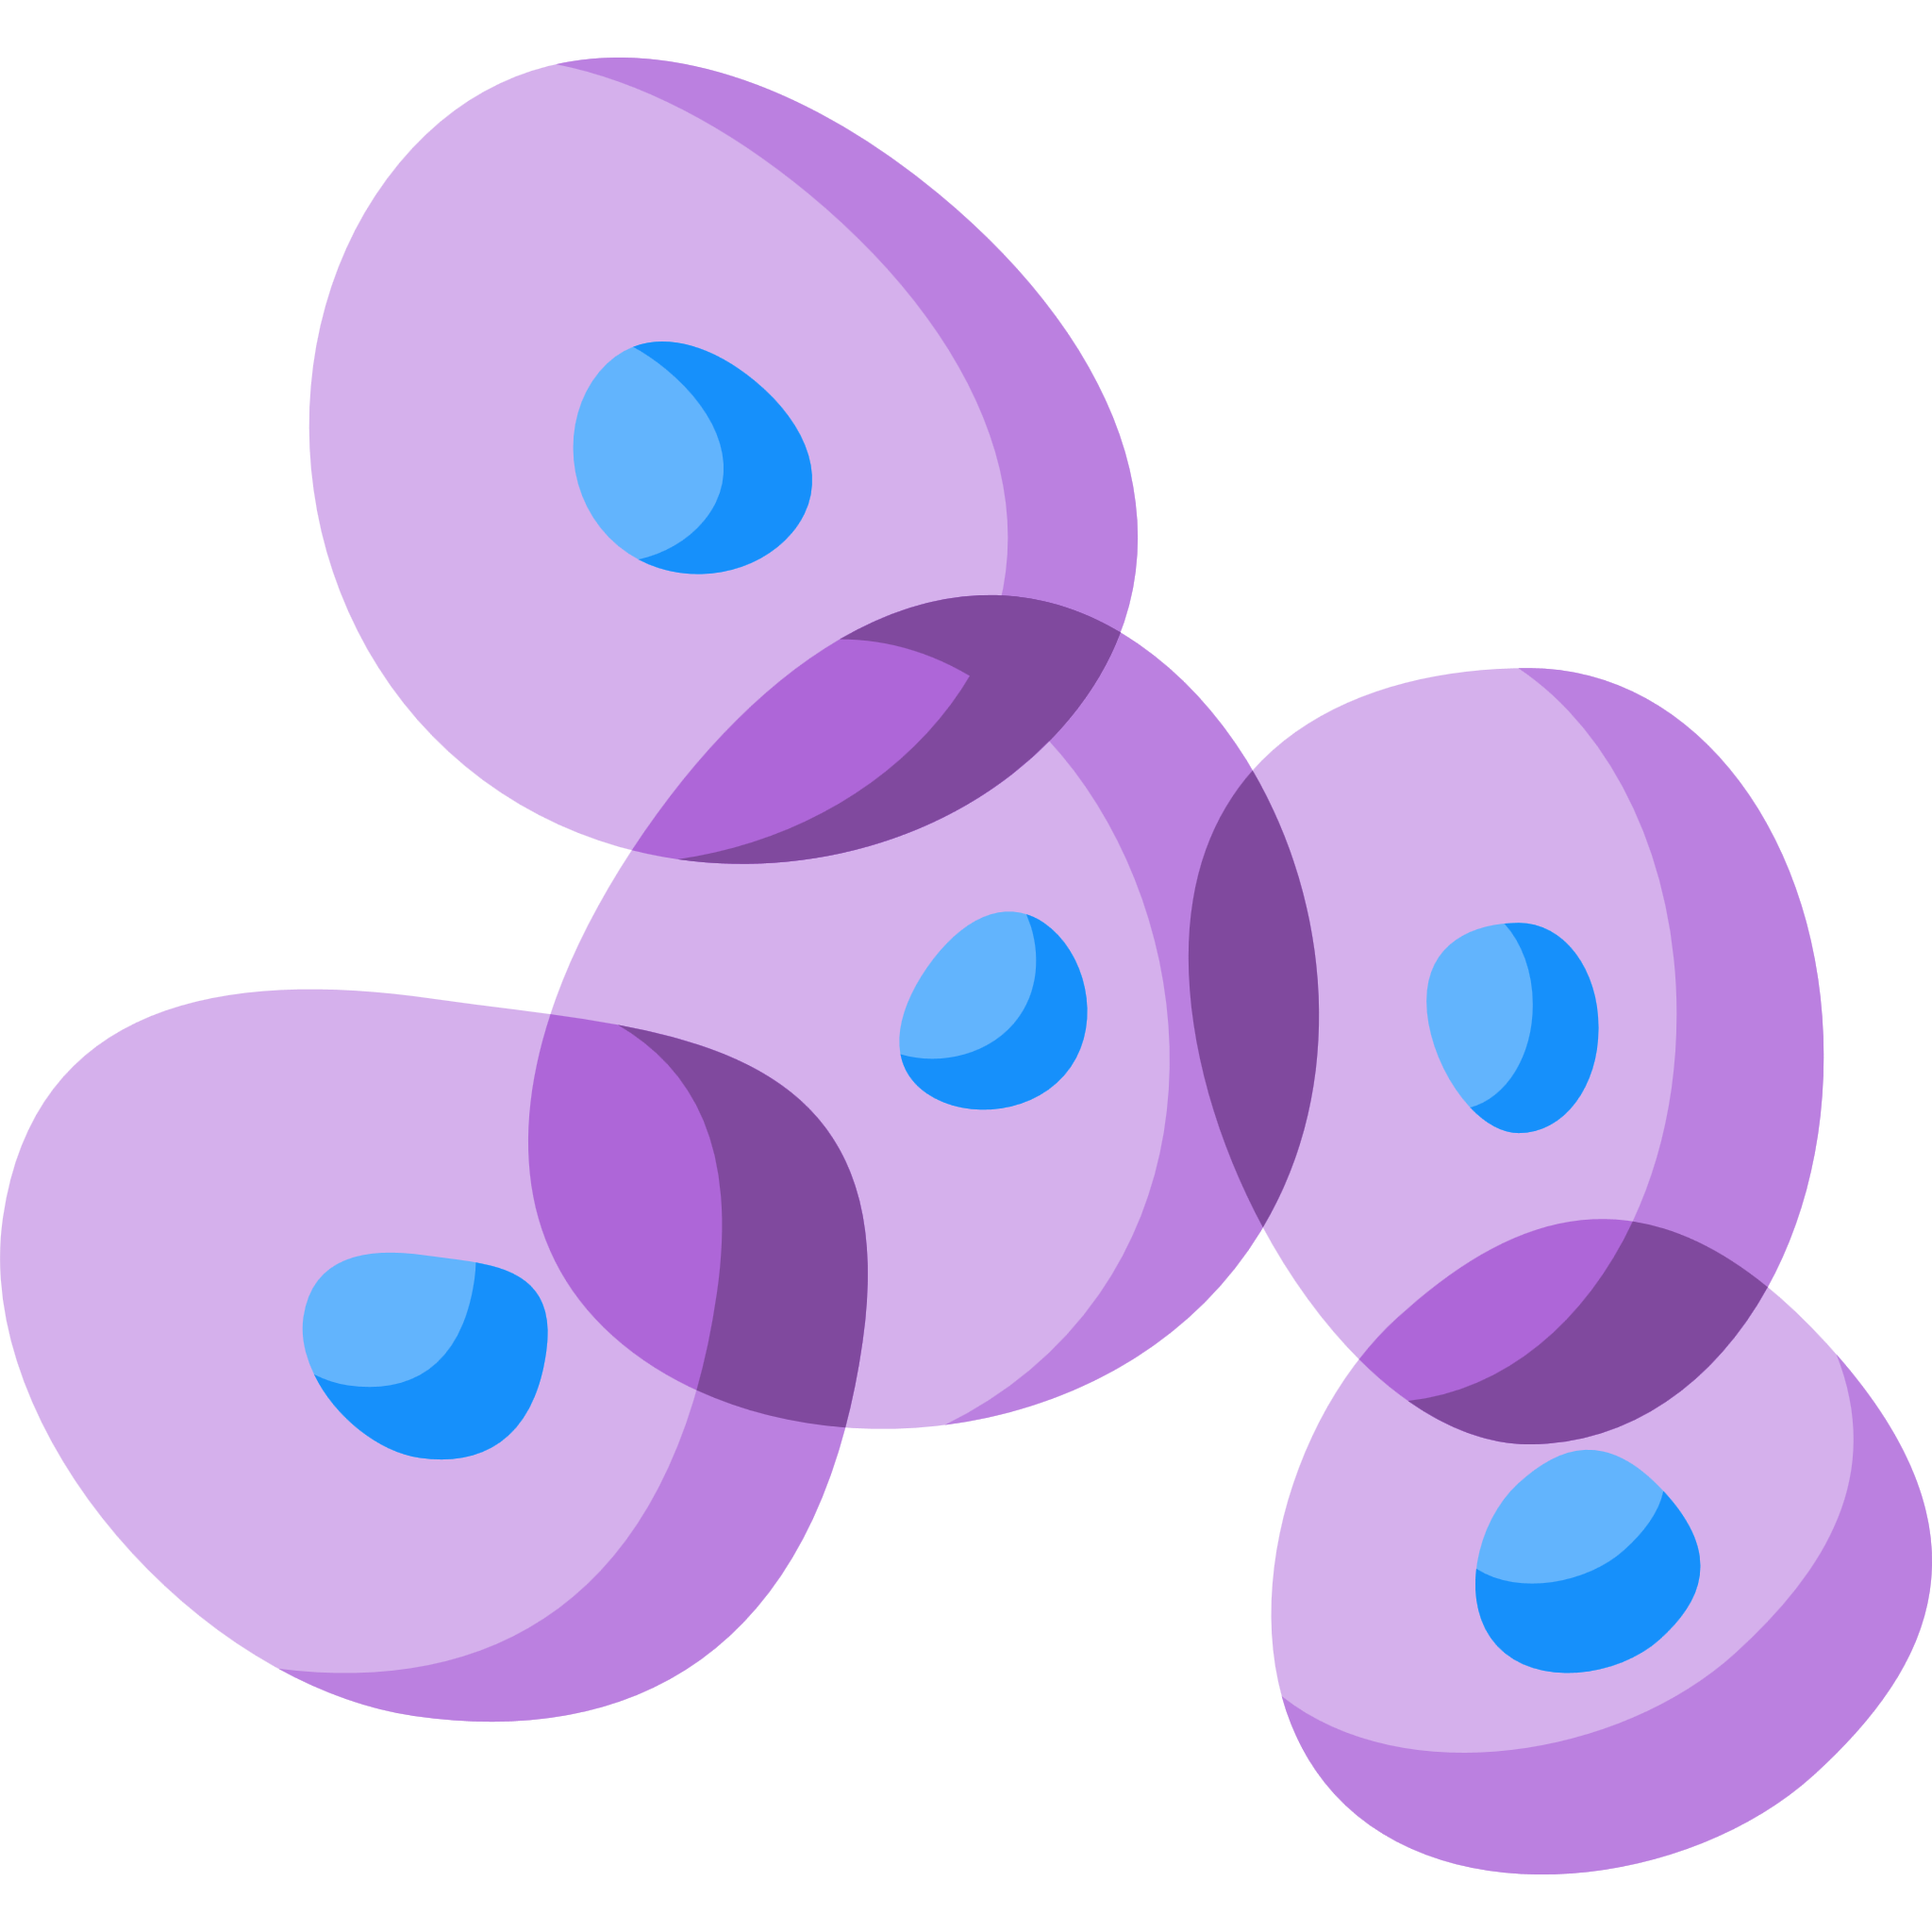
Treatment Landscape of Comorbidities Associated with MAFLD
Anti-obesity agents^{1,2}
Genetics
(PNPLA3, TM6SF2 and MBOAT7)
Lipid lowering agents
The USFDA ordered the withdrawal of lorcaserin in 2020
The anti-obesity drugs approved for long-term use:
  Orlistat, Naltrexone ER/bupropion ER, Phentermine/topiramate CR, Liraglutide
Statins have a beneficial effect on MAFLD, in terms of liver enzyme reduction and ultrasonographic amelioration⁴
Statin treatment halved CVD morbidity and mortality in statin-treated MAFLD patients⁵
Statin treatment had a protective effect on steatosis, steatohepatitis and fibrosis⁵
Statins have favorable effects on adiponectin levels and can reduce the risk of cardiovascular morbidity and mortality due to their antioxidant properties⁵
1
2
1
MAFLD
Lipotoxicity
(FFAs, proinflammatory
Cytokines and adiponectin)
Insulin sensitizers³
Lifestyle
modification
(dietary change, weight loss and structured exercise intervention)
Gut microbiota
(dysbiosis, increased gut permeability, small intestinal bacterial overgrowth and
gut-derived metabolites)
Pioglitazone have an established effect on the histology of MASH with T2DM
Metformin improves liver functions and body composition of non-diabetic patients with MAFLD
GLP-1RAs improve liver histology and reduce high cardiovascular risks in MAFLD patients
SGLT2 inhibitors, reverse liver diseases and metabolic abnormalities in MAFLD
3
2
Bariatric surgery
Sleeve gastrectomy
3
Pharmacotherapy
(anti-obesity drugs, insulin sensitizers, new antidiabetic agents, lipid-lowering agents, vitamin D and vitamin E)
4
Vitamin E and D
Insulin resistance
(hepatic tissue, adipose tissue
and muscle)
Guidelines have recommended the use of vitamin E in patients with biopsy-proven MAFLD and without diabetes⁶
Vitamin E has antioxidant, anti-inflammatory and anti-apoptotic effect in patients with MAFLD⁶
Lower serum 25-hydroxy vitamin D in patients with MAFLD might contribute to the progression of the condition⁷
Vitamin D supplementation might improve lipid profile and inflammatory mediators⁷
4
Innovative treatment
(reduce sympathetic activation, programmed cell death, nanotechnology and targeting macrophages)
Liver supporting agents
Healthy Liver
EPL, Silymarin and others
1) Tak YJ et al. Curr Obes Rep. 2021;10(1):14–30; 2) Son JW et al. Diabetes Metab J. 2020;44(6):802-818; 3) Kothari S, et al. J Clin Exp Hepatol 2019;9(6):723-730;
4) Athyros VG et al. Curr Vasc Pharmacol. 2018;16(3):246–253; 5) Ahsan F et al. Cureus. 2020;12(9):e10446; 6) Perumpail BJ et al. Diseases. 2018;6(4):86; 7) Hariri M et al. Int J Prev Med. 2019;10:14.
CVD, cardiovascular disease; CR, controlled-release; EPL, essential phospholipid; ER, extended-release; GLP-1RA, glucagon-like peptide-1 receptor agonist; MAFLD, metabolic dysfunction-associated fatty liver disease; NASH, non-alcoholic steatohepatitis; SGLT2, sodium-glucose cotransporter-2; T2DM, type 2 diabetes mellitus; USFDA, United States Food and Drug Administration.

Slide 9
Role of EPLs in the Repair of Hepatocyte Damage
Support
Did you find these results useful?
Improves cellular membrane fluidity and restore membrane-associated functions¹:
1-palmitoyl-2-linoleoyl-sn-glycero-3-phosphatidylcholine (PLiPC) improved cellular membrane fluidity
Decrease the activity of cytochrome P450 2E1, reducing alcohol-induced oxidative stress²
Inhibit hepatic stellate cell proliferation and inhibited TGF-induced collagen mRNA levels, thus reducing collagen production^{3,4}
Activate phospholipid-dependent enzymes⁵
Decrease fatty infiltration of hepatocytes⁵
Inhibit or correct fibrogenic processes⁵
Influence apoptosis⁵
Exhibit anti-inflammatory and anti-oxidant properties⁵
Autoimmune
ASH
MAFLD
EPLs
DILI
Cirrhosis
of liver
Viral hepatitis

Slide 10
Existing Evidence Supporting the Adjunctive Use of PPC in Patients with MAFLD and Comorbidities
Support
Did you find these results useful?

Slide 11
Support
Did you find these results useful?
EPLs for Patients with MAFLD with Comorbid Conditions¹
Mean values for the transaminases (IU) in the treatment groups
ALT
AST
Significant clinical improvement of all symptoms: general and gastroenterological.
Significant reduction in ALT and AST values, P=0.001.
Reasonable regression of ultrasonographic findings
and fibroscan scores.
Treatment was safe with no recordable adverse effects.
Before treatment
After treatment
Before treatment
After treatment
Ultrasound and elastography findings in the treatment groups

Slide 12




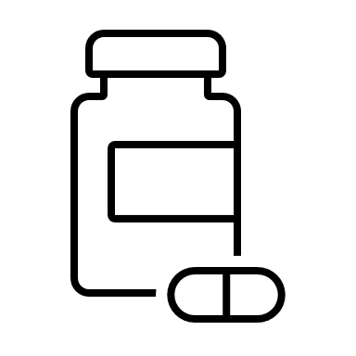










Support
Did you find these results useful?
PPC as Adjunctive Therapy in Patients with MAFLD and Metabolic Comorbidities – The MANPOWER Study^{1,2}
Study design: Observational, multicentre, prospective study
N=2843; aged 18-60Y
Sept 2015 - Sept 2016
174 medical sites across
6 federal districts of Russia
1.8 g of PPC daily in three doses as an adjunctive treatment to standard care
Inclusion
Exclusion
MAFLD diagnosed
≤30 days prior to study entry
Other
hepatoprotectors ≤30 days before study entry
Obesity
T2DM
Hypercholesterolemia
Hypertension
Other acute or chronic conditions
≤1 of four comorbidities
Endpoints
Patient demographics
Baseline
12 weeks
24 weeks
Baseline characteristics | Study population (N=2843)
Age, years | 48.7±8.6
Male/female (%) | 37.8/62.2
Weight (kg) | 91.0±14.1
Body mass index (kg/m²) | 32.0±4.6
Waist circumference (cm) | 98.4±12.4
Improvement in
liver enzymes
Improvement in lipid profile
Improvement in ultrasonographic findings
Data are expressed as mean ± SD

Slide 13
Support
Did you find these results useful?
PPC as Adjunctive Therapy Improves Liver Enzymes in Patients with MAFLD¹
Proportion of patients (%) on PPC showing increase in normal liver enzyme levels
Change in liver enzyme levels (U/L) in the overall study population on PPC
ALT
AST
GGT
0 months
3 months
6 months
50.2
38.2
30.2
43.6
33.3
27.1
51.7
42.0
35.8
Data are expressed as n (%). P value (χ2 test with Benjamini-Hochberg correction for multiple comparisons): p<0.001.
Data are expressed as mean ± SD. all p<0.001 by paired t-test
Relative to baseline, at the end of 24 weeks:
A significantly higher proportion of patients (p<0.001) attained normal levels of liver enzymes compared with baseline.
A significant reduction in serum ALT, AST, and GGT levels was noted in the overall study population.

Slide 14
Support
Did you find these results useful?
PPC as Adjunctive Therapy Improves Liver Enzymes in Patients with MAFLD and Comorbidities¹
Changes in liver function tests at 24 weeks of the study, according to the nature and number of comorbidities
Comorbidity | Enzyme activity (U/L) at 24 weeks of the study
 | ALT |  | AST |  | GGT
[ | Baseline | Change from baseline | Baseline | Change from baseline | Baseline | Change from baseline
Type
Hypertension | 50.3±32.8 | −19.7±26.5 | 44.3±27.3 | −16.9±21.8 | 53.7±39.3 | −17.6±31.6
Overweight/ obesity | 52.3±34.7 | −21.6±29.4 | 45.1±26.6 | −17.7±21.6 | 52.6±38.0 | −17.9±31.6
T2D | 53.9±31.0 | −22.0±22.7 | 46.4±24.9 | −18.4±19.9 | 57.7±38.2 | −18.7±31.2
Elevated cholesterol | 51.4±33.4 | −20.8±27.3 | 44.8±26.8 | −17.1±21.6 | 52.3±37.4 | −17.2±30.6
Number
One | 44.5±30.9 | −18.4±28.1 | 38.2±20.5 | −14.8±18.2 | 47.8±39.0 | −15.7±33.5
Two | 49.7±33.0 | −20.4±28.2 | 42.8±23.3 | −16.2±19.3 | 48.8±33.6 | −15.5±28.4
Three | 52.8±34.2 | −21.2±28.3 | 47.1±30.5 | −18.7±24.3 | 56.5±40.7 | −19.5±32.4
Four | 56.3±33.5 | −22.4±23.9 | 47.5±25.6 | −17.9±20.3 | 57.2±39.7 | −18.6±32.9
There was a mean drop from baseline in ALT levels ranging from 19.7 to 22.0U/L, of AST from 16.9 to 18.4U/L, and of GGT from 17.2 to 18.7U/L in all comorbidity subgroups.
Liver enzyme levels decreased in the subgroups with either one, two, three, or four comorbidities, ranging from 18.4 to 22.4U/L for ALT, from 14.8 to 18.7U/L for AST, and from 15.5 to 19.5U/L for GGT.
Data are expressed as mean±SD. p<0.001 compared with baseline, paired t-test.
Notes:
Figure 1: Compared with baseline, mean ALT levels decreased by 20.0U/L, mean AST by 16.5U/L, and mean GGT by 15.9U/L at 24 weeks of the study.

Slide 15
Support
Did you find these results useful?
PPC as Adjunctive Therapy Improves Lipid Parameters in Patients on/not on Lipid-lowering Therapy¹
Mean changes in serum lipid profile from baseline to 12 weeks and 24 weeks
Compared with baseline, all lipid parameters were significantly improved at 12 and 24 weeks of the study in both subgroups.
Patients undergoing LPT had significantly greater improvements in all lipid parameters at both 12 and 24 weeks.
p<0.05, by Wilcoxon-Mann-Whitney test with Benjamini-Hochberg correction for multiple comparisons.

Slide 16
Support
Did you find these results useful?
PPC as Adjunctive Therapy Improves Liver Enzymes in Patients with MAFLD and Comorbidities¹
Proportion (%) of patients with improved ultrasonographic findings after 24 weeks of PPC treatment
 |  | Nature of comorbidity |  |  |  | No. of comorbidity nature
Features (%) |  | Hypertension (n=1635) | Overweight/obesity (n=2285) | T2D (n=475) | High cholesterol (n=2119) | One (n=570) | Two (n=1108) | Three (n=868) | Four (n=281)
Diffuse liver hyperechogenicity | Baseline | 84.5 | 83.3 | 86.0 | 84.7 | 80.4 | 84.1 | 83.0 | 89.7
 | Improved | 67.7 | 68.8 | 68.2 | 67.8 | 69.3 | 68.8 | 67.2 | 69.0
Heterogeneous structure of the liver | Baseline | 58.3 | 63.3 | 62.1 | 64.2 | 53.3 | 64.9 | 65.7 | 62.4
 | Improved | 43.6 | 43.3 | 40.6 | 43.7 | 35.6 | 45.3 | 45.3 | 38.8
Indistinctness and/or underlined vascular pattern | Baseline | 29.1 | 26.9 | 30.6 | 28.8 | 49.7 | 24.6 | 31.1 | 35.5
 | Improved | 24.8 | 23.1 | 24.8 | 24.4 | 15.4 | 21.1 | 26.5 | 24.4
Distal echo signal attenuation | Baseline | 28.0 | 31.0 | 33.3 | 29.6 | 19.3 | 27.6 | 31.7 | 36.2
 | Improved | 21.7 | 22.5 | 22.7 | 21.5 | 14.6 | 20.0 | 23.8 | 25.3
P<0.05; Data are expressed as a percentage of n
The most frequently identified abnormalities on ultrasound at baseline were liver hyperechogenicity and heterogeneous liver structure which were significantly improved at 24 weeks.
Liver echogenicity improved in 67.2%–69.3% and liver structure in 35.6%–45.3% of patients depending on the number of comorbidities.

Slide 17
Patient and Clinician Satisfaction Seem to Correlate With Objective Improvements in Patients with MAFLD/MASLD and Comorbidities Receiving EPLs as Adjunctive Treatment¹
Support
Did you find these results useful?
A pooled analysis (EPOCH-2) of 3 Russian real-world studies: MANPOWER; LIDER; LIDER-2 (n=3,384)
Clinician satisfaction and laboratory improvements
Patient satisfaction and liver structure improvements
Laboratory improvements, median change from baseline | Clinician satisfaction
Laboratory improvements, median change from baseline | Low + very low | High + very high | p value†
ALT, U/L | –8.0 | –15.0 | <0.001
AST, U/L | –7.0 | –13.0 | <0.001
GGT, U/L | –6.0 | –10.0 | <0.001
HbA1c, % | –0.1 | –0.1 | 0.029
Total cholesterol, mmol/L | –0.6 | –1.1 | <0.001
HDL, mmol/L | 0.1 | 0.1 | 0.028
LDL, mmol/L | –0.4 | –0.8 | <0.001
VLDL, mmol/L | 0.0 | –0.2 | <0.001
Triglycerides, mmol/L | –0.2 | –0.4 | <0.001
ALP, U/L | –8.5 | –13.6 | <0.001
Total bilirubin, µmol/L | –1.0 | –2.0 | <0.001
 | Improvement |  | P value‡
Patient’s satisfaction, %* | Low + very low | High + very high
Diffuse hyperechogenicity of the liver parenchyma on ultrasound | 65.3 | 84.6 | <0.001
Heterogeneity of liver structure on ultrasound | 61.8 | 81.2 | <0.001
Vascular blurring and/or underlined vascular pattern on ultrasound | 67.4 | 87.9 | <0.001
Distal attenuation of the echo-signal | 51.8 | 77.8 | <0.001
*Clinicians’ and patients’ satisfaction with EPL treatment were assessed on a 10-point scale, where 1 is the lowest satisfaction and 10 is the highest satisfaction. †Wilcoxon signed-rank test. ‡chi squared test.

Slide 18
Support
Did you find these results useful?
EPLs Adjunctive Treatment-associated Reduction of Symptoms Frequency Reported by Patients in MANPOWER Cohort¹
Symptom frequency at baseline and after 24 weeks of treatment (MANPOWER study cohort)
Symptom/complaint | Number of patients (%) experiencing each symptom |  | P valueª
 | Before treatment | After treatment
Abdominal distension | 1475 (53.8) | 365 (13.3) | <0.0001
Headache and muscular pain | 555 (20.2) | 77 (2.8) | <0.0001
Epigastric discomfort | 2254 (82.1) | 268 (9.8) | <0.0001
Pruritus | 173 (6.3) | 9 (0.3) | <0.0001
General weakness | 1306 (47.6) | 257 (9.4) | <0.0001
Lack of appetite | 460 (16.8) | 40 (1.5) | <0.0001
Fatigue | 1480 (53.9) | 398 (14.5) | <0.0001
Irritability | 693 (25.3) | 98 (3.6) | <0.0001
Nausea | 1067 (38.9) | 50 (1.8) | <0.0001
ªChi-squared test

Slide 19
EPLs Adjunctive Treatment is Associated With Significant Improvements of Symptoms in MAFLD/MASLD – Effects on Disease Burden¹
Support
Did you find these results useful?
Lean MAFLD
Diabetic MAFLD
Hyperlipidemic MAFLD
 | Subjects | After treatment | Subjects | After treatment | Subjects | After treatment
Asymptomatic | (n=70) 61.9% | (n=92) 81.4% | (n=64) 59.8% | (n=85) 79.4% | (n=55) 52.9% | (n=80) 76.9%
Symptomatic | (n=43) 38.1% | (n=21) 18.6% | (n=43) 40.2% | (n=22) 20.6% | (n=49) 47.1% | (n=24) 23.1%
General symptoms Asthenia Sleeping disorder Irritability | (13/43) 30.2% (13/43) 30.2% (14/43) 32.6% | (3/21) 14.3% (2/21) 9.5% (3/21) 14.3% | (19/43) 44.2% (13/43) 30.2% (21/43) 48.8% | (4/22) 18.2% (3/22) 13.6% (6/22) 27.3% | (19/49) 44.2% (13/49) 30.2% (21/49) 48.8% | (13/24) 30.2% (8/24) 18.6% (6/24) 13.9%
GI symptoms Postprandial distress Flatulence RUQ pain Nausea Heartburn | (12/43) 27.9% (13/43) 30.2% (9/43) 20.9% (8/43) 18.6% (5/43) 11.6% | (4/21) 19.0% (6/21) 28.6% (2/21) 9.5% (2/21) 9.5% (3/21) 14.3% | (21/43) 48.8% (21/43) 48.8% (9/43) 20.9% (8/43) 18.6% (5/43) 11.6% | (6/22) 27.3% (8/22) 36.4% (4/22) 18.2% (3/22) 13.6% (2/22) 9.1% | (21/49) 42.9% (21/49) 42.9% (9/49) 18.3% (8/49) 16.3% (5/49) 10.2% | (9/24) 20.9% (18/24) 41.9% (4/24) 9.3% (7/24) 16.3% (2/24) 4.65%
Clinical finding Jaundice Hepatomegaly | (4/43) 9.3% (9/43) 20.9% | (2/21) 9.5% (4/21) 19.0% | (5/43) 11.6% (13/43) 30.2% | (2/22) 9.1% (2/22) 9.1% | (5/49) 10.2% (13/49) 26.5% | (3/24) 6.97% (11/24) 25.6%
 |  | P<0.01 |  | P<0.01 |  | P<0.01

Slide 20
Other Innovative Therapeutics for MAFLD
Support
Did you find these results useful?
Emerging therapeutics in phase II/III registration¹
Pathogenesis Target | PPAR Target | GLP-1R target | FXR and FGF Targets | Fibrosis Targets
ACC inhibitor Firsocostat PF-05221304 | PPARγ agonist Pioglitazone | GLP1R agonist Semaglutide Liraglutide | FXR agonist 1st generation OCA (Ocaliva) | LOXL-2 Simtuzumab
FASN inhibitor TVB-2640 | PPARδ agonist Seladelpar | GLP1R+GIPR agonist Tirzepatide | FXR agonist 2nd generation Vonafexor Tropifexor Cilofexor | ASK1 Selonsertib
DGAT2 inhibitor Ervogastat PF-06865571 PF-05221304 | PPARα/γ/δ agonist Elafibranor | GLP1R+GCG agonist Cotadutide | FGF19 analogue Aldafermin | CCR2 & CCR5 Cenicriviroc
Artificial ω-3 PUFAs Icosabutate | PPARα/γ agonist Saroglitazar | GLP1R/GCG/GIPR Efocipegtrutide | FGF21 analogue Efruxifermin | Gal-3 inhibitor Belapectin
THR-β1 agonist Resmetirom

Slide 21
Existing Evidence Supporting the Adjunctive Use of PPC in Patients with DILI
Support
Did you find these results useful?

Slide 22



Hepatotoxic Liver Disease: Drug- and Chemical- Induced
Risk factors^{1,2}
Host Factors
Genetic
Ethnicity
Sex
Comorbidity
HLA alleles
Polymorphisms
Mitochondrial variations
Metabolomics
Alteration in drug transport and clearance
Detoxification process errors
Enzyme inhibitions
Environmental Factors
Viral coinfection
Products of mitochondrial stress
Co-Rx of immune-modulators
Alcohol consumption
Compound Factors
Molecular weight
Dose
Chemical structure
Lipophilicity

Slide 23
Types of DILI and the Causal Agents¹
Intrinsic
Paracetamol, amiodarone, valproic acid, statins and anti-metabolites
Hepatic: Isoniazid, nitrofurantoin, lamotrigine, interferon-B, anti-TNF agents,
proton-pump inhibitors
Cholestatic: Amoxicillin/clavulanate, trimethoprim, azathioprine
DILI
Idiosyncratic
Mixed: Fluoroquinolone, macrolides, phenytoin, carbamazepine, sulfasalazine
Steatohepatitis: Amiodarone, tamoxifen, methotrexate
Indirect
Neoplastic: Anabolic steroids
Vascular: Azathioprine
Notes:
Types of DILI
Intrinsic
Direct hepatotoxic effect in individuals with exposure exceeding critical dose
Common predictable, dose dependent and reproducible experimentally
Short and consistent latency period
Distinctive liver pathology
Higher incidence
Idiosyncratic
Affects only susceptible individuals
May be caused by agents without hepatotoxicity
Unpredictable, dose independent, and not reproducible experimentally
Long and variable latency period
Variable liver pathology and clinical expression
Lower incidence
Indirect
Exposure of one week to few months
Caused by the action of the drug, neither toxic nor idiosyncratic
Leads to exacerbation of existing liver disease or to a Novo liver disease
Immune mediated
Obesity, triglycerides and insulin sensitivity are risk factors

Slide 24


Management of DILI: Role of Hepatoprotectors^{1,2}
Prevention
Treatment
Primary prevention remains the key to avoiding DILI and the need for acute treatment.
Rational drug prescribing is central to minimizing DILI particularly in patients with risk factors.
Pharmacogenomics, including human leukocyte antigen genotyping and the discovery of specific DILI biomarkers offers significant promise for the future.
Caution should be exercised in the empirical treatment for tuberculosis.
The offending drug(s) is/are discontinued.
Treatment for patients with marked jaundice, ascites, encephalopathy and coagulopathy:
N-Acetyl Cysteine
Corticosteroids
Hepatoprotectants: EPLs, Silymarin, Glycerrhizin, SAMe, UDCA
Bile acid sequestrants
Patients needing intensive supportive care
should be transferred to advanced centers
for consideration of:
Liver support systems
Emergency transplantation with acute
liver failure.
1) Devarbhavi H. J Clin Exp Hepatol. 2012; 2(3):247-259; 2) Stine JG et al. Expert Rev Gastroenterol Hepatol. 2016;10(4):517-536.
DILI, drug-induced liver injury; EPL, essential phospholipid; SAMe, S-adenosine methionine; UDCA, ursodeoxycholic acid.
24

Slide 25
PPC and Silymarin for Management of DILI
Author | Type of research | Drug | Result
Lei et al¹ | Literature analysis | Multiple drugs | LFT improvement
Liu et al² | Retrospective controlled study | Anti-TB drug | LFT improvement
Enjalbert et al³ | Retrospective analysis | Toadstool | Survival improvement
Grabhorn et al⁴ | Retrospective study | Toadstool | Survival improvement
Masoumeh et al⁵ | Open Label randomized clinical trial | Anti-convulsive drugs | LFT improvement
Marjani et al⁶ | Randomized double blind clinical trial | Anti-TB drug | NSD
Zhao et al⁷ | Retrospective cohort study | Multiple drugs | LFT improvement
1) Lei X et al. J Int Med Res. 2021;49(8):1-14; 2) Liu Y et al. J Prac Hepatol. 2021;24(2):228–231; 3) Enjalbert F et al. J Toxicol Clin Toxicol. 2002;40(6):715–757; 4) Grabhorn E et al. Pediatr Transpl. 2013;17(6);550–555; 5) Masoumeh A et al Inflamm Cel Signal 2. 2015;e971; 6) Marjani M et al. Gastroenterol Hepatol Bed Bench. 2019;12(2):138–142; 7) Zhao et al. Gansu Med J. 2021;40(6):490–493.
DILI, drug-induced liver injury; LFT, liver function test; NSD, no significant difference; PPC, polyenyl phosphatidylcholine; TB, tuberculosis.

Slide 26
Support
Did you find these results useful?
Efficacy of PPC in Anti-tuberculosis Agents-induced
Liver Injury¹
Study design: Retrospective controlled study
N=78
Mar 2018 – Mar 2019
Inclusion: Patients with DILI during anti-tuberculosis therapy for pulmonary tuberculosis
Diammonium glycyrrhizinate vs. PPC orally for 12 weeks
Endpoints: Serum IL-6, IL-1β, TNF-ɑ, serum HO-1, GSH-Px and SOD levels
Results
Parameter | PPC | Control group
ALT (U/L) | 28.1 ± 20.5 | 59.4 ± 22.7
AST (U/L) | 345.1 ± 17.3 | 45.1 ± 17.3
TNF-ɑ (pg/mL) | 7.4 ± 1.5 | 10.3 ± 1.8
IL-1β (ng/mL) | 13.7 ± 2.1 | 34.2 ± 4.8
HO-1 (U/L) | 294.1 ± 16.9 | 198.8 ± 17.2
SOD (U/L) | 544.2 ± 13.3 | 421.0 ± 12.8
At the end of 12 weeks, PPC group experienced significantly (P<0.05) higher serum HO-1 and SOD levels and lower oxidative stress response.
Data are expressed as mean±SD

Slide 27
Support
Did you find these results useful?
Efficacy of PPC in Chemotherapeutic Agents-induced
Liver Injury¹
Study design: Open-label, controlled study
Patients with solid malignant tumours received chemotherapeutic agents for 3 weeks in combination with:
  Chemotherapy alone (n=55) (chemotherapy 231 episodes)
  PPC, 600 mg, t.i.d + chemotherapy (n=70) (chemotherapy 202 episodes)
N=150
Percentage of patients with an increase in serum ALT activities during chemotherapy in combination with PPC
Percentage of patients with an increase in Grade 3/4 liver function (WHO) impairment during chemotherapy in combination with PPC
Lower incidence of liver dysfunction with PPC after chemotherapy (16.8% vs 44.2%, p<0.0001) and lower hepatoxicity grade (2.5% vs 13.9%, p<0.0001)

Slide 28
Support
Did you find these results useful?
Summary
1
PPC has a promising role in the management of patients with MAFLD and its extrahepatic manifestations.
2
PPC adjunctive therapy is effective in improving liver function markers of MAFLD in patients with associated metabolic comorbidities.
3
PPC might have a positive impact on serum lipid profile.
4
Liver transaminases can be useful markers for monitoring the progression of MAFLD over time.
5
PPC adjunctive therapy can effectively improve the ultrasonographic features of MAFLD in routine clinical practice in patients with metabolic comorbidities.
6
Long-term intake of EPLs can be beneficial to patients with metabolic comorbidities.
7
PPC is one of the potential hepatoprotective drugs for DILI.

Slide 29
Thank you

