Slide 1
Reducing the burden of liver disease
New evidence revealed

Slide 2

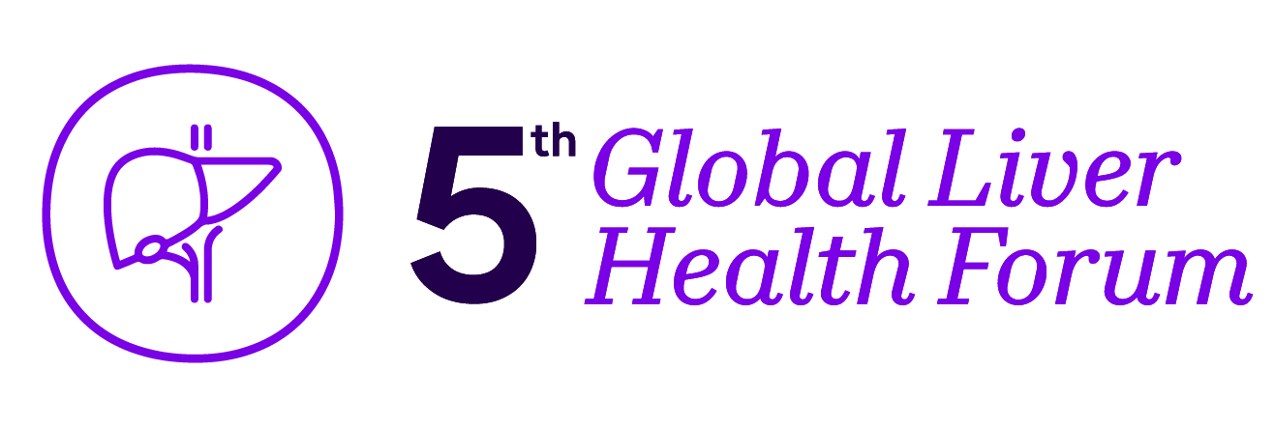
Metabolic Comorbidities Unmasked: Redefining MASLD/MASH Impact
Professor Marek Hartleb
Department of Gastroenterology and Hepatology, Faculty of Medicine, Medical University of Silesia, Katowice, Poland
MAT-GLB-2402732-v-1.0 │ Date of approval: May 2024

Slide 3


Disclosures
Received lecture honoraria from Sanofi and ProMed

Slide 4
Steatotic liver disease nomenclature changes
NAFLD
MAFLD
MASLD
Non-Alcoholic
Fatty Liver Disease
Metabolic Dysfunction-Associated
Steatotic Liver Disease
Exclusion
Inclusion
Alcohol intake moderate/severe
< 140 g/wk. (F), < 210 g/wk. (M)
Viral hepatitis
Other known etiologies of CLD
Overweight/Obesity
T2DM
Metabolic disorders
CLD, chronic liver disease; F, female; M, male; MAFLD, metabolic dysfunction-associated fatty liver disease; MASLD, metabolic disfunction-associated steatotic liver disease; NAFLD, non-alcoholic fatty liver disease; T2DM, type 2 diabetes mellitus.
EASLTM The home of hepatology. Available at https://easl.eu/news/new_fatty_liver_disease_nomenclature-2
Notes:
.

Slide 5
Steatotic liver disease (SLD)
SLD
Alcohol liver disease
MASLD & increased alcohol intake (MetALD)
Metabolic Dysfunction-Associated Steatotic Liver Disease (MASLD)
Other metabolic liver diseases
Drug-related SLD
Cryptogenic SLD
> 350 g (F)
> 420 g (M)
140-350 g/(F)
210-420 g (M)
EtOH/weekly
At least 1 among 5 cardiometabolic criteria
BMI > 25 kg/m² OR waist circumference > 94 cm/80 cm in males/females
Fasting glucose level > 100 mg/dL (> 5.6 mmol/l) OR > 140 mg/dL (>7,8mmol/l) at 2 hr in OGTT
Blood pressure > 130/85 mmHg OR treatment
TG level > 150 mg/dL) OR treatment
HDL-cholesterol level < 40/50 mg/dL in males/females OR treatment
Resigning of more demanding criteria like HOMA-IR test
BMI is only one of five independent criteria - 40% of MASLD patients are non-obese (BMI 25-30 kg/m²)
Pathophysiological significance of alcohol intake in range of 140-350/210-420 g/wk (F/M) is poorly known
BMI, body mass index; EtOH, ethyl alcohol; F, female; HDL, high density lipoprotein; HOMA-IR, homeostatic model assessment of insulin resistance; M, male; MASLD, metabolic-disfunction associated steatotic liver disease; OGTT, oral glucose tolerance test; SLD, Steatotic liver disease; T2DM, type 2 diabetes mellitus; TG, triglycerides
AASLD. Available at https://www.aasld.org/new-masld-nomenclature

Slide 6
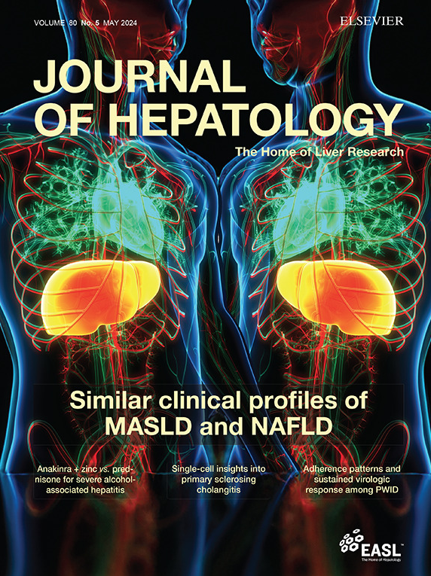




Clinical profiles and mortality rates are similar for metabolic dysfunction-associated steatotic liver disease and non-alcoholic fatty liver disease
Zobair M. Younossi, James M. Paik, Maria Stepanova, Janus Ong, Saleh Alqahtani, Linda Henry
Patients: tertiary-care NAFLD database + NHANES-III
Excellent diagnostic concordance between NAFLD and MASLD (Cohen’s kappa coefficient 0.968; 95%CI 0.962-0.973)
Median follow-up 22.83 years; no differences in all-cause, cardiac and cancer mortality rates between NAFLD and MASLD
NAFLD and MASLD can be used interchangeably
CI, confidence interval; MASLD, metabolic disfunction-associated steatotic liver disease; NAFLD, non-alcoholic fatty liver disease; NHANES, National Health and Nutrition Examination Survey
Younossi ZM, et al. J Hepatol 2024;80:694-701.

Slide 7





Endocrinologist
Diabetologist
Heart
Vessels
Kidneys
LIVER
Cardiologist
Primary care doctor
MASLD-based diagnostic criteria better identify
population with cardio-metabolic risks than those of NAFLD
MASLD, metabolic disfunction-associated steatotic liver disease; NAFLD, non-alcoholic fatty liver disease.

Slide 8


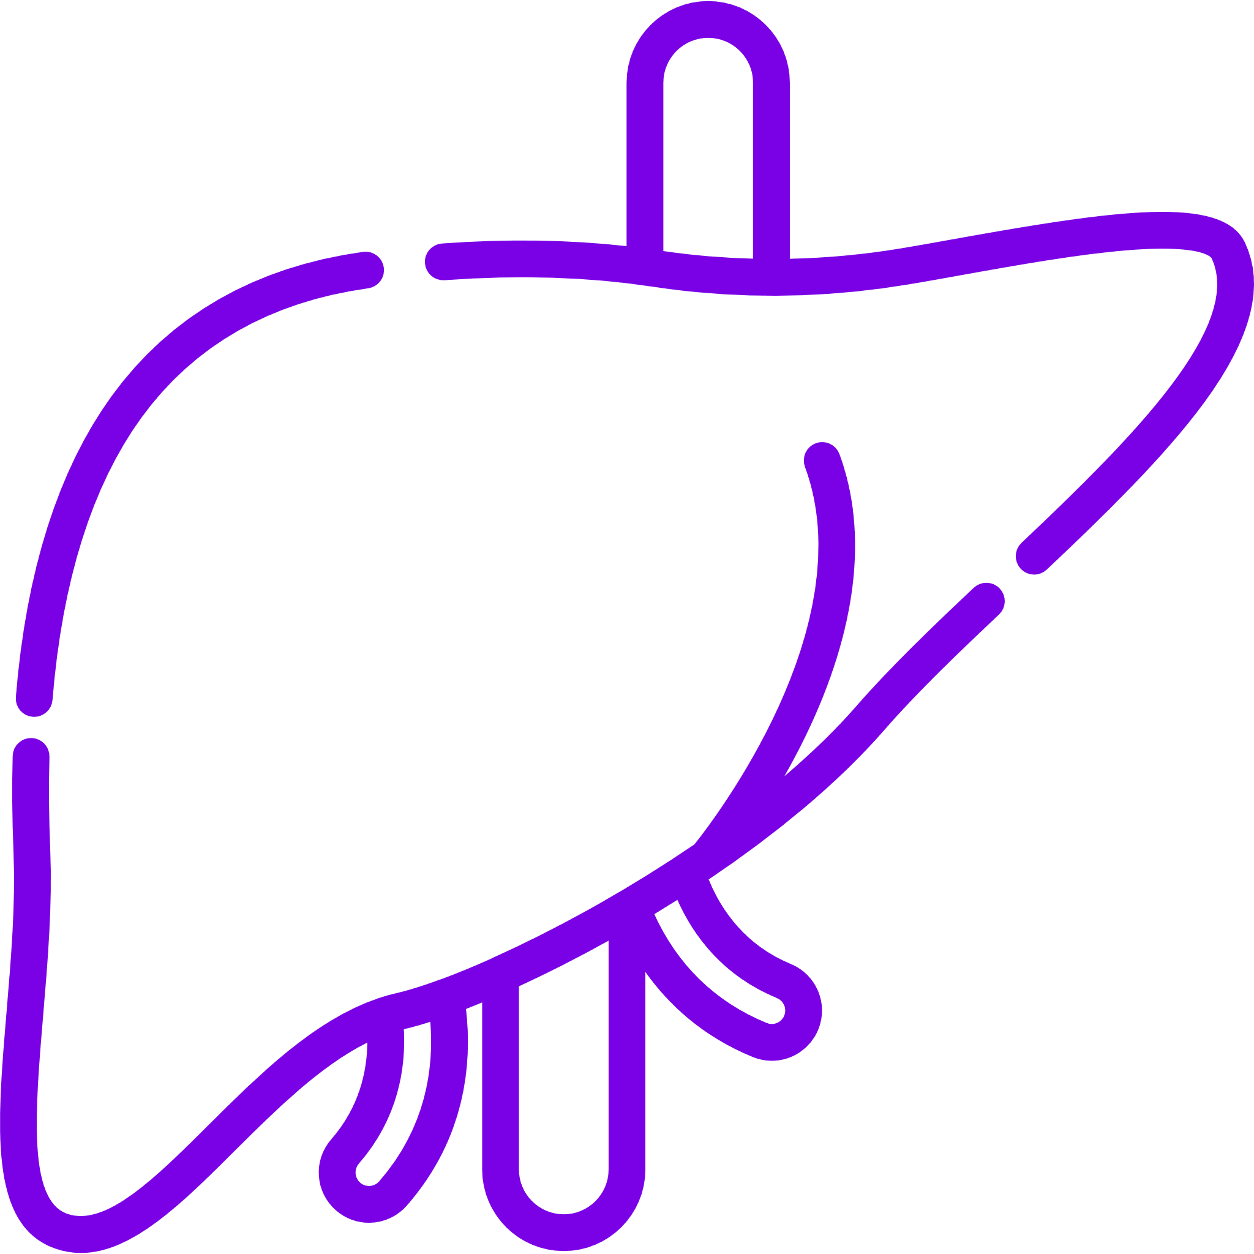


MASLD is a part of systemic disorders involving many organs
Diet-induced obesity
Metabolic stress
Insulin resistance
Systemic inflammation and fibrosis
+
+
Pancreas
Kidney
Arteries
Heart
Liver
(HTN, CVD, CAD)
(Failure)
(T2DM)
(CRF)
(MASLD)
+
+
CAD, coronary artery disease; CRF, chronic renal failure; CVD, cardiovascular disease; HTN, hypertension; MASLD, metabolic disfunction-associated steatotic liver disease; T2DM, type 2 diabetes mellitus.
Friedman SL, et al. Nat Med 2018;24(7):908-922.

Slide 9



The Liver and Cardiometabolic Risk in T2DM¹
MASLD promotes:
Worsening of IR
2.2-fold increase in risk
T2DM promotes:
risk of MASH
risk of T2DM
(difficulty to manage)
risk of cirrhosis
T2DM
MASLD
risk of AD
risk of HCC
risk of CVD
2- to 6-fold increase in risk
MASLD and CVD
Risk of cardiovascular disease, and all-cause mortality is higher in patients with MASLD than in the general population²
Steatosis grade predicts mortality and the risk of developing T2DM in patients with MASLD³
AD, atherogenic dyslipidemia; CVD, cardiovascular disease; HCC, hepatocellular carcinoma; IR, insulin resistance; MAFLD, metabolic dysfunction-associated fatty liver disease; MASLD, metabolic dysfunction-associated steatotic liver disease; NASH, non-alcoholic steatohepatitis; T2DM, type 2 diabetes mellitus.
1. Budd J, et al. Current Diabetes Reports 2020;20:59; 2. Simon TG, et al. Gut 2021;70:1375-1382; 3. Nasr P, et al. Liver Int 2020;40:1069-1078.

Slide 10
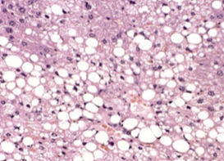
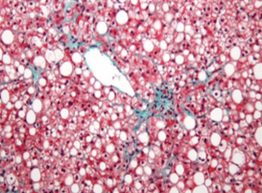
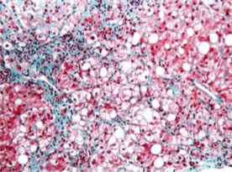
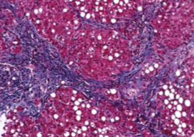
Fibrosis as a predictor of premature mortality in MASLD patients
Liver-related mortality
All-cause mortality
Absolute risk (%)
Absolute risk (%)
MASLD, metabolic dysfunction-associated steatotic liver disease.
Taylor RS, et al. Gastroenterology 2020;158:1611-1625.

Slide 11
Fibrosis as a predictor of premature mortality in MASLD patients¹⁻³
MASLD/MASH
fibrosis 0
MASH
fibrosis 1-2
MASH
fibrosis 3-4
Liver-related events
Cardiovascular complications /Extrahepatic cancers
Cardio-vascular events
Extrahepatic neoplasms
All-cause mortality
Absolute risk (%)
Higher incident fatal and non-fatal CV events
Higher incidence of subclinical atherosclerosis (carotid intima-media thickness; calcium score)
Higher prevalence of atrial fibrillation and diastolic heart failure
MASLD is a risk factor for CVD
Non-liver-related mortality
Liver-related mortality
CV, cardiovascular; CVD, cardiovascular disease; MASH, metabolic dysfunction-associated steatohepatitis ; MASLD, metabolic-disfunction associated steatotic liver disease.
1. Taylor RS, et al. Gastroenterology 2020;158:1611-1625; 2. Wong CR, et al. Clin Liv Dis 2018;12:39–44; 3. Manikat R and Nguyen MH. Clin Mol Hepatol 2023;29(Suppl):s86–s102,

Slide 12








From metabolic alterations to CVD
Adipose
tissue
Intestinal
dysbiosis
Cardiometabolic risk factors
MASLD/MASH
Cardiovascular diseases
Insulin
resistance
Dyslipidemia
T2DM
Obesity
Sedentary
life-style
Arterial
hypertension
Genetic
predisposition
CVD, cardiovascular disease; MASH, metabolic dysfunction-associated steatohepatitis; MASLD, metabolic disfunction-associated steatotic liver disease; T2DM, type 2 diabetes mellitus.

Slide 13



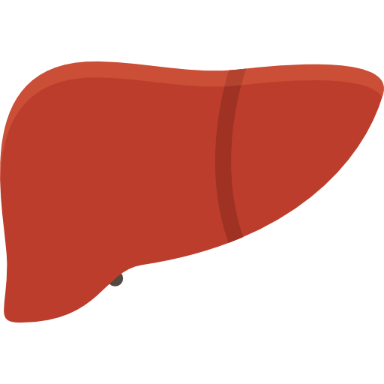

Hepatic control of TG metabolism
Intestine
Dietary fat
Suppression of
gluconeogenesis
Insulin
(physiology)
Adipose tissue
TG
Muscle
Promotion
of lipogenesis
TG
Chylomicron remnant
FA
Glucose ⇧
FA
Spillover
TG
FA
Spillover
χ
Inefficient suppression of gluconeogenesis (increased glucose production)
TG
TG
Insulin
SREBP1c
TG
LD
TG
De novo lipogenesis
FA
TG
TG
MASLD Hyperinsulinemia
(IRS)
ChREBP
Acyl-CoA
TG
TG
TG ⇧
FA oxidation
VLDL
Glucose
Preserved promotion
of lipogenesis
Liver
ChREBP, carbohydrate response element-binding protein; FA, fatty acid; IRS, insulin receptor substrate; MASLD, metabolic-disfunction associated steatotic liver disease; SREBP1c, sterol regulatory element-binding protein 1; TG, triglycerides; VLDL, very-low-density lipoprotein
Esler WP, Cohen DE. J Hepatol 2024;80(2):362-377.
Notes:
s

Slide 14
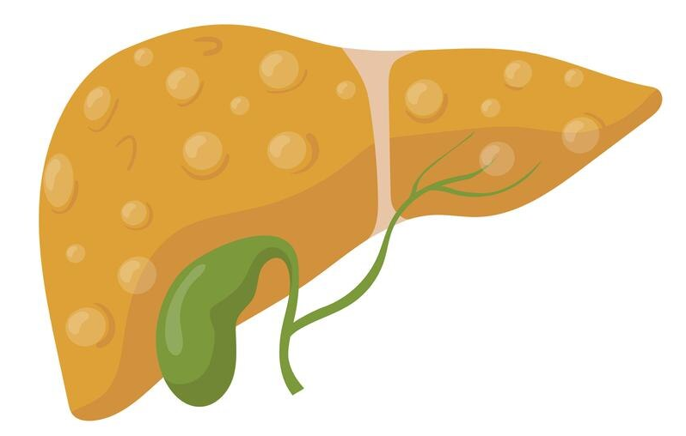
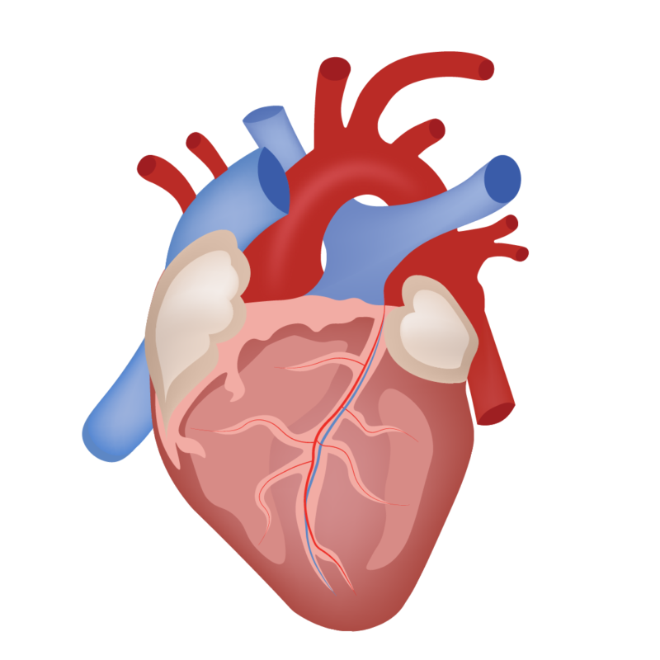
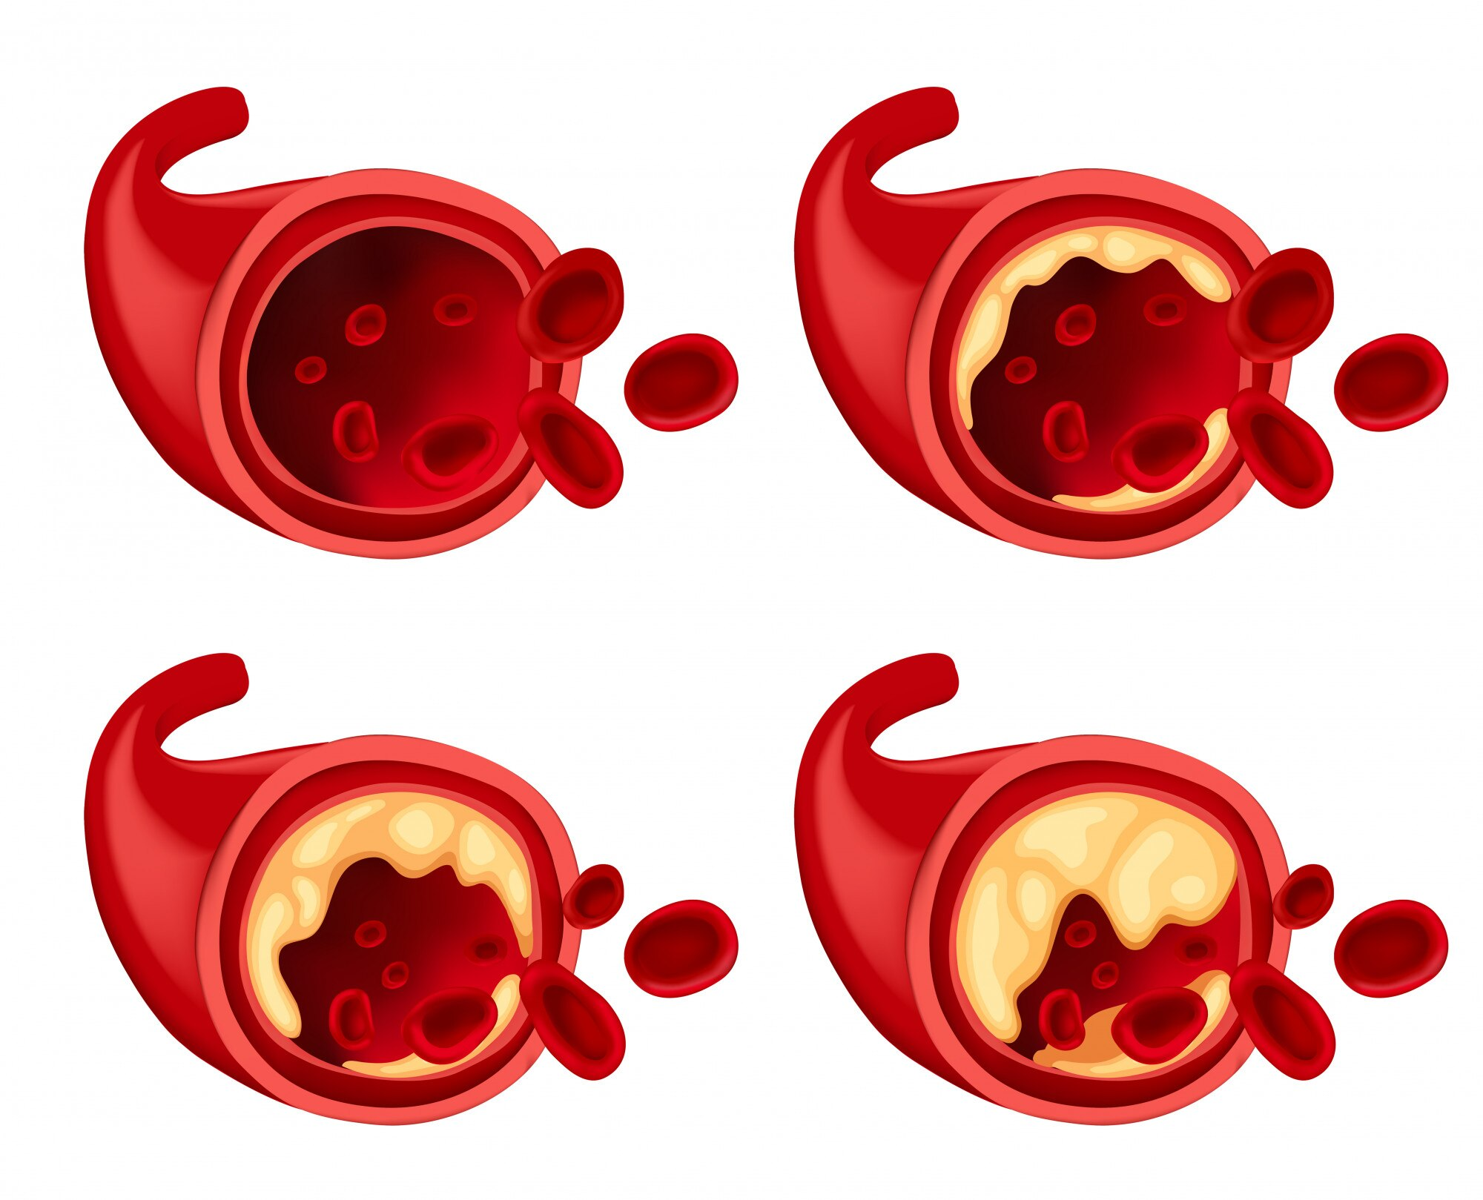

From MASLD to cardiovascular diseases
Subclinical inflammation
Oxidative stress
Dyslipidemia
Triglycerydes (VLDL)
HDL-C
Apo B secretion
Small dense LDL-C
Glucose T2DM
Hyperinsulinemia
insulin resistance
insulin clearance
MASLD/MASH
Cardiovascular disease
Atherosclerosis
Dysfunctional adipose tissue „Adiposopathy”
Inflammation
Fibrosis
Stem cell abnormalities
Lipolysis (FFA ) Adipokines Cytokines
FFA, free fatty acids; HDL, high density lipoprotein; LDL, low density lipoprotein; MASH, metabolic dysfunction-associated steatohepatitis; MASLD, metabolic-disfunction associated steatotic liver disease; T2DM, type 2 diabetes mellitus; VLDL, very-low-density lipoprotein.
Lomonaco R, et al. Ther Adv Metab. 2011;2:211-225.

Slide 15


Monitoring of metabolic risk factors
Atherogenic dyslipidemia?
Non-HDL cholesterol > 130 mg/dl; ApoB > 120 mg/dL
Arterial hypertension?
> 130/85 mmHg
Prediabetes/Diabetes?
HbA1c > 6.4%; fast glucose > 100 mg/dL; > 140 mg/dl (2 hr OGTT)
For patient’s survival metabolic risk factors are more important than ALT activity
ApoB, Apolipoprotein B-100; HbA1c, hemoglobin A1C; HDL, high density lipoprotein; OGTT, oral glucose tolerance test;

Slide 16
Therapeutic approaches for managing MASLD and associated comorbidities¹
Weight loss
Lifestyle (diet, physical activity)
GLP-1RA and/or SGLT2i
Bariatric surgery
Treat T2DM and cardiovascular risk factors
Hyperglycemia (GLP-1RA and/or SGLT2i)
Dyslipidaemia (statin)
Hypertension (ACEi/sartans)
Smoking cessation
Antiplatelet drugs
Control
obesity
Reduce
CVD risk
Reduce
end-stage
complications
Target
MASH
Other approaches
Statin (reducing portal hypertension)
Metformin (decrease of HCC risk)
Liver-directed treatment
Vitamin E
Pioglitazone
Semaglutide
Resmetirom
EPL as adjunctive therapy
EPL given as adjunctive therapy to metformin or SoC in patients with T2DM, and as an adjunctive therapy to sibutramine in patients with obesity, is associated with better MASLD clinical outcomes^{2,3}.
RESTORE study showed, EPL having good efficacy and tolerability in comparison with other interventions⁴.
EPL is recommended ​in several practice guidelines of countries like Latvia, China, Poland, Romania and Russia.⁵⁻⁹
ACEi, angiotensin-converting enzyme inhibitors; CVD, cardiovascular disease; EPL, essential phospholipid; GLP-1RA, glucagon-like peptide-1 receptor agonist; HCC, hepatocellular carcinoma; MASLD, metabolic dysfunction-associated steatotic liver disease; MASH, metabolic dysfunction-associated steatohepatitis; RESTORE, Reducing Exacerbations and Symptoms by Treatment with ORal Erdosteine in COPD; SGLT2i, sodium/glucose cotransporter-2 inhibitor; SoC, standard of care; T2DM, type 2 diabetes mellitus.
1. Manikat R and Nguyen MH. Clin Mol Hepatol 2023;29(Suppl):s86–s102; 2. Sun C et al. Clinical Focus 2008;23:1272–3; 3. Sas E et al. Gut 2012;61:A216–A7; 4. Hartleb M, et al. Eur J Gastroenterol Hepatol 2021;34(4):426–34; 5. Russian Scientific Liver Society. Diagnosis and treatment of nonalcoholic fatty liver disease. 2015. http://www.rsls.ru/files/Guidelines-RSLS-NASH-2016-01-03.pdf Accessed May 2021; 6. Society of Digestive Diseases. 2020. https://www.globalliverforum.com/-/media/Project/One-Sanofi-Web/Websites/Chc/Essentiale/Liver-Health-forum-HCP/Home/resources-for-your-clinical-practice/Vadlinijas_en-GB.pdf Accessed May 2021; 7. Fan JG, et al. J Dig Dis 2019;20:163–173; 8. Hartleb M, et al. Med Prakt 2019;10:47–74; 9. Position Paper on NAFLD treatment. Romanian Society of Gastroenterology and Hepatology, 2018

Slide 17
EPL as Adjunctive Therapy Improves Lipid Parameters in Patients on/not on Lipid-lowering Therapy
Mean changes in serum lipid profile from baseline to 12 weeks and 24 weeks
Compared with baseline, all lipid parameters were significantly improved at 12 and 24 weeks of the study in both subgroups.
Patients undergoing LLT had significantly greater improvements in all lipid parameters at both 12 and 24 weeks.
Week12NLLT
Week12LLT
Week24NLLT
Week24LLT
Baseline
p<0.05, by Wilcoxon-Mann-Whitney test with Benjamini-Hochberg correction for multiple comparisons.
EPL, essential phospholipid; HDL, high-density lipoprotein; LDL, low-density lipoprotein; LLT, undergoing lipid-lowering therapy; NLLT, not undergoing lipid-lowering therapy; TG, triglyceride; VLDL, very-low-density lipoprotein.
Maev IV et al. BMJ Open Gastroenterol 2020;7(1):e000368.

Slide 18
Take home messages
MASLD is multi-systemic disease that increases risk of CVD and T2DM, and MASLD-based diagnostic criteria better identify population with cardio-metabolic risks than those of NAFLD
The change in nomenclature
01
Enhances disease awareness and ends perception of MASLD as isolated hepatic manifestation of Metabolic Syndrome
Imposes multidisciplinary approach involving specialists in different areas of internal medicine
Limitations and consequences of changes in nomenclature
02
Hepatologists should expand their competence on the role of the liver in metabolism.
The use of non-invasive tests should become a pan-speciality screening.
Precise guidelines in diagnosis and treatment of MASLD should be agreed by Liver, Diabetes and Obesity societies and introduced in clinical practice.
CVD, cardiovascular disease; EPL, essential phospholipids; MAFLD, metabolic-associated fatty liver disease; MASLD, metabolic dysfunction-associated steatotic liver disease; MS, metabolic syndrome; SLD, steatotic liver disease; T2DM, type 2 diabetes mellitus.
Marchesini G, et al. J Hepatol 2024;80:178-180.

Slide 19
Thank you

