Slide 1



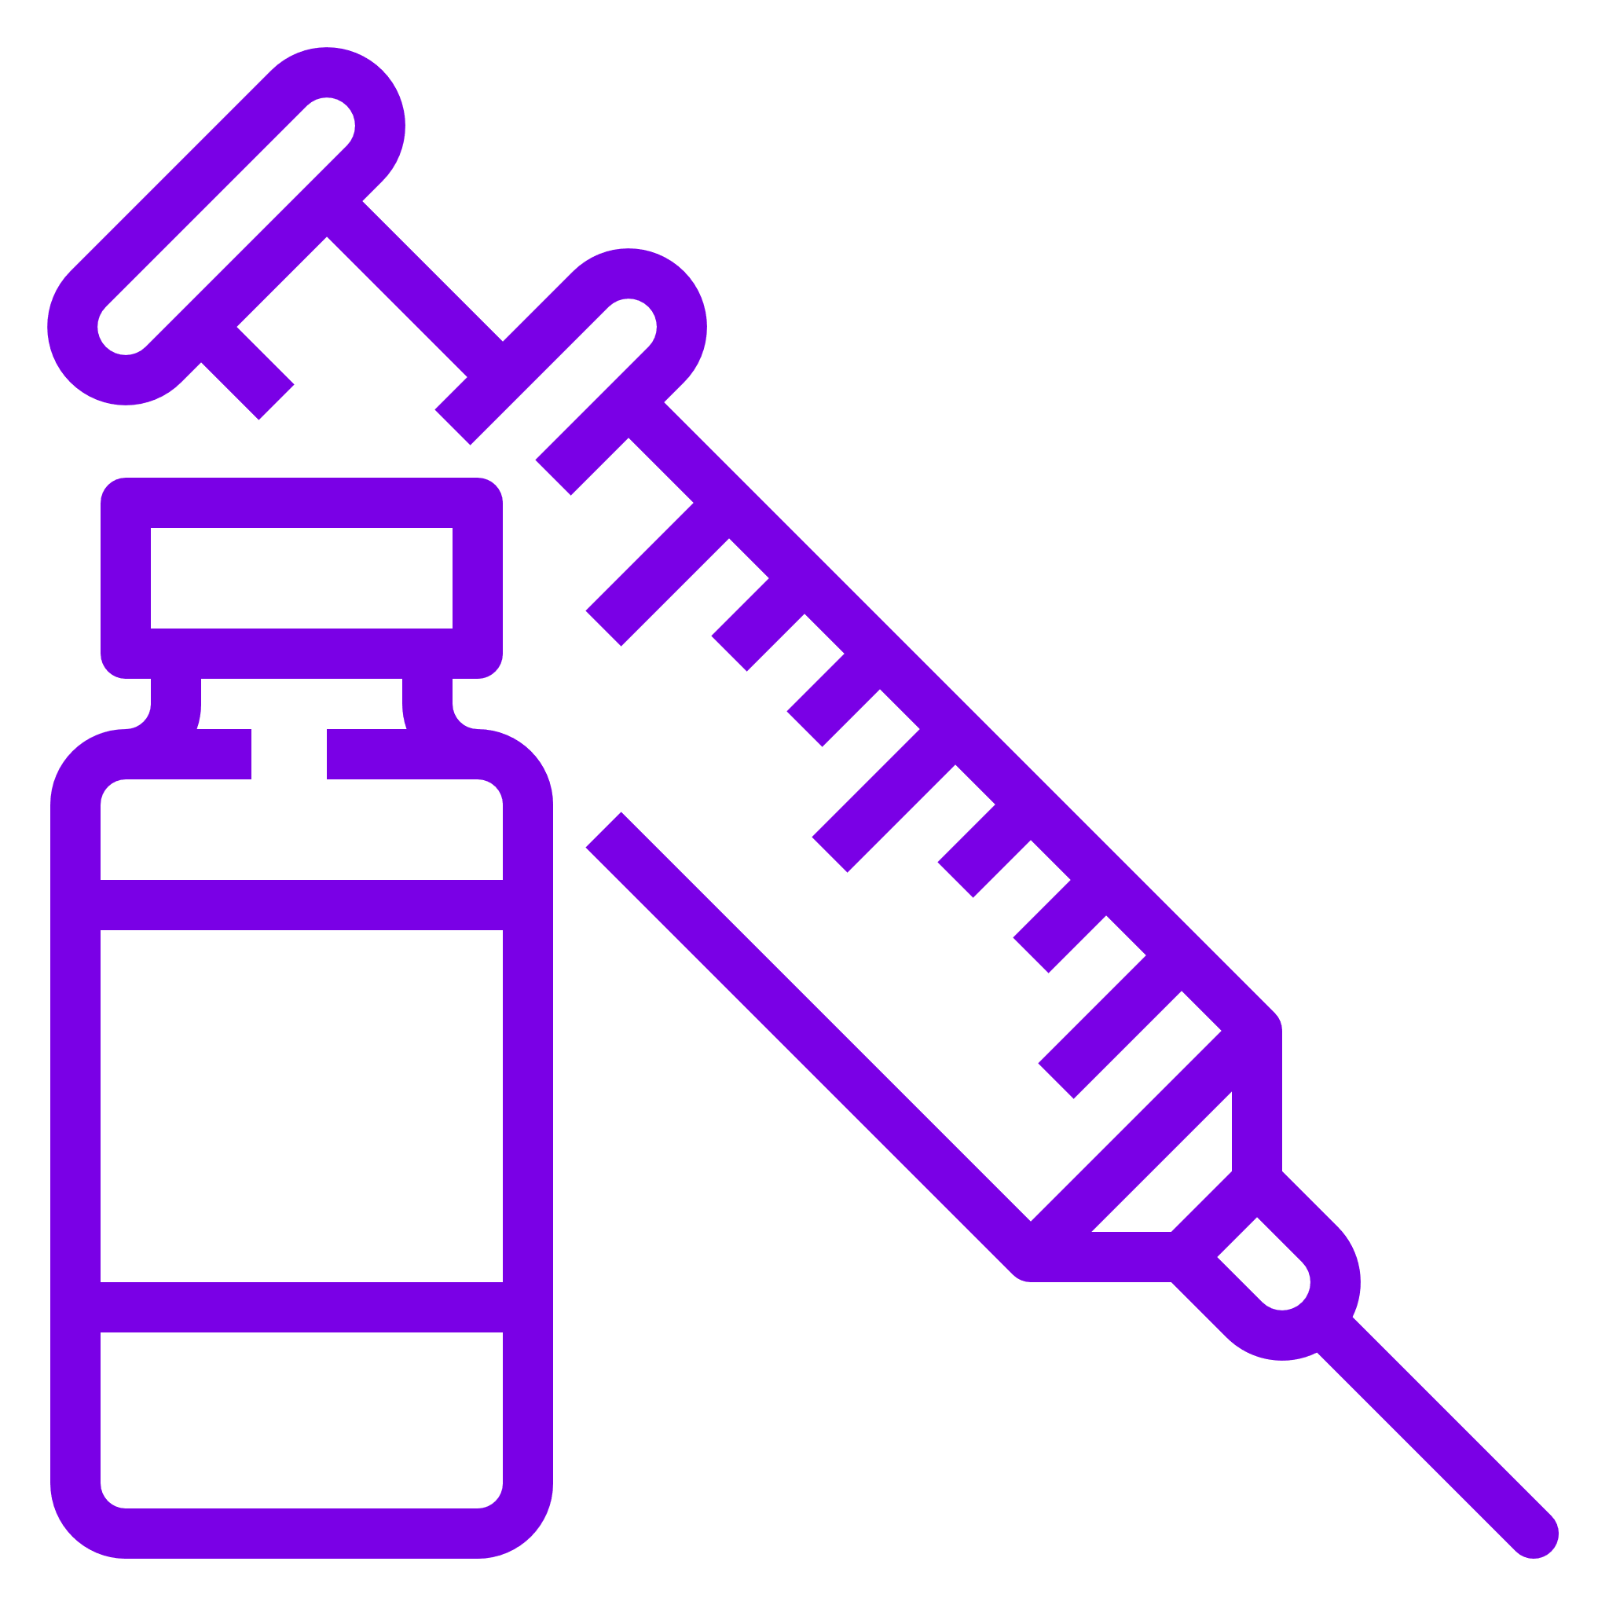

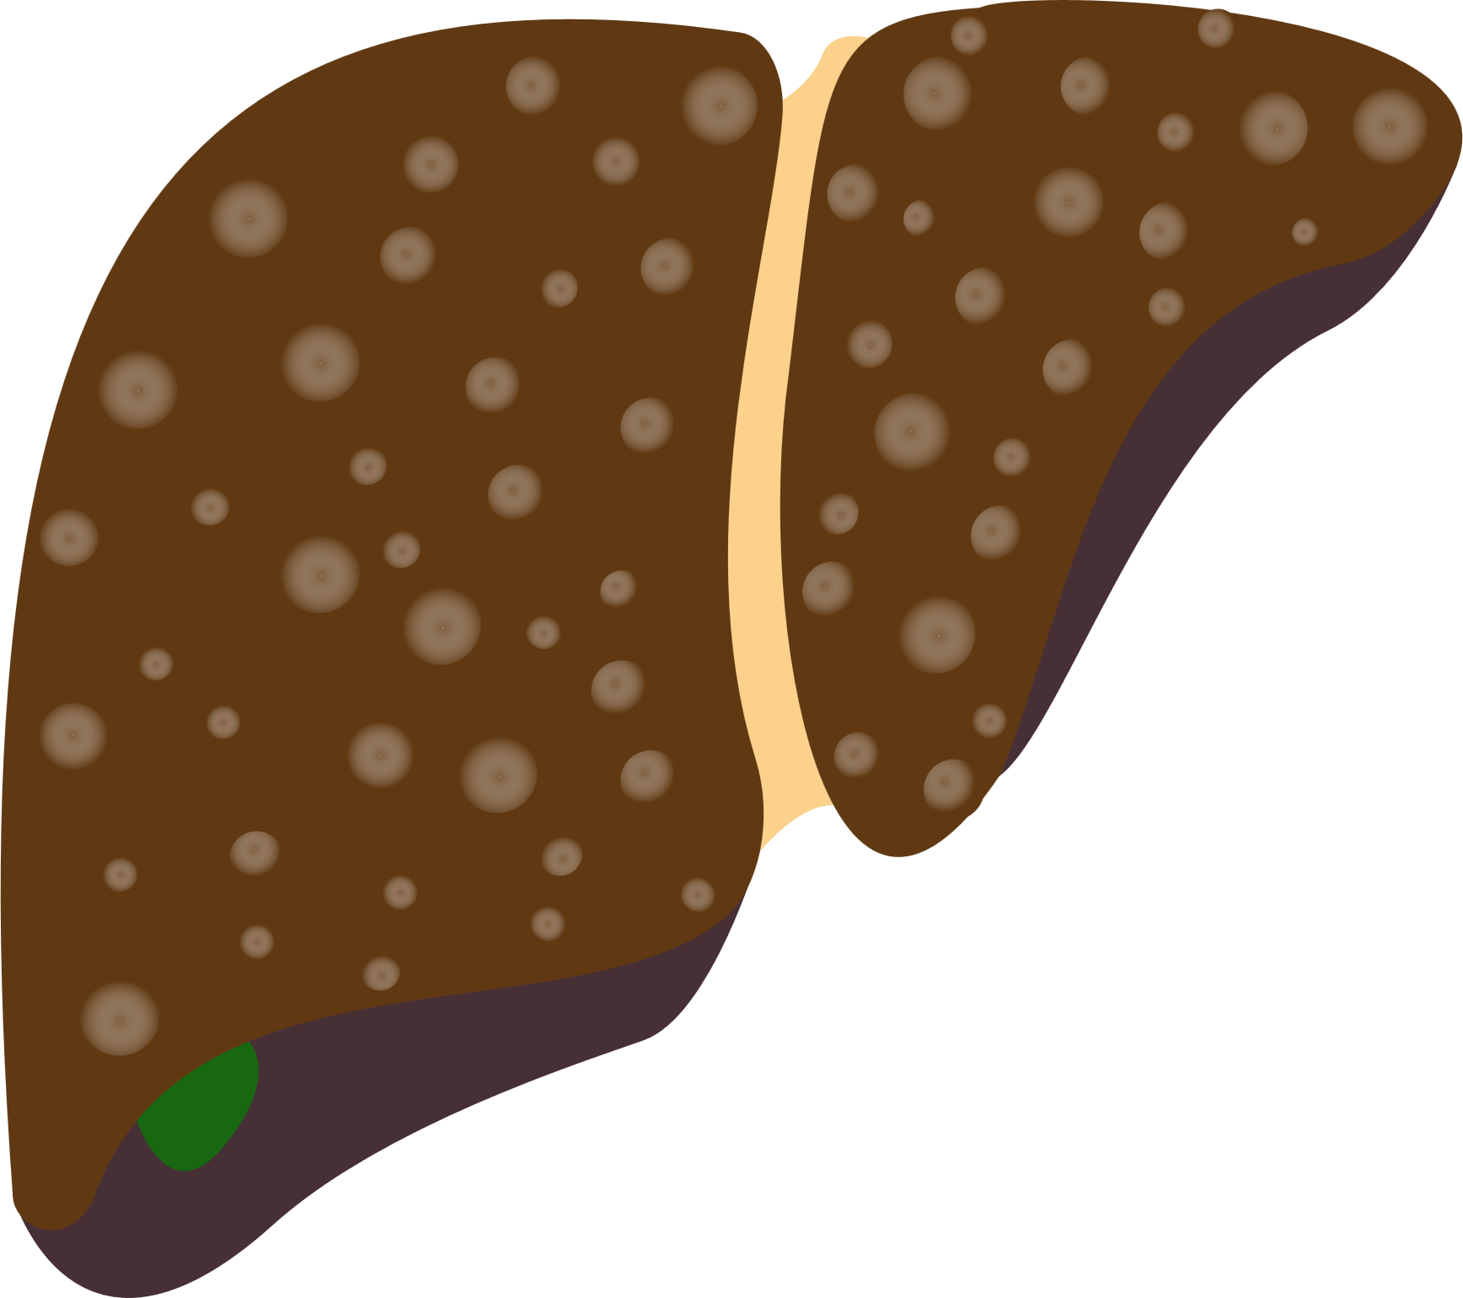



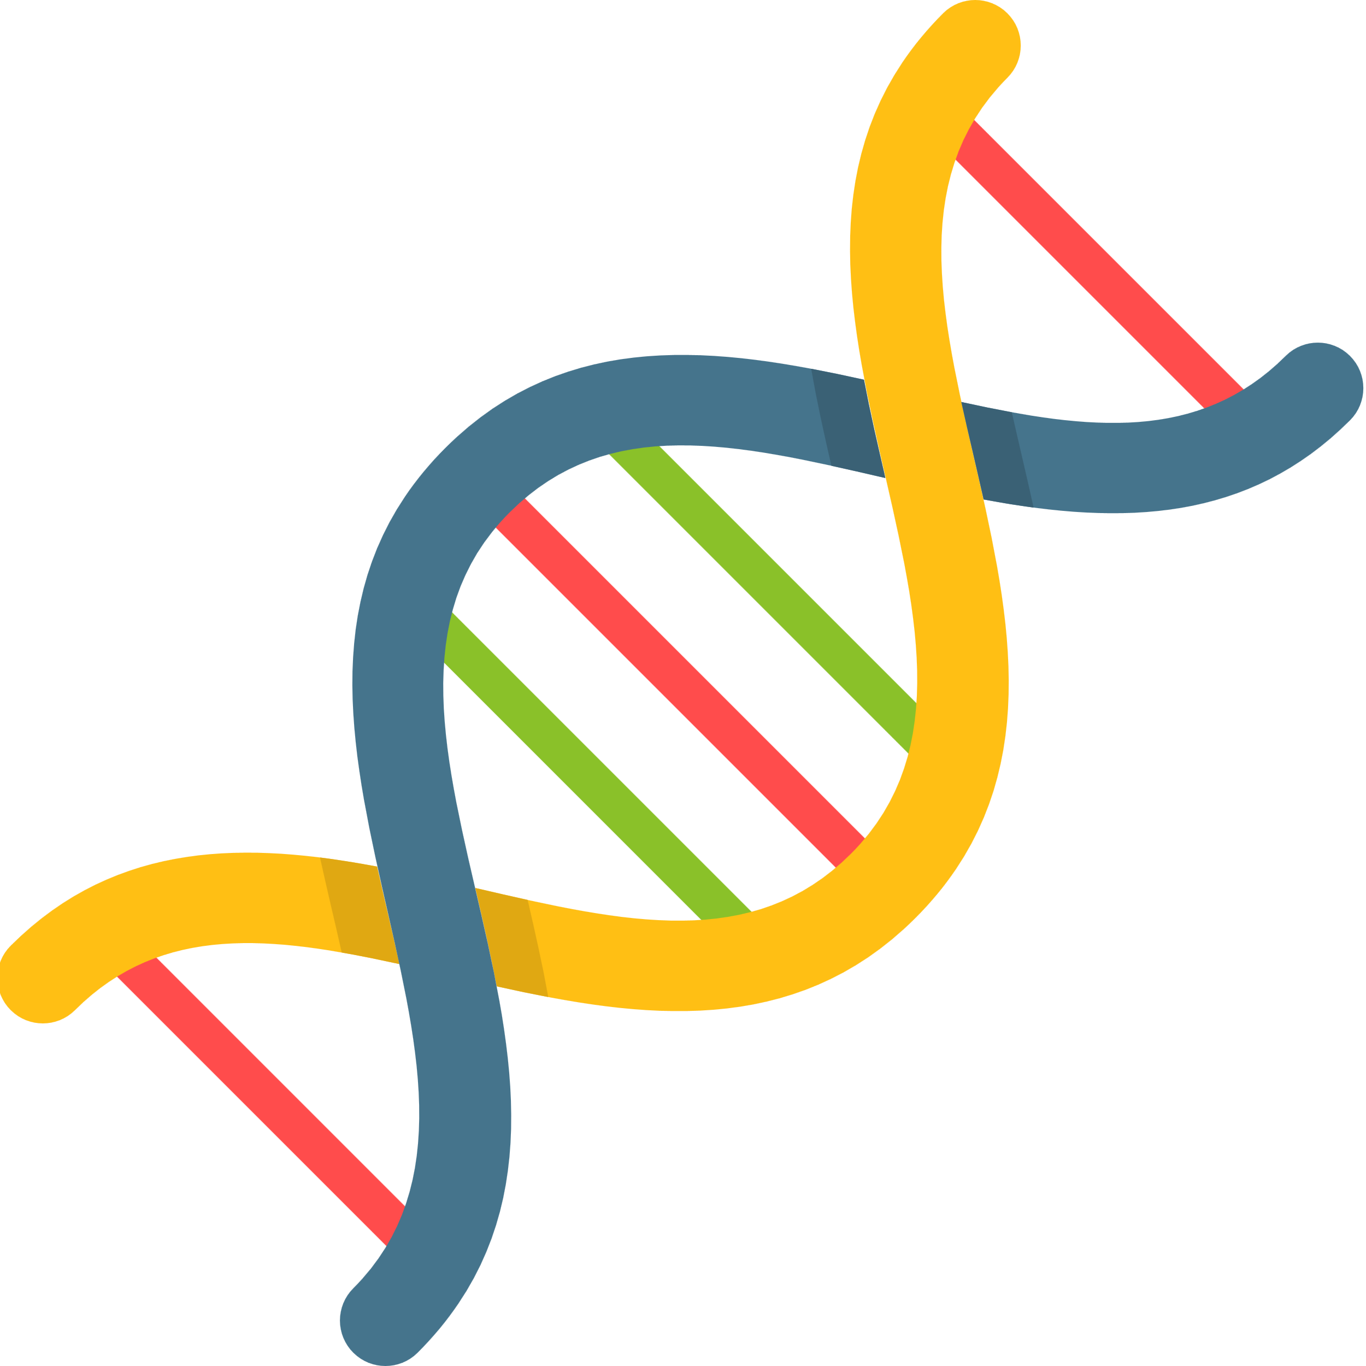
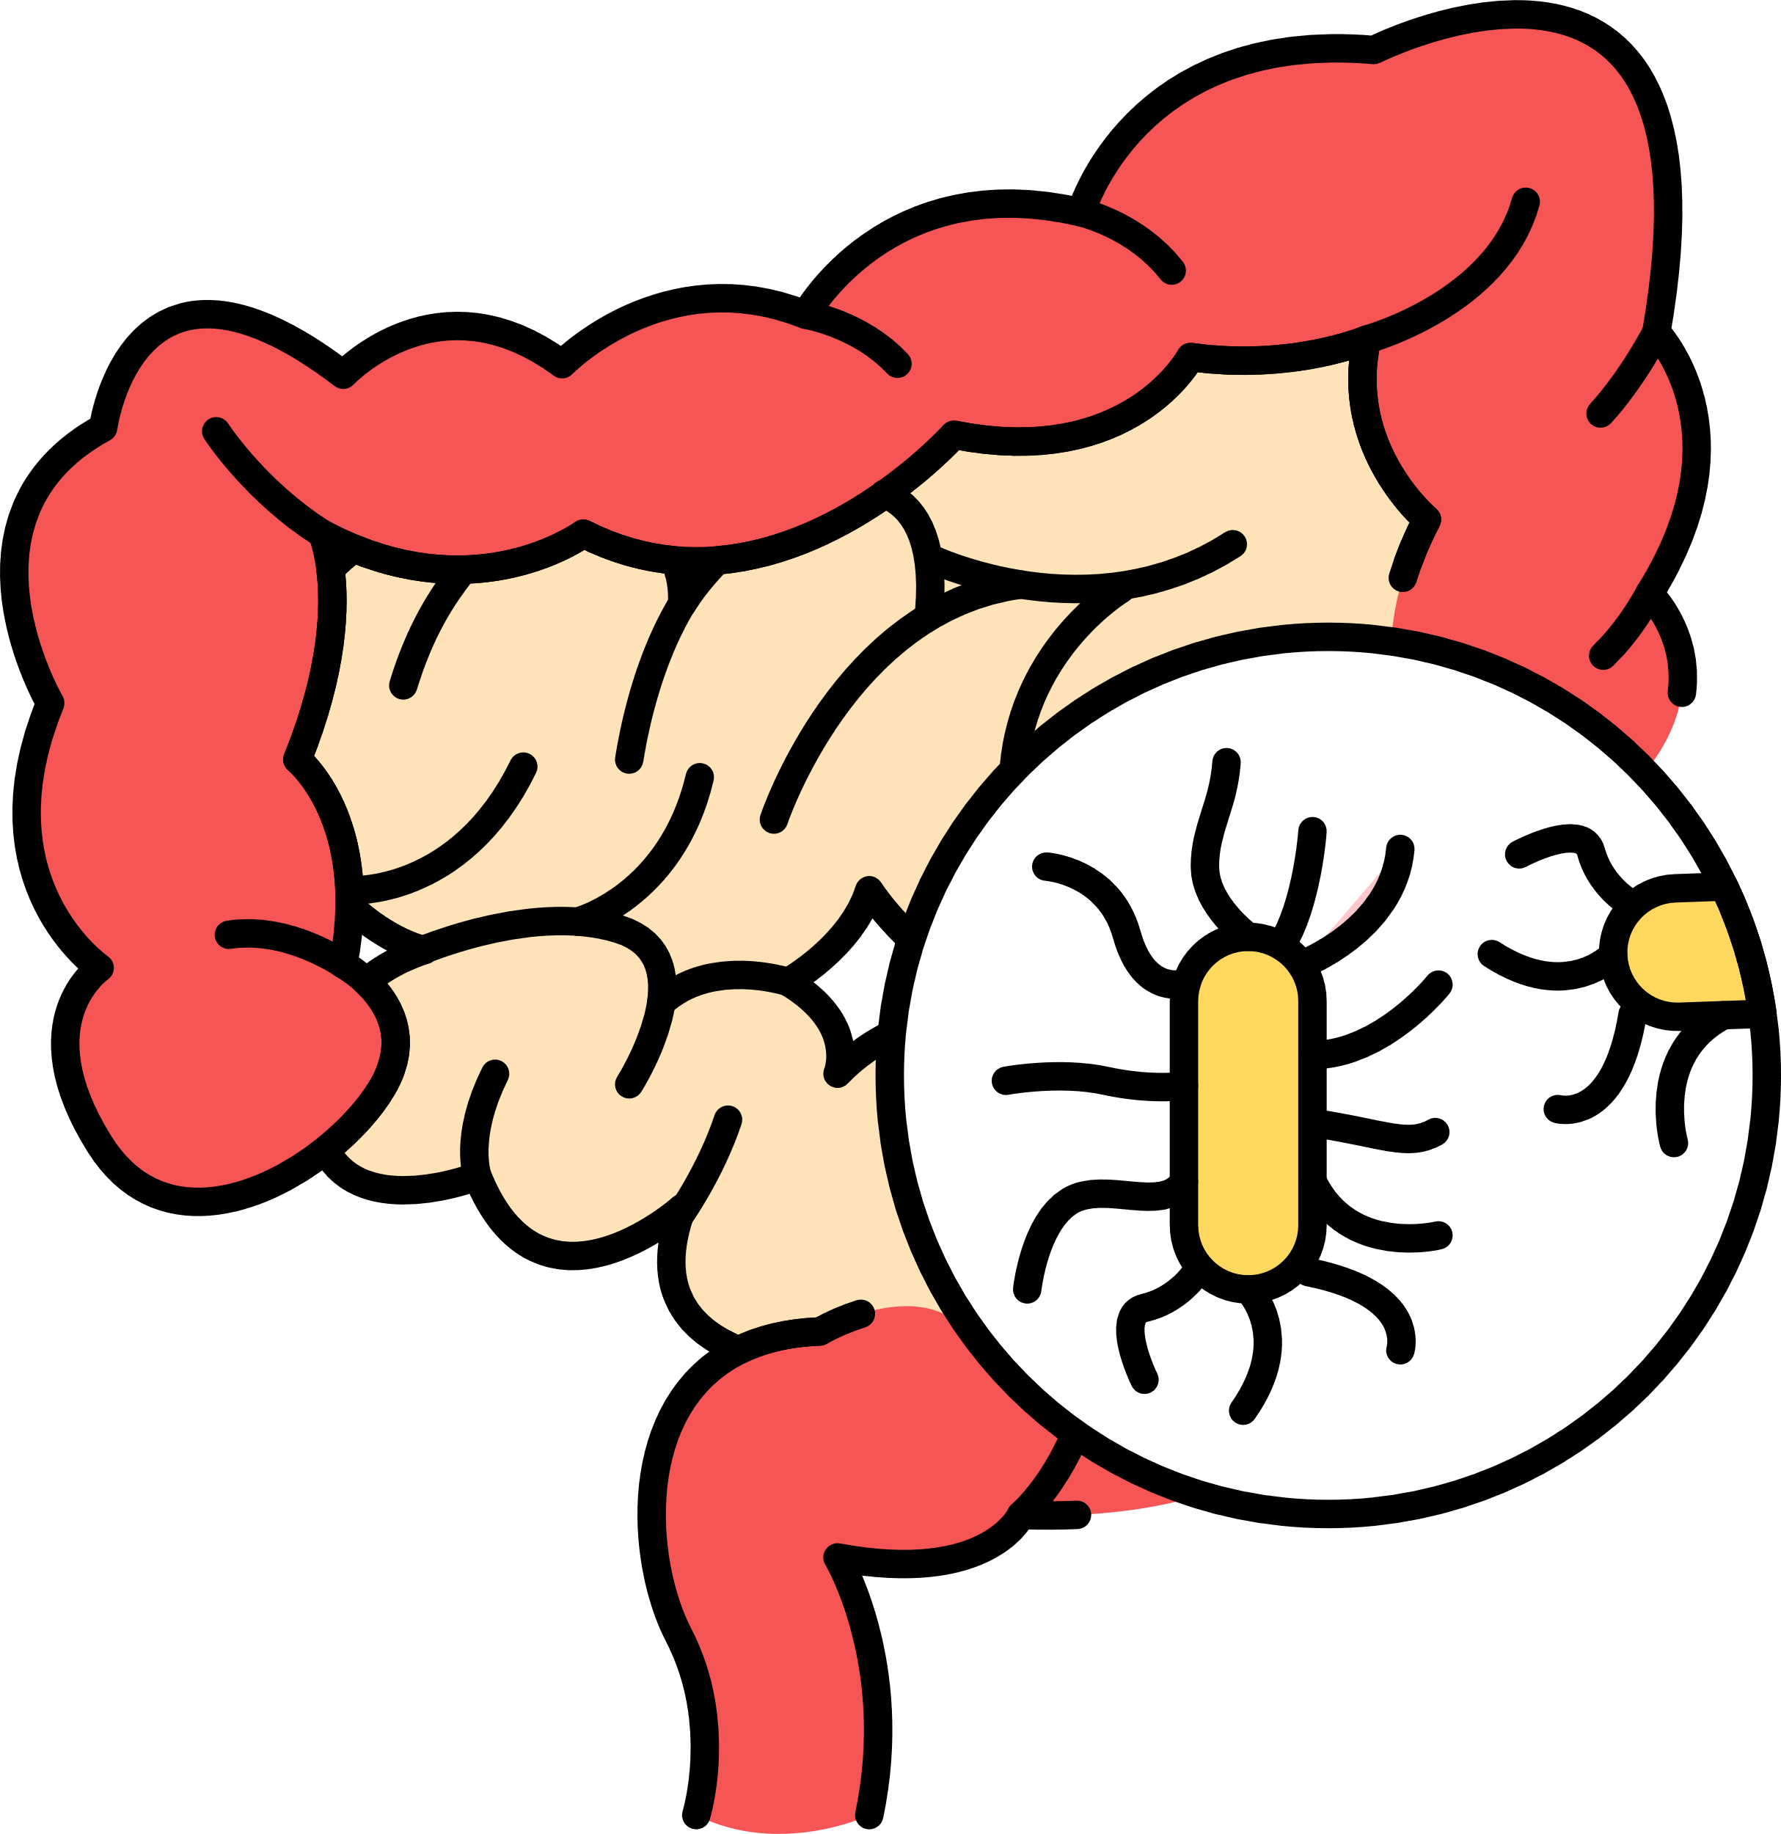
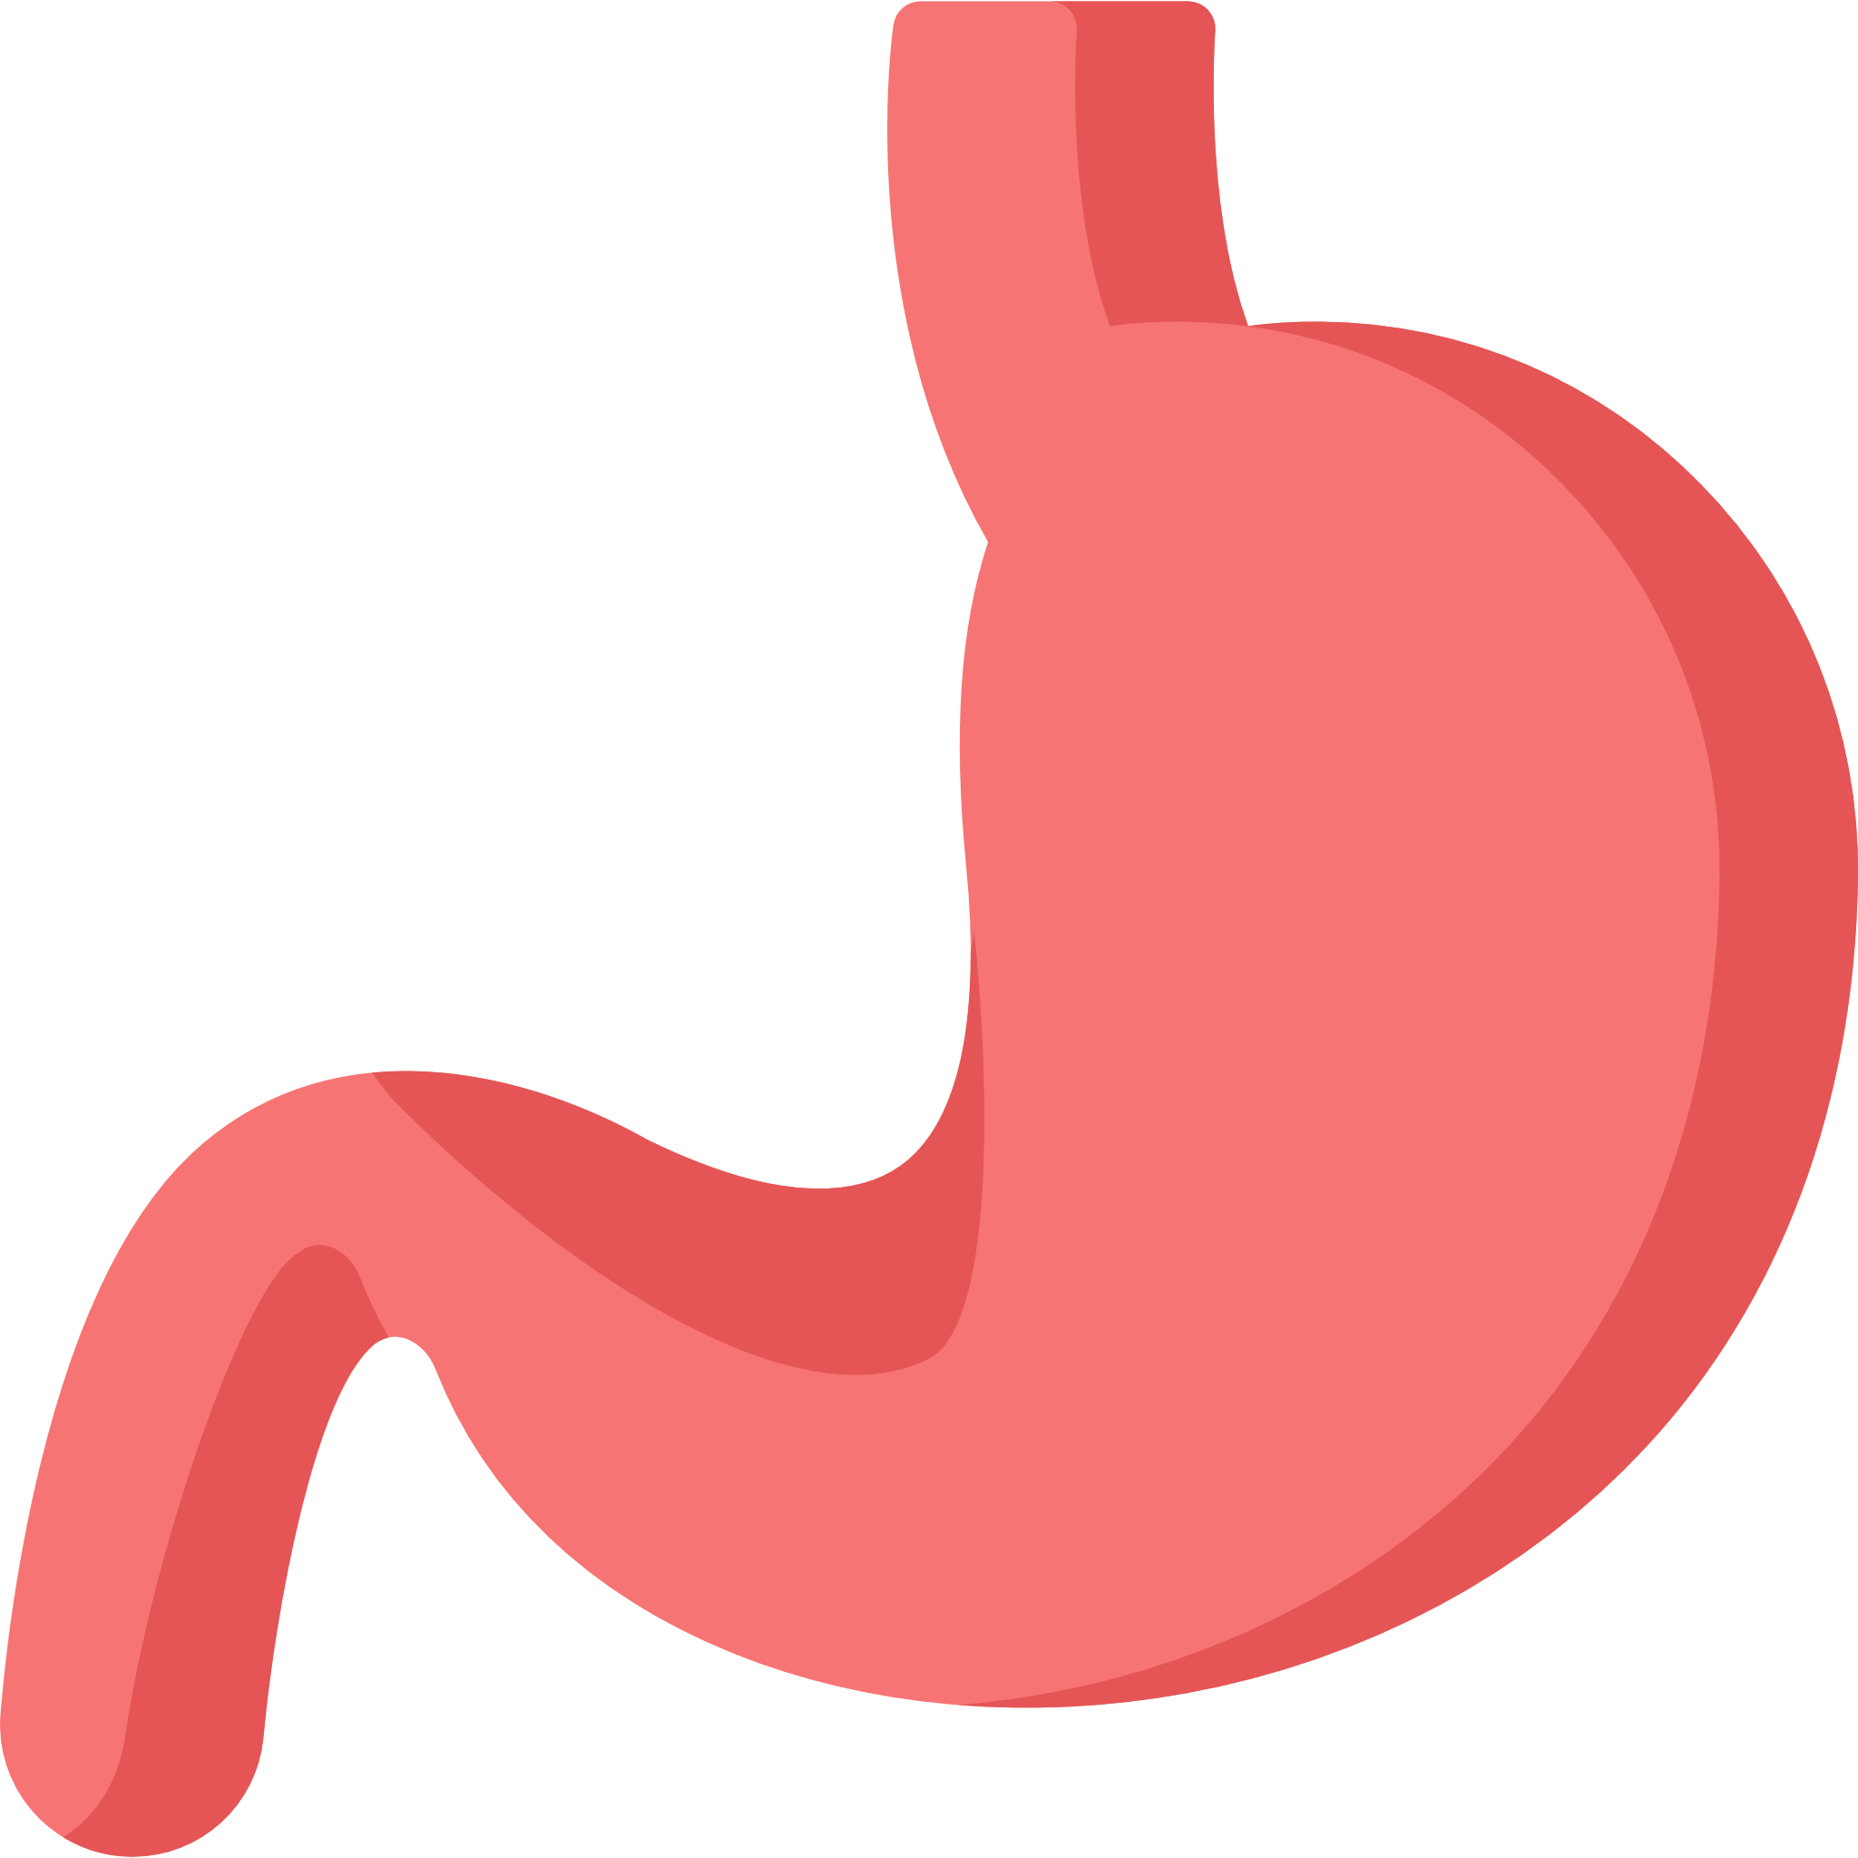
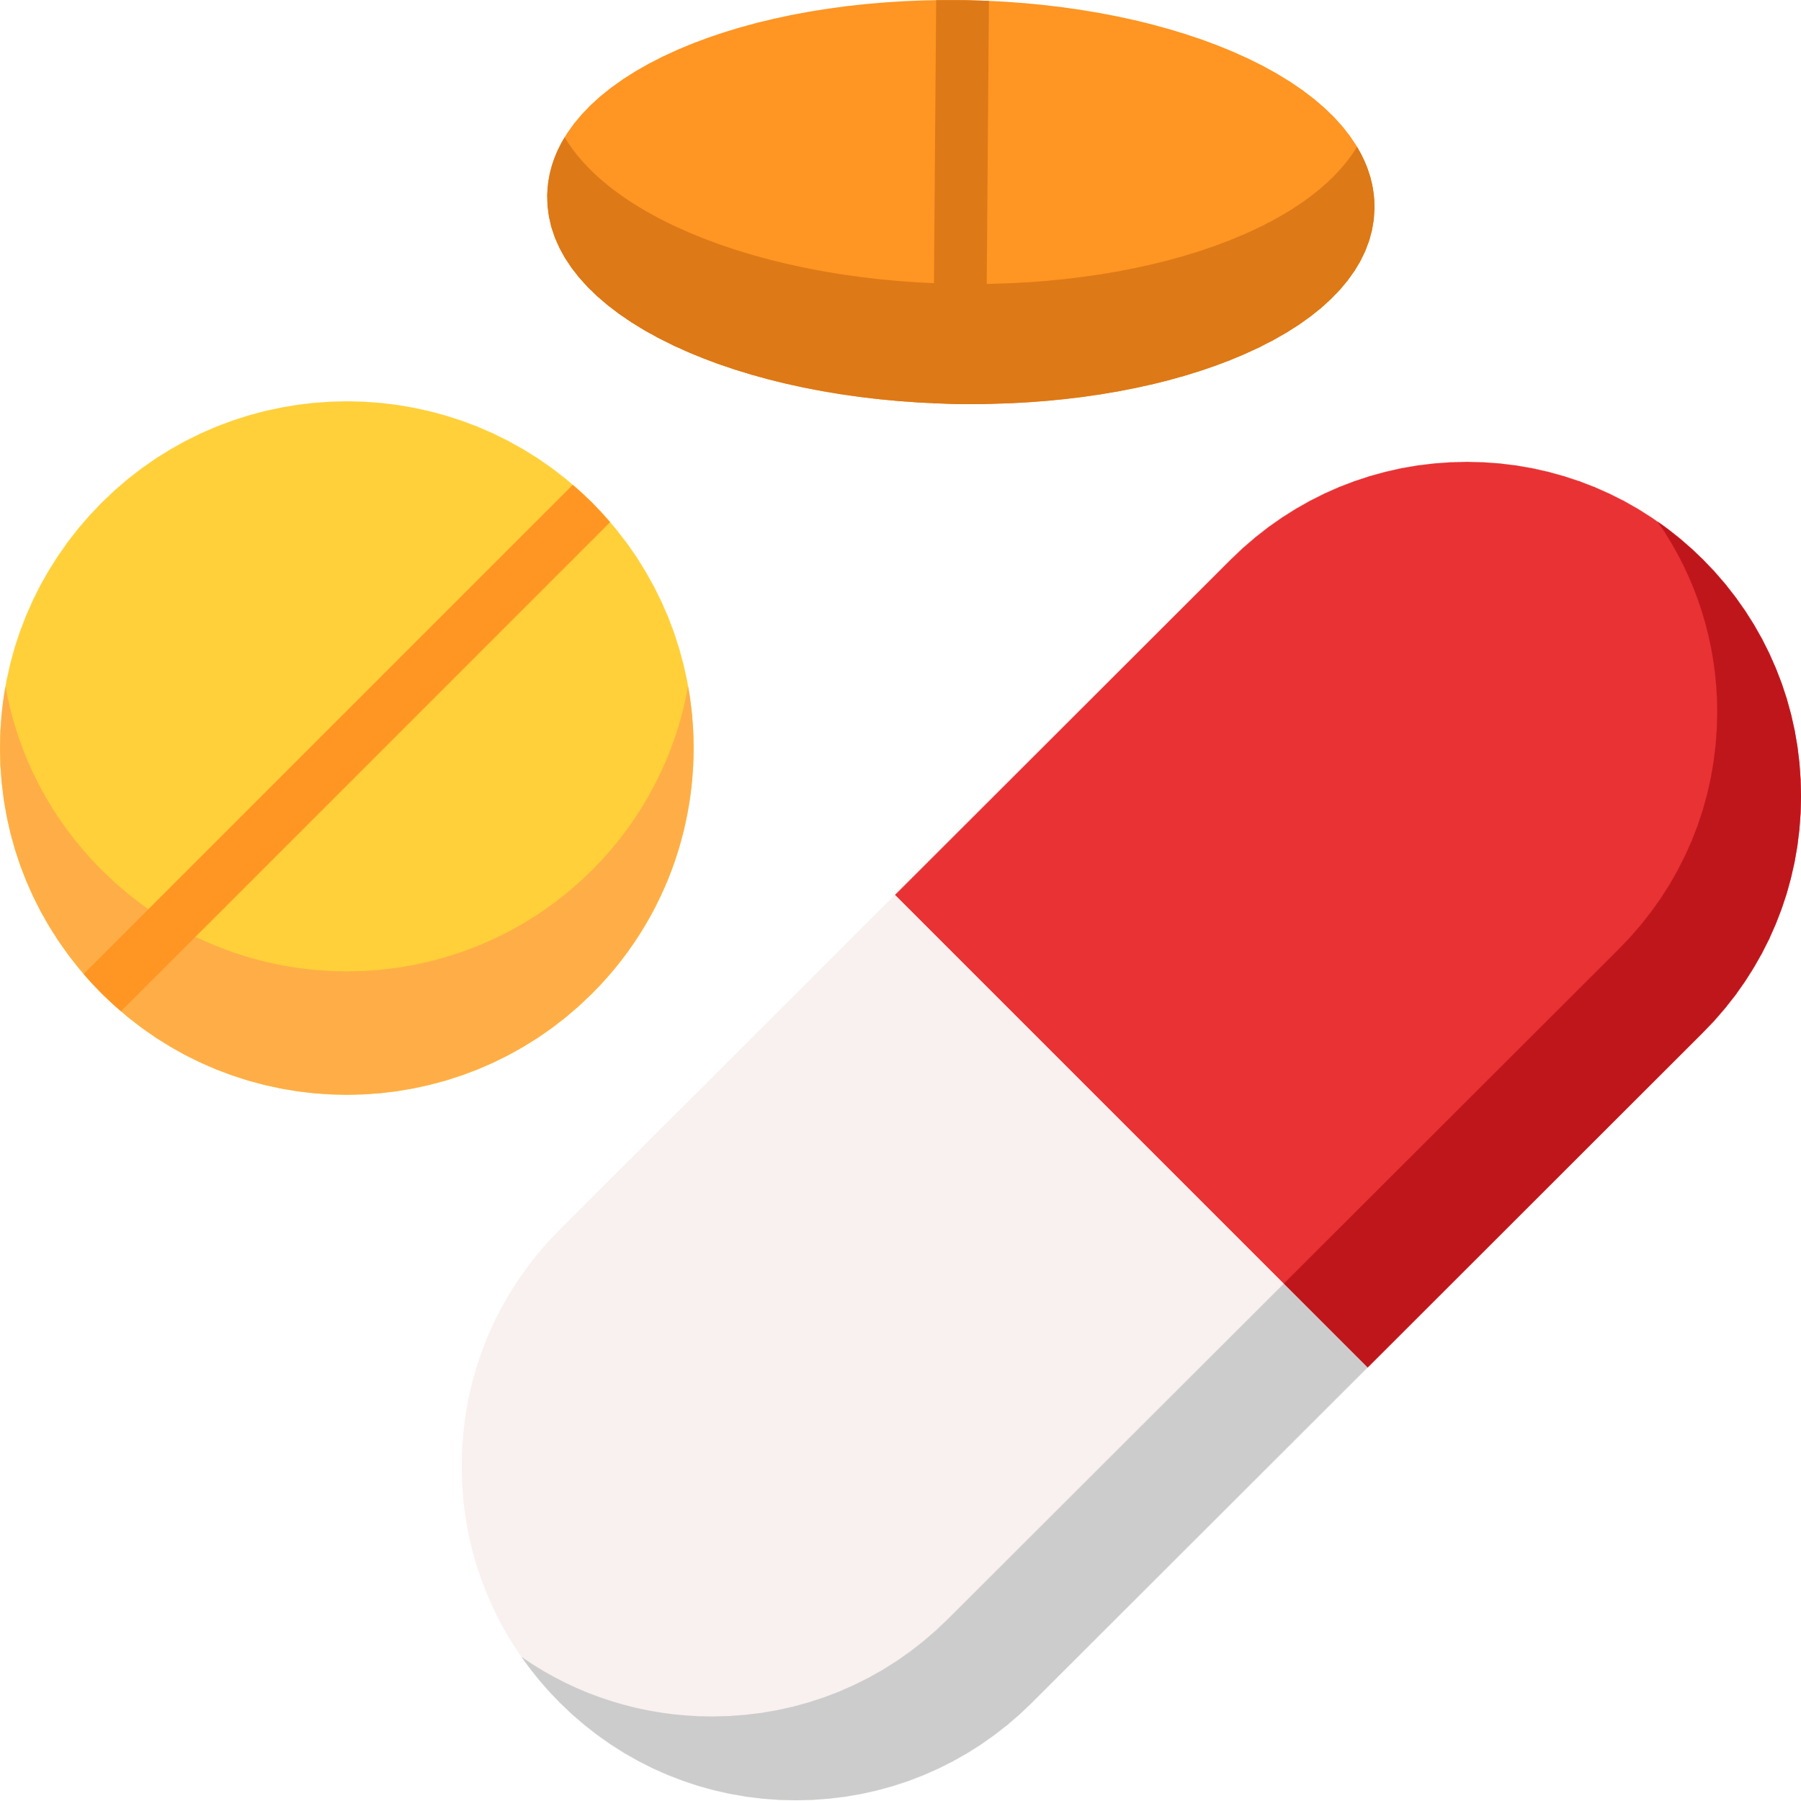
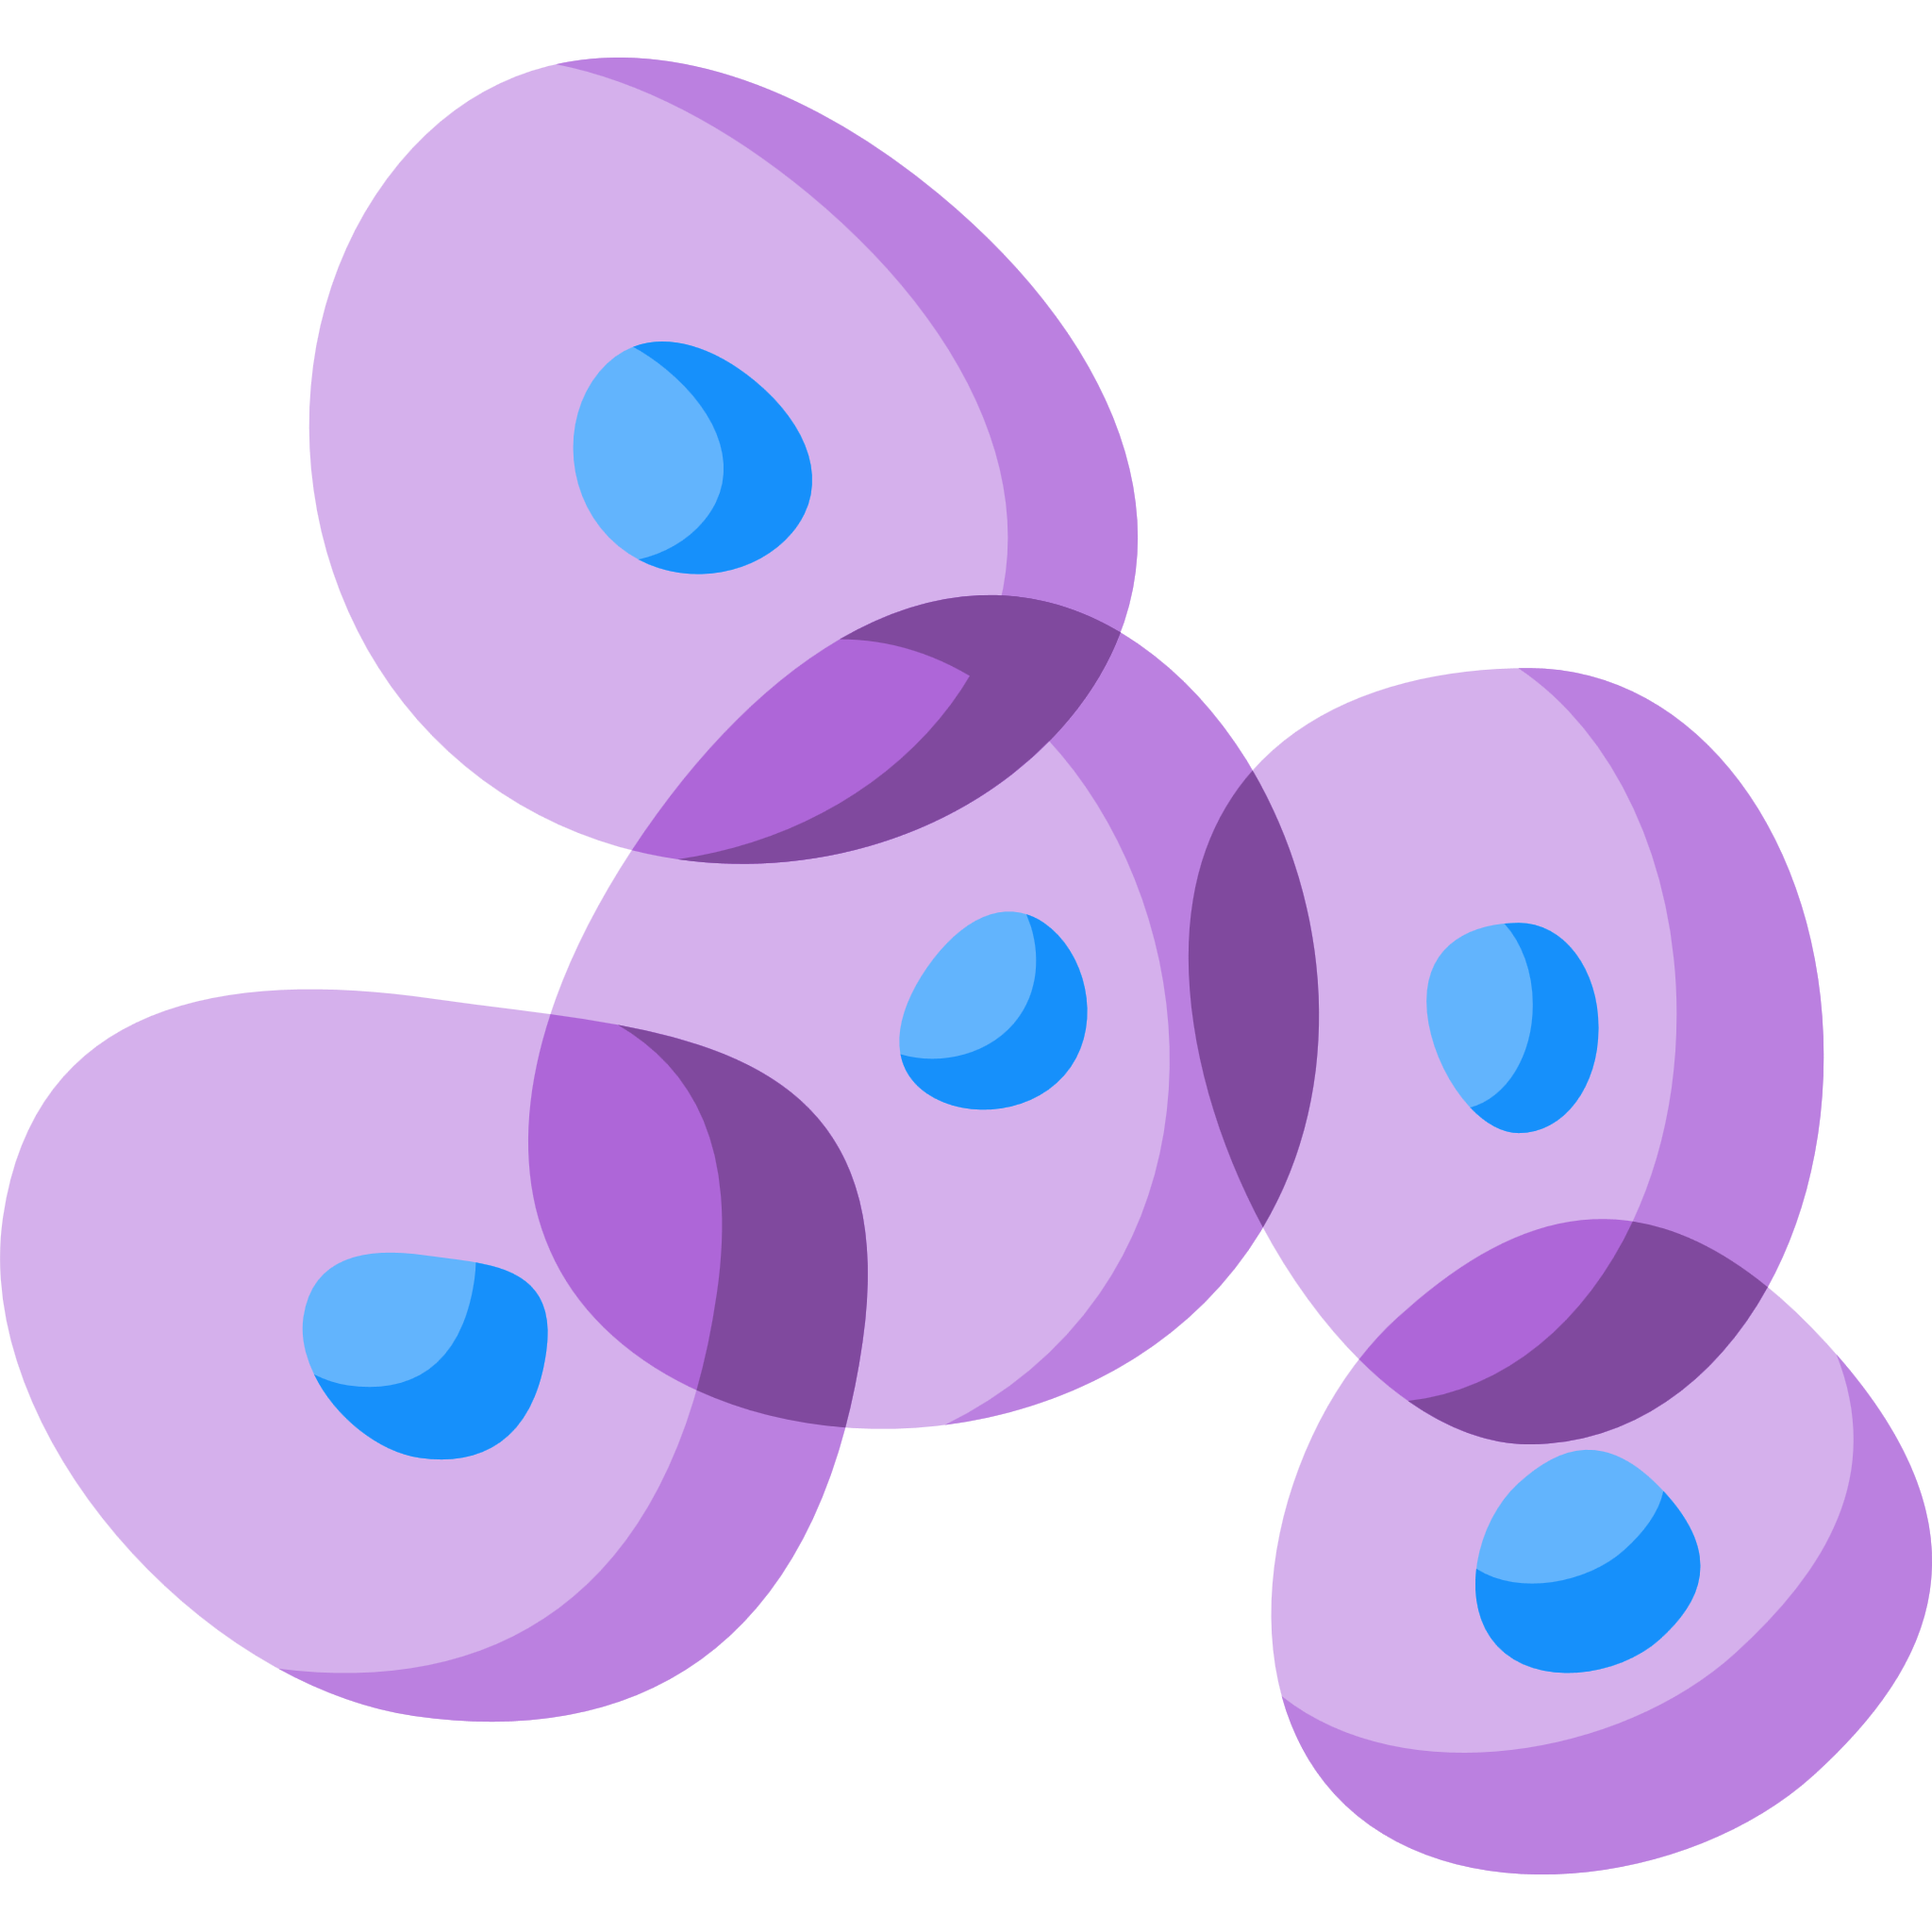
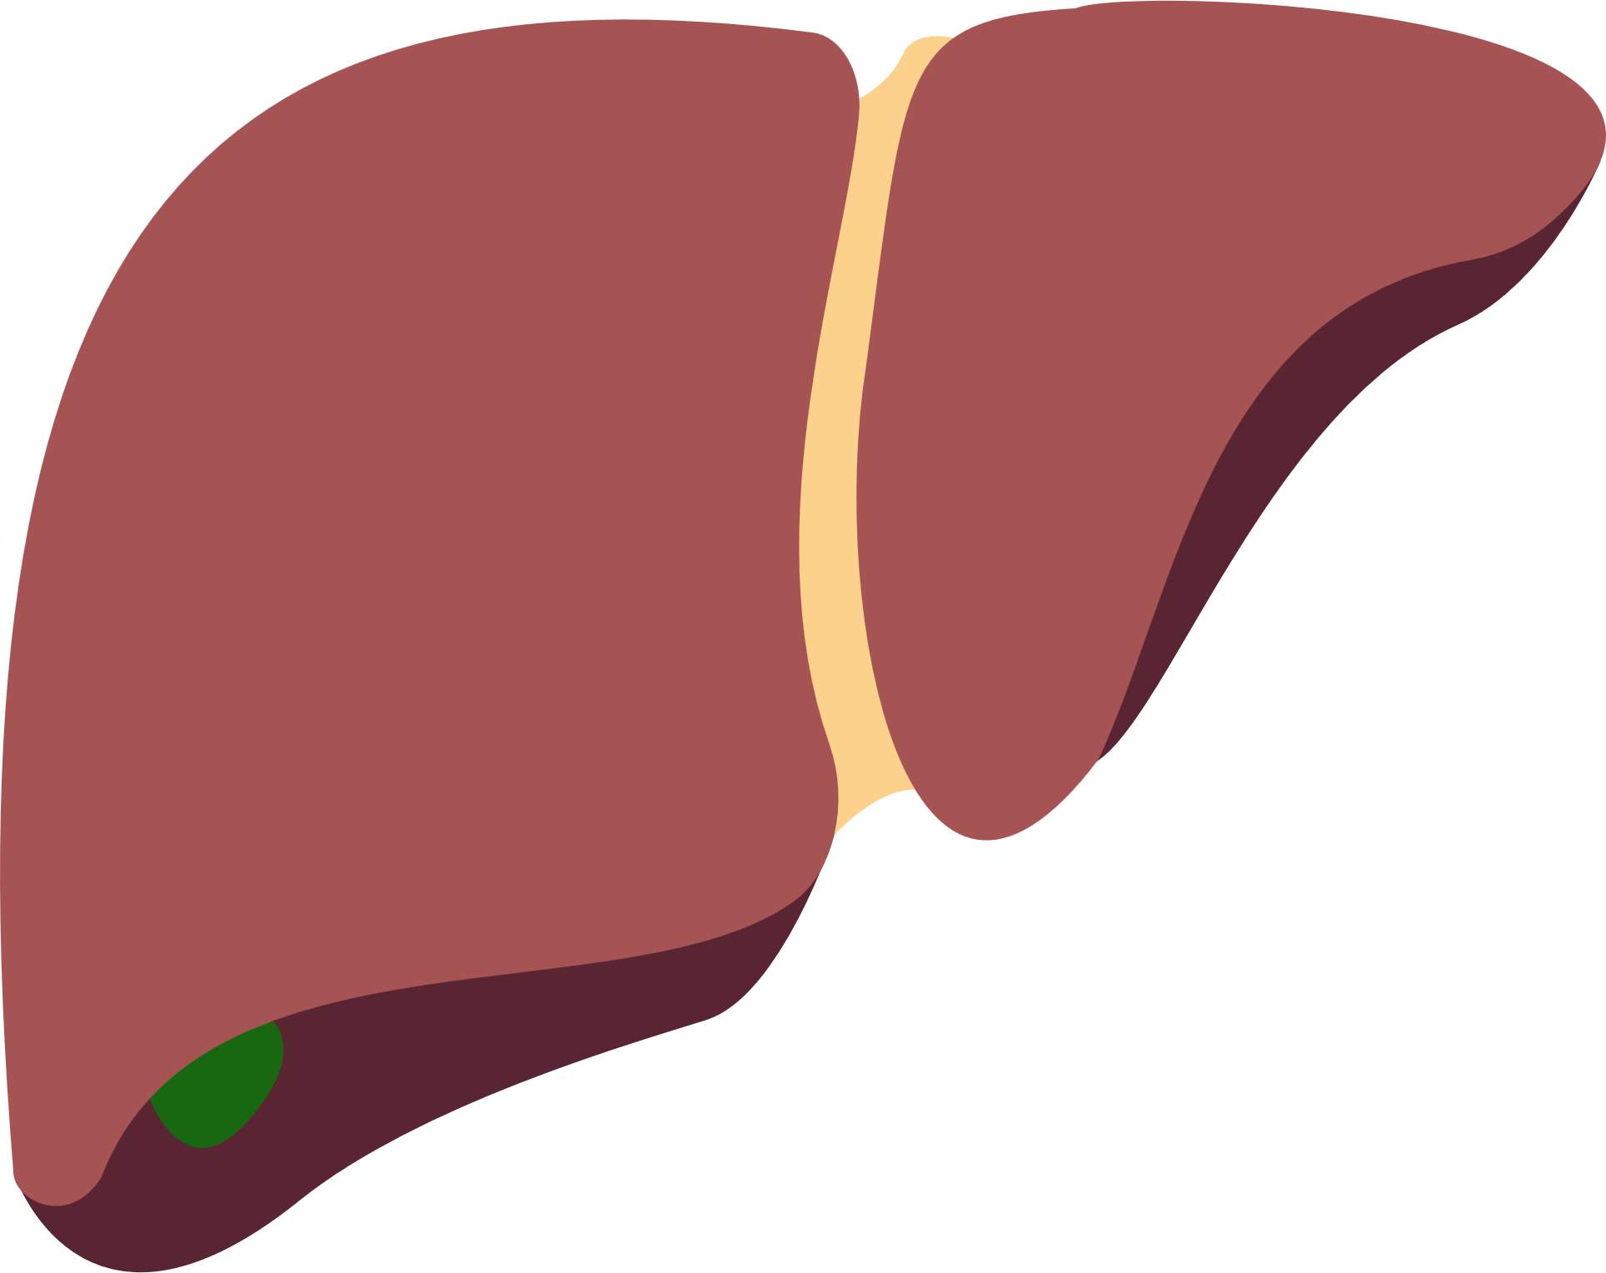
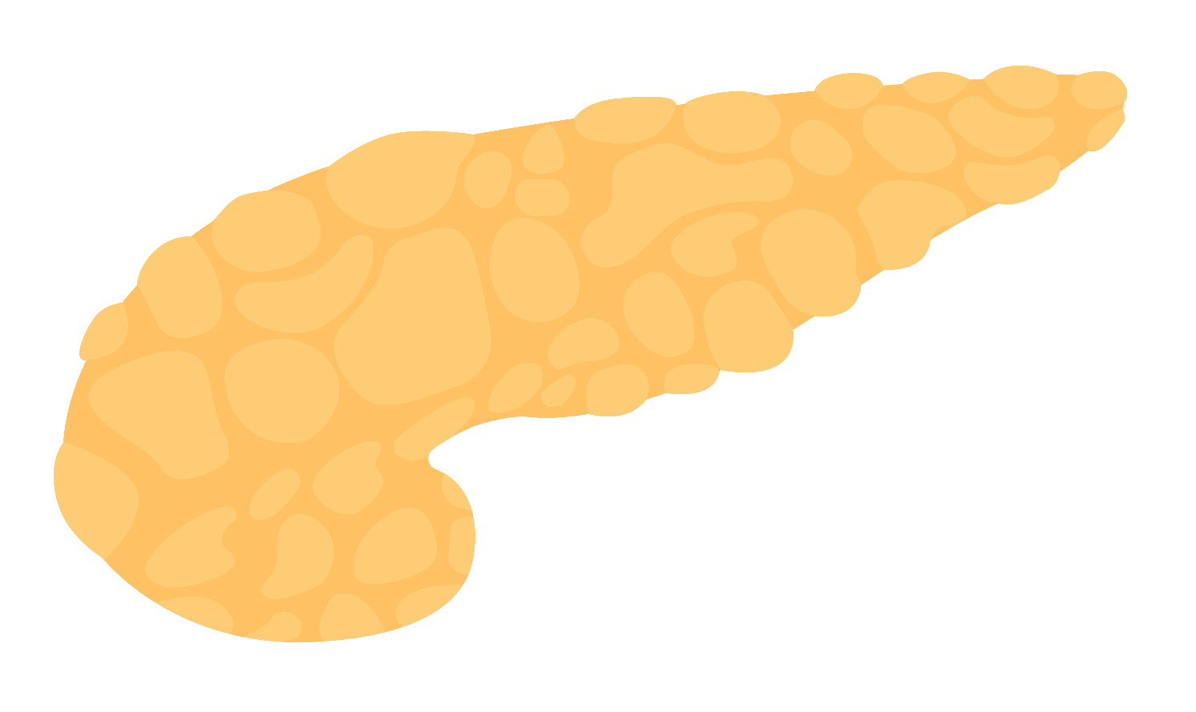

Metabolic and Toxic Liver Damage in Focus: MANPOWER's Latest Breakthroughs Revealed
Professor Asad Dajani
Saudi German Hospital, and ADSC Clinic Sharjah, United Arab Emirates
Liver function inhibition is a consequence of reduced phospholipids and altered phospholipid composition¹.
MAFLD ranges from simple steatosis to NASH and cirrhosis and can predispose to hepatotoxicity induced by certain drugs².
Treatment landscape of MAFLD–associated comorbidities
MAFLD
Anti-obesity
agents³
Insulin
sensitizers⁴
1
2
Lipid-lowering agents⁵
Vitamin E⁶
and D⁷
Genetics
Lipotoxicity
Lifestyle
modification
1
Gut microbiota
Liver supporting agents (EPLs)^{8,9}
3
2
Bariatric surgery
3
Pharmaco-therapy
4
Insulin resistance
Improve cellular membrane fluidity¹⁰
Act as anti-fibrogenic agent¹
Regulate abnormal liver enzyme and lipid levels¹¹
Increase collagen breakdown¹²
4
Innovative treatment
Healthy Liver
Polyenyl phosphatidylcholine (PPC): Active ingredient of EPL
Improves
Liver enzyme levels (ALT, AST, GGT)¹¹
Lipid parameters in patients on/not
on lipid-lowering therapy¹¹
Patient and clinician satisfaction¹⁴
Ultrasonographic findings and fibroscan scores¹³
Reduces
Patient-reported symptom
frequency¹⁴
Disease burden¹³
DILI^{5,6}
PPC has a promising role in the management of MAFLD and its extrahepatic manifestations
It is a potential hepatoprotective drug for DILI
1. Gundermann K et al. Pharmacol Rep. 2011;63:643-659; 2. Caballano-Infantes E et al. Biomedicines. 2022;10:55; 3. Tak YJ et al. Curr Obes Rep. 2021;10:14–30; 4. Kothari S, et al. J Clin Exp Hepatol 2019;9:723-730; 5. Ahsan F et al. Cureus. 2020;12:e10446; 6. Perumpail BJ et al. Diseases. 2018;6:86; 7. Hariri M et al. Int J Prev Med. 2019;10:14; 8. Lei X et al. J Int Med Res. 2021;49:1-14; 9. Liu Y et al. J Prac Hepatol. 2021;24:228–231; 10. Minto RE et al. Chem Phys Lipids. 2004;132:55–64; 11. Maev IV et al. BMJ Open Gastroenterol. 2020;7:e000368; 12. Brady LM et al. Biochem Biophys Res Commun. 1998;248:174–179; 13. Dajani A et al. Arab J Gastroenterol. 2015;16:99–104; 14. Ivashkin VT et al. Drugs Real World Outcomes. 2021;8:369–382.
ALT, alanine aminotransferase; ASH, alcoholic steatohepatitis; AST, aspartate aminotransferase; DILI, drug-induced liver injury; EPL, essential phospholipid; GGT, gamma glutamyltransferase; MAFLD, metabolic dysfunction-associated fatty liver disease; mRNA, messenger ribonucleic acid; NASH, non-alcoholic steatohepatitis; TGF, transforming growth factor;
Notes:
Next graph:: only labels and the lipid droplets %
Crop out the rest
RNA: See-saw arrangement;

